Slide 1



The Smart Mobile Messenger.

Slide 2

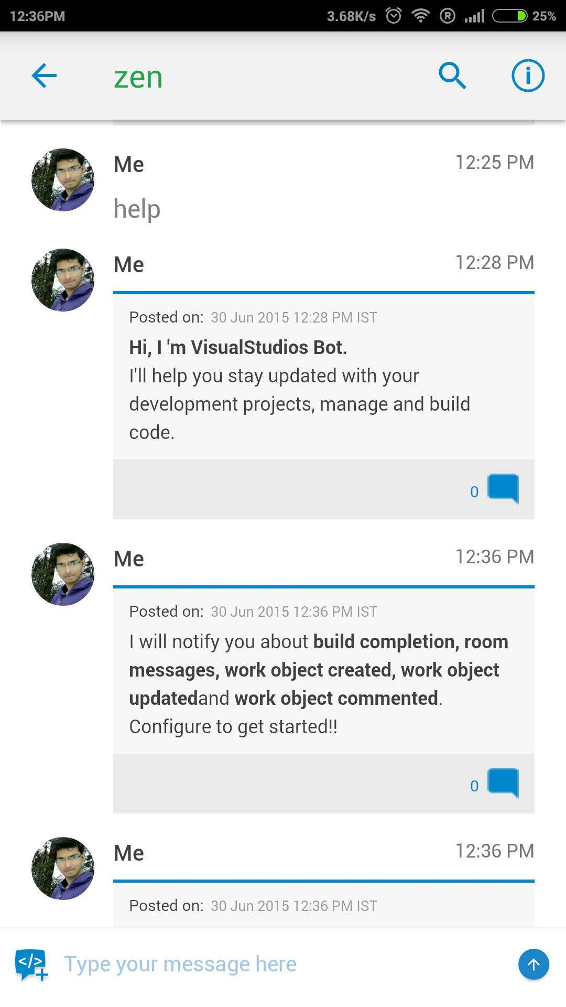
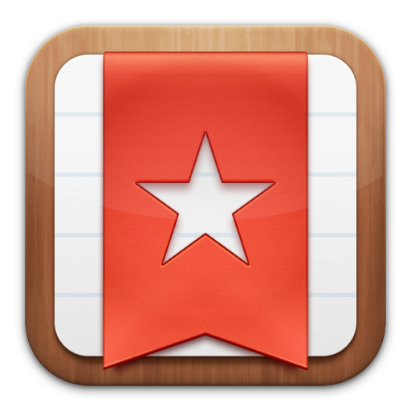

Teamchat App introduces "Wunderlist" integration
WunderlistBot
This message will be shown only if the user is not logged in.
User need to enter keyword “help” to start integration.
WunterlistBot
Bot
Bot
To Configure click on the link below and enter your Wunderlist login credentials.
https//:www.wunterlist.com/login
Hi, I’m Wunderlist Bot.
I’ll help you stay updated with you Wunderlist To-do-list and notes.
If user enter correct credentials, a success message is displayed.
Bot
Login Successful!!
Configuration successful!!
Bot
Use me to perform these functions:
add item to add item to your inbox
add starred item- to add starred item to your inbox
view items: to view all of your item
view inbox items- to view all of your inbox items
view lists- to view all all your lists

Slide 3
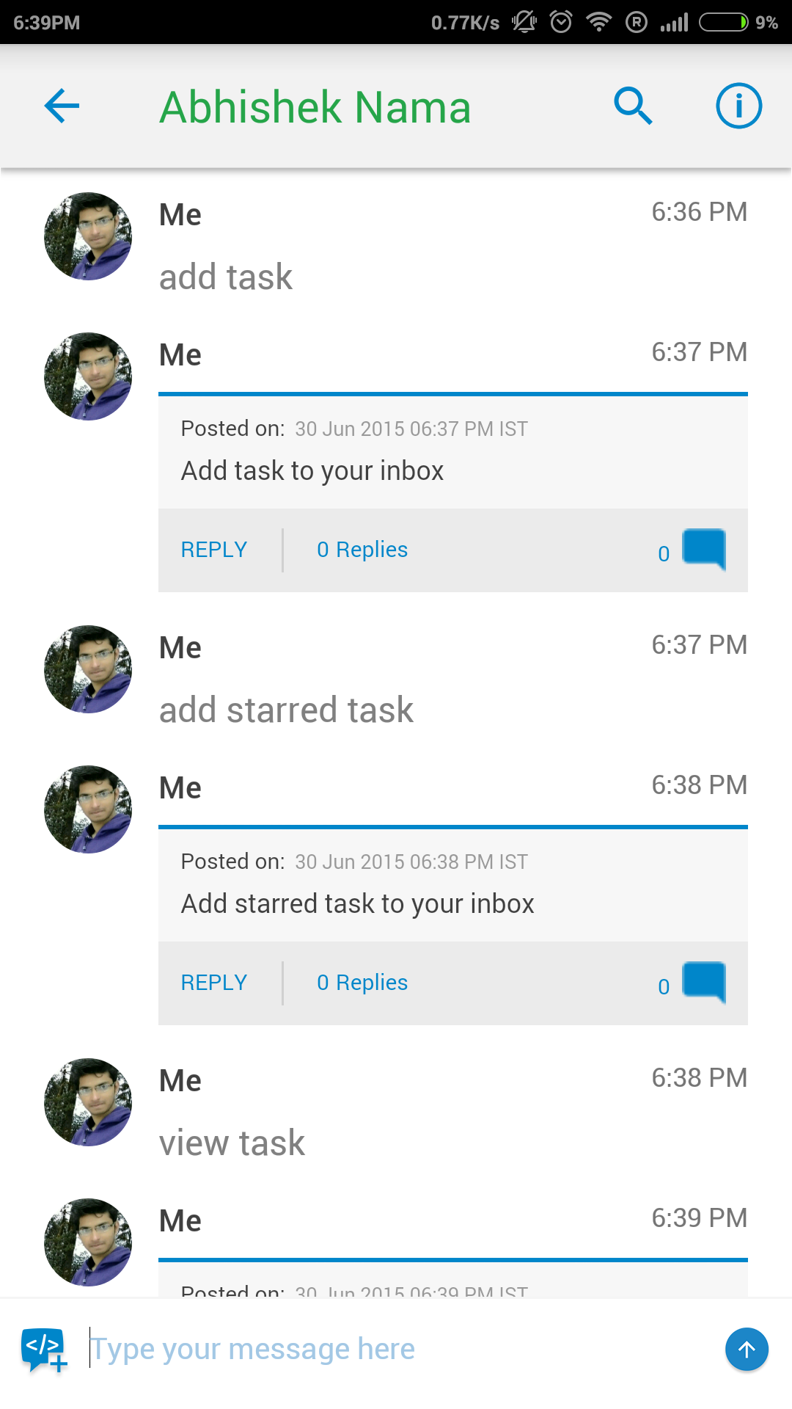
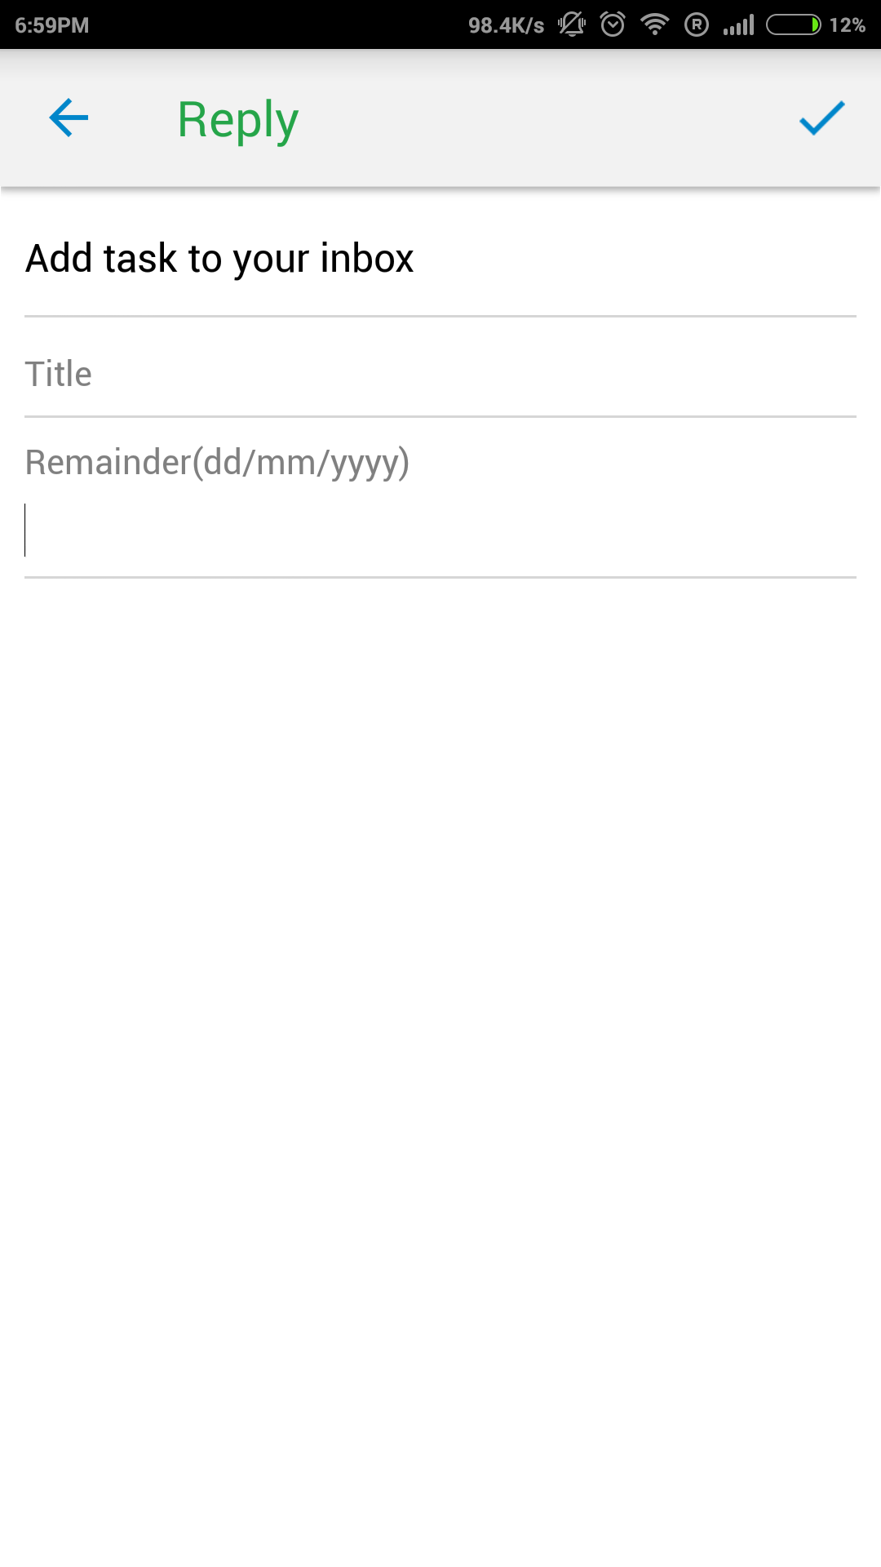
Teamchat App introduces "Wunderlist" integration.
WunterlistBot
WunderlistBot
add item
Bot
Bot
add starred item
Bot
Bot
view items
Bot
Bot

Slide 4
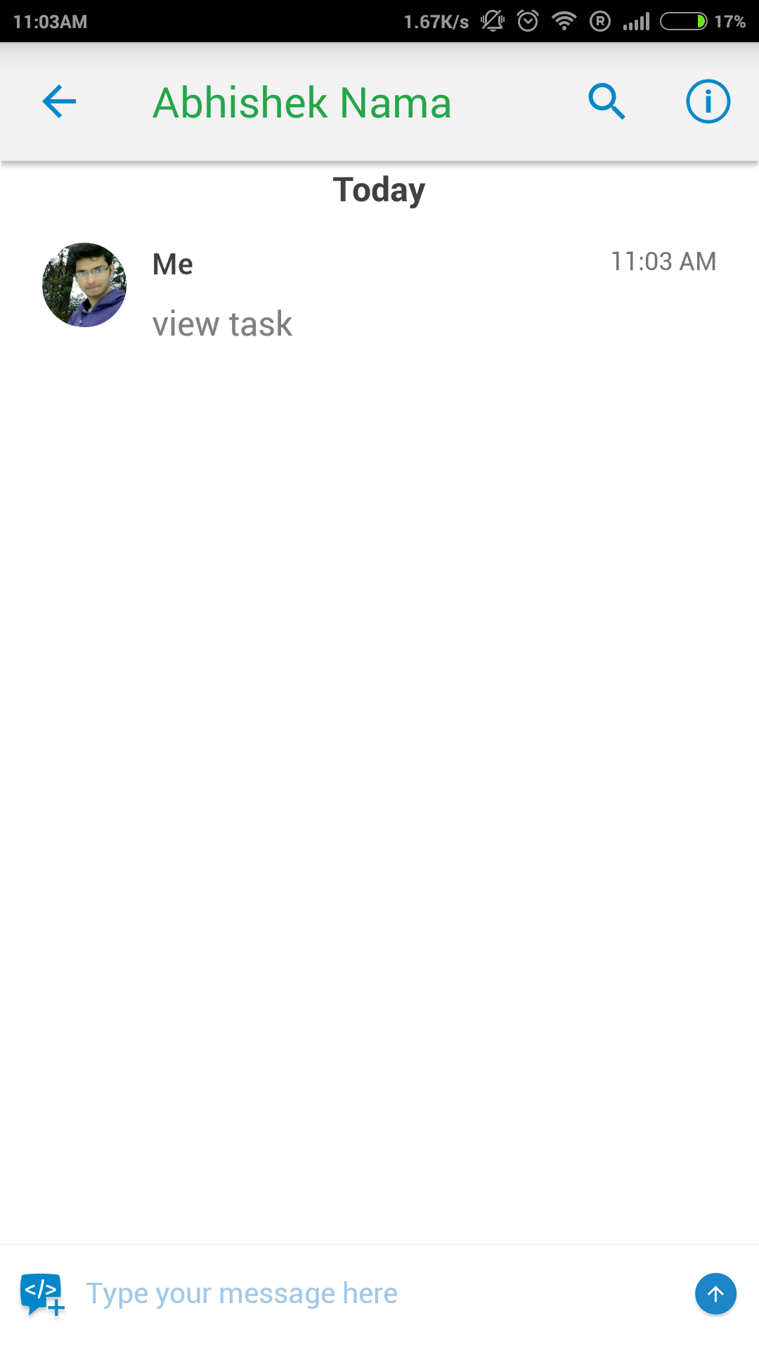
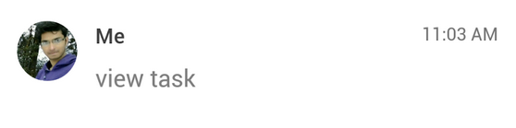
Teamchat App introduces "Wunderlist" integration.
WunterlistBot
view items
Entering keyword “view items” will display all of the items in their respective lists.
Bot
The list of items on the list 'Groceries':
water
choco chips
waffles
The list of items on the list ‘New Movies’:
Insidious 3
Avengers: Age of Ultron
view list
Entering keyword “view lists” will display all of your wunderlist
Bot
The list of all your wunderlists:
Groceries
New Movies

Slide 5
Teamchat App introduces "Wunderlist" integration.
WunterlistBot
Bot
You have a new item remainder for the item “water” in the list “Groceries”.
Entering keyword “view items” will display all of the items in their respective lists.

Slide 6

Thank You

