Slide 1
Predictive Analytics
For Premium Subscribers
XYZ
XYZ Data Analyst Team
Lily, Yoon, Shreya, Ujjawal, Harshithan

Slide 2
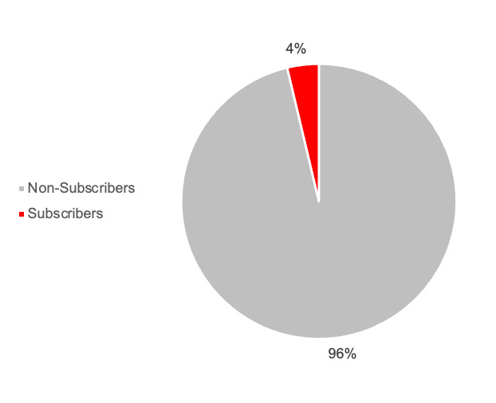

Purpose of the analytics
“
How to build a predictive model to identify
which free users are most likely to convert to premium subscribers in the next campaign
”
PREMIUM SUBSCRIPTION
[ Previous Campaign Result ]
Notes:
Our company operates on a freemium model, offering basic services for free and premium features via subscription. After a previous campaign targeted 41,540 non-subscribers, only 1,540 (3.7%) upgraded.

Slide 3
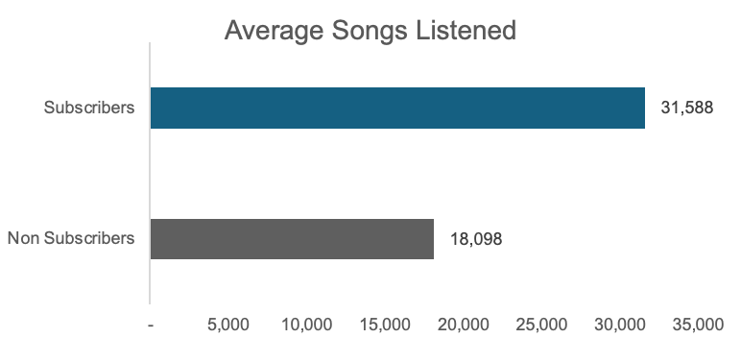
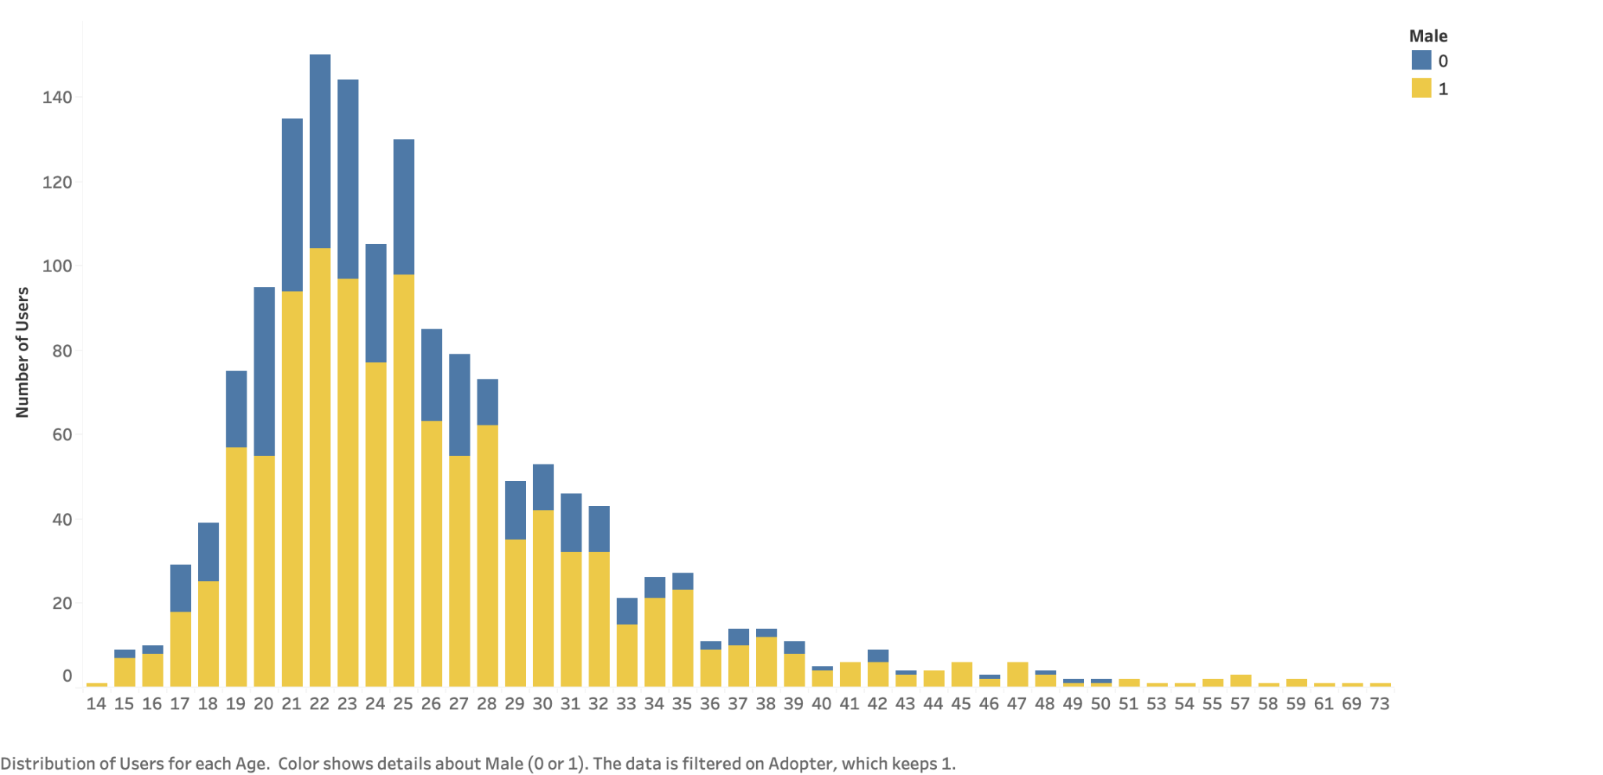
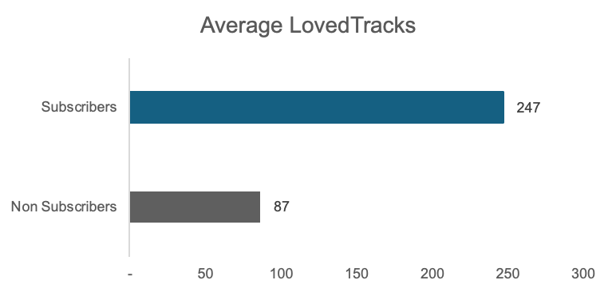
Target Audience - What does our adopters look like?
To predict, we analyze 25 user attributes including age, gender, number of friends, listening habits, and engagement.
Distribution of Users for each Age and Gender
playlists
Posts
Friend
count
Delta
Songs Listened
Loved Tracks
Age
Subscribers
friend count
Delta posts
Notes:
Most adopters are concentrated in the younger age groups, particularly between 18 and 30 years old, with a peak around ages 22-24.
The number of adopters decreases significantly after age 30, with very few adopters over the age of 40.
For each age group, males (yellow) tend to make up a larger portion of adopters compared to females (blue), especially in the peak age range of 20-29.

Slide 4
Analytics Results : AUC 0.7718
What is AUC
Why AUC
We can adopt our model, since it gives as a AUC value of 0.7718.
AUC is a metric that helps measure a model’s ability to distinguish between two classes. AUC reflects how well the model can rank potential adopters above non-adopters.
An AUC of 0.7718 suggests that our model has a good ability to discriminate between users who are likely to convert to premium subscribers and those who are not. Specifically, there is a 77.18% chance that a randomly selected user who will become a subscriber will have a higher predicted probability of conversion than a randomly selected user who will not convert.
AUC is especially useful in imbalanced datasets like ours, where accuracy alone might be misleading. Furthermore, as AUC shows the model’s ranking ability, it allows us to targeted marketing efforts to focus on the highest probability users.
This level of accuracy means that the model can effectively identify a significant portion of potential adopters, which is crucial for the success of the marketing campaign.
Notes:
In our case, a higher AUC means the model can more effectively identify those users who are more likely to subscribe to the premium service.
The closer the AUC (Area Under the ROC Curve) is to 1, the better the model's ability to discriminate between the positive and negative classes.
Random Forest AUC = 0.7718: This means that, on average, the Random Forest model has a 77.18% chance of ranking a randomly chosen adopter higher than a randomly chosen non-adopter. This is relatively good and indicates the model has meaningful discriminatory power.
“We chose AUC as the primary evaluation metric because it gives a comprehensive assessment of the model’s ability to distinguish between adopters and non-adopters, which is critical given our imbalanced dataset. Unlike accuracy, AUC isn’t misled by class imbalance and provides a threshold-independent measure of performance, allowing us to adjust the threshold based on business goals. A high AUC score indicates that the model is effective at ranking users by their likelihood of adopting, which is invaluable for targeted marketing strategies.”
For a subscription campaign, the priority might not only be classifying users as adopters or non-adopters but also ranking users by their likelihood to adopt. This allows targeted marketing efforts to focus on the highest probability users.

Slide 5
Analytics Results
Confusion Matrix It shows how well our predictive model identifies users who will subscribe to the premium service (adopters) versus those who won’t (non-adopters) Predicted Adopters (0): 4,228 users are correctly classified as non adopters, meaning marketing resources were not spent on them unnecessarily. 52 represents missed opportunities—users who were likely to subscribe but were not identified by the model.
Predicted Adopters (1): 1,783 are users that the model incorrectly identified as likely to subscribe but did not convert. 168 are users accurately identified as likely to adopt the premium service.
 | Predicted Non-Adopter(0) | Predicted Adopter(1)
Actual Non-Adopter(0) | 4,228 | 1,783
Actual Adopter(1) | 52 | 168
The cost savings from accurately identifying non-adopters outweigh the resources spent on incorrect predictions, and the number of correctly identified adopters is greater than the missed opportunities.
Notes:
4,228 users were correctly classified as non adopters, meaning marketing resources were not spent on them unnecessarily. This helps in cost savings and optimizing budget allocation by avoiding low-probability users.
52 This represents missed opportunities—users who were likely to subscribe but were not identified by the model. Minimizing false negatives can improve revenue potential, as capturing these users would mean converting additional subscribers.
1783 These are users that the model incorrectly identified as likely to subscribe but did not convert. This can lead to wasted marketing resources on users unlikely to adopt, which affects campaign efficiency and may inflate customer acquisition costs.

Slide 6
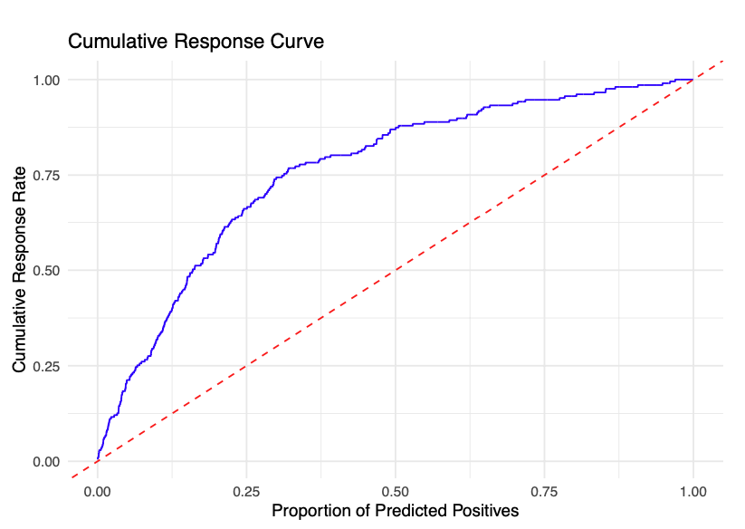
Analytics Results
Efficient Targeting: By targeting 25% of the users, our model can capture about 65% of the actual premium subscribers. We can ensure marketing resources are spent on users with the highest likelihood of conversion, which boosts the effectiveness of the marketing campaign
Cost Savings: Since the model outperforms random targeting (as shown by the blue curve above the red line), We can reduce marketing costs by targeting fewer users while still driving significant conversion rates.
Diminishing Returns: After targeting around 40% of users, the model’s effectiveness declines, meaning further targeting adds fewer subscribers. Focusing on the top users identified by the model will maximize impact without wasting resources on less likely converters.
Notes:
Now, let’s further looking at how our model can help optimizing the overall marketing resources. By targeting the top 25% of users (our model predicts are most likely to subscribe),
we expect about 65% to actually convert to premium subscribers. This ensures our marketing resources are spent on potential premium users.

Slide 7
How can our model help our business?
Concentrate resources on users most likely to convert, Reduce the cost on users unlikely to convert
Improves the overall conversion rate for the marketing campaign
Focus on features of our models in communication and marketing campaigns to better resonate with users who are most likely to subscribe.

Slide 8
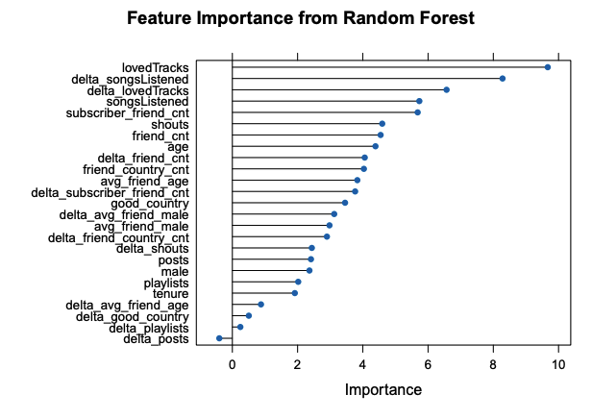
Features of Our Model
Our model highlights several top features—: loved tracks, delta song listened, delta loved tracks, song listened, subscriber friend count, shouts—as primary factors in predicting whether users will subscribe to the premium service after the marketing campaign.
Loved tracks, Song listened: The volume of music that users have liked and listened are key factors influencing conversion to premium users
Delta song listened, Delta loved tracks: During the marketing campaign, users who have shown a change in song-listening activity and interest in exploring new music are more likely to convert.
Subscriber friend count, Shouts: Potential premium subscribers are influenced by their premium-subscribing friends and social engagement on the platform
Corresponding to these important features, we can emphasize our premium services such as personalized tracks recommendations and social interaction features to attract potential subscribers.

Slide 9
Conclusion and Next Step
We can target more potential premium subscribers and optimize marketing costs using this predictive model in the next marketing campaigns.
Next Steps: We recommend testing the model in the next marketing campaign and monitor the adoption rates. By collecting more adopters data, we can further refine the predictive model to improve our targeting strategies.
Notes:
The model allows us to identify potential premium subscribers, enabling us to allocate marketing resources to users who are most likely to convert to premium subscribers.

Slide 10
End of Document

Slide 11
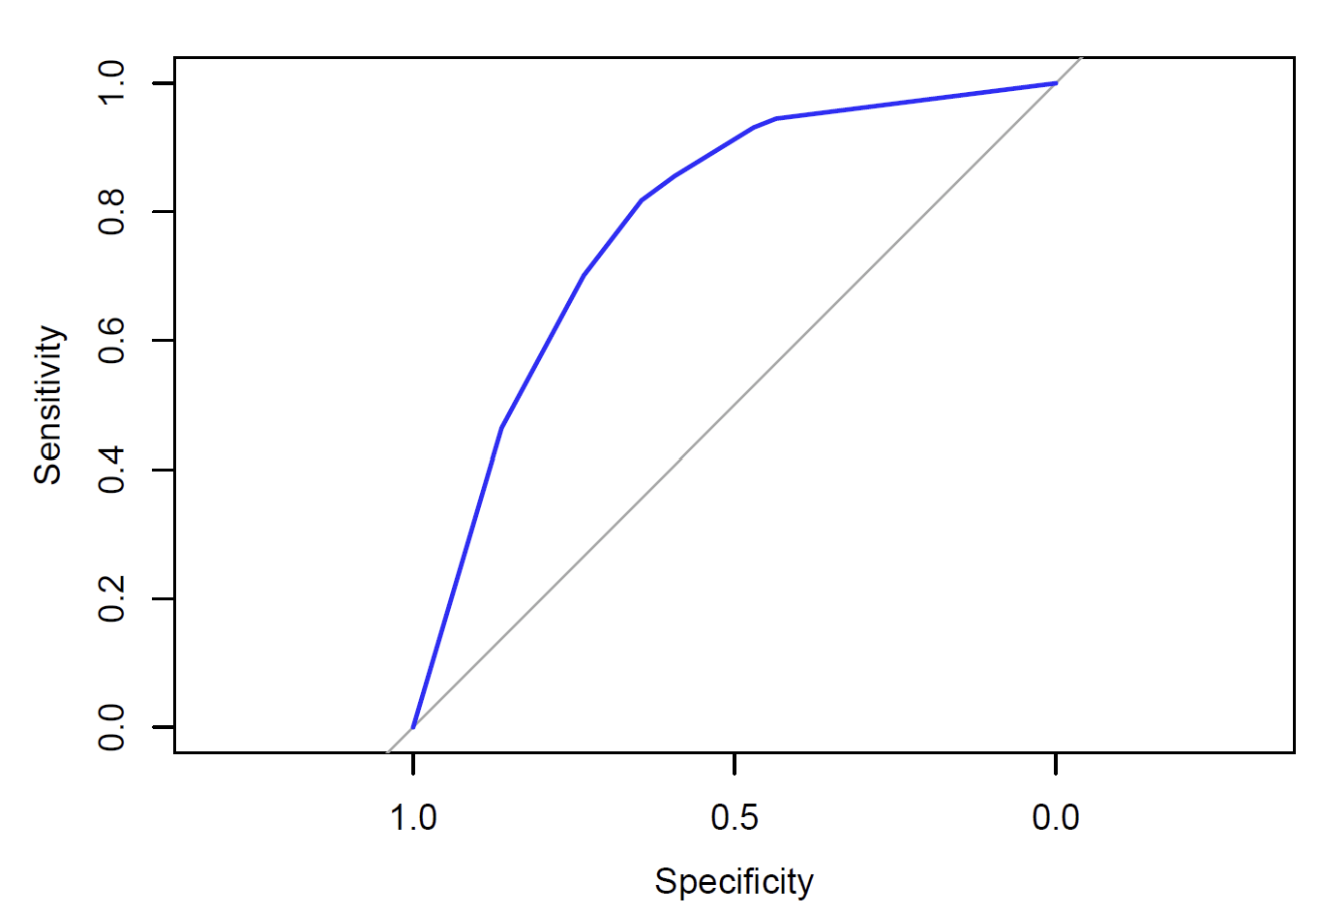
Analytics Results
Specificity tell us about the proportion of non-adopters incorrectly predicted as adopters.
Sensitivity tell us about the proportion of actual adopters that are correctly identified by the model.
The ROC curve in blue indicates the trade-off between the true positive rate and the false positive rate at various threshold levels.
The closer the curve is to the top-left corner, the better the model is at distinguishing between adopters and non-adopters. In this case, the ROC curve is above the diagonal line and bends towards the top-left, showing that the decision tree model is better than random guessing. However, it doesn't fully hug the top-left corner, indicating that while the model is somewhat effective, it could be improved further.

Slide 12
The benefit of our solutions
Our model achieves an AUC of 0.7599, meaning it has about a 76% chance of correctly identifying a potential premium subscriber when comparing one adopter and one non-adopter.
This demonstrates that our model can distinguish between users likely to convert and those who are not, correctly ranking a potential subscriber higher than a non-subscriber approximately 76 out of 100 times in similar cases.
This level of accuracy suggests that the model is significantly more effective than random targeting, which would succeed only 50 out of 100 times.

Slide 13
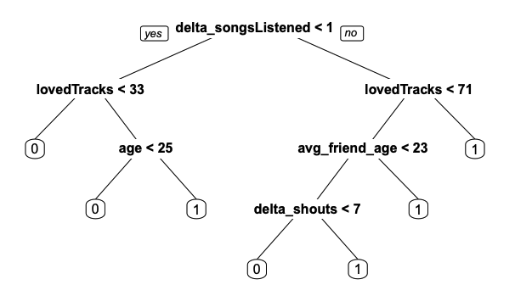
Features of Our Model
Our model highlights several features—: delta song listened, loved tracks, age, average friend age, delta shouts—as primary factors influencing a user’s decision to subscribe to the premium service.
Potential premium subscribers: Users who didn’t increase their song-listening activity (delta song listened < 1): a. with higher loved Tracks (>= 33), and older age (>= 25) are more likely to convert. Users who increased their song-listening activity (delta song listened >= 1): b. with interest in discovering different music (loved Tracks >= 71) c. with lower loved tracks (< 71), and older friends (average age >= 23) d. with less loved tracks(< 71), younger friend (average age < 23), and more social engagement (delta shouts >= 7)
XYZ can emphasize its premium features such as personalized tracks recommendations, social interaction features to attract the potential subscribers.
b
a
a
c
d

Slide 14
Cost Sensitive Evaluation
XYZ’s goal is to prioritize marketing costs to potential adopters, which means targeting users unlikely to convert costs more to XYZ company, comparing to miss potential subscribers. Thus, we want to minimize the cost of misclassifying non-adopter(”0”) to adopter(”1”)
Let’s assume the average marketing spend per user is $10
Let’s assume the monthly premium subscription fee is $10, and a user remains subscribed for an average of 12 months
 | last campaign (random targeting) | next campaign (our predictive model)
cost of misclassifying each user | 4.4 | 4.5

Slide 15
Cost Sensitive Evaluation (Appendix)
 | last campaign (random targeting) | next campaign (predictive model)
FP cost | 10 | 10
FN cost | 120 | 120
adopters % | 0.5
non adopter % | 0.5
FP | 4416 | 2213
FN | 89 | 47
total users | 12462 | 6171
FP* FP cost | 44160 | 22130
FN* FN cost | 10680 | 5640
total misclassification cost | 54840 | 27770
Cost per users (total misclassification cost / total users) | 4.400577756 | 4.500081024

