Slide 1
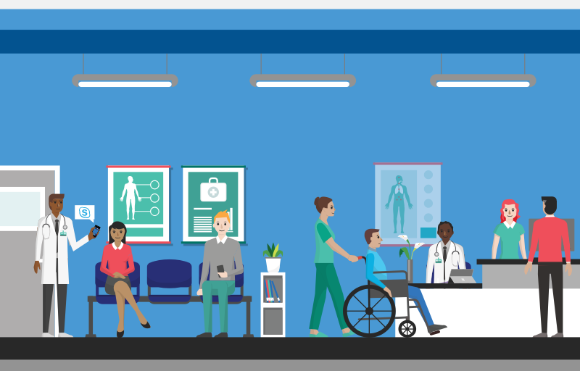
MEDTECH

Slide 2
ABSTRACT
We serve our users in 3 ways:
Longer waiting times has been noticed for booking hospital appointment. For this solution has been provided by online booking of appointment in the desired hospital. It also notifies the arrival time at the hospital for consulting the doctor.
Through this length of stay of patients in hospital decreases.
In these days most of the people are habituated to tablets(medicines) even

Slide 3
for a simple problems. To address these
kind of situations natural therapies are provided.
People who want to donate organs can register
themselves in the website where their
Information is accessed by various hospitals.
We would be helpful fr the user in these
situations.

Slide 4
Problem Statement-Needs Identified
Time is very important.
To know the best hospital.
Waiting for long hours.
Long waits increase patients length of stay.
This has to be addressed by reducing the wait time.
Habituated to pills.
No knowledge of home remedy.

Slide 5
Damaged organs reduce life time.
So organ transplantation is required.
Required for scientific and medical research.
Develop new technologies.
Cure diseases.

Slide 6
Objectives-Use Cases
This project is aimed to give the users
immediate response to their health issue.
Booking an appointment
Home remedies
Organ donation

Slide 7
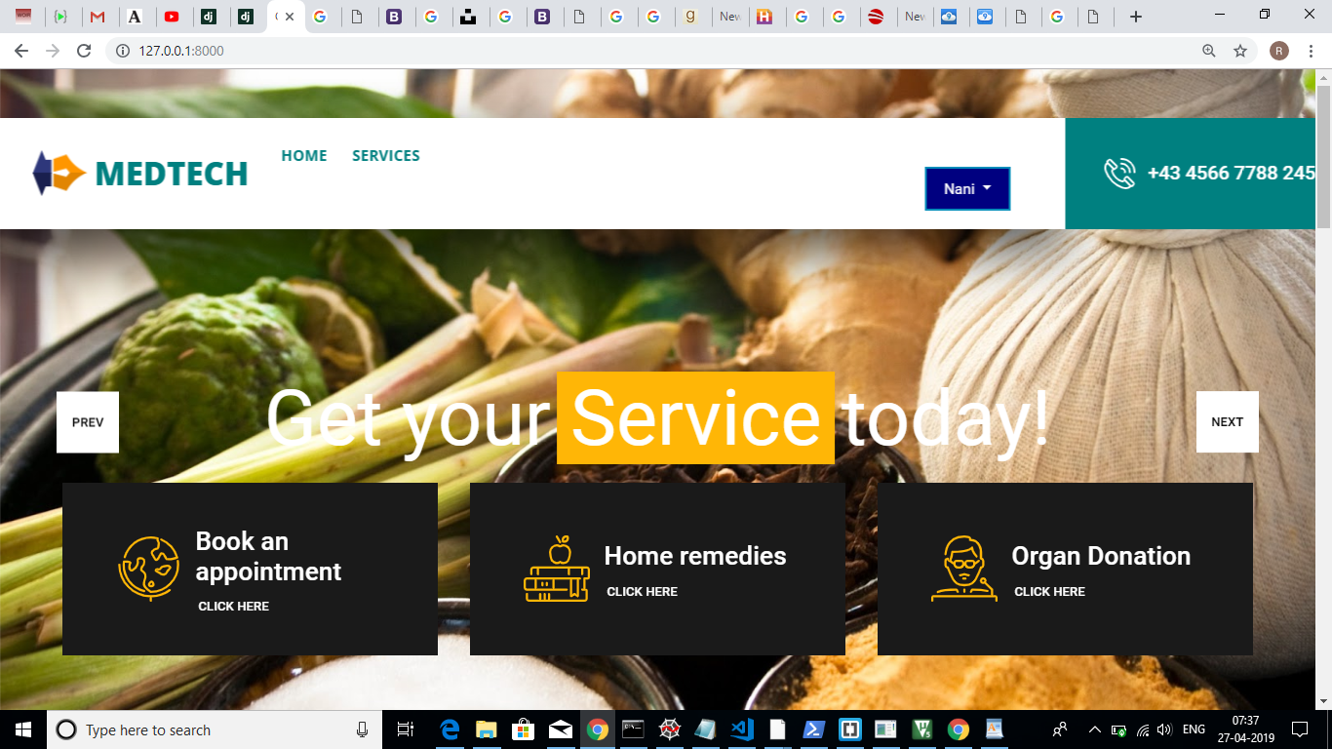
UI PROTOTYPES

Slide 8
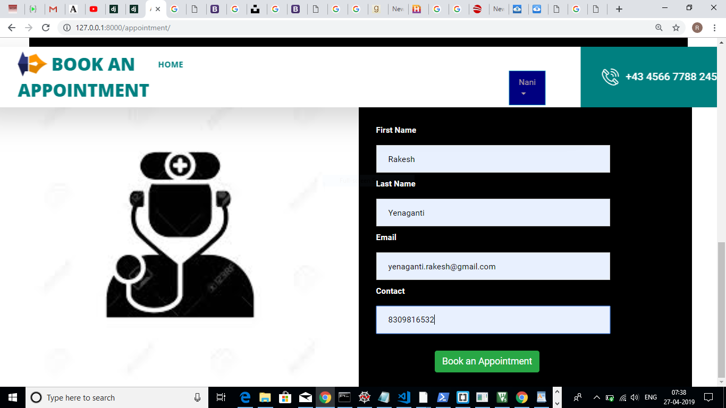
UI PROTOTYPE

Slide 9
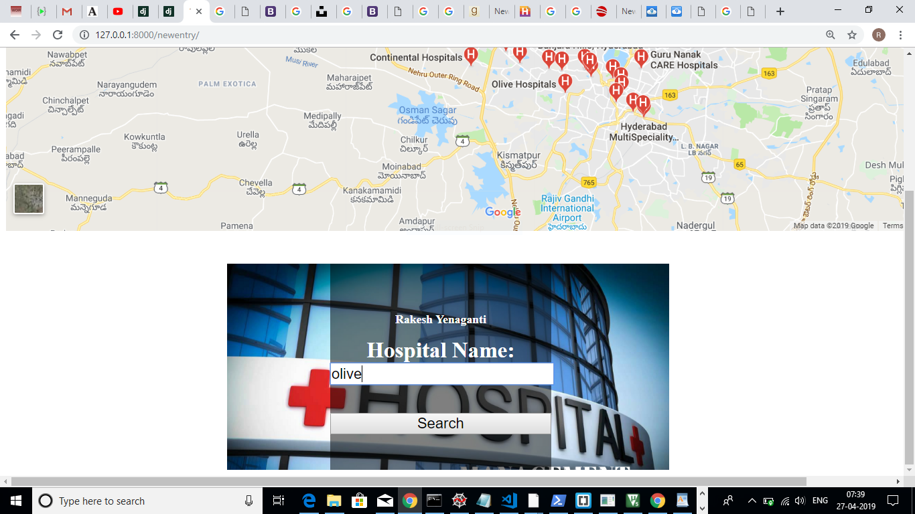
UI PROTOTYPE

Slide 10
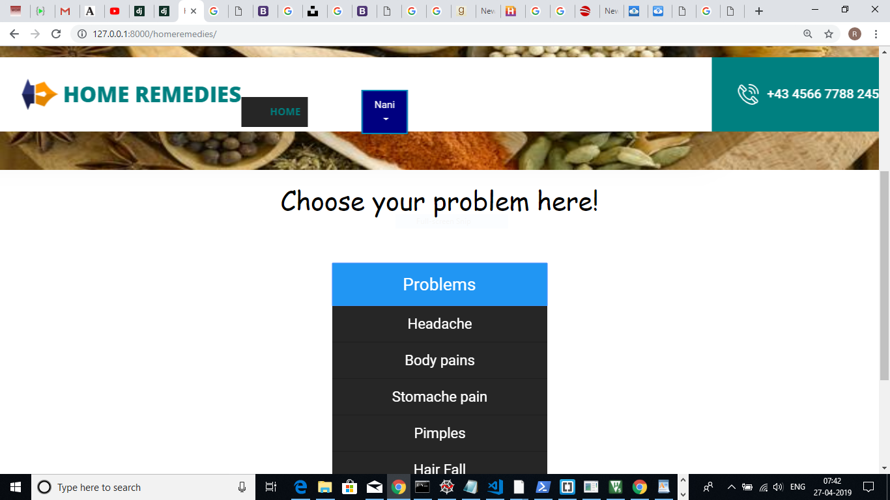
UI PROTOTYPE

Slide 11
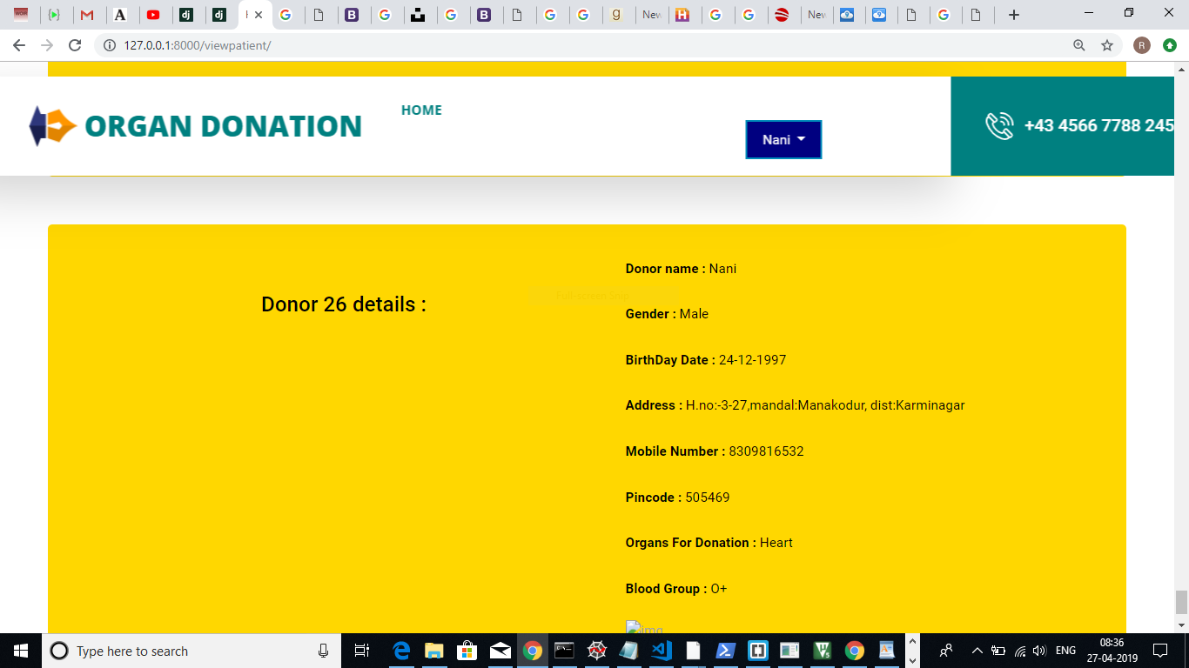
UI PROTOTYPE

Slide 12
ARCHITECTURE AND TECHNOLOGY USED
Front end: HTML,CSS,javascript,Bootstrap
Backend: django framework,python
Database:Mysql

Slide 13
RESULTS
User is able to book appointment without delay and is also able to track is token number and arrival time which has been generated.
People who are in lack of knowledge of home remedies are now able to go through different kinds natural therapies available.

Slide 14
People who are willing to donate their organs
can now give their details and fulfill their wish of
donating organs.

Slide 15
DISCUSSION AND FUTURE WORK
We would like to extend our project by adding more features into it. After user consults doctor hospital management should update the database that particular person has finished his appointment. So that users can keep a track of number of people present before them to consult the doctor. We would also like to extend the number of home remedies given the portal and also few more many solutions to it.

Slide 16
THANK YOU
BY
S.SHREYA
Y.RAKESH
A.VARSHA

