Slide 1
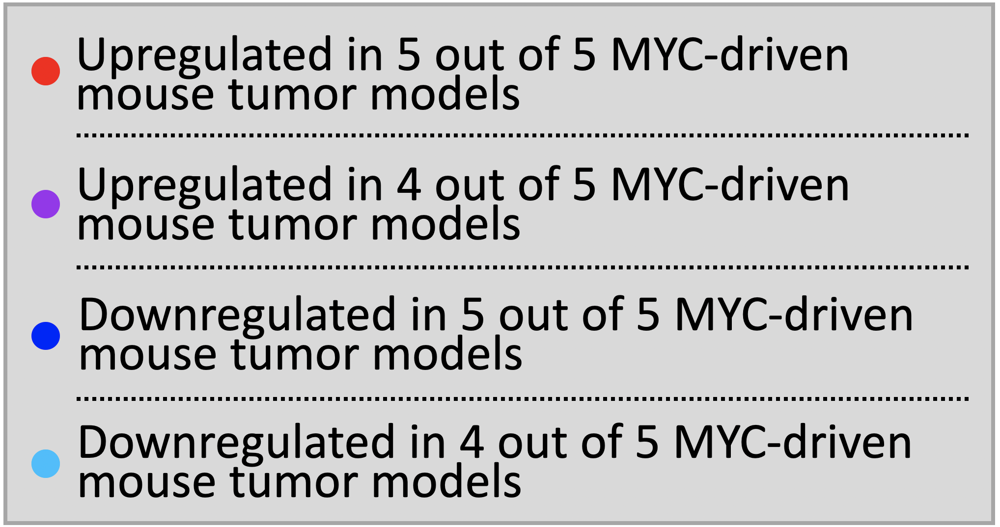
(across 33 TCGA cancer types)

