Slide 1
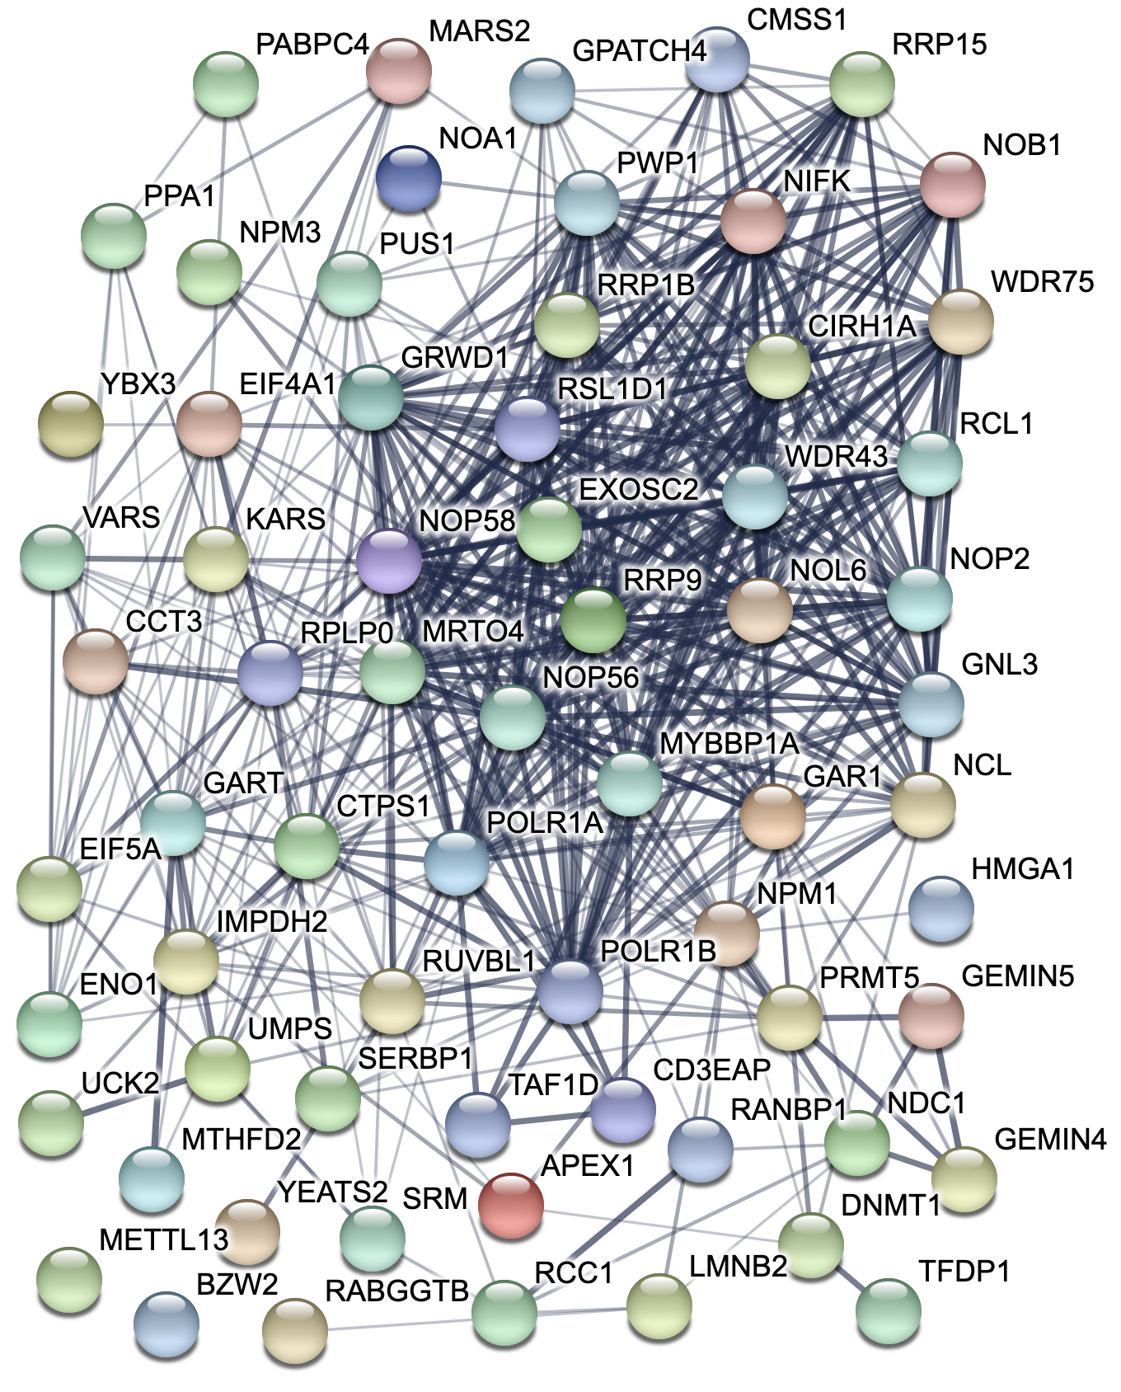
Figure 4
a
DDX21
d
Upregulated in 5 out of 5 MYC-driven mouse tumor models
NOLC1
Upregulated in 4 out of 5 MYC-driven mouse tumor models
NOP14
BYSL
WDR43
Downregulated in 5 out of 5 MYC-driven mouse tumor models
WDR3
IPO4
TWNK
NOB1
Downregulated in 4 out of 5 MYC-driven mouse tumor models
NIFK
TAF4B
-Log₁₀(FDR-adjusted p-value)
BZW2
Robust Rank Aggregation
ULK2
SLC46A3
Median Pearson’s r
(across 33 TCGA cancer types)
b
Tumorigenesis-associated
(MYC-driven mouse tumor models)
MYC-correlated
(TCGA human cancers)
17
184
67
476
Mouse genes
not mapped to human orthologs
Combined MYC gene signature
c
Ribosome biogenesis
and RNA metabolism
184 genes
67 genes
GO:0006364, GO:0042254, GO:0016072,
GO:0034470, GO:0045815
Mitosis, DNA replication,
and chromatin organization
GO:0000070, GO:0006259, GO:0006260,
GO:0034080, GO:0061641
Median r = 0.3
Rank (by median Pearson’s r)
[251 tumorigenesis-associated genes]
e
q-value | Gene Ontology (Biological Process)
7.64E-13 | rRNA processing (GO:0006364)
2.06E-12 | ribosome biogenesis (GO:0042254)
6.61E-12 | rRNA metabolic process (GO:0016072)
q-value | BioGPS Mouse Gene Atlas tissue
3.94E-20 | embryonic stem line Bruce4 p13
4.38E-20 | embryonic stem line V26.2 p16
1.01E-05 | mega erythrocyte progenitor
Combined
MYC gene
signature
f
P493-6 cells
EC4 cells
UCK2
YBX3
NOP56
NOB1
MARS2
SLC46A3
Uck2
Ybx3
Nop56
Nob1
Mars2
Slc46a3

