Slide 1
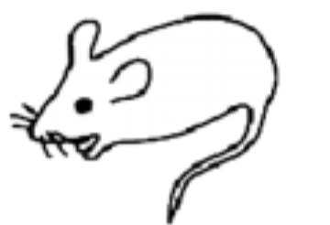
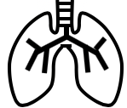


Figure 5
Normal tissue state
MYC on
New tissue state
✓
Embryonic stem-cell like genes
(e.g. ribosome biogenesis genes)
Embryonic stem-cell like genes
Embryonic stem-cell like genes
MYC on
Tissue 1
Tissue 2
✓
Liver-lineage genes
Overlap of differentially expressed
genes
Kidney-lineage genes
Tissue-lineage genes
Tissue-lineage genes
Lung-lineage genes
Spleen-lineage genes

