Slide 1

Exploring a Public Dataset with Dataprep on Google Cloud Platform Yenchi Wang (Louis)

Slide 2
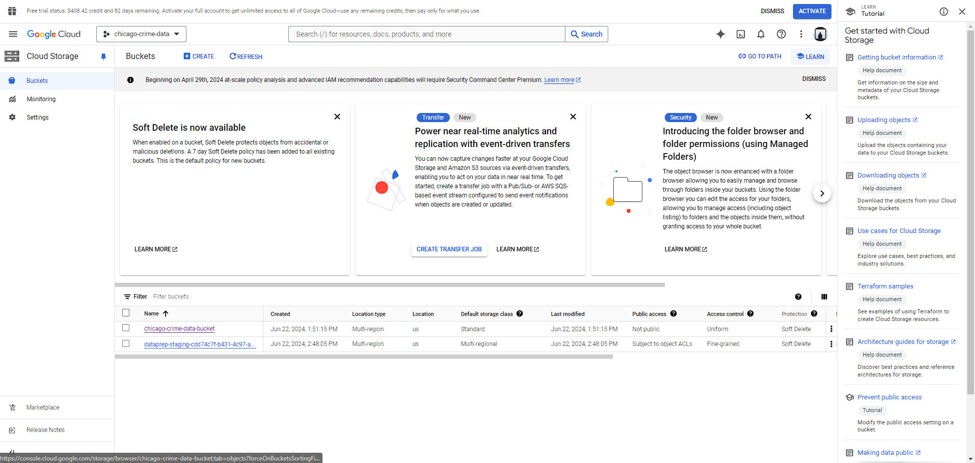
Importing the Dataset
Selecting the appropriate storage bucket, uploading the dataset, and ensuring proper access permissions are set

Slide 3
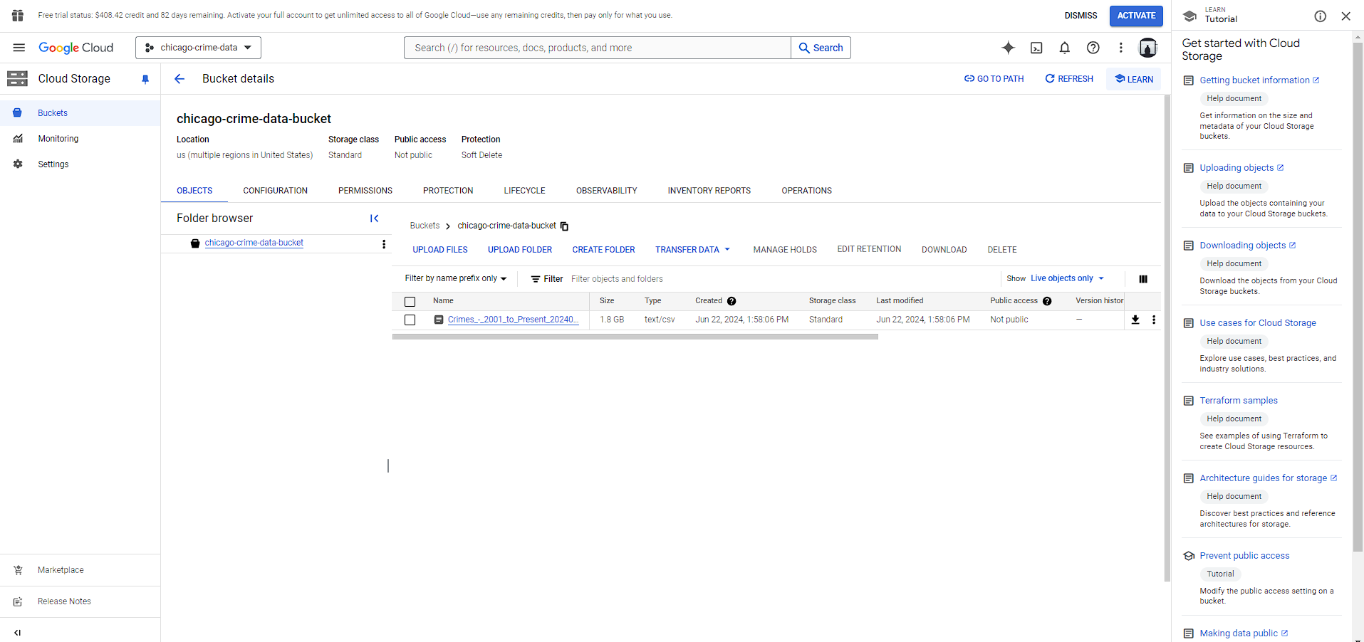
Bucket detail
Checking the bucket's location, storage class, and access controls.

Slide 4
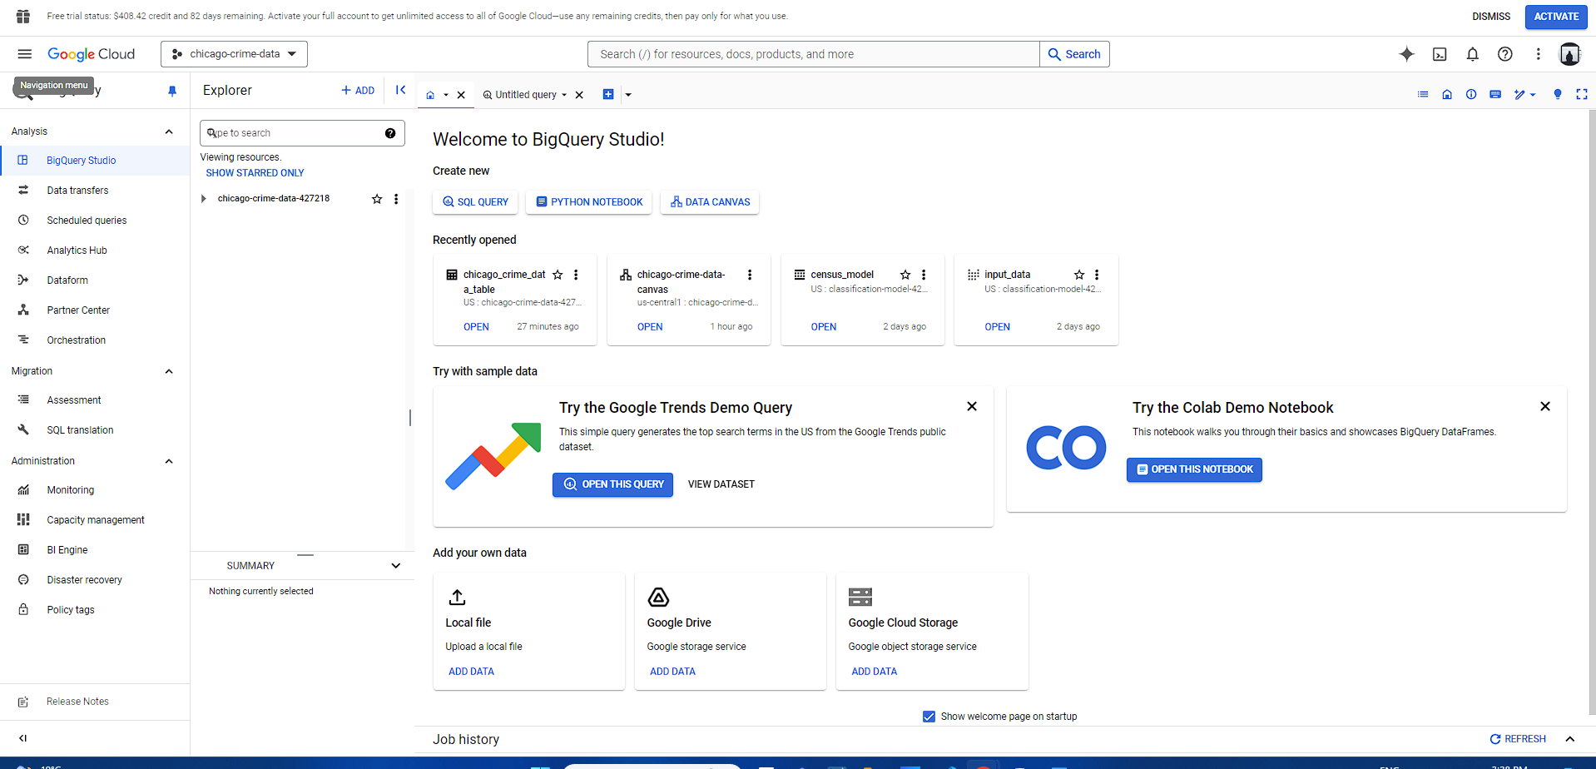
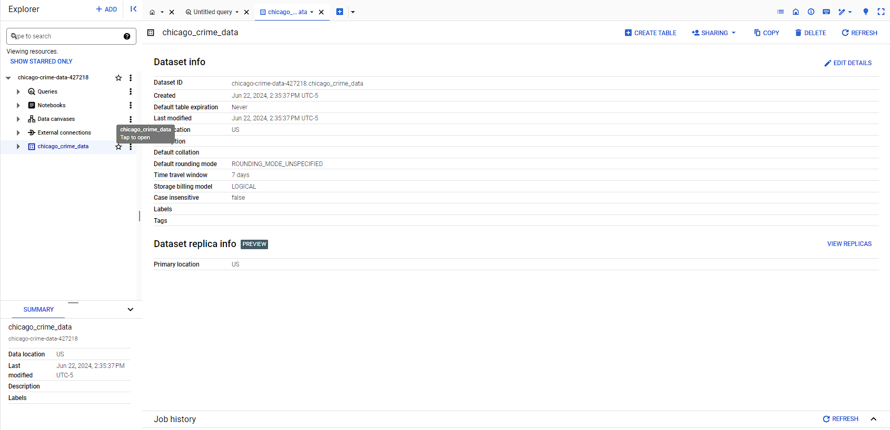
Bigquery
set up a BigQuery project, create datasets, and link our imported data for further analysis

Slide 5
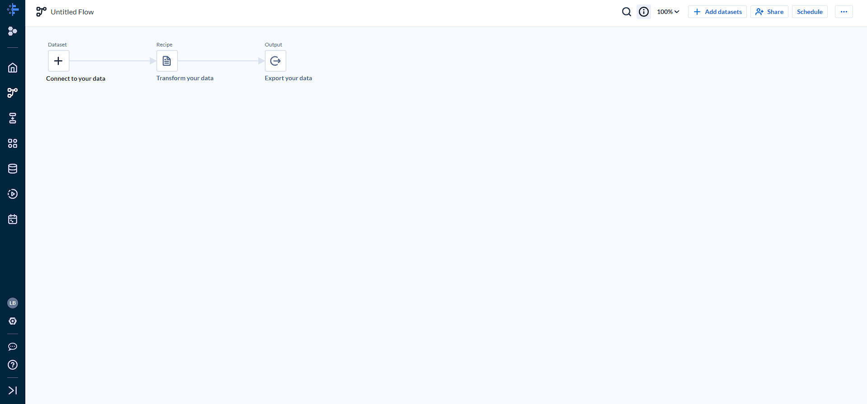
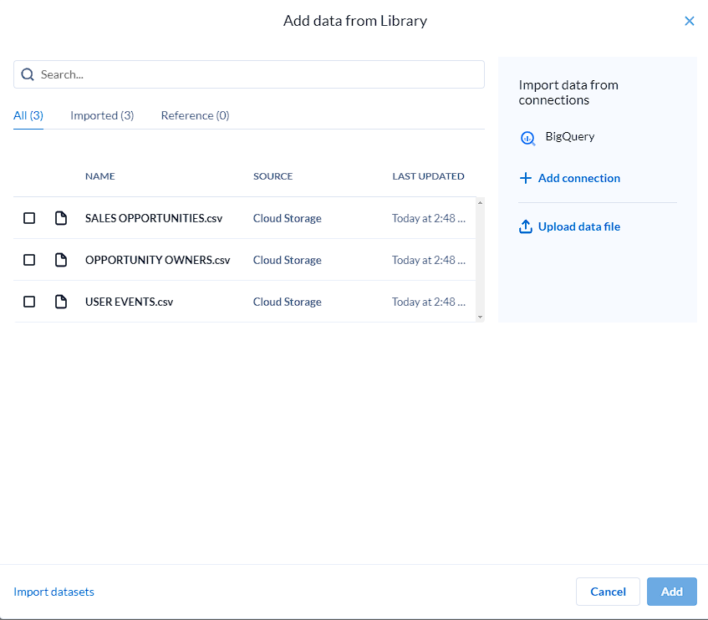
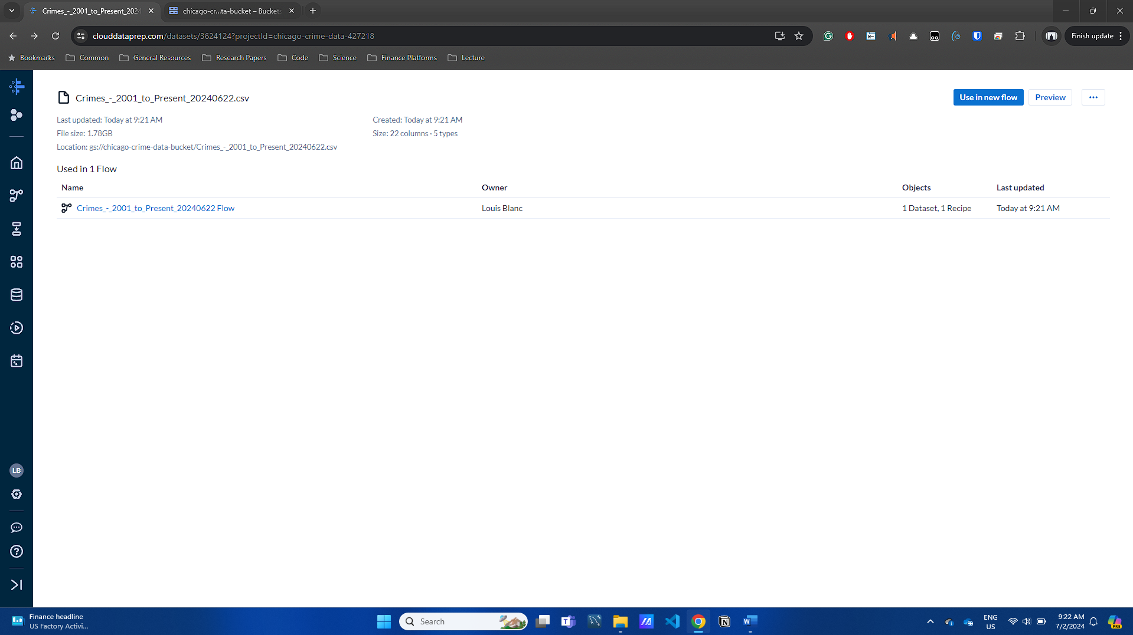
Getting data from BigQuery to Dataprep

Slide 6
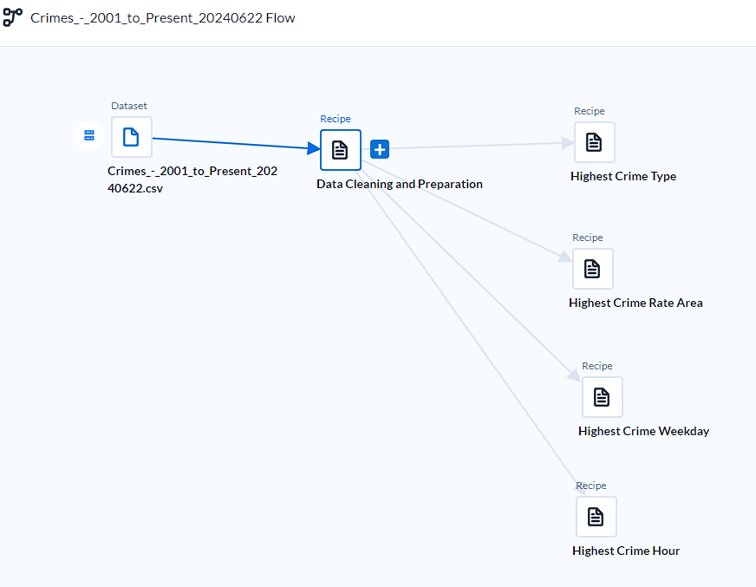
Overview of the workflow
Dataset: Crime_-_2001_to_Present_20240622.csv
Recipe: Data Cleaning and Preparation
Recipe: Highest Crime Type
Recipe: Highest Crime Rate Area
Recipe: Highest Crime Weekday
Recipe: Highest Crime Hour

Slide 7
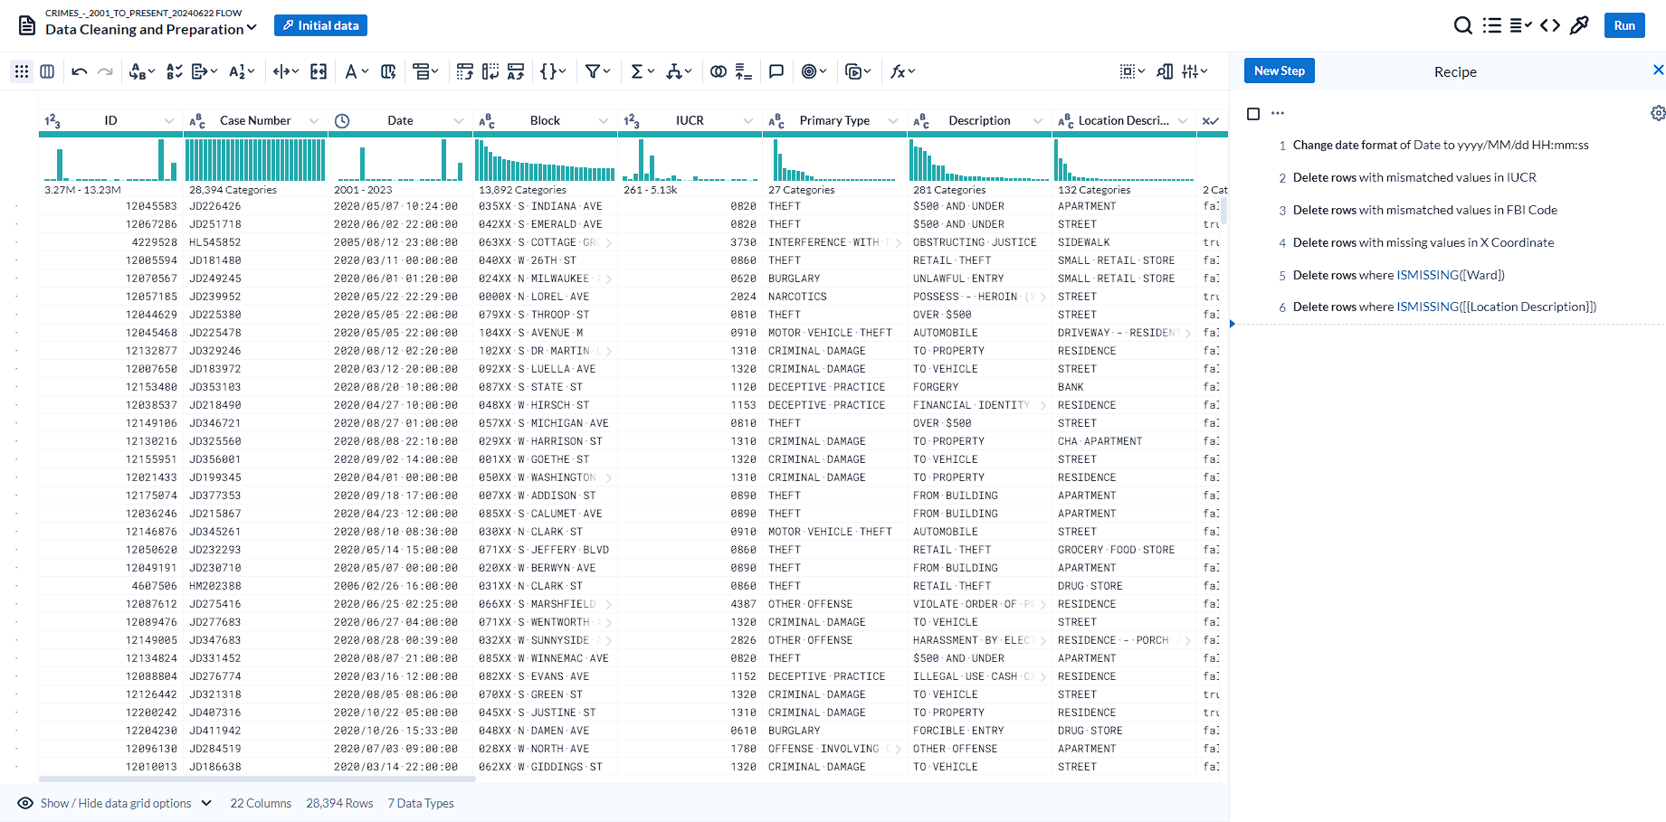
Data Cleaning and Preparation

Slide 8
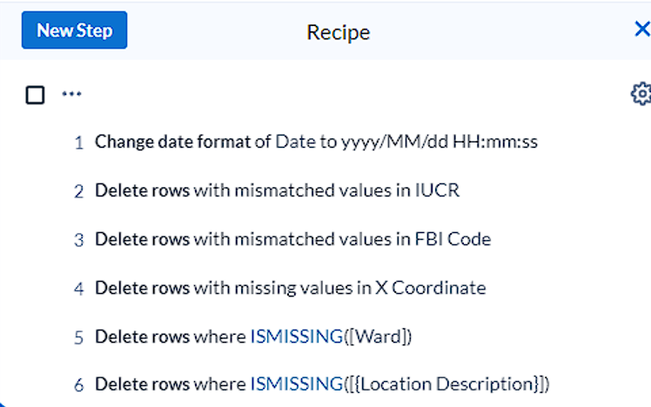
modifications for data cleaning

Slide 9
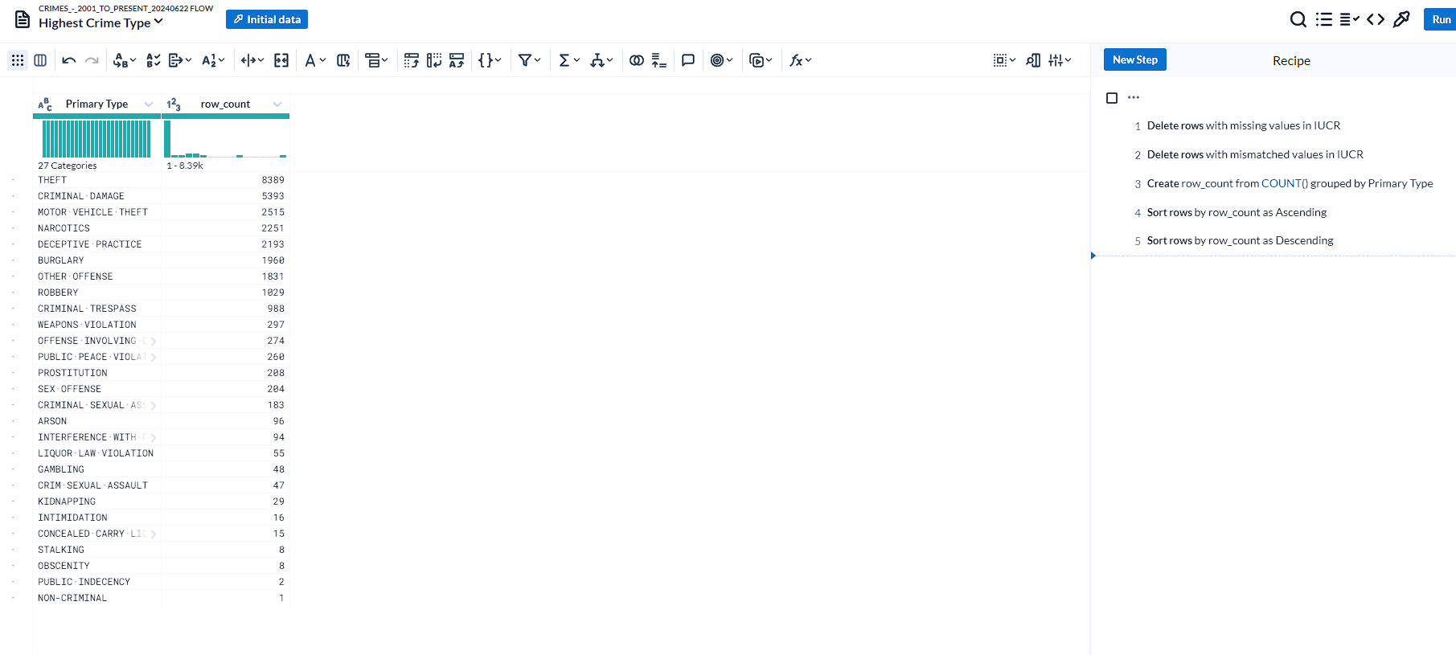
Highest Crime type

Slide 10
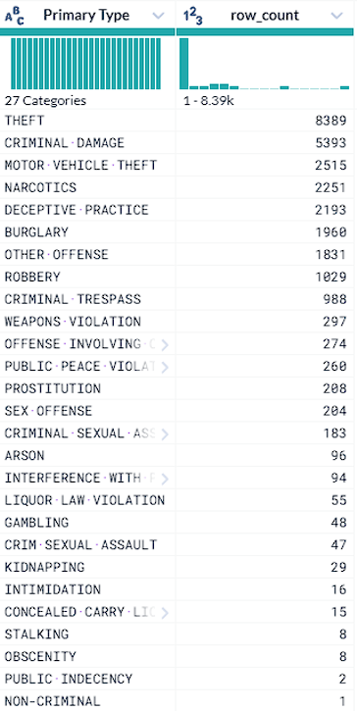
Highest Crime type
The top 2 crime types are theft and criminal damage with 8389 and 5393 cases reported
Beside the top 2 crimes, other common crimes in Chicago includes motor vehicle theft, narcotics, deceptive practice, burglary and offense (other).

Slide 11
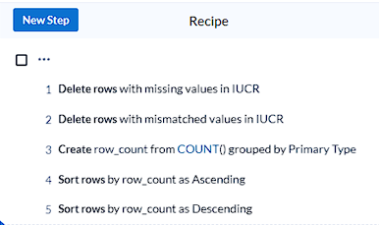
Highest crime type steps

Slide 12
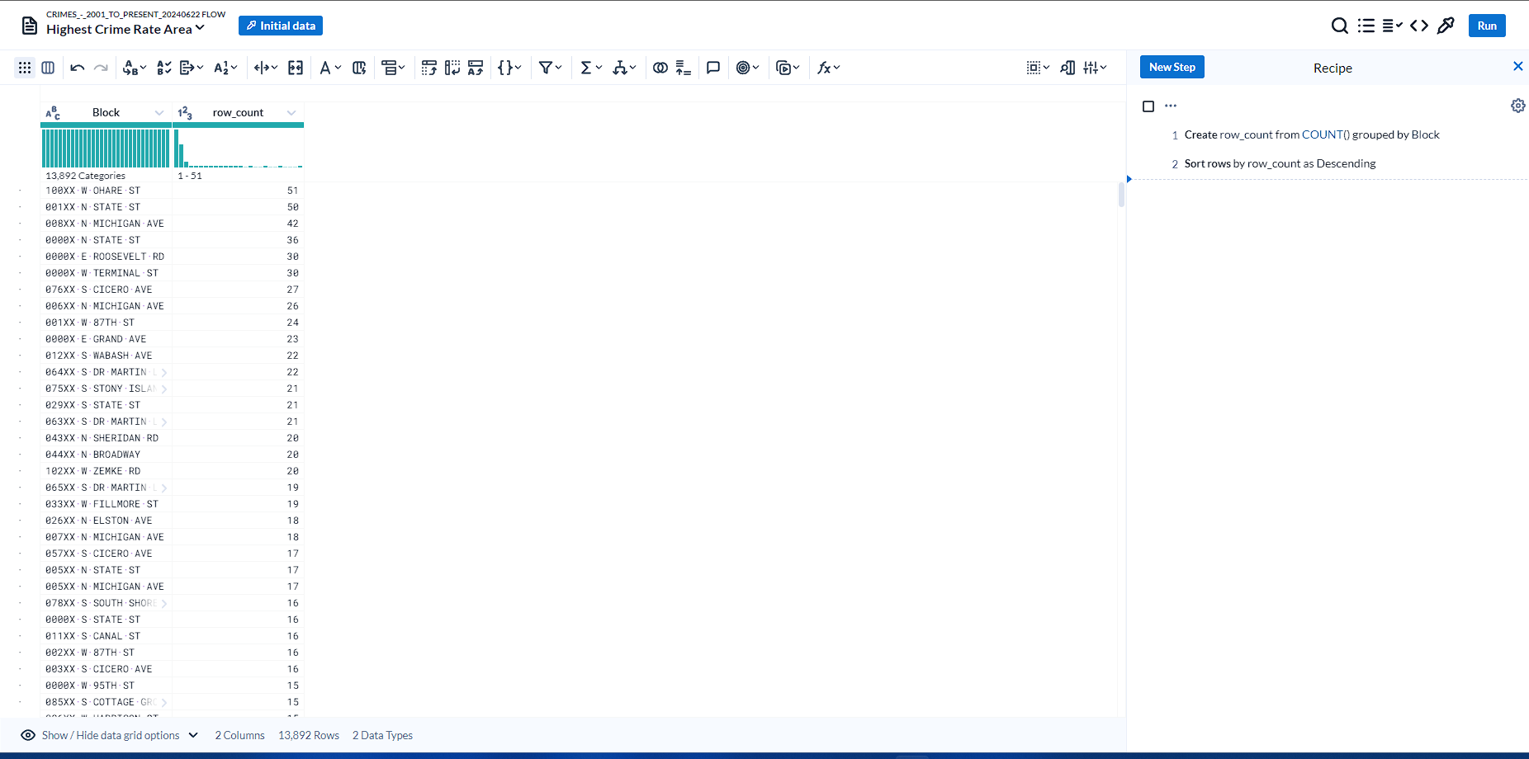
Highest crime rate area

Slide 13
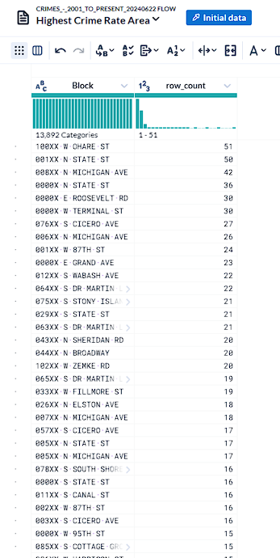
Highest crime rate area
Based on the data, the top 3 highest crime rate areas in Chicago would be
Chare Street (100XXW) with 51 reports, State Street (001XXN) with 50 reports, and Michigan Avenue (006XXN) with 42 reports.

Slide 14
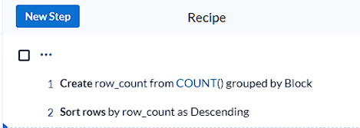
Highest crime rate area steps

Slide 15
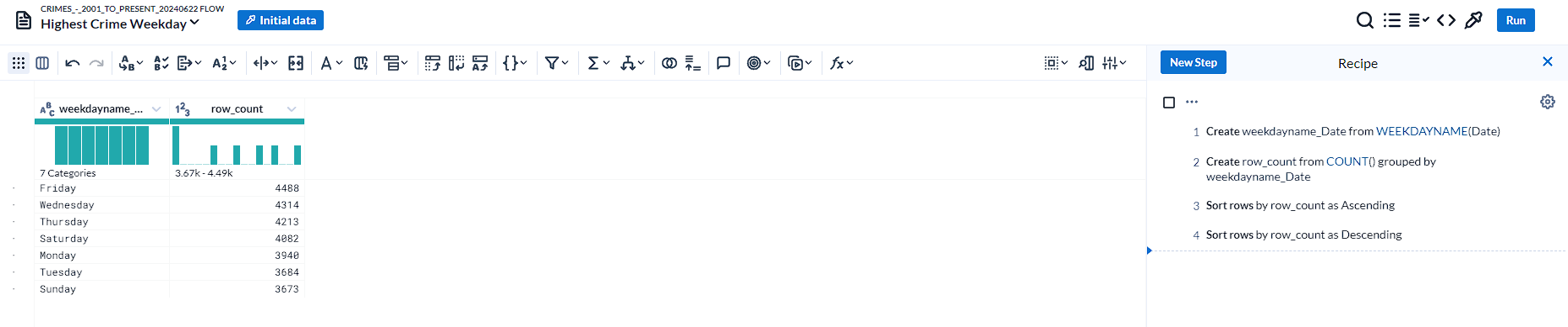
Highest crime weekday

Slide 16
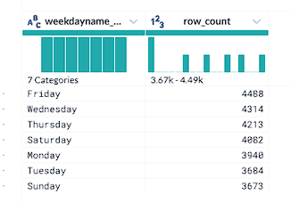
Highest crime weekday
Based on the data, in Chicago,
Friday has the highest crime rate (4488 cases reported), while Sunday has the lowest crime rate with the gap of 18% (3673 cases reported).

Slide 17
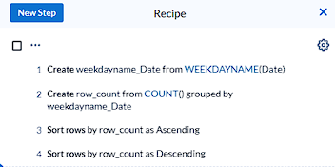
Highest crime weekday Steps

Slide 18
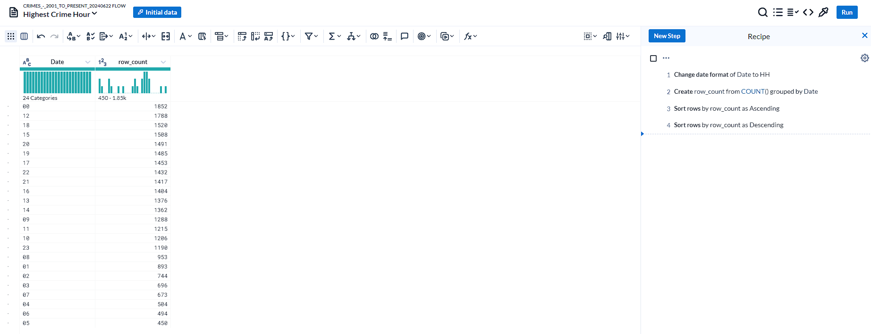
Highest crime Hour

Slide 19
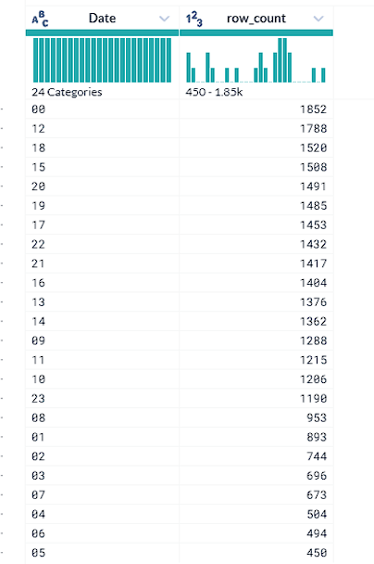
Highest crime Hour
Based on the data, in Chicago,
The hour with highest crime rate would be 12 a.m., 12 p.m. and 6 p.m.. The hour with lowest crime rate would be 4 a.m., 6 a.m., and 5 a.m..
This result could indicate that there’re less crime happening in the early morning in the city of Chicago.

Slide 20
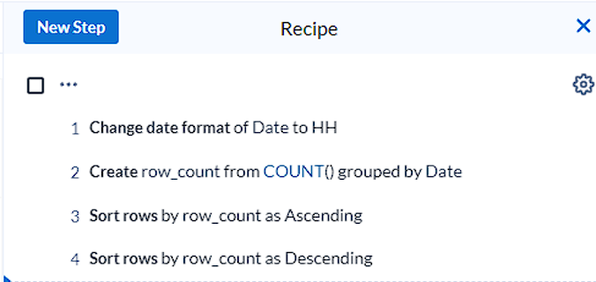
Highest crime Hour steps

Slide 21
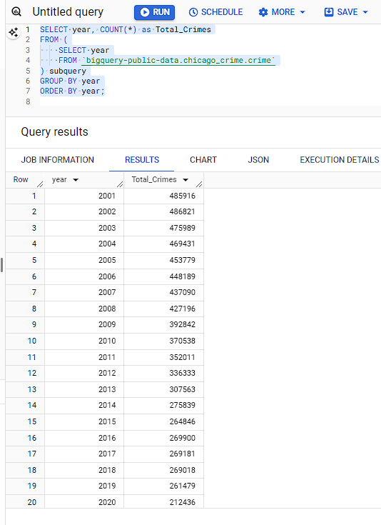
Total crime reported each year
With BigQuery, the total number of crimes in each specific year reported in Chicago could be list out chronologically.

Slide 22
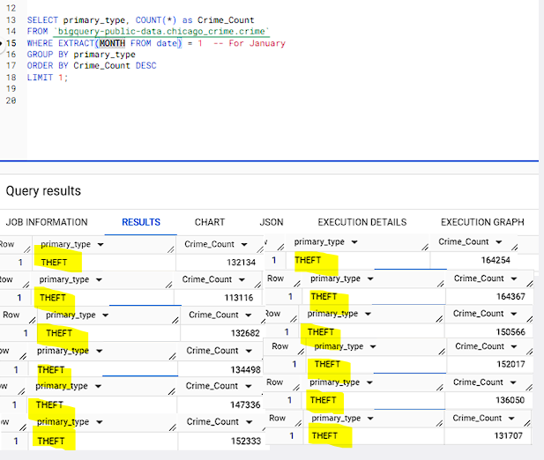
The most common type of crime reported in a specific month.
The most common type of crime in the Chicago crime dataset would be theft, the query result on the left shows the top crime and the reported number of cases for each specific month. From the top left to the bottom right, it goes by January to December.
As result, no matter what month, theft is the most common crime in Chicago.

Slide 23
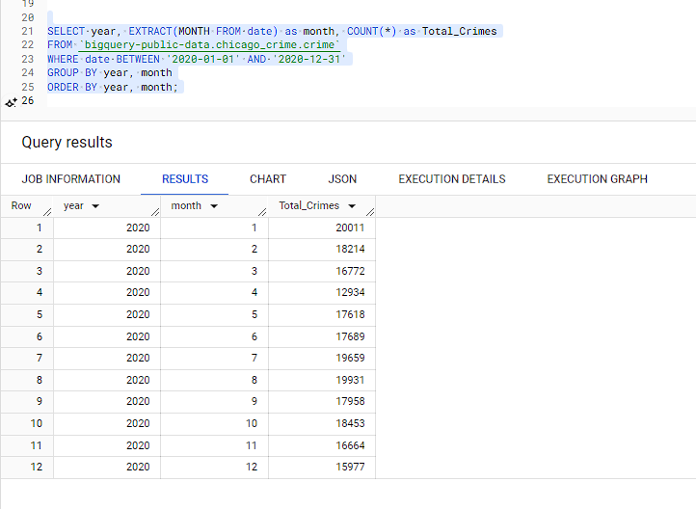
Crime Trends over the year of 2020
The crime cases over the year of 2020 is relatively stable without any specific season of crime rate spiking (ranging from 12934 to 20011).
Despite of not having significant trend, in 2020, Chicago has the most crime cases reported in January and the least crime cases reported in April.

Slide 24
Key Insights
Highest Crime Type:
Top crimes: Theft (8389 cases), Criminal Damage (5393 cases)
Other common crimes: Motor Vehicle Theft, Narcotics, Deceptive Practice, Burglary
Highest Crime Rate Area:
Top areas: Chare Street (51 reports), State Street (50 reports), Michigan Avenue (42 reports)
Crime Distribution by Weekday:
Highest crime day: Friday (4488 cases)
Lowest crime day: Sunday (3673 cases)
Crime Distribution by Hour:
Peak crime hours: 12 a.m., 12 p.m., 6 p.m.
Lowest crime hours: 4 a.m., 6 a.m., 5 a.m.
Yearly Crime Trends:
Analysis of crime reports by year
Stable crime rate in 2020 with highest reports in January and lowest in April

Slide 25
Project Conclusion
Comprehensive analysis of crime data in Chicago
Valuable insights for understanding crime patterns and trends
Utilized Google Cloud tools for efficient data handling and analysis

Slide 26
Questions & Answers

