Slide 1
FINAL PROJECT
GROUP 1
Network Project
안현우, 김태은, 여혁수

Slide 2

Contents
01
Implemented for key function 1
02
Implemented for key function 2
03
Performance evaluation

Slide 3
PART 1
Implemented for key function 1
1. Let client to consume packet in an order.
Need to make a lot of frames in advance.
Retransmit loss packet smoothly & fast
Frame to be consumed next will be composed of lowest number of seqN.
Sequentially find loss packet, and send sequentially

Slide 4


1
100, 101, 102, 103, 106, 107, 109, 110…199
5
104, 105, 108, 200, 201, 202…296
4
104..?
Retransmit!
105..? Retransmit! 108..? Retransmit!
HandleRead
3
Packet #104
2
104..? Loss!
105..? Loss! 108..? Loss!
Streamer
Packet #105
Packet #108
Frame generator

Slide 5
PART 2
Implemented for key function 2
2. Maintain high buffer holding rate.
Continue to make frame
Retransmit loss packet smoothly & fast
Should hold many valid frames as possible
Send resume packet faster, remove useless frame

Slide 6
1250..? 1270..? Already no consumed, pass!
4
3
1250, 1270, 1800, 1801, 1802, 1803, 1804, 1805…1899
HandleRead
NoConsume(Frame 12),
Consume(Frame 13)…
1
Streamer
Frame Consumer
Frame Generator
2
Remove Frame 12 in frame buffer!

Slide 7
PART 3
Performance evaluation
How well to consume
in order
276, 259
106.564%
16, 519
Calculate the number of occurrence NoConsume, and occurrence Consume.
Frame 0, 1->equally NoConsume in any condition.
9, 526
5, 530
4, 531
5, 530
5, 530
5, 530
2, 533
2, 533
3, 532
2, 533

Slide 8
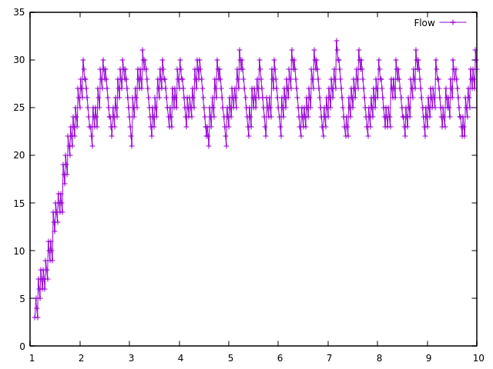
PART 3
Performance evaluation
How well to keep buffer holding
Loss rate = 5%
RxNoiseFigure = 45.0
Send resume packet if buffer size < 25
Get paused more than 3 times per seconds.
Buffer size goes 30 in 1 seconds at first.
Buffer size does not decrease lower than 21.

Slide 9
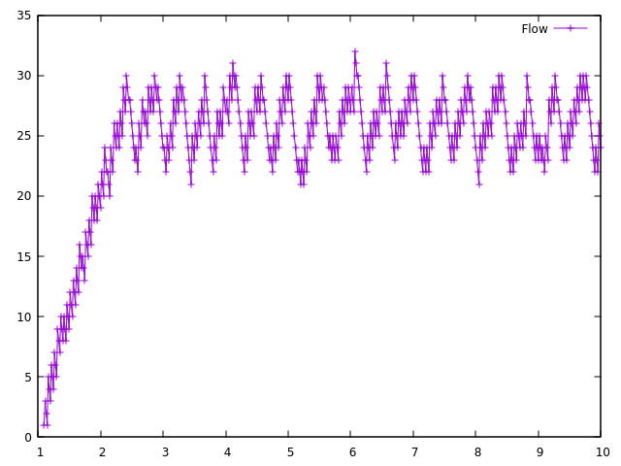
PART 3
Performance evaluation
How well to keep buffer holding
Loss rate = 10%
RxNoiseFigure = 45.0
Send resume packet if buffer size < 25
Get paused almost 3 times per seconds.
Buffer size goes 30 in 1.5 seconds at first.
Buffer size does not decrease lower than 21.

Slide 10
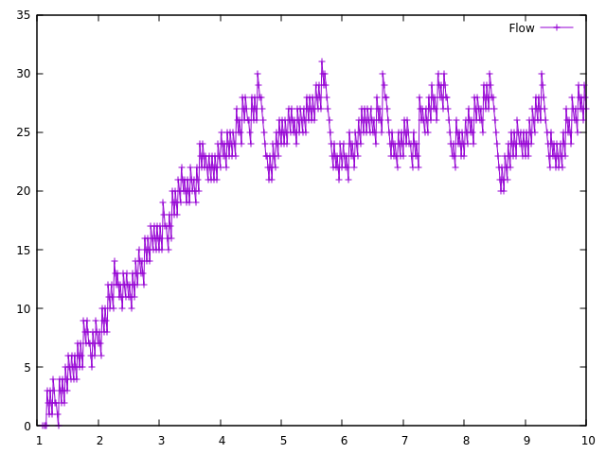
PART 3
Performance evaluation
How well to keep buffer holding
Loss rate = 20%
RxNoiseFigure = 45.0
Send resume packet if buffer size < 25
Get paused 1 times per seconds.
Buffer size goes 30 in 4.5 seconds at first.
Buffer size does not decrease lower than 20.

Slide 11

Thank You

