Slide 1
Read Summarization
It’s ALL RELATIVE!!

Slide 2
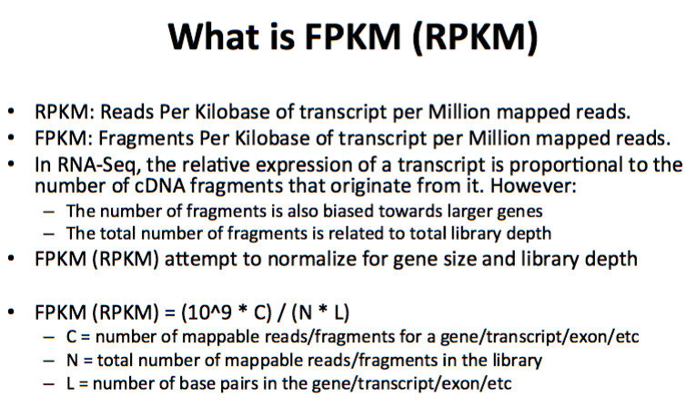
What is FPKM?

Slide 3
What’s the difference between RPKM/FPKM and TPM?
What do we normalize for ?
RPKM:
Get total read counts
Normalize by depth and scale
Normalize for gene lengths
TPM:
Normalize for gene length (to get RPK)
Get total RPK and scale (RPK)
Normalize by depth
http://www.rna-seqblog.com/rpkm-fpkm-and-tpm-clearly-explained/

Slide 4
Gene name | Rep 1 read counts | Rep 2 | Rep 3
A (2kb) | 10 | 12 | 30
B (4kb) | 20 | 25 | 60
C (1kb) | 5 | 8 | 15
D (10kb) | 0 | 0 | 1
RPKM:
Sum total # reads
Scale total by 10^6
Divide by total scaled # reads in library
Divide by length of the gene (kb)
TPM:
Divide by length of the gene (kb)
Sum RPK values
Scale total by 10^6
Divide RPK by total

