Slide 1
EGR 150 Quiz Maker
Yeochan Youn

Slide 2
Goals:
Goal.01 - Use Use GUI to send quiz to other person
Goal.02 - Use list box to show the list of quizes(.csv) in the folder
Goal.03 - Use edit box to show preview of quiz before send it to the client
Goal.04 - Use GUI to get the quiz file from server
Goal.05 - Use pushbuttons to go backward and forward
Goal.06 - Show the number of current number of problem in the quiz
Goal.07 - Client able to save the answers in a file in their folder
Goal.08 - Clients only can start the quiz once they provide their name
Goal.09 - Clients can get their scores after submit the answer
Goal.10 -Clients cannot change answers once they submit the quiz

Slide 3
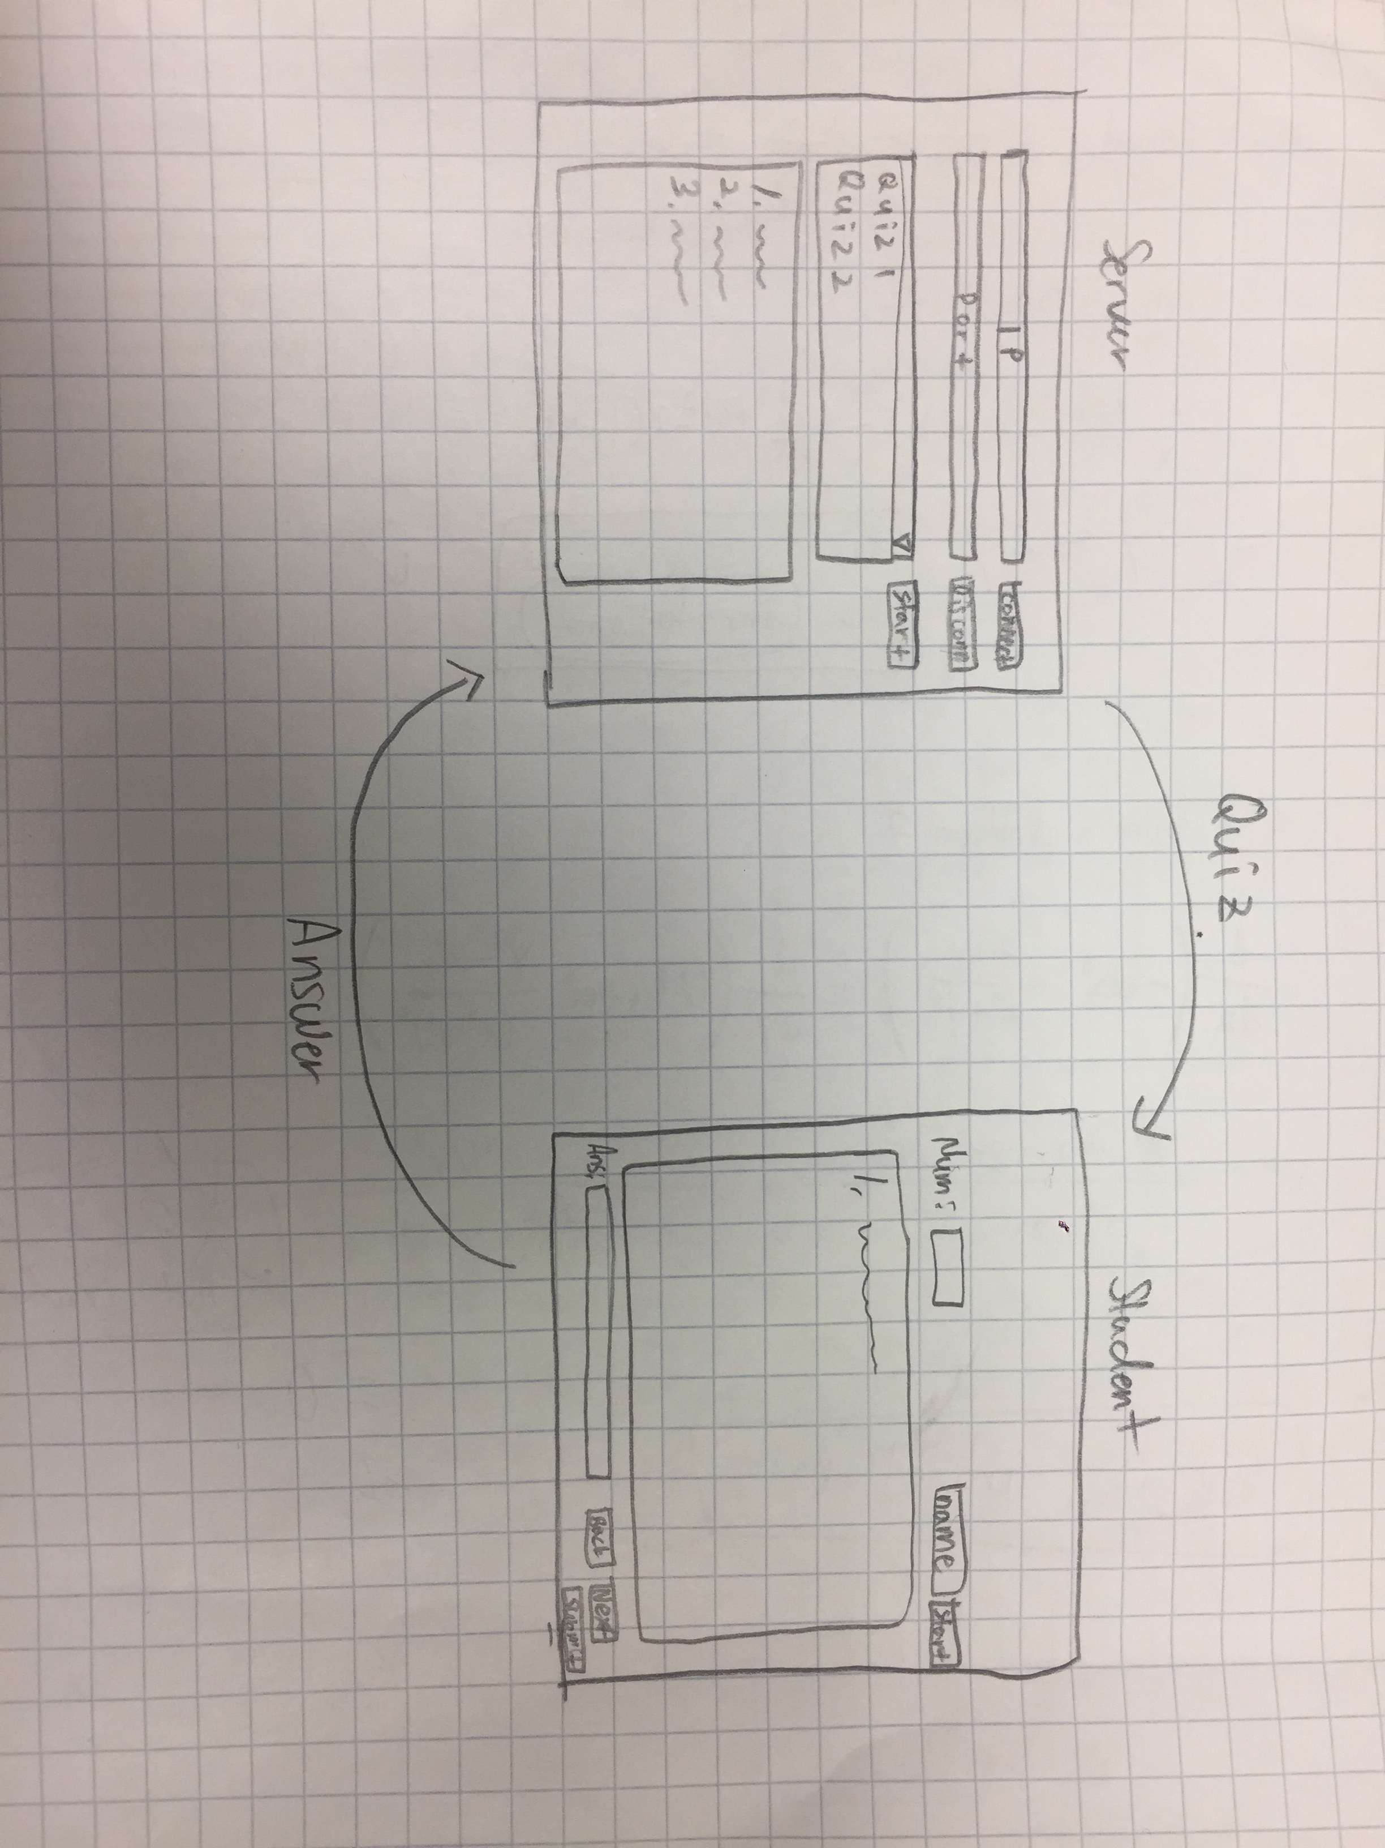
Sketch

Slide 4
Details
Create and edit quiz in .csv file
Server can choose a quiz and send it to students.
Students can see quiz when server send it.
Students will be able to start the quiz once they put their names.

Slide 5
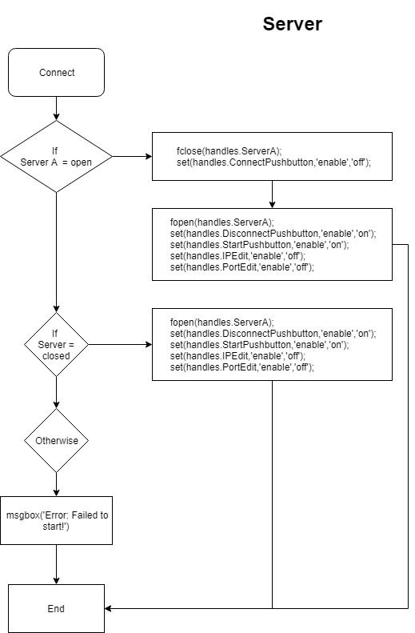

Slide 6
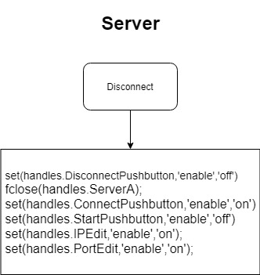

Slide 7
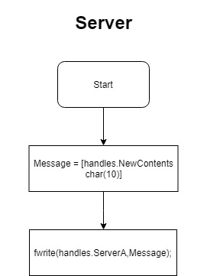

Slide 8
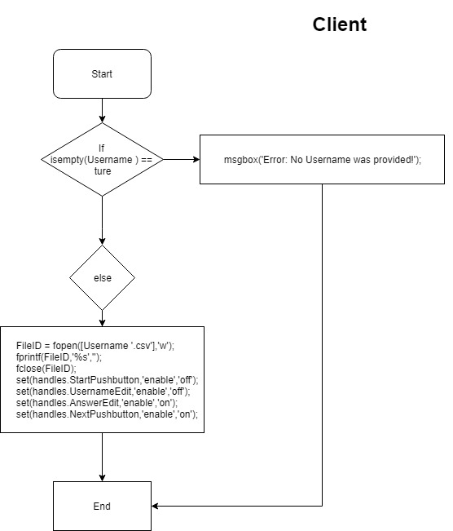

Slide 9
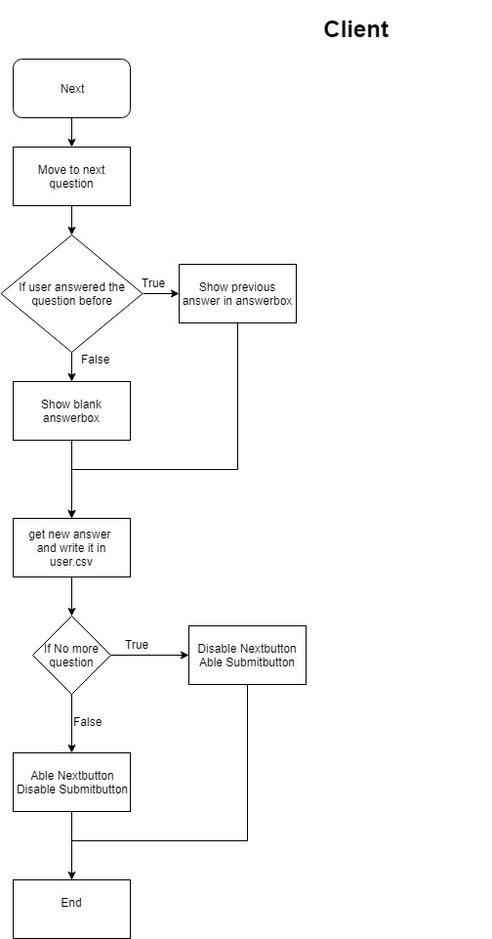

Slide 10
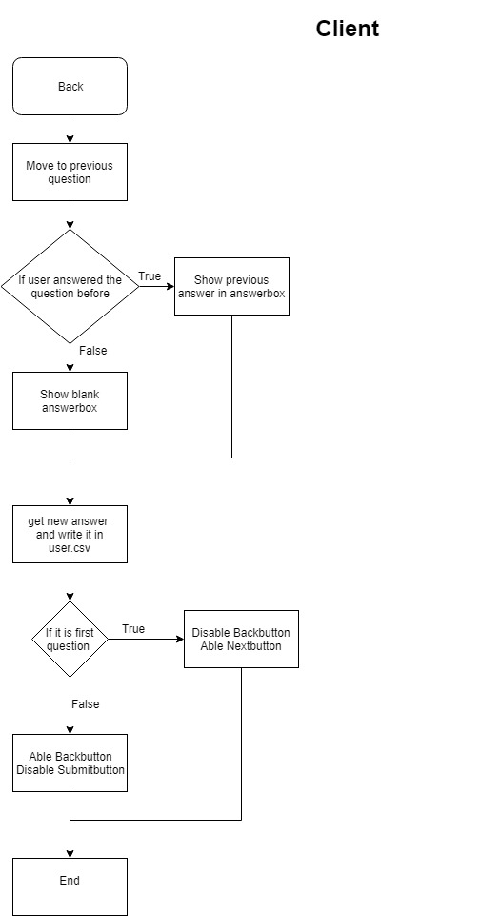

Slide 11
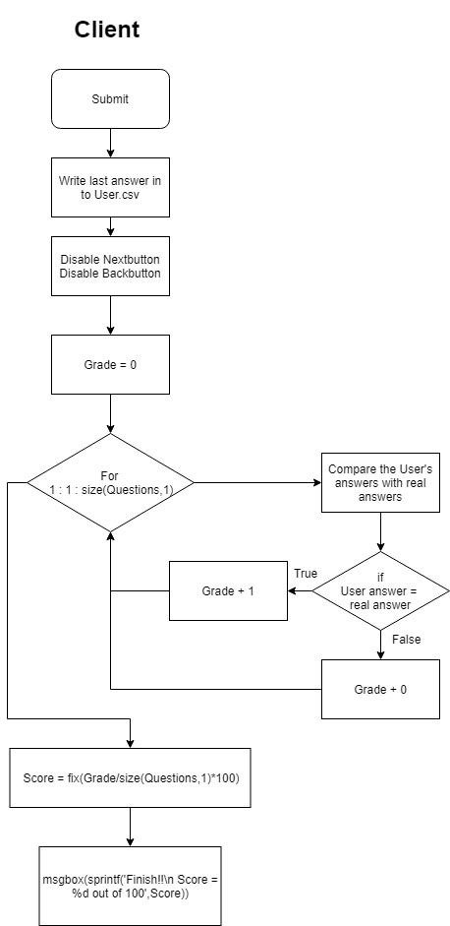

Slide 12
Problem
Connecting server and client.
Send .csv file to client.
Display the information into separate axis in client’s GUI.
Fixing the problem that server keep send same files to the server.

Slide 13
Futurework
Make better display.
Getting grades from each clients.
Make easier to connect two GUIs.
Able to send images.
Set timer into the quiz.

