Slide 1
Mockify: AI-Powered Mock Test Platform
Containerized Deployment using Docker and AWS EC2
Presented by: Krushna Ravindra Yeole

Slide 2
Index
Introduction
Problem Statement
System’s Architecture
Architecture Details
Implementation
Applications

Slide 3
INTRODUCTION
AI-powered mock test web application designed to help users practice any topic instantly
Developed using Flask, HTML, CSS, and JavaScript for full-stack web development
Allows users to generate, attempt, and analyze MCQ-based tests in a structured way
Focus on containerized deployment using Docker for consistency and portability
Application is deployed on AWS EC2 using a Docker container

Slide 4
Problem Statement
In traditional systems, generating and practicing topic-specific tests is often manual and time-consuming. Users rely on static question banks, which lack flexibility and personalization. Additionally, deploying full-stack applications manually can lead to configuration issues, inconsistencies, and errors. Managing dependencies and environment setup across systems becomes difficult without proper standardization. Therefore, there is a need for an intelligent system that can generate dynamic tests and a deployment approach that ensures consistency, scalability, and efficiency.

Slide 5
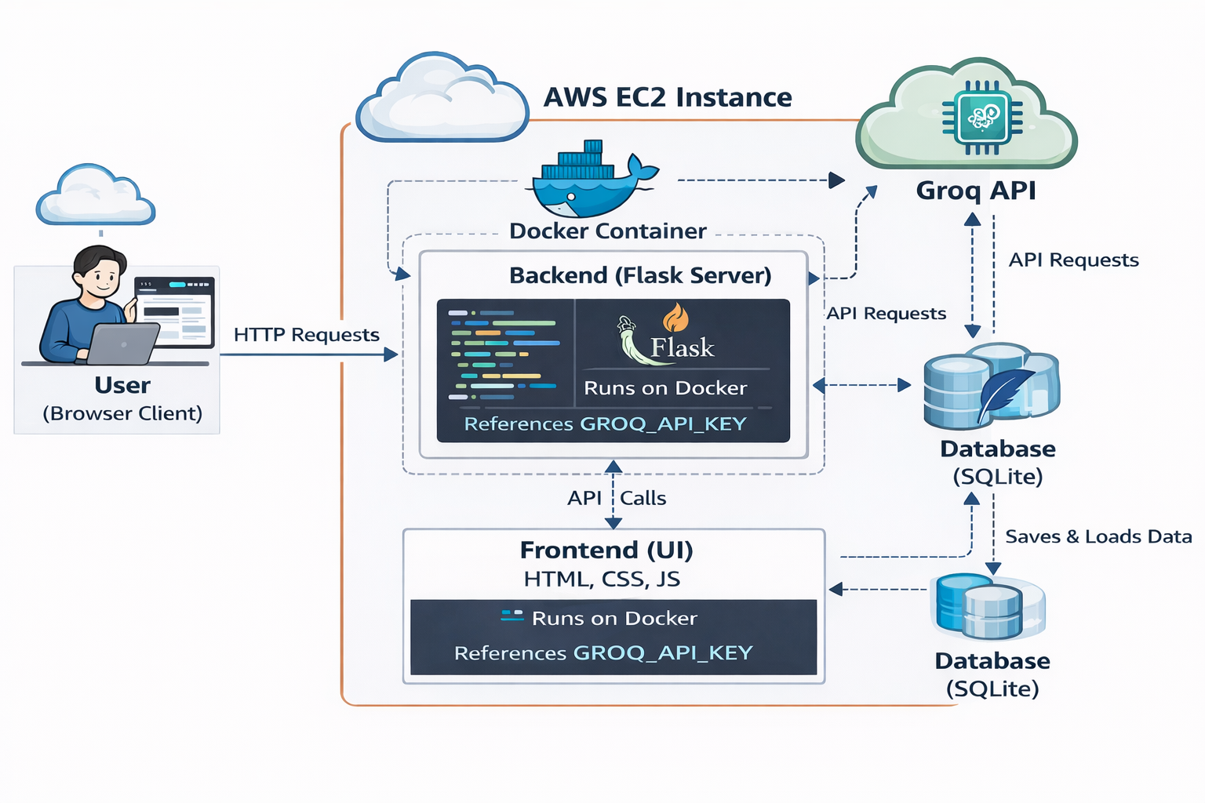
ARCHITECTURE

Slide 6
ARCHITECTURE
User accesses application through browser
Frontend sends API requests to Flask backend
Backend processes request and handles logic
Backend calls Groq API for MCQ generation
Groq API returns generated questions
Backend stores and retrieves data from SQLite database
Backend sends response back to frontend
Frontend displays results to user

Slide 7
IMPLEMENTATION
Launched AWS EC2 instance for deployment
Installed Docker and Git on EC2
Cloned project from GitHub repository
Created Dockerfile for application setup
Built Docker image with project and dependencies
Configured environment variables using .env file
Ran Docker container to start the application
Exposed application using port mapping
Tested complete workflow for successful deployment

Slide 8
APPLICATIONS
Used by students for topic-wise practice tests
Helps job seekers prepare for aptitude and technical exams
Useful for quick revision before exams or interviews
Can be used in colleges for mock assessments
Supports self-learning through instant feedback and analysis
Applicable in online test platforms and e-learning systems

Slide 9
Thank You....!!!!

