Slide 1
Project #0-2: Pintos Data Structure Analysis
[CSE4070]
Fall 2019
Hyeongu Kang

Slide 2
Data Structures

Slide 3
Data Structures in Pintos Kernel
Before we dive into Pintos project, we will practice Pintos data structures
Pintos provides kernel and user libraries
You can find it in "pintos/src/lib/kernel" and "pintos/src/lib/user"
In this project, we will cover data structures of Pintos kernel libraries → List, Hash table and Bitmap

Slide 4
List
List in Pintos is a doubly linked list
It is different from usual list structure
It splits list element pointers and data
struct list_elem
Each structure that will be a list item must embed a struct list_elem member
All of the list functions operate on struct list_elem not the list item
head
elem
elem
elem
tail

Slide 5
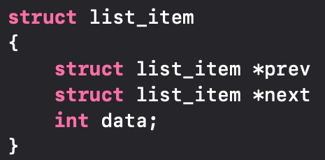
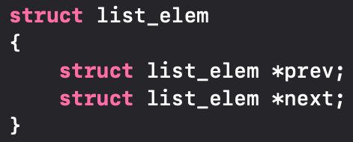
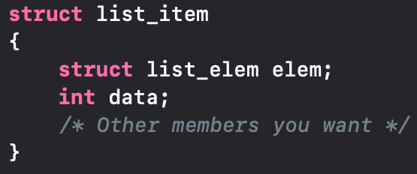
List
Linked List: Usual way
Linked List: Pintos kernel
list_item
list_item
*prev
*prev
*next
*next
int data
int data
list_item
list_item
list_elem elem
list_elem elem
*prev
*prev
*next
*next
int data
int data
Split the pointer and data

Slide 6
List Function Analysis
void list_init(struct list *list)
Initialize LIST as an empty list
It should be performed before an element is inserted in LIST
struct list_elem* list_begin(struct list *list)
Return the first element of LIST
Usually used to iterate LIST
struct list_elem* list_next(struct list_elem *elem)
Return the next element of ELEM
Usually used to iterate LIST or search ELEM in LIST

Slide 7
List Function Analysis
struct list_elem* list_end(struct list *list)
Return the last ELEM in LIST
Usually used to iterate LIST
#define list_entry(list_elem, struct, member)
Converts pointer to LIST_ELEM into a pointer to STRUCT that LIST_ELEM is embedded inside
Usually used to get address of STURCT which embeds LIST_ELEM
sample_list
*e
list_elem head
*temp
*prev
/* Assume that there already exists a list, sample_list */
struct list_elem *e;
e = list_begin (&sample_list);
struct list_item *temp = list_entry(e, struct list_item, elem)
int temp_data = temp->data
By using list_elem, we can get address of list_item
*next
list_elem elem
*prev
*next
list_elem tail
*prev
*next
int data
struct list_item

Slide 8
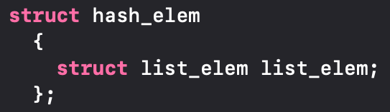
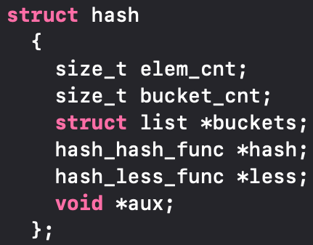
Hash Table
A hash table is a data structure that associates keys with values
We assume that key and value are same in this project
The primary operation it supports efficiently is a lookup
Given a key, find the corresponding value
It works by transforming the key using a hash function into a hash
Key
Buckets
Entries
0
prev
100
1
head
next
tail
f(x)=x/100
2
100
550
3
4
prev
prev
500
5
head
next
next
tail
6
500
550
7

Slide 9
Hash Table Function Analysis
void hash_init(struct hash *h, hash_hash_func *hash, hash_less_func *less, void *aux)
Initialize hash table H and set hash function HASH and comparison function LESS
You can see the example hash function such as hash_bytes, hash_string and hash_int
Comparison function LESS is used to compare two hash elements
You need to make your own hash function and comparison function
void hash_apply(struct hash *h, hash_action_func *action)
You can apply any ACTION function which you make to hast table H
You can learn the usage of it from 'hash_apply.in' and 'hash_apply.out' in tester directory
#define hash_entry(hash_elem, struct, member)
Converts pointer to HASH_ELEM into a pointer to STRUCT that HASH_ELEM is embedded inside
Usually used to get address of STURCT which embeds HASH_ELEM

Slide 10
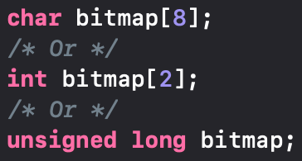
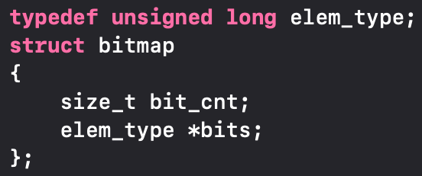
Bitmap
A bit array(or bitmap, in some cases) is an array which compactly stores individual bits (Boolean values)
A bitmap can reduce the waste of memory space
0
0
0
1
0
0
0
1
0
0
0
0
ᐧᐧᐧ
0
1
0
0
0
1
0
0
0
0
8 Bytes (64 bit)
Bitmap: Usual way
Bitmap: Pintos kernel

Slide 11
Bitmap Function Analysis
struct bitmap *bitmap_create(size_t bit_cnt)
Initialize a bitmap of BIT_CNT bits and sets all of its bits to false
void bitmap_set (struct bitmap *b, size_t idx, bool value)
Atomically sets the bit numbered IDX in B to VALUE
size_t bitmap_count (const struct bitmap *b, size_t start, size_t cnt, bool value)
Returns the number of bits in B between START and START + CNT, exclusive, that are set to VALUE

Slide 12
Requirements

Slide 13
Project #0-2
Write the interactive program that can check functionalities of list, hash table and bitmap in Pintos kernel
Assumptions
All inputs are from standard input (STDIN)
All inputs and outputs are lower cases
All the type used in the program is integer
Use hash_int() as hash function for hash table
Print true or false when the return type is Boolean
The number of list, hash table and bitmap is less than 10
You can use any function in given source codes and you can implement your own code if it is needed

Slide 14
Project #0-2: List of Functions to Implement
You need to implement the following functions as well
List
void list_swap(struct list_elem *a, struct list_elem *b)
Parameter : Two list elements that will be swapped
Return value : None
Functionality : Swap two list elements in parameters
void list_shuffle(struct list *list)
Parameter : List that will be shuffled
Return value : None
Functionality : Shuffle elements of LIST in the parameter

Slide 15
Project #0-2: List of Functions to Implement
You need to implement the following functions as well
Hash table
unsigned hash_int_2(int i)
Parameter : Integer that will be hashed
Return value : Hash value of integer I
Functionality : You can implement this function in your own way and describe what you implement in the document
Bitmap
struct bitmap *bitmap_expand(struct bitmap *bitmap, int size)
Parameter : Bitmap that you want to expand and the size of it
Return value : Expanded bitmap if succeed, NULL if fail
Functionality : Expand the given BITMAP to the SIZE (backward expansion)
※ You must not use this function in your code, just implement hash_int_2() in your code
※ Please use hash_int() as hash function to pass the test program

Slide 16
Project #0-2
These are small part of commands used in interactive program
You should check the tester file (*.in) to see what commands are used for the test
create list <LIST>
Create LIST
create hashtable <HASH_TABLE>
Create HASH_TABLE
create bitmap <BITMAP> <BIT_CNT>
Create BITMAP with the size of BIT_CNT
delete <LIST | HASH_TABLE | BITMAP>
Delete the given data structure
dumpdata <LIST | HASH_TABLE | BITMAP>
Print the given data structure to standard out (STDOUT)
quit
Terminate the interactive program

Slide 17
Project #0-2
Note that this is just the example of the test case. You should test your program by yourself or by test program!
Example (List)
$ ./testlib
create list list1
dumpdata list1
list_push_front list1 1
list_push_back list1 4
list_puch_back list1 3
dumpdata list1
1 4 3
list_max list1
4
list_shuffle list1
dumpdata list1
4 1 3
quit
$
No output yet
Output of 'dumpdata list1'
Output of 'list_max list1'
Output of 'dumpdata list1'

Slide 18
Project #0-2
Kernel Library source files are in ‘pintos/src/lib/kernel’
list.h, list.c, hash.h, hash.c, bitmap.h, bitmap.c
Some files are dependent on Pintos source codes
You should use the source files in 'lib_hw1.tar.gz' which we provide

Slide 19
Project #0-2: Tester Program
You can use tester program (hw1_tester.sh) to test your implementation
Download os_hw1_tester.tar.gz from e-class
Extract it ($ tar –zxvf os_hw1_tester.tar.gz)
Go to os_hw1_tester directory ($ cd os_hw1_tester)
Run tester script with your interactive program ($ sh hw1_tester.ssh ../20179999/testlib)
It will produce .output files which show you the output contents of each test, .result files which show you the result of each test and Score.txt will show you the total score

Slide 20
Project #0-2: Cautions
If you use printf() to print size_t type values, use length sub-specifier, such as z, not to harm the length of data
Ex) size_t a=10; printf("%zu", a);
Refer the webpage http://www.cplusplus.com/reference/cstdio/printf/ for more information

Slide 21
Submission
Contents
makefile (You will get no point if you do not use makefile)
Provided libraries (files in lib_hw1 directory)
Source code you made
document (softcopy and hardcopy) → Explain briefly library functions which you used and functions which you wrote (functionality, parameter, return value)
Form and way to submit
Form of the file
document: document.doc or document.docx (Other format is not allowed such as .hwp)
Submission contents should be contained in the directory that has ID as directory name
For example, if your ID is 20179999, makefile, provided libraries, source code you made and document file should be in '20179999' directory.
Compress the 'ID' directory into 'os#0_2_[ID].tar.gz'
You should use -zcf options for using tar
Way to submit: Upload the tar.gz file to e-class
The name of interactive program (produced by 'make' command) should be "testlib" (Other name such as a.out, output, main is not allowed)
You should 'make clean' before you compress the directory
Submit Hardcopy to AS916 (You should submit softcopy and hardcopy both, if not 3% of point will be deducted)
Due date: 2019. 10. 6 23:59
5% of point will be deducted for a wrong form and way to submit
Late submission is allowed up to 3 days (~10/9) and 10% of point will be deducted per day

Slide 22
Project Schedule
Projects | Points | Contents | Periods | Lectures
Project 0-1 | 1 | Installing Pintos | 9/16 – 9/22 | Manual will be provided
Project 0-2 | 3 | Pintos Data Structures | 9/21 – 10/6 | 9/21 (Sat.)
Project 1 | 6 | User Programs (1) | 10/5 – 11/3 | 10/5 (Sat.)
Project 2 | 4 | User Programs (2) | 11/2 – 11/17 | 11/2 (Sat.)
Project 3 | 6 | Threads | 11/16 – 12/8 | 11/16 (Sat.)
※ Once you copy other's codes, you will get F grade

Slide 23
Appendix

Slide 24
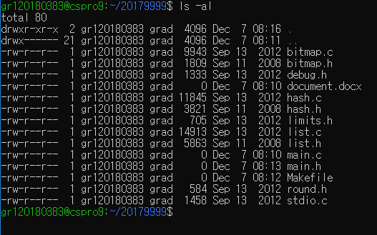
Way to Submit Your Work
Correct case
All the files should be in your 'ID' directory

Slide 25
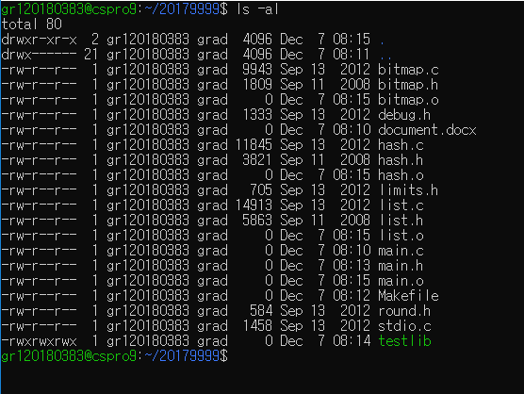
Way to Submit Your Work
Wrong case (1)
'make clean' is not performed in this case (There are *.o and testlib files)

Slide 26
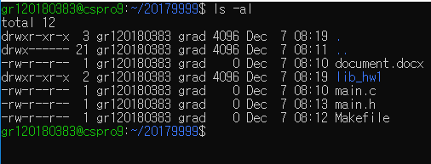
Way to Submit Your Work
Wrong case (2)
Library files are in 'lib_hw1' directory in this case
Don't contain libraries in other directory, just contain it in 'ID' directory

Slide 27
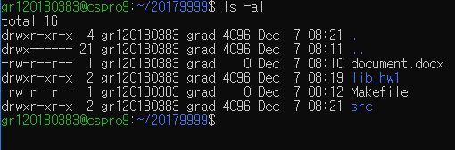
Way to Submit Your Work
Wrong case (3)
Source codes are in 'src' directory and also libraries are in 'lib_hw1'

Slide 28
Way to Submit Your Work
How to use tar (Assume that your ID is 20179999)
Compress: tar -zcvf os#0_2_20179999.tar.gz 20179999
Extract: tar -zxvf os#0_2_20179999.tar.gz
Don't compress your directory in Windows, compress it in Linux
20179999 directory, not os#0_2_20179999, should be shown after extracting tar.gz file
If you did 'tar -zcvf os#0_2_20179999.tar.gz os#0_2_20179999', you will get os#0_2_20179999 directory after extracting os#0_2_20179999.tar.gz ← This is wrong case!

