Slide 1
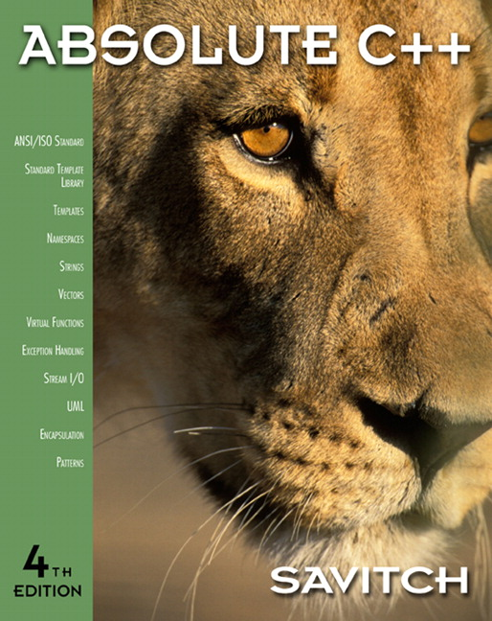

Chapter 10
Pointers and Dynamic Arrays
Copyright © 2010 Pearson Addison-Wesley. All rights reserved

Slide 2
Learning Objectives
Pointers
  Pointer variables
  Memory management
Dynamic Arrays
  Creating and using
  Pointer arithmetic
Classes, Pointers, Dynamic Arrays
  The this pointer
  Destructors, copy constructors
Copyright © 2010 Pearson Addison-Wesley. All rights reserved.
10-<number>

Slide 3
Pointer Introduction
Pointer definition:
  Memory address of a variable
Purposes of pointer
  Manipulating with address
  Dynamic memory allocation
Declaration
  Type *variableName; ex) double * p;
  A memory allocation to store address of the data type
  Note that the address can be used to point out a single data or chunk data(starting address)
Copyright © 2010 Pearson Addison-Wesley. All rights reserved.
10-<number>

Slide 4
What a Pointer contains
int *p1, v1;
  P1 has a memory space to contain an address of integer type data.
    It does not actually has a memory space to contain an integer type data
Two ways to store an actual data
  Borrow a memory space from an already allocated space;
    p1 = &v1; // borrow from a memory space for v1
  Allocate a memory space at the heap memory
    P1 = new int;
Copyright © 2010 Pearson Addison-Wesley. All rights reserved.
10-<number>

Slide 5
Opeator & and *
Level of equivalence
  int *p1, v1,v2=3;
  p1 = &v1; // pointer is equivalent to address of a variable
  *p1 = v2; // dereferenced pointer is equivalent to a variable
  If you print out
    Cout << p1; // print out an address
    Cout << *p1 ; // print out a data pointed by a pointer variable p1
Copy a data vs pointer
  int *p1, *p2, v1=3,v2=4;
  P1 = &v1; p2 =&v2;
  P1= p2; // copy an address
  *p1 = *p2; // copy data itself
Copyright © 2010 Pearson Addison-Wesley. All rights reserved.
10-<number>

Slide 6
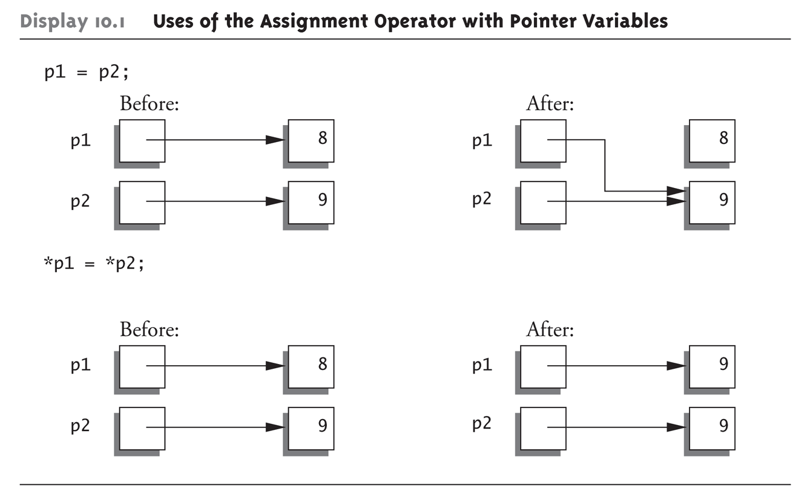
Pointer Assignments Graphic:
Display 10.1 Uses of the Assignment Operator with Pointer Variables
Copyright © 2010 Pearson Addison-Wesley. All rights reserved.
10-<number>

Slide 7
실습예제
Chap10 이라는 프로젝트를 만든다.
int *p1,*p2, v1=3,v2=4; 로 객체를 선언한다
Cout << p1<<endl; cout << *p1<<endl; 해본다
  P1=0 ; 하고 해본다
두 개의 문장 사이에 cout <<&v1; p1 = &v1; cout << p1; 넣고 수행
그 다음에 p2 =&v2; *p1 = *p2; 후에 p1과 p2, *p1과 *p2를 출력한다
그 뒤로 p1= p2; 하고 다시 위처럼 출력
Copyright © 2010 Pearson Addison-Wesley. All rights reserved.
10-<number>

Slide 8
The new Operator
Since pointers can refer to variables…
  No "real" need to have a standard identifier
Can dynamically allocate variables
  Operator new creates variables
    No identifiers to refer to them
    Just a pointer!
p1 = new int;
  Creates new "nameless" variable, and
  assigns p1 to "point to" it
  Can access with *p1
    Use just like ordinary variable
Copyright © 2010 Pearson Addison-Wesley. All rights reserved.
10-<number>

Slide 9
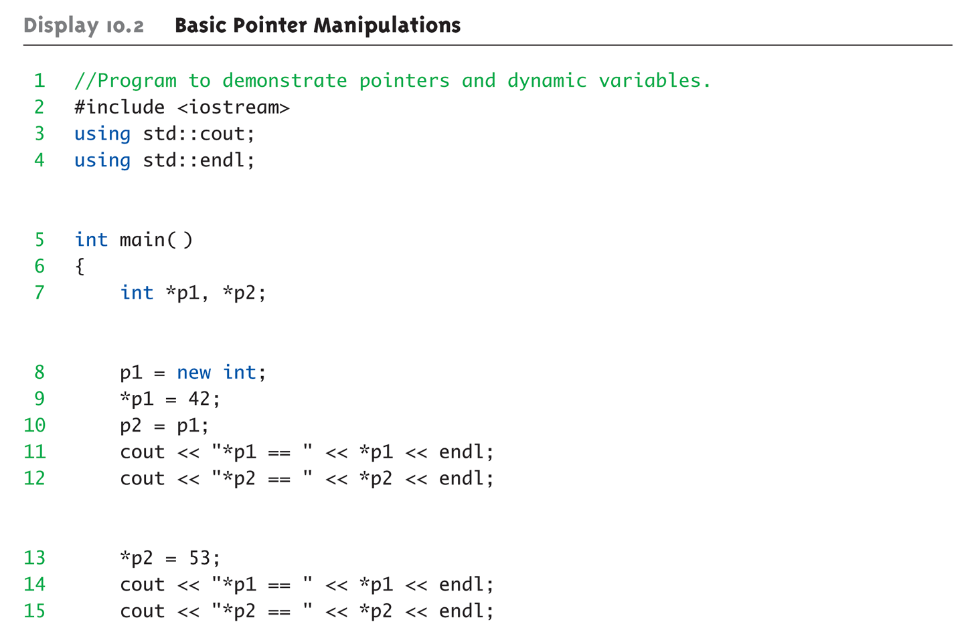
Basic Pointer Manipulations Example:
Display 10.2 Basic Pointer
Manipulations (1 of 2)
Copyright © 2010 Pearson Addison-Wesley. All rights reserved.
10-<number>

Slide 10
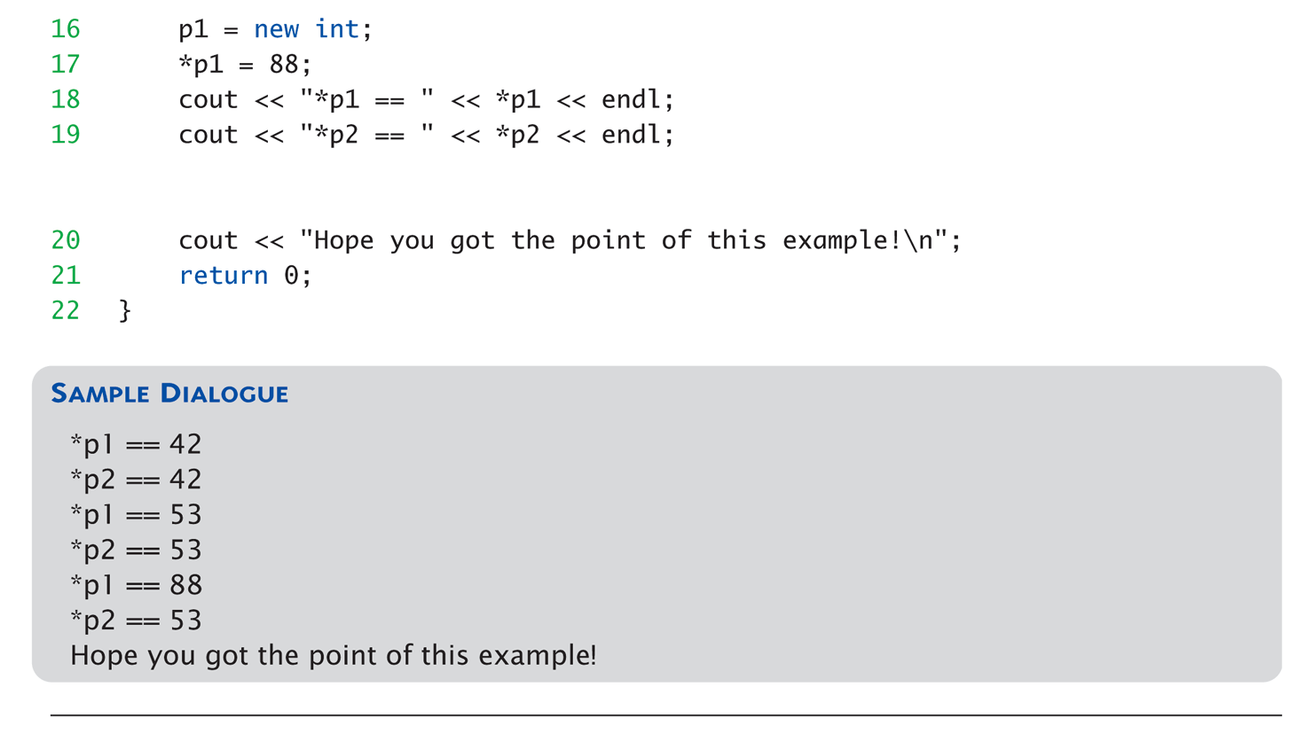
Basic Pointer Manipulations Example:
Display 10.2 Basic Pointer
Manipulations (2 of 2)
Copyright © 2010 Pearson Addison-Wesley. All rights reserved.
10-<number>

Slide 11
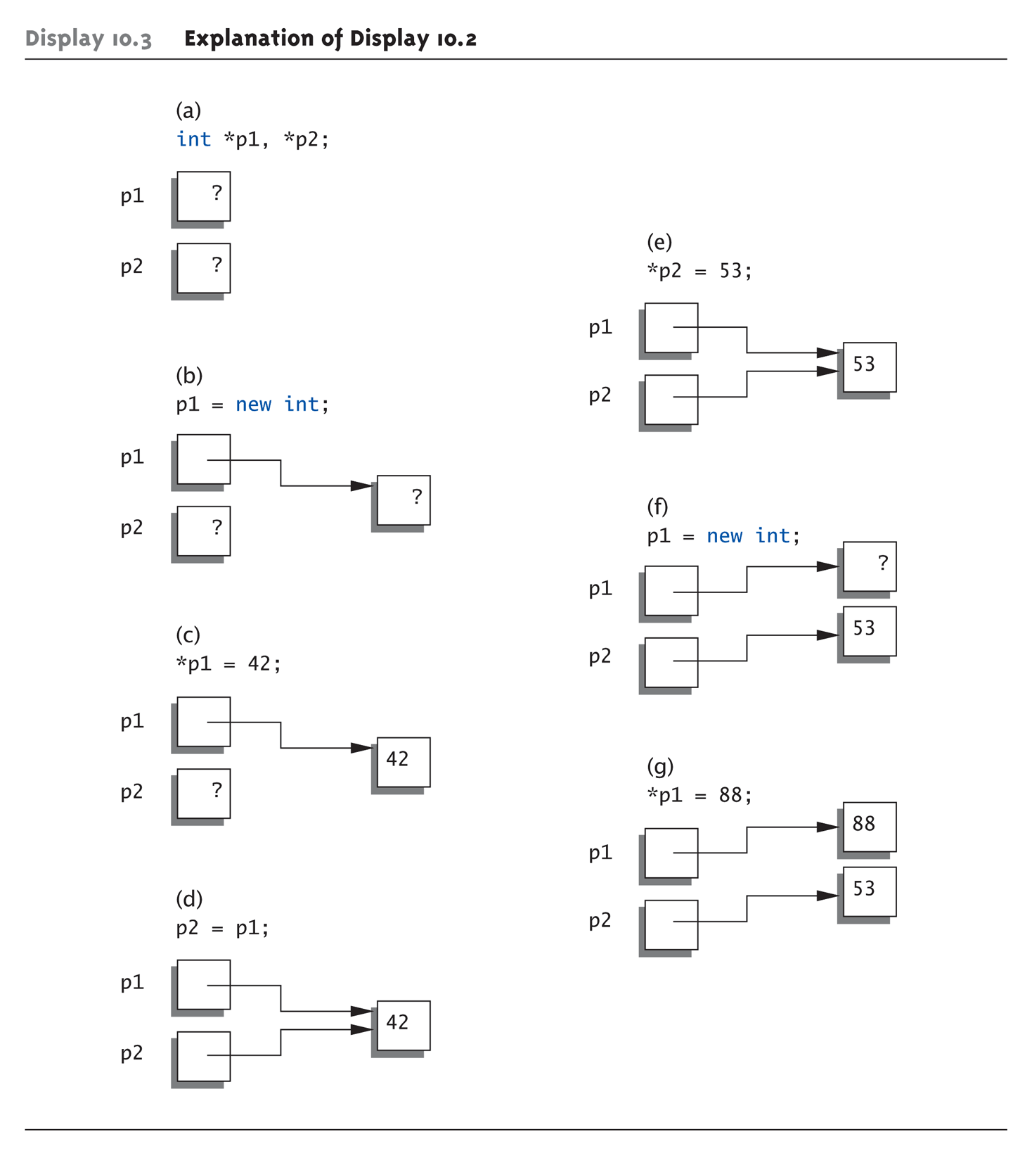
Basic Pointer Manipulations Graphic:
Display 10.3 Explanation of Display 10.2
Copyright © 2010 Pearson Addison-Wesley. All rights reserved.
10-<number>

Slide 12
More on new Operator
Creates new dynamic variable
Returns pointer to the new variable
If type is class type:
  Constructor is called for new object
  Can invoke different constructor with
  initializer arguments:
  MyClass *mcPtr;
  mcPtr = new MyClass(32.0, 17);
Can still initialize non-class types:
int *n;
n = new int(17); //Initializes *n to 17
Copyright © 2010 Pearson Addison-Wesley. All rights reserved.
10-<number>

Slide 13
Pointers and Functions
Pointers are full-fledged types
  Can be used just like other types
Can be function parameters
Can be returned from functions
Example:
int* findOtherPointer(int* p);
  This function declaration:
    Has "pointer to an int" parameter
    Returns "pointer to an int" variable
Copyright © 2010 Pearson Addison-Wesley. All rights reserved.
10-<number>

Slide 14
Memory Management
Heap
  Also called "freestore"
  Reserved for dynamically-allocated variables
  All new dynamic variables consume memory
  in freestore
    If too many → could use all freestore memory
Future "new" operations will fail if freestore
is "full"
Copyright © 2010 Pearson Addison-Wesley. All rights reserved.
10-<number>

Slide 15
Checking new Success
Older compilers:
  Test if null returned by call to new:
  int *p;
  p = new int;
  if (p == NULL)
  {
  cout << "Error: Insufficient memory.\n";
  exit(1);
  }
  If new succeeded, program continues
Copyright © 2010 Pearson Addison-Wesley. All rights reserved.
10-<number>

Slide 16
new Success – New Compiler
Newer compilers:
  If new operation fails:
    Program terminates automatically
    Produces error message
Still good practice to use NULL check
Copyright © 2010 Pearson Addison-Wesley. All rights reserved.
10-<number>

Slide 17
Freestore Size
Varies with implementations
Typically large
  Most programs won’t use all memory
Memory management
  Still good practice
  Solid software engineering principle
  Memory IS finite
    Regardless of how much there is!
Copyright © 2010 Pearson Addison-Wesley. All rights reserved.
10-<number>

Slide 18
delete Operator
De-allocate dynamic memory
  When no longer needed
  Returns memory to freestore
  Example:
  int *p;
  p = new int(5);
  … //Some processing…
  delete p;
  De-allocates dynamic memory "pointed to by
  pointer p"
    Literally "destroys" memory
Copyright © 2010 Pearson Addison-Wesley. All rights reserved.
10-<number>

Slide 19
Dangling Pointers
delete p;
  Destroys dynamic memory
  But p still points there!
    Called "dangling pointer"
  If p is then dereferenced ( *p )
    Unpredicatable results!
    Often disastrous!
Avoid dangling pointers
  Assign pointer to NULL after delete:
  delete p;
  p = NULL;
Copyright © 2010 Pearson Addison-Wesley. All rights reserved.
10-<number>

Slide 20
실습예제
앞서 수행했던 예제를 수정해서 사용해보자
Int *p3, *p4; 를 선언하고
P3 = new int; p4 = new int; 이후에 p3, p4, *p3, *p4를 출력해본다
*p3 = 7; *p4 = 8; 이후에 다시 출력
P3 = p4; 를 하고 다시 출력
  여기서 잠깐, 우리가 이전에 공간을 할당했으니 이제 풀어보자
  delete p3; delete p4; ???
Copyright © 2010 Pearson Addison-Wesley. All rights reserved.
10-<number>

Slide 21
Dynamic and Automatic Variables
Dynamic variables
  Created with new operator
  Created and destroyed while program runs
Local variables
  Declared within function definition
  Not dynamic
    Created when function is called
    Destroyed when function call completes
  Often called "automatic" variables
    Properties controlled for you
Copyright © 2010 Pearson Addison-Wesley. All rights reserved.
10-<number>

Slide 22
Define Pointer Types
Can "name" pointer types
To be able to declare pointers like other
variables
  Eliminate need for "*" in pointer declaration
typedef int* IntPtr;
  Defines a "new type" alias
  Consider these declarations:
  IntPtr p;
  int *p;
    The two are equivalent
Copyright © 2010 Pearson Addison-Wesley. All rights reserved.
10-<number>

Slide 23
Pitfall: Call-by-value Pointers
Behavior subtle and troublesome
  If function changes pointer parameter
  itself → only change is to local copy
Best illustrated with example…
Copyright © 2010 Pearson Addison-Wesley. All rights reserved.
10-<number>

Slide 24
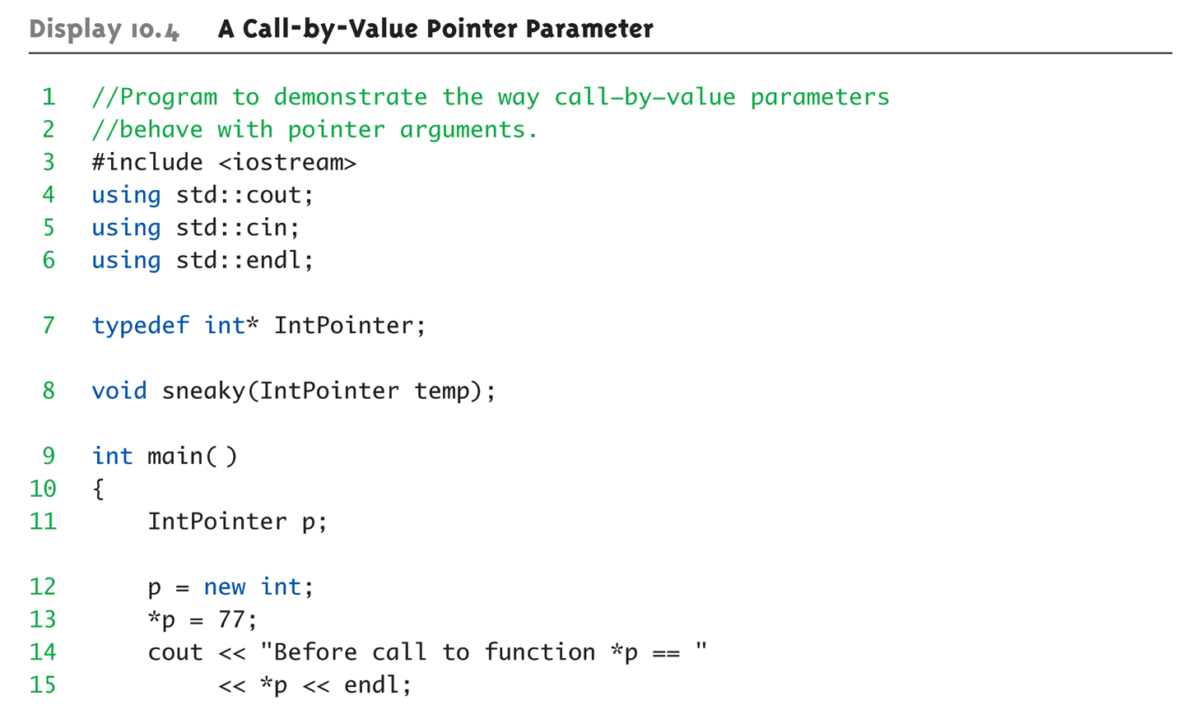
Call-by-value Pointers Example:
Display 10.4 A Call-by-Value Pointer Parameter (1 of 2)
Copyright © 2010 Pearson Addison-Wesley. All rights reserved.
10-<number>

Slide 25
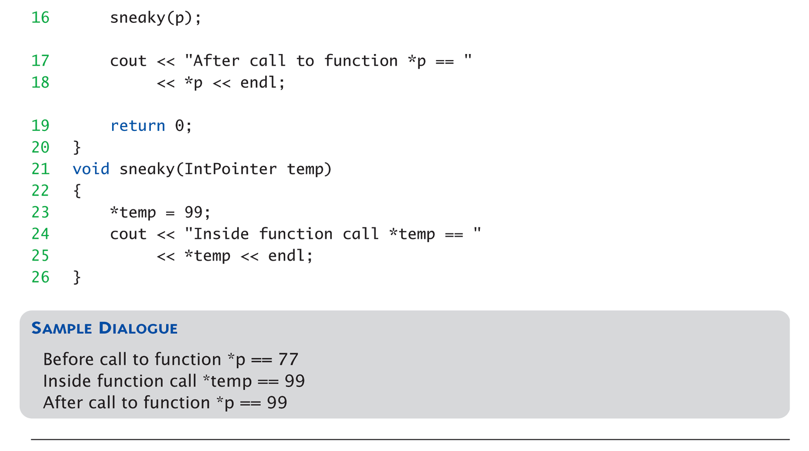
Call-by-value Pointers Example:
Display 10.4 A Call-by-Value Pointer Parameter (2 of 2)
Copyright © 2010 Pearson Addison-Wesley. All rights reserved.
10-<number>

Slide 26
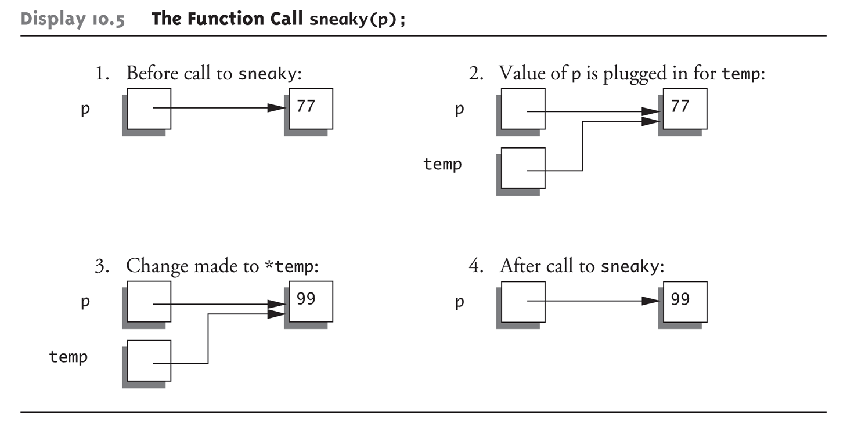
Call-by-value Pointers Graphic:
Display 10.5 The Function Call sneaky(p);
Copyright © 2010 Pearson Addison-Wesley. All rights reserved.
10-<number>

Slide 27
Dynamic Arrays
Array variables
  Really pointer variables!
Standard array
  Fixed size
Dynamic array
  Size not specified at programming time
  Determined while program running
Copyright © 2010 Pearson Addison-Wesley. All rights reserved.
10-<number>

Slide 28
Array Variables
Recall: arrays stored in memory
addresses, sequentially
  Array variable "refers to" first indexed variable
  So array variable is a kind of pointer variable!
Example:
int a[10];
int * p;
  a and p are both pointer variables!
Copyright © 2010 Pearson Addison-Wesley. All rights reserved.
10-<number>

Slide 29
Array Variables → Pointers
Recall previous example:
int a[10];
typedef int* IntPtr;
IntPtr p;
a and p are pointer variables
  Can perform assignments:
  p = a; // Legal.
    p now points where a points
      To first indexed variable of array a
  a = p; // ILLEGAL!
    Array pointer is CONSTANT pointer!
Copyright © 2010 Pearson Addison-Wesley. All rights reserved.
10-<number>

Slide 30
Array Variables → Pointers
Array variable
int a[10];
MORE than a pointer variable
  "const int *" type
  Array was allocated in memory already
  Variable a MUST point there…always!
    Cannot be changed!
In contrast to ordinary pointers
  Which can (& typically do) change
Copyright © 2010 Pearson Addison-Wesley. All rights reserved.
10-<number>

Slide 31
Dynamic Arrays
Array limitations
  Must specify size first
  May not know until program runs!
Must "estimate" maximum size needed
  Sometimes OK, sometimes not
  "Wastes" memory
Dynamic arrays
  Can grow and shrink as needed
Copyright © 2010 Pearson Addison-Wesley. All rights reserved.
10-<number>

Slide 32
Creating Dynamic Arrays
Very simple!
Use new operator
  Dynamically allocate with pointer variable
  Treat like standard arrays
Example:
typedef double * DoublePtr;
DoublePtr d;
d = new double[10]; //Size in brackets
  Creates dynamically allocated array variable d,
  with ten elements, base type double
Copyright © 2010 Pearson Addison-Wesley. All rights reserved.
10-<number>

Slide 33
Deleting Dynamic Arrays
Allocated dynamically at run-time
  So should be destroyed at run-time
Simple again. Recall Example:
d = new double[10];
… //Processing
delete [] d;
  De-allocates all memory for dynamic array
  Brackets indicate "array" is there
  Recall: d still points there!
    Should set d = NULL;
Copyright © 2010 Pearson Addison-Wesley. All rights reserved.
10-<number>

Slide 34
Function that Returns an Array
Array type NOT allowed as return-type
of function
Example:
int [] someFunction(); // ILLEGAL!
Instead return pointer to array base type:
int* someFunction(); // LEGAL!
Copyright © 2010 Pearson Addison-Wesley. All rights reserved.
10-<number>

Slide 35
Pointer Arithmetic
Can perform arithmetic on pointers
  "Address" arithmetic
Example:
typedef double* DoublePtr;
DoublePtr d;
d = new double[10];
  d contains address of d[0]
  d + 1 evaluates to address of d[1]
  d + 2 evaluates to address of d[2]
    Equates to "address" at these locations
Copyright © 2010 Pearson Addison-Wesley. All rights reserved.
10-<number>

Slide 36
Alternative Array Manipulation
Use pointer arithmetic!
"Step thru" array without indexing:
for (int i = 0; i < arraySize; i++)
cout << *(d + I) << " " ;
Equivalent to:
for (int i = 0; i < arraySize; i++)
cout << d[I] << " " ;
Only addition/subtraction on pointers
  No multiplication, division
Can use ++ and -- on pointers
Copyright © 2010 Pearson Addison-Wesley. All rights reserved.
10-<number>

Slide 37
Multidimensional Dynamic Arrays
Yes we can!
Recall: "arrays of arrays"
Type definitions help "see it":
typedef int* IntArrayPtr;
IntArrayPtr *m = new IntArrayPtr[3];
  Creates array of three pointers
  Make each allocate array of 4 ints
for (int i = 0; i < 3; i++)
m[i] = new int[4];
  Results in three-by-four dynamic array!
Copyright © 2010 Pearson Addison-Wesley. All rights reserved.
10-<number>

Slide 38
실습예제
앞서 실습한 것 다음에
int *p5, **p6;를 선언하고
P5에는 int nSize= 3;개 의크기의 array를 선언하고 값을 넣은 다음 출력해보기
P6에는 2차원 배열로 3 x 4 의 크기의 배열을 선언하고 1부터 12까지 넣고 출력해보기
  int nSizeRow =3; int nSizeCol =4;
두개의 배열의 공간 지우기
Copyright © 2010 Pearson Addison-Wesley. All rights reserved.
10-<number>

Slide 39
Back to Classes
The -> operator
  Shorthand notation
Combines dereference operator, *, and
dot operator
Specifies member of class "pointed to"
by given pointer
Example:
MyClass *p;
p = new MyClass;
p->grade = "A"; Equivalent to:
(*p).grade = "A";
Copyright © 2010 Pearson Addison-Wesley. All rights reserved.
10-<number>

Slide 40
The this Pointer
Member function definitions might need to refer to calling object
Use predefined this pointer
  Automatically points to calling object:
  Class Simple
  {
  public:
  void showStuff() const;
  private:
  int stuff;
  };
Two ways for member functions to access:
cout << stuff;
cout << this->stuff;
Copyright © 2010 Pearson Addison-Wesley. All rights reserved.
10-<number>

Slide 41
Overloading Assignment Operator
Assignment operator returns reference
  So assignment "chains" are possible
  e.g., a = b = c;
    Sets a and b equal to c
Operator must return "same type" as it’s
left-hand side
  To allow chains to work
  The this pointer will help with this!
Copyright © 2010 Pearson Addison-Wesley. All rights reserved.
10-<number>

Slide 42
Overloading Assignment Operator
Recall: Assignment operator must be
member of the class
  It has one parameter
  Left-operand is calling object
  s1 = s2;
    Think of like: s1.=(s2);
s1 = s2 = s3;
  Requires (s1 = s2) = s3;
  So (s1 = s2) must return object of s1"s type
    And pass to " = s3";
Copyright © 2010 Pearson Addison-Wesley. All rights reserved.
10-<number>

Slide 43
Overloaded = Operator Definition
Uses string Class example:
StringClass& StringClass::operator=(const StringClass& rtSide)
{
if (this == &rtSide) // if right side same as left side
return *this;
else
{
capacity = rtSide.length;
length
length = rtSide.length;
delete [] a;
a = new char[capacity];
for (int I = 0; I < length; I++)
a[I] = rtSide.a[I];
return *this;
}
}
Copyright © 2010 Pearson Addison-Wesley. All rights reserved.
10-<number>

Slide 44
Shallow and Deep Copies
Shallow copy
  Assignment copies only member variable
  contents over
  Default assignment and copy constructors
Deep copy
  Pointers, dynamic memory involved
  Must dereference pointer variables to
  "get to" data for copying
  Write your own assignment overload and
  copy constructor in this case!
Copyright © 2010 Pearson Addison-Wesley. All rights reserved.
10-<number>

Slide 45
Destructor Need
Dynamically-allocated variables
  Do not go away until "deleted"
If pointers are only private member data
  They dynamically allocate "real" data
    In constructor
  Must have means to "deallocate" when
  object is destroyed
Answer: destructor!
Copyright © 2010 Pearson Addison-Wesley. All rights reserved.
10-<number>

Slide 46
Destructors
Opposite of constructor
  Automatically called when object is out-of-scope
  Default version only removes ordinary
  variables, not dynamic variables
Defined like constructor, just add ~
  MyClass::~MyClass()
  {
  //Perform delete clean-up duties
  }
Copyright © 2010 Pearson Addison-Wesley. All rights reserved.
10-<number>

Slide 47
Copy Constructors
Automatically called when:
  Class object declared and initialized to other object
  When function returns class type object
  When argument of class type is "plugged in"
  as actual argument to call-by-value parameter
Requires "temporary copy" of object
  Copy constructor creates it
Default copy constructor
  Like default "=", performs member-wise copy
Pointers → write own copy constructor!
Copyright © 2010 Pearson Addison-Wesley. All rights reserved.
10-<number>

Slide 48
실습예제
Chap10-part2 프로젝트를 만든다
CDyna 클래스를 생성하고, 멤버변수로 int m_nSize, int *m_pnSchedule; 을 만든다.
멤버함수로 ShowSchedule을 만들어서 m_pnSchedule 에 공간이할당 됐으면 값을 출력하고 안됐으면 안됨을 알림
  메인 함수에서 pointer변수로 객체를 선언하고 크래스 객체를 new로 만들고 화면에 출력한다
멤버함수로 SetInfo(int nSize, int*pSch) 해서 값을 넣는것 만듬. 메인함수에서 3개 크기인 schedule 넣고 화면 출력
Copyright © 2010 Pearson Addison-Wesley. All rights reserved.
10-<number>

Slide 49
실습예제 계속
Destruct에서 *m_pnSchedule 이 NULL이 아니면 메모리를 풀어준다.
  물론 생성자에서 처음에 m_pnSchedule = NULL; 로 했었다.
  Main함수 끝에서 delete pDyna해줌
Main 함수에서 위의 객체를 delete하기전에 새로운 객체를 한 개 만들고 값을 할당한다. CDyna anotherDyna;anotherDyna = *pDyna;
  화면에 출력 // 죽죠?
Operator = overloading 한다. 10-43쪽 참조
Copyright © 2010 Pearson Addison-Wesley. All rights reserved.
10-<number>

Slide 50
실습예제 계속
CDyna& CDyna::operator=(const CDyna& rtSide)
{
if (this == &rtSide){// if right side same as left side
return *this;
}
else{
m_nSize = rtSide.m_nSize;
if(m_pnSchedule != NULL){
delete [] m_pnSchedule;
}
m_pnSchedule = new int [m_nSize];
for(int nIndex = 0; nIndex< m_nSize; nIndex++){
m_pnSchedule[nIndex] = rtSide.m_pnSchedule[nIndex];
}
}
return *this;
}
Copyright © 2010 Pearson Addison-Wesley. All rights reserved.
10-<number>

Slide 51
Summary 1
Pointer is memory address
  Provides indirect reference to variable
Dynamic variables
  Created and destroyed while program runs
Freestore
  Memory storage for dynamic variables
Dynamically allocated arrays
  Size determined as program runs
Copyright © 2010 Pearson Addison-Wesley. All rights reserved.
10-<number>

Slide 52
Summary 2
Class destructor
  Special member function
  Automatically destroys objects
Copy constructor
  Single argument member function
  Called automatically when temp copy needed
Assignment operator
  Must be overloaded as member function
  Returns reference for chaining
Copyright © 2010 Pearson Addison-Wesley. All rights reserved.
10-<number>

