Slide 1
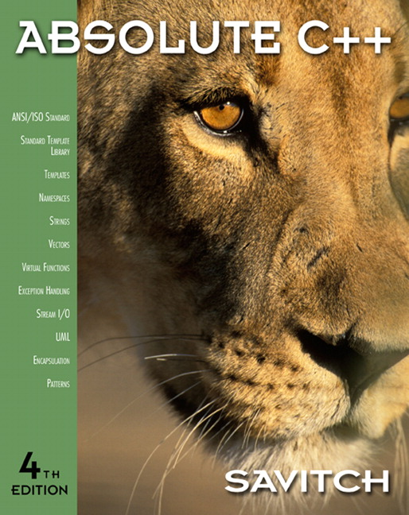

Chapter 15
Polymorphism and Virtual Functions
Copyright © 2010 Pearson Addison-Wesley. All rights reserved

Slide 2
Learning Objectives
Virtual Function Basics
  Late binding
  Implementing virtual functions
  When to use a virtual function
  Abstract classes and pure virtual functions
Pointers and Virtual Functions
  Extended type compatibility
  Downcasting and upcasting
  C++ "under the hood" with virtual functions
Copyright © 2010 Pearson Addison-Wesley. All rights reserved.
15-<number>

Slide 3
요점정리
virtual 함수는 compile 중에 함수를 결정하지 않고 runtime 중에 어떤 함수를 사용할 것인지를 그 함수를 부르는 객체의 겉모습이 아닌 실제 속 모습을 보고 결정한다
  즉 부모 클래스에서 virtual함수로 선언된 것은 부모 클래스의 다른 함수 A에서 사용되었을때, 부모 클래스의 객체가 함수 A를 부르면 부모 클래스의 virtual 함수가 불려지지만, 자식 클래스의 객체가 함수 A를 부르면 자식 클래스의 virtual 함수가 불려진다
Copyright © 2010 Pearson Addison-Wesley. All rights reserved.
15-<number>

Slide 4
Virtual Function Basics
Polymorphism
  Associating many meanings to one function
  Virtual functions provide this capability
  Fundamental principle of object-oriented
  programming!
Virtual
  Existing in "essence" though not in fact
Virtual Function
  Can be "used" before it’s "defined"
Copyright © 2010 Pearson Addison-Wesley. All rights reserved.
15-<number>

Slide 5
Figures Example
Best explained by example:
Classes for several kinds of figures
  Rectangles, circles, ovals, etc.
  Each figure an object of different class
    Rectangle data: height, width, center point
    Circle data: center point, radius
All derive from one parent-class: Figure
Require function: draw()
  Different instructions for each figure
Copyright © 2010 Pearson Addison-Wesley. All rights reserved.
15-<number>

Slide 6
Figures Example 2
Each class needs different draw function
Can be called "draw" in each class, so:
Rectangle r;
Circle c;
r.draw(); //Calls Rectangle class’s draw
c.draw(); //Calls Circle class’s draw
Nothing new here yet…
Copyright © 2010 Pearson Addison-Wesley. All rights reserved.
15-<number>

Slide 7
Figures Example: center()
Parent class Figure contains functions
that apply to "all" figures; consider:
center(): moves a figure to center of screen
  Erases 1st, then re-draws
  So Figure::center() would use function draw()
  to re-draw
  Complications!
    Which draw() function?
    From which class?
Copyright © 2010 Pearson Addison-Wesley. All rights reserved.
15-<number>

Slide 8
Figures Example: New Figure
Consider new kind of figure comes along:
Triangle class
derived from Figure class
Function center() inherited from Figure
  Will it work for triangles?
  It uses draw(), which is different for each figure!
  It will use Figure::draw() → won’t work for triangles
Want inherited function center() to use function
Triangle::draw() NOT function Figure::draw()
  But class Triangle wasn’t even WRITTEN when
  Figure::center() was! Doesn’t know "triangles"!
Copyright © 2010 Pearson Addison-Wesley. All rights reserved.
15-<number>

Slide 9
Figures Example: Virtual!
Virtual functions are the answer
Tells compiler:
  "Don’t know how function is implemented"
  "Wait until used in program"
  "Then get implementation from object
  instance"
Called late binding or dynamic binding
  Virtual functions implement late binding
Copyright © 2010 Pearson Addison-Wesley. All rights reserved.
15-<number>

Slide 10
Virtual Functions: Another Example
Bigger example best to demonstrate
Record-keeping program for automotive
parts store
  Track sales
  Don’t know all sales yet
  1st only regular retail sales
  Later: Discount sales, mail-order, etc.
    Depend on other factors besides just price, tax
Copyright © 2010 Pearson Addison-Wesley. All rights reserved.
15-<number>

Slide 11
Virtual Functions: Auto Parts
Program must:
  Compute daily gross sales
  Calculate largest/smallest sales of day
  Perhaps average sale for day
All come from individual bills
  But many functions for computing bills will
  be added "later"!
    When different types of sales added!
So function for "computing a bill" will
be virtual!
Copyright © 2010 Pearson Addison-Wesley. All rights reserved.
15-<number>

Slide 12
Class Sale Definition
class Sale
{
public:
Sale();
Sale(double thePrice);
double getPrice() const;
virtual double bill() const;
double savings(const Sale& other) const;
private:
double price;
};
Copyright © 2010 Pearson Addison-Wesley. All rights reserved.
15-<number>

Slide 13
Member Functions savings and operator <
double Sale::savings(const Sale& other) const
{
return (bill() – other.bill());
}
bool operator < ( const Sale& first,
const Sale& second)
{
return (first.bill() < second.bill());
}
Notice BOTH use member function bill()!
Copyright © 2010 Pearson Addison-Wesley. All rights reserved.
15-<number>

Slide 14
Class Sale
Represents sales of single item with no
added discounts or charges.
Notice reserved word "virtual" in
declaration of member function bill
  Impact: Later, derived classes of Sale can
  define THEIR versions of function bill
  Other member functions of Sale will use
  version based on object of derived class!
  They won’t automatically use Sale’s version!
Copyright © 2010 Pearson Addison-Wesley. All rights reserved.
15-<number>

Slide 15
Derived Class DiscountSale Defined
class DiscountSale : public Sale
{
public:
DiscountSale();
DiscountSale( double thePrice,
double the Discount);
double getDiscount() const;
void setDiscount(double newDiscount);
double bill() const;
private:
double discount;
};
Copyright © 2010 Pearson Addison-Wesley. All rights reserved.
15-<number>

Slide 16
DiscountSale’s Implementation of bill()
double DiscountSale::bill() const
{
double fraction = discount/100;
return (1 – fraction)*getPrice();
}
Qualifier "virtual" does not go in actual
function definition
  "Automatically" virtual in derived class
  Declaration (in interface) not required to have
  "virtual" keyword either (but usually does)
Copyright © 2010 Pearson Addison-Wesley. All rights reserved.
15-<number>

Slide 17
DiscountSale’s Implementation of bill()
Virtual function in base class:
  "Automatically" virtual in derived class
Derived class declaration (in interface)
  Not required to have "virtual" keyword
  But typically included anyway,
  for readability
Copyright © 2010 Pearson Addison-Wesley. All rights reserved.
15-<number>

Slide 18
Derived Class DiscountSale
DiscountSale’s member function bill()
implemented differently than Sale’s
  Particular to "discounts"
Member functions savings and "<"
  Will use this definition of bill() for all objects
  of DiscountSale class!
  Instead of "defaulting" to version defined in
  Sales class!
Copyright © 2010 Pearson Addison-Wesley. All rights reserved.
15-<number>

Slide 19
Virtual: Wow!
Recall class Sale written long before
derived class DiscountSale
  Members savings and "<" compiled before
  even had ideas of a DiscountSale class
Yet in a call like:
DiscountSale d1, d2;
d1.savings(d2);
  Call in savings() to function bill() knows to
  use definition of bill() from DiscountSale class
Powerful!
Copyright © 2010 Pearson Addison-Wesley. All rights reserved.
15-<number>

Slide 20
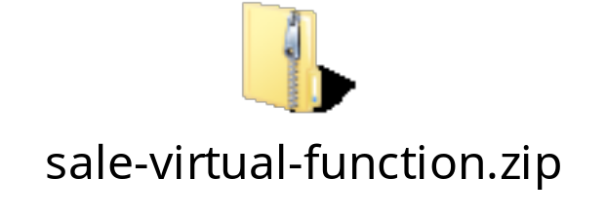
실습예제
sale 클래스와 discount sale클래스를 프로젝트에 포함한다
display 15.5 를 수행한다.
  어떤 bill을 사용되는지를 trace해 본다
Copyright © 2010 Pearson Addison-Wesley. All rights reserved.
15-<number>

Slide 21
Virtual: How?
To write C++ programs:
  Assume it happens by "magic"!
But explanation involves late binding
  Virtual functions implement late binding
  Tells compiler to "wait" until function is used in
  program
  Decide which definition to use based on
  calling object
Very important OOP principle!
Copyright © 2010 Pearson Addison-Wesley. All rights reserved.
15-<number>

Slide 22
Overriding
Virtual function definition changed in a
derived class
  We say it’s been "overidden"
Similar to redefined
  Recall: for standard functions
So:
  Virtual functions changed: overridden
  Non-virtual functions changed: redefined
Copyright © 2010 Pearson Addison-Wesley. All rights reserved.
15-<number>

Slide 23
Virtual Functions: Why Not All?
Clear advantages to virtual functions as
we’ve seen
One major disadvantage: overhead!
  Uses more storage
  Late binding is "on the fly", so programs run slower
So if virtual functions not needed, should
not be used
Copyright © 2010 Pearson Addison-Wesley. All rights reserved.
15-<number>

Slide 24
Pure Virtual Functions
Base class might not have "meaningful"
definition for some of it’s members!
  It’s purpose solely for others to derive from
Recall class Figure
  All figures are objects of derived classes
    Rectangles, circles, triangles, etc.
  Class Figure has no idea how to draw!
Make it a pure virtual function:
virtual void draw() = 0;
Copyright © 2010 Pearson Addison-Wesley. All rights reserved.
15-<number>

Slide 25
Abstract Base Classes
Pure virtual functions require no definition
  Forces all derived classes to define "their
  own" version
Class with one or more pure virtual
functions is: abstract base class
  Can only be used as base class
  No objects can ever be created from it
    Since it doesn’t have complete "definitions" of all
    it’s members!
If derived class fails to define all pure’s:
  It’s an abstract base class too
Copyright © 2010 Pearson Addison-Wesley. All rights reserved.
15-<number>

Slide 26
Extended Type Compatibility
Given:
Derived is derived class of Base
  Derived objects can be assigned to objects
  of type Base
  But NOT the other way!
Consider previous example:
  A DiscountSale "is a" Sale, but reverse
  not true
Copyright © 2010 Pearson Addison-Wesley. All rights reserved.
15-<number>

Slide 27
Extended Type
Compatibility Example
class Pet
{
public:
string name;
virtual void print() const;
};
class Dog : public Pet
{
public:
string breed;
virtual void print() const;
};
Copyright © 2010 Pearson Addison-Wesley. All rights reserved.
15-<number>

Slide 28
Classes Pet and Dog
Now given declarations:
Dog vdog;
Pet vpet;
Notice member variables name and breed are public!
  For example purposes only! Not typical!
Copyright © 2010 Pearson Addison-Wesley. All rights reserved.
15-<number>

Slide 29
Using Classes Pet and Dog
Anything that "is a" dog "is a" pet:
  vdog.name = "Tiny";
  vdog.breed = "Great Dane";
  vpet = vdog;
  These are allowable
Can assign values to parent-types, but
not reverse
  A pet "is not a" dog (not necessarily)
Copyright © 2010 Pearson Addison-Wesley. All rights reserved.
15-<number>

Slide 30
Slicing Problem
Notice value assigned to vpet "loses" it’s
breed field!
  cout << vpet.breed;
    Produces ERROR msg!
  Called slicing problem
Might seem appropriate
  Dog was moved to Pet variable, so it should
  be treated like a Pet
    And therefore not have "dog" properties
  Makes for interesting philosphical debate
Copyright © 2010 Pearson Addison-Wesley. All rights reserved.
15-<number>

Slide 31
Slicing Problem Fix
In C++, slicing problem is nuisance
  It still "is a" Great Dane named Tiny
  We’d like to refer to it’s breed even if it’s been treated as a Pet
Can do so with pointers to
dynamic variables
Copyright © 2010 Pearson Addison-Wesley. All rights reserved.
15-<number>

Slide 32
Slicing Problem Example
Pet *ppet;
Dog *pdog;
pdog = new Dog;
pdog->name = "Tiny";
pdog->breed = "Great Dane";
ppet = pdog;
Cannot access breed field of object
pointed to by ppet:
cout << ppet->breed; //ILLEGAL!
Copyright © 2010 Pearson Addison-Wesley. All rights reserved.
15-<number>

Slide 33
Slicing Problem Example
Must use virtual member function:
ppet->print();
  Calls print member function in Dog class!
    Because it’s virtual
  C++ "waits" to see what object pointer ppet is actually pointing to before "binding" call
Copyright © 2010 Pearson Addison-Wesley. All rights reserved.
15-<number>

Slide 34
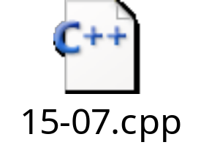
실습예제
Pet과 dog 클래스 포함
display 15.7 main 함수 실행
Copyright © 2010 Pearson Addison-Wesley. All rights reserved.
15-<number>

Slide 35
Virtual Destructors
Recall: destructors needed to de-allocate
dynamically allocated data
Consider:
Base *pBase = new Derived;
…
delete pBase;
  Would call base class destructor even though
  pointing to Derived class object!
  Making destructor virtual fixes this!
Good policy for all destructors to be virtual
Copyright © 2010 Pearson Addison-Wesley. All rights reserved.
15-<number>

Slide 36
Casting
Consider:
Pet vpet;
Dog vdog;
…
vdog = static_cast<Dog>(vpet); //ILLEGAL!
Can’t cast a pet to be a dog, but:
vpet = vdog; // Legal!
vpet = static_cast<Pet>(vdog); //Also legal!
Upcasting is OK
  From descendant type to ancestor type
Copyright © 2010 Pearson Addison-Wesley. All rights reserved.
15-<number>

Slide 37
Downcasting
Downcasting dangerous!
  Casting from ancestor type to descended type
  Assumes information is "added"
  Can be done with dynamic_cast:
  Pet *ppet;
  ppet = new Dog;
  Dog *pdog = dynamic_cast<Dog*>(ppet);
    Legal, but dangerous!
Downcasting rarely done due to pitfalls
  Must track all information to be added
  All member functions must be virtual
Copyright © 2010 Pearson Addison-Wesley. All rights reserved.
15-<number>

Slide 38
Inner Workings of Virtual Functions
Don’t need to know how to use it!
  Principle of information hiding
Virtual function table
  Compiler creates it
  Has pointers for each virtual member function
  Points to location of correct code for that function
Objects of such classes also have pointer
  Points to virtual function table
Copyright © 2010 Pearson Addison-Wesley. All rights reserved.
15-<number>

Slide 39
Summary 1
Late binding delays decision of which
member function is called until runtime
  In C++, virtual functions use late binding
Pure virtual functions have no definition
  Classes with at least one are abstract
  No objects can be created from
  abstract class
  Used strictly as base for others to derive
Copyright © 2010 Pearson Addison-Wesley. All rights reserved.
15-<number>

Slide 40
Summary 2
Derived class objects can be assigned to
base class objects
  Base class members are lost; slicing problem
Pointer assignments and dynamic objects
  Allow "fix" to slicing problem
Make all destructors virtual
  Good programming practice
  Ensures memory correctly de-allocated
Copyright © 2010 Pearson Addison-Wesley. All rights reserved.
15-<number>

