Slide 1
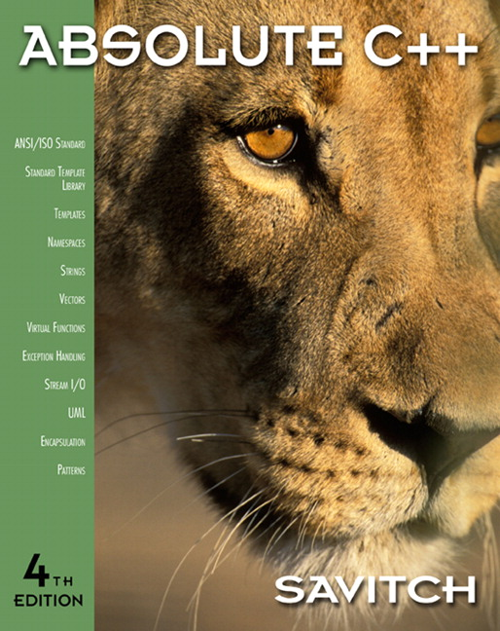

Chapter 1
C++ Basics
Copyright © 2010 Pearson Addison-Wesley. All rights reserved

Slide 2
Learning Objectives
Introduction to C++
  Origins, Object-Oriented Programming, Terms
Variables, Expressions, and
Assignment Statements
Console Input/Output
Program Style
Libraries and Namespaces
Copyright © 2010 Pearson Addison-Wesley. All rights reserved.
1-<number>

Slide 3
Introduction to C++
C++ Origins
  Low-level languages
    Machine, assembly
  High-level languages
    C, C++, ADA, COBOL, FORTRAN
  Object-Oriented-Programming in C++
C++ Terminology
  Programs and functions
  Basic Input/Output (I/O) with cin and cout
Copyright © 2010 Pearson Addison-Wesley. All rights reserved.
1-<number>

Slide 4
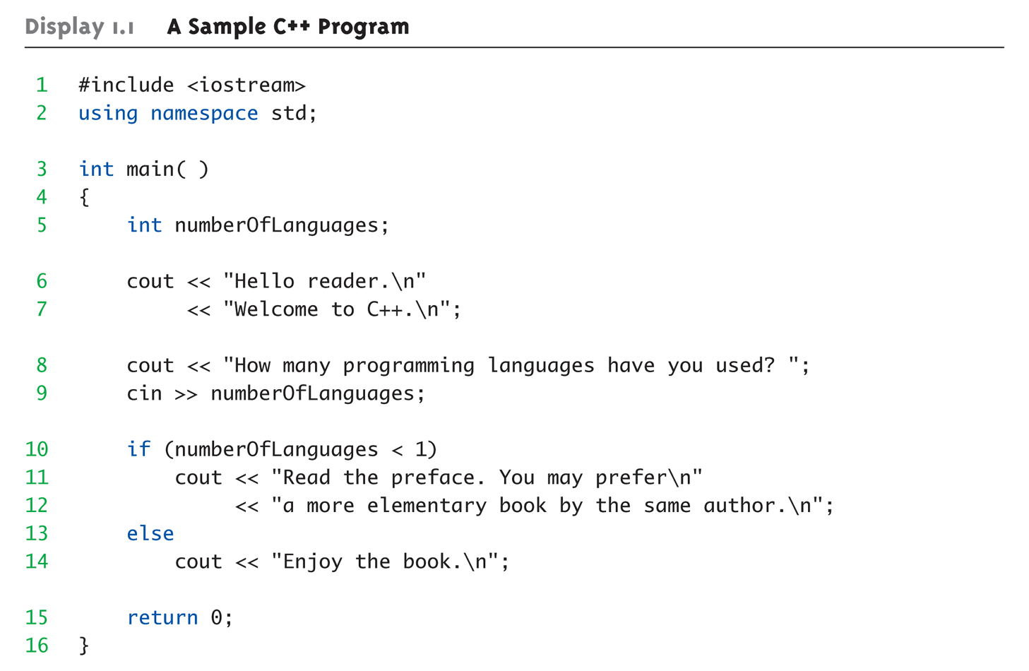
Display 1.1
A Sample C++ Program (1 of 2)
Copyright © 2010 Pearson Addison-Wesley. All rights reserved.
1-<number>

Slide 5
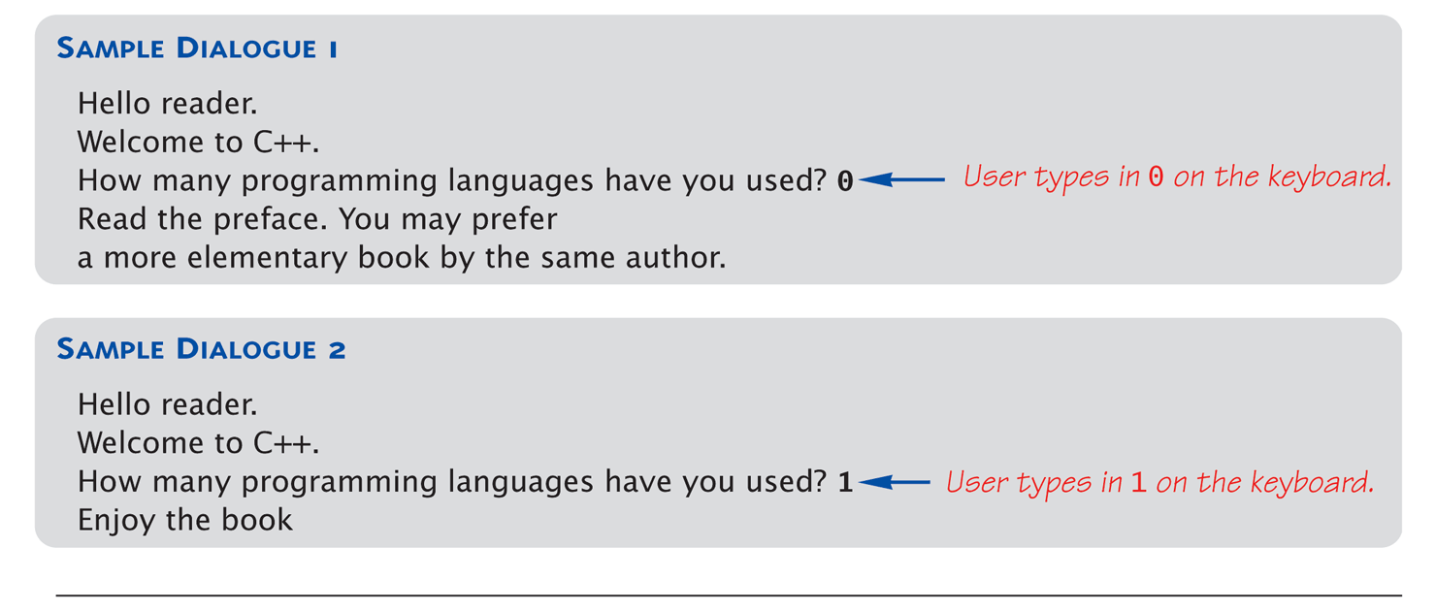
Display 1.1
A Sample C++ Program (2 of 2)
Copyright © 2010 Pearson Addison-Wesley. All rights reserved.
1-<number>

Slide 6
실습 예제
Visual studio 2017 기준으로 작성함
  Visual studio를 연다
  파일 -> 새로만들기 ->프로젝트
  여기서 win32 콘솔 응용프로그램을 선택
  아래쪽에 보면 이름을 "hello" 로 정하고
  디렉토리 위치는 여러분이 원하는 적당한 곳을 선택
  "확인" 한 다음 "마침" 으로 프로젝트 시작하기
  교재 내용을 추가해서 실행해보기
Copyright © 2010 Pearson Addison-Wesley. All rights reserved.
1-<number>

Slide 7
C++ Variables
C++ Identifiers
  Keywords/reserved words vs. Identifiers
  Case-sensitivity and validity of identifiers
  Meaningful names!
Variables
  A memory location to store data for a program
  Must declare all data before use in program
Copyright © 2010 Pearson Addison-Wesley. All rights reserved.
1-<number>

Slide 8
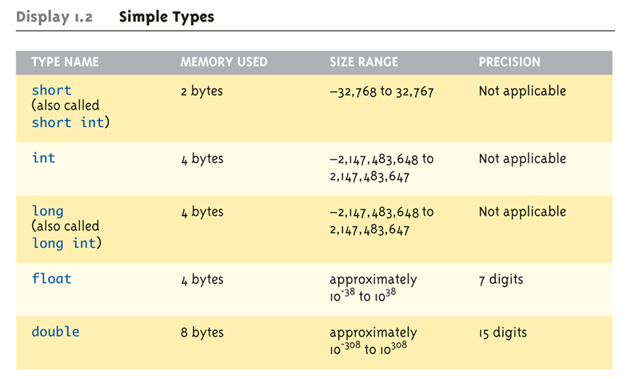
Data Types:
Display 1.2 Simple Types (1 of 2)
Copyright © 2010 Pearson Addison-Wesley. All rights reserved.
1-<number>

Slide 9
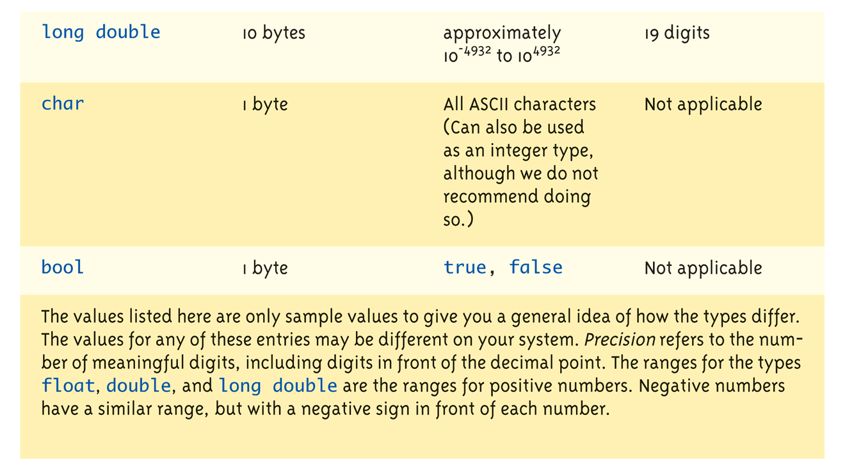
Data Types:
Display 1.2 Simple Types (2 of 2)
Copyright © 2010 Pearson Addison-Wesley. All rights reserved.
1-<number>

Slide 10
Assigning Data
Initializing data in declaration statement
  Results "undefined" if you don’t!
    int myValue = 0;
Assigning data during execution
  Lvalues (left-side) & Rvalues (right-side)
    Lvalues must be variables
    Rvalues can be any expression
    Example:
    distance = rate * time;
    Lvalue: "distance"
    Rvalue: "rate * time"
Copyright © 2010 Pearson Addison-Wesley. All rights reserved.
1-<number>

Slide 11
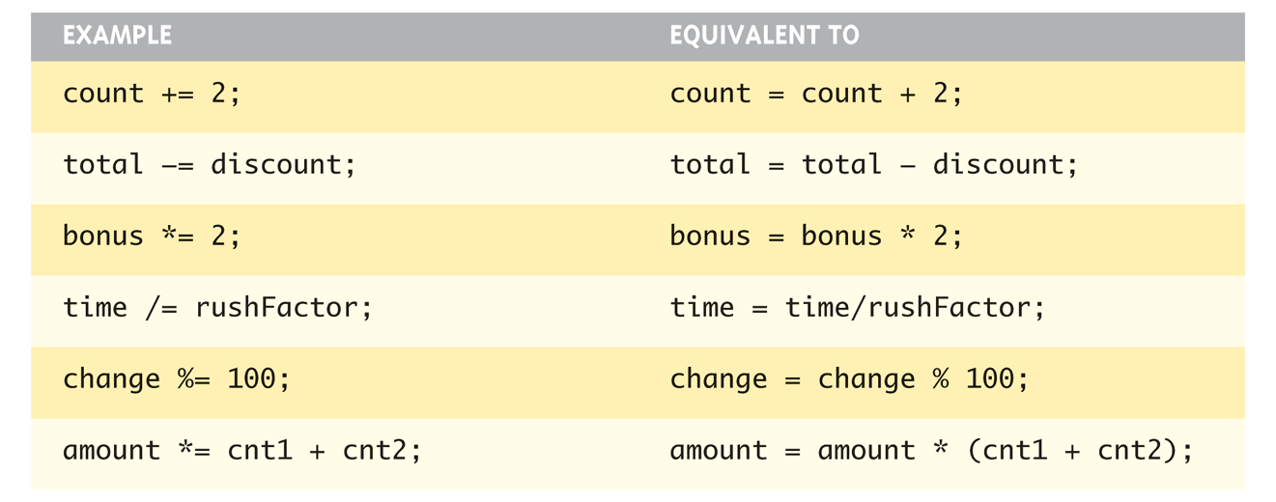
Assigning Data: Shorthand Notations
Display, page 14
Copyright © 2010 Pearson Addison-Wesley. All rights reserved.
1-<number>

Slide 12
Data Assignment Rules
Compatibility of Data Assignments
  Type mismatches
    General Rule: Cannot place value of one type into variable of another type
  intVar = 2.99; // 2 is assigned to intVar!
    Only integer part "fits", so that’s all that goes
    Called "implicit" or "automatic type conversion"
  Literals
    2, 5.75, "Z", "Hello World"
    Considered "constants": can’t change in program
Copyright © 2010 Pearson Addison-Wesley. All rights reserved.
1-<number>

Slide 13
Literal Data
Literals
  Examples:
    2 // Literal constant int
    5.75 // Literal constant double
    "Z" // Literal constant char
    "Hello World" // Literal constant string
Cannot change values during execution
Called "literals" because you "literally typed"
them in your program!
Copyright © 2010 Pearson Addison-Wesley. All rights reserved.
1-<number>

Slide 14
Escape Sequences
"Extend" character set
Backslash, \ preceding a character
  Instructs compiler: a special "escape
  character" is coming
  Following character treated as
  "escape sequence char"
  Display 1.3 next slide
Copyright © 2010 Pearson Addison-Wesley. All rights reserved.
1-<number>

Slide 15
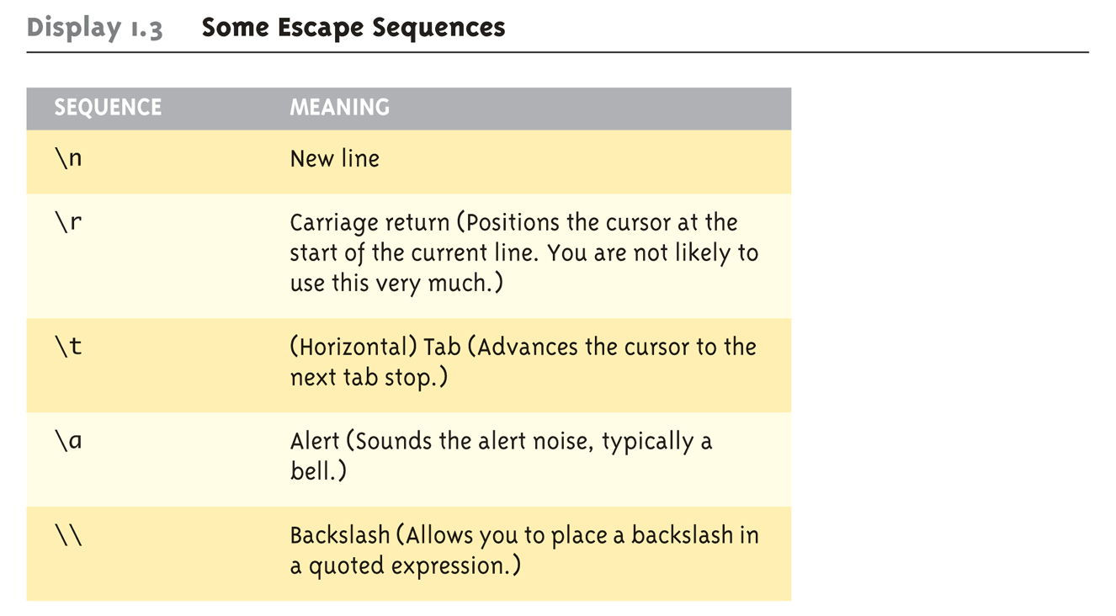
Display 1.3
Some Escape Sequences (1 of 2)
Copyright © 2010 Pearson Addison-Wesley. All rights reserved.
1-<number>

Slide 16
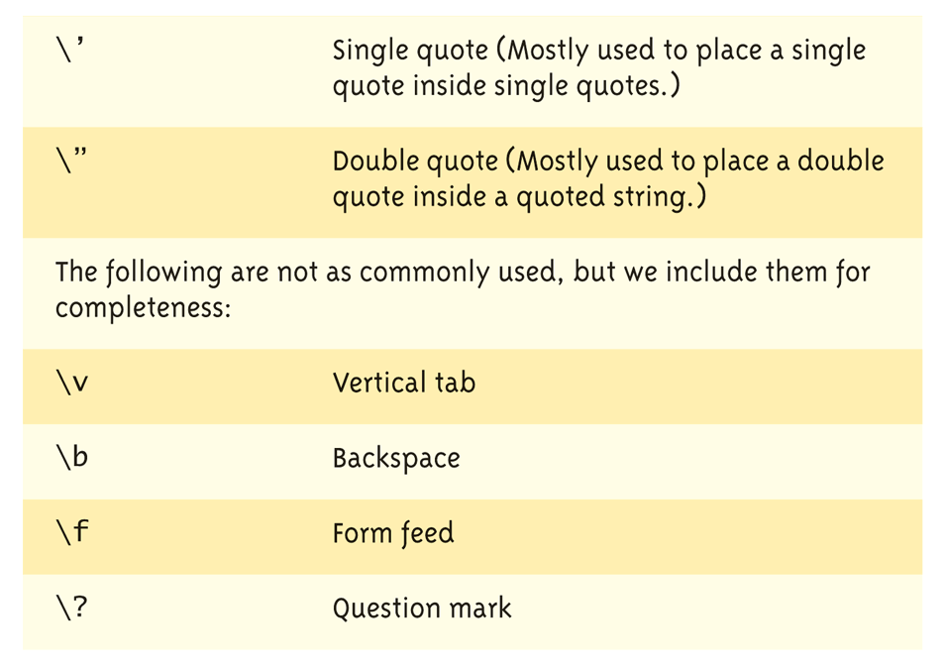
Display 1.3
Some Escape Sequences (2 of 2)
Copyright © 2010 Pearson Addison-Wesley. All rights reserved.
1-<number>

Slide 17
Constants
Naming your constants
  Literal constants are "OK", but provide
  little meaning
    e.g., seeing 24 in a pgm, tells nothing about
    what it represents
Use named constants instead
  Meaningful name to represent data
  const int NUMBER_OF_STUDENTS = 24;
    Called a "declared constant" or "named constant"
    Now use it’s name wherever needed in program
    Added benefit: changes to value result in one fix
Copyright © 2010 Pearson Addison-Wesley. All rights reserved.
1-<number>

Slide 18
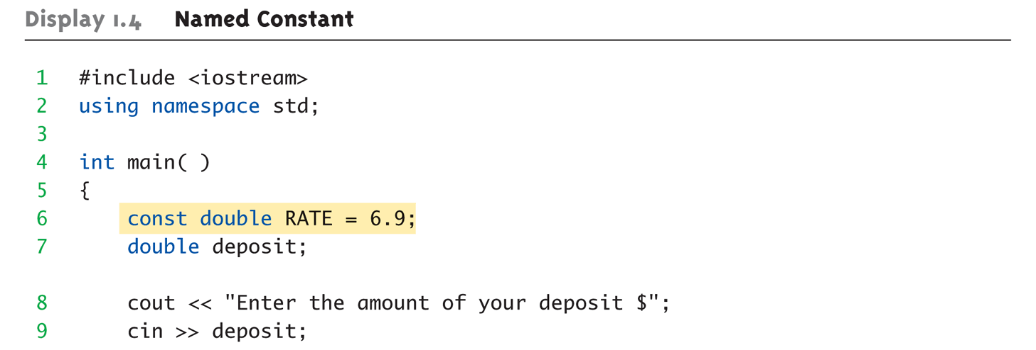
Arithmetic Operators:
Display 1.4 Named Constant (1 of 2)
Standard Arithmetic Operators
  Precedence rules – standard rules
Copyright © 2010 Pearson Addison-Wesley. All rights reserved.
1-<number>

Slide 19
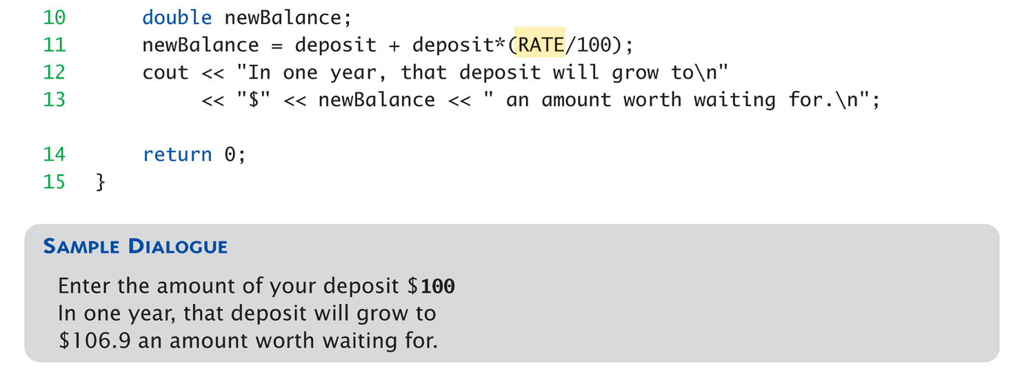
Arithmetic Operators:
Display 1.4 Named Constant (2 of 2)
Copyright © 2010 Pearson Addison-Wesley. All rights reserved.
1-<number>

Slide 20
Arithmetic Precision
Precision of Calculations
  VERY important consideration!
    Expressions in C++ might not evaluate as
    you’d "expect"!
  "Highest-order operand" determines type
  of arithmetic "precision" performed
  Common pitfall!
Copyright © 2010 Pearson Addison-Wesley. All rights reserved.
1-<number>

Slide 21
Arithmetic Precision Examples
Examples:
  17 / 5 evaluates to 3 in C++!
    Both operands are integers
    Integer division is performed!
  17.0 / 5 equals 3.4 in C++!
    Highest-order operand is "double type"
    Double "precision" division is performed!
  int intVar1 =1, intVar2=2;
  intVar1 / intVar2;
    Performs integer division!
    Result: 0!
Copyright © 2010 Pearson Addison-Wesley. All rights reserved.
1-<number>

Slide 22
실습예제
Precision 계산에서 나오는 예제 3개를 이전에 만든 hello 예제에 넣어서 확인해보자.
Copyright © 2010 Pearson Addison-Wesley. All rights reserved.
1-<number>

Slide 23
Individual Arithmetic Precision
Calculations done "one-by-one"
  1 / 2 / 3.0 / 4 performs 3 separate divisions.
    First→ 1 / 2 equals 0
    Then→ 0 / 3.0 equals 0.0
    Then→ 0.0 / 4 equals 0.0!
So not necessarily sufficient to change
just "one operand" in a large expression
  Must keep in mind all individual calculations
  that will be performed during evaluation!
Copyright © 2010 Pearson Addison-Wesley. All rights reserved.
1-<number>

Slide 24
Type Casting
Casting for Variables
  Can add ".0" to literals to force precision
  arithmetic, but what about variables?
    We can’t use "myInt.0"!
  static_cast<double>intVar
  Explicitly "casts" or "converts" intVar to
  double type
    Result of conversion is then used
    Example expression:
    doubleVar = static_cast<double>intVar1 / intVar2;
      Casting forces double-precision division to take place
      among two integer variables!
Copyright © 2010 Pearson Addison-Wesley. All rights reserved.
1-<number>

Slide 25
Type Casting
Two types
  Implicit—also called "Automatic"
    Done FOR you, automatically
    17 / 5.5
    This expression causes an "implicit type cast" to
    take place, casting the 17 → 17.0
  Explicit type conversion
    Programmer specifies conversion with cast operator
    (double)17 / 5.5
    Same expression as above, using explicit cast
    (double)myInt / myDouble
    More typical use; cast operator on variable
Copyright © 2010 Pearson Addison-Wesley. All rights reserved.
1-<number>

Slide 26
Shorthand Operators
Increment & Decrement Operators
  Just short-hand notation
  Increment operator, ++
  intVar++; is equivalent to
  intVar = intVar + 1;
  Decrement operator, --
  intVar--; is equivalent to
  intVar = intVar – 1;
Copyright © 2010 Pearson Addison-Wesley. All rights reserved.
1-<number>

Slide 27
Shorthand Operators: Two Options
Post-Increment
intVar++
  Uses current value of variable, THEN increments it
Pre-Increment
++intVar
  Increments variable first, THEN uses new value
"Use" is defined as whatever "context"
variable is currently in
No difference if "alone" in statement:
intVar++; and ++intVar; → identical result
Copyright © 2010 Pearson Addison-Wesley. All rights reserved.
1-<number>

Slide 28
Post-Increment in Action
Post-Increment in Expressions:
int n = 2,
valueProduced;
valueProduced = 2 * (n++);
cout << valueProduced << endl;
cout << n << endl;
  This code segment produces the output:
  4
  3
  Since post-increment was used
Copyright © 2010 Pearson Addison-Wesley. All rights reserved.
1-<number>

Slide 29
Pre-Increment in Action
Now using Pre-increment:
int n = 2,
valueProduced;
valueProduced = 2 * (++n);
cout << valueProduced << endl;
cout << n << endl;
  This code segment produces the output:
  6
  3
  Because pre-increment was used
Copyright © 2010 Pearson Addison-Wesley. All rights reserved.
1-<number>

Slide 30
Console Input/Output
I/O objects cin, cout, cerr
Defined in the C++ library called
<iostream>
Must have these lines (called pre-
processor directives) near start of file:
  #include <iostream>
  using namespace std;
  Tells C++ to use appropriate library so we can
  use the I/O objects cin, cout, cerr
Copyright © 2010 Pearson Addison-Wesley. All rights reserved.
1-<number>

Slide 31
Console Output
What can be outputted?
  Any data can be outputted to display screen
    Variables
    Constants
    Literals
    Expressions (which can include all of above)
  cout << numberOfGames << " games played.";
  2 values are outputted:
  "value" of variable numberOfGames,
  literal string " games played."
Cascading: multiple values in one cout
Copyright © 2010 Pearson Addison-Wesley. All rights reserved.
1-<number>

Slide 32
Separating Lines of Output
New lines in output
  Recall: "\n" is escape sequence for the
  char "newline"
A second method: object endl
Examples:
  cout << "Hello World\n";
    Sends string "Hello World" to display, & escape
    sequence "\n", skipping to next line
  cout << "Hello World" << endl;
    Same result as above
Copyright © 2010 Pearson Addison-Wesley. All rights reserved.
1-<number>

Slide 33
Formatting Output
Formatting numeric values for output
  Values may not display as you’d expect!
  cout << "The price is $" << price << endl;
    If price (declared double) has value 78.5, you
    might get:
      The price is $78.500000 or:
      The price is $78.5
We must explicitly tell C++ how to output numbers in our programs!
Copyright © 2010 Pearson Addison-Wesley. All rights reserved.
1-<number>

Slide 34
Formatting Numbers
"Magic Formula" to force decimal sizes:
cout.setf(ios::fixed);
cout.setf(ios::showpoint);
cout.precision(2);
These stmts force all future cout’ed values:
  To have exactly two digits after the decimal place
  Example:
  cout << "The price is $" << price << endl;
    Now results in the following:
    The price is $78.50
Can modify precision "as you go" as well!
Copyright © 2010 Pearson Addison-Wesley. All rights reserved.
1-<number>

Slide 35
실습예제
Formatting 예제를 실행해보자
  double price;
  price = 78.5;
  cout.setf(ios::fixed);
  cout.setf(ios::showpoint);
  cout.precision(2);
  cout <<price <<endl;
Copyright © 2010 Pearson Addison-Wesley. All rights reserved.
1-<number>

Slide 36
Error Output
Output with cerr
  cerr works same as cout
  Provides mechanism for distinguishing
  between regular output and error output
Re-direct output streams
  Most systems allow cout and cerr to be
  "redirected" to other devices
    e.g., line printer, output file, error console, etc.
Copyright © 2010 Pearson Addison-Wesley. All rights reserved.
1-<number>

Slide 37
Input Using cin
cin for input, cout for output
Differences:
  ">>" (extraction operator) points opposite
    Think of it as "pointing toward where the data goes"
  Object name "cin" used instead of "cout"
  No literals allowed for cin
    Must input "to a variable"
cin >> num;
  Waits on-screen for keyboard entry
  Value entered at keyboard is "assigned" to num
Copyright © 2010 Pearson Addison-Wesley. All rights reserved.
1-<number>

Slide 38
Prompting for Input: cin and cout
Always "prompt" user for input
cout << "Enter number of dragons: ";
cin >> numOfDragons;
  Note no "\n" in cout. Prompt "waits" on same
  line for keyboard input as follows:
    Enter number of dragons: ____
    Underscore above denotes where keyboard entry
    is made
Every cin should have cout prompt
  Maximizes user-friendly input/output
Copyright © 2010 Pearson Addison-Wesley. All rights reserved.
1-<number>

Slide 39
Program Style
Bottom-line: Make programs easy to read and modify
Comments, two methods:
  // Two slashes indicate entire line is to be ignored
  /*Delimiters indicates everything between is ignored*/
  Both methods commonly used
Identifier naming
  ALL_CAPS for constants
  lowerToUpper for variables
  Most important: MEANINGFUL NAMES!
Copyright © 2010 Pearson Addison-Wesley. All rights reserved.
1-<number>

Slide 40
Libraries
C++ Standard Libraries
#include <Library_Name>
  Directive to "add" contents of library file to
  your program
  Called "preprocessor directive"
    Executes before compiler, and simply "copies"
    library file into your program file
C++ has many libraries
  Input/output, math, strings, etc.
Copyright © 2010 Pearson Addison-Wesley. All rights reserved.
1-<number>

Slide 41
Namespaces
Namespaces defined:
  Collection of name definitions
For now: interested in namespace "std"
  Has all standard library definitions we need
Examples:
#include <iostream>
using namespace std;
    Includes entire standard library of name definitions
#include <iostream>using std::cin;
using std::cout;
    Can specify just the objects we want
Copyright © 2010 Pearson Addison-Wesley. All rights reserved.
1-<number>

Slide 42
Summary 1
C++ is case-sensitive
Use meaningful names
  For variables and constants
Variables must be declared before use
  Should also be initialized
Use care in numeric manipulation
  Precision, parentheses, order of operations
#include C++ libraries as needed
Copyright © 2010 Pearson Addison-Wesley. All rights reserved.
1-<number>

Slide 43
Summary 2
Object cout
  Used for console output
Object cin
  Used for console input
Object cerr
  Used for error messages
Use comments to aid understanding of
your program
  Do not overcomment
Copyright © 2010 Pearson Addison-Wesley. All rights reserved.
1-<number>

