Slide 1
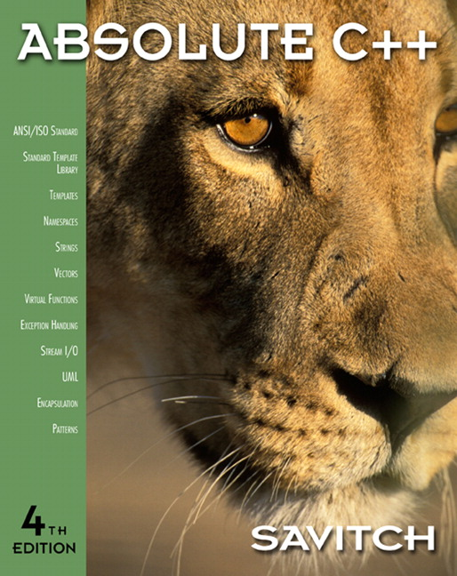

Chapter 2
Flow of Control
Copyright © 2010 Pearson Addison-Wesley. All rights reserved

Slide 2
Learning Objectives
Boolean Expressions
  Building, Evaluating & Precedence Rules
Branching Mechanisms
  if-else
  switch
  Nesting if-else
Loops
  While, do-while, for
  Nesting loops
Copyright © 2010 Pearson Addison-Wesley. All rights reserved.
2-<number>

Slide 3
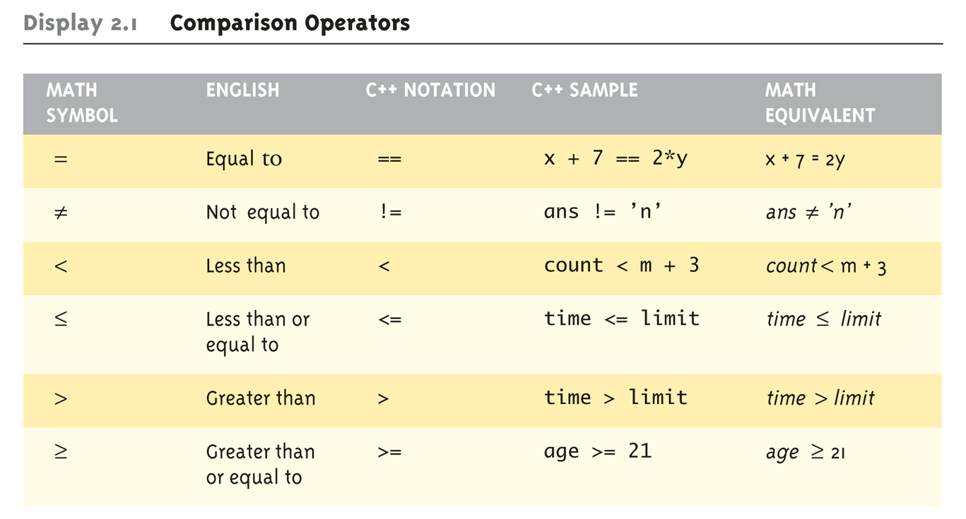
Boolean Expressions:
Display 2.1 Comparison Operators
Logical Operators
  Logical AND (&&)
  Logical OR (||)
Copyright © 2010 Pearson Addison-Wesley. All rights reserved.
2-<number>

Slide 4
Evaluating Boolean Expressions
Data type bool
  Returns true or false
  true, false are predefined library consts
Truth tables
  Display 2.2 next slide
Copyright © 2010 Pearson Addison-Wesley. All rights reserved.
2-<number>

Slide 5
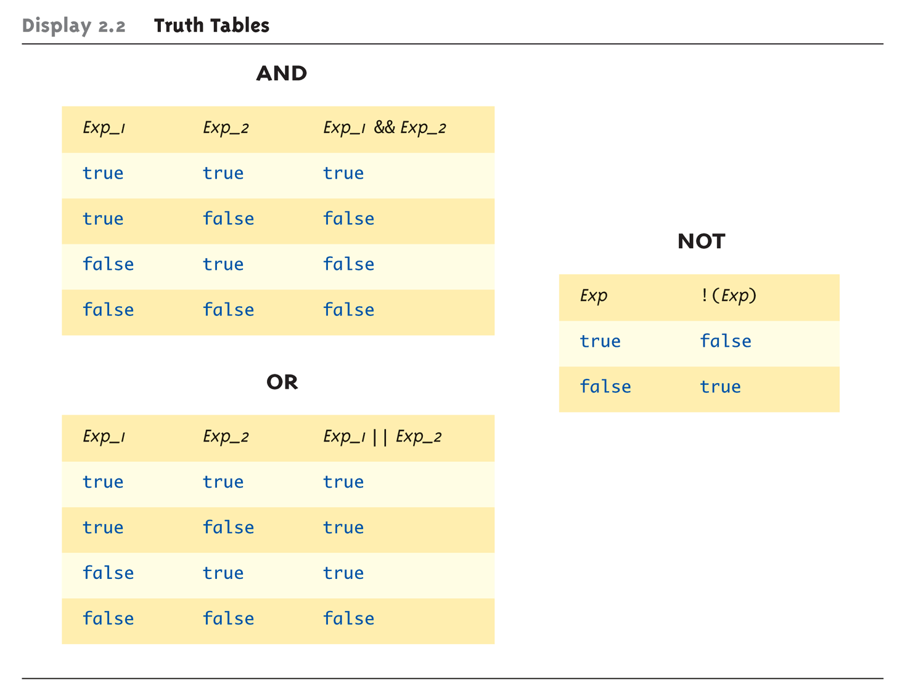
Evaluating Boolean Expressions: Display 2.2 Truth Tables
Copyright © 2010 Pearson Addison-Wesley. All rights reserved.
2-<number>

Slide 6
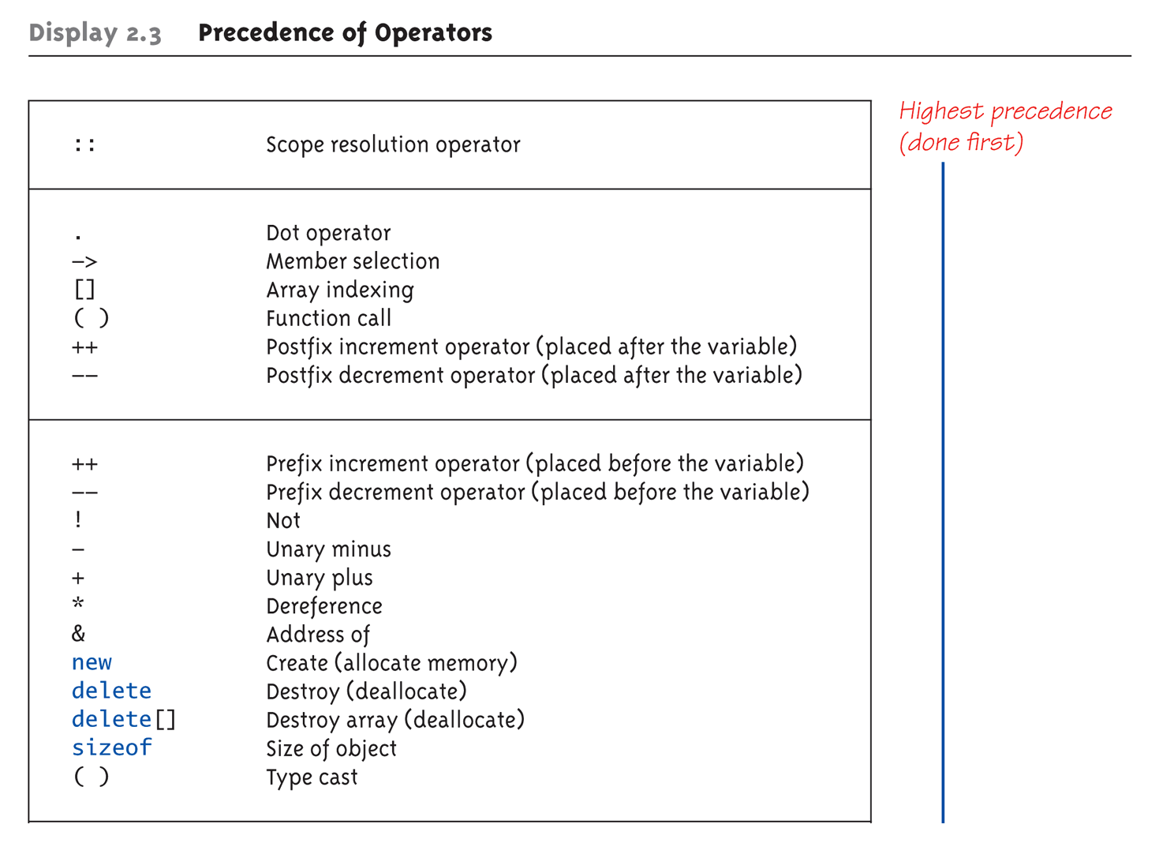
Display 2.3
Precedence of Operators (1 of 4)
Copyright © 2010 Pearson Addison-Wesley. All rights reserved.
2-<number>

Slide 7
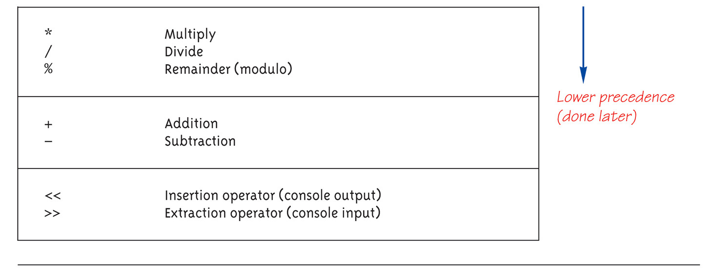
Display 2.3
Precedence of Operators (2 of 4)
Copyright © 2010 Pearson Addison-Wesley. All rights reserved.
2-<number>

Slide 8
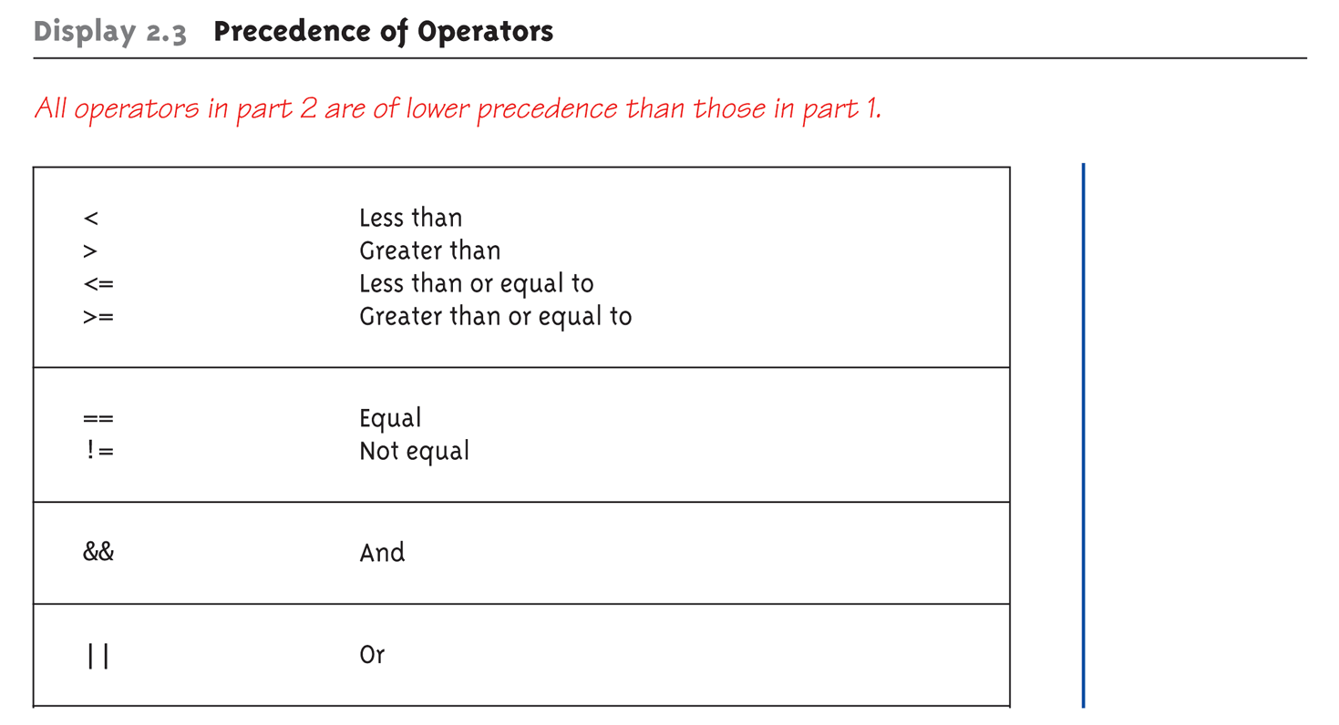
Display 2.3
Precedence of Operators (3 of 4)
Copyright © 2010 Pearson Addison-Wesley. All rights reserved.
2-<number>

Slide 9
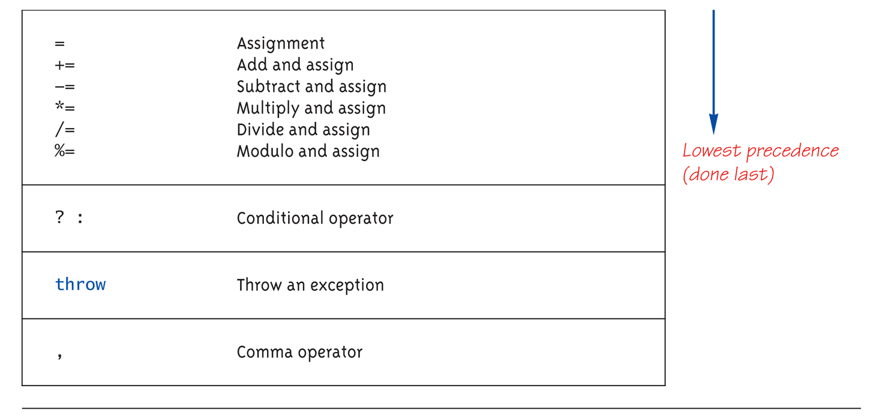
Display 2.3
Precedence of Operators (4 of 4)
Copyright © 2010 Pearson Addison-Wesley. All rights reserved.
2-<number>

Slide 10
Precedence Examples
Arithmetic before logical
  x + 1 > 2 || x + 1 < -3 means:
    (x + 1) > 2 || (x + 1) < -3
Short-circuit evaluation **이해필요**
  (x >= 0) && (y > 1)
  Be careful with increment operators!
    (x > 1) && (y++)
Integers as boolean values
  All non-zero values → true
  Zero value → false
Copyright © 2010 Pearson Addison-Wesley. All rights reserved.
2-<number>

Slide 11
Branching Mechanisms
if-else statements
  Choice of two alternate statements based
  on condition expression
  Example:
  if (hrs > 40)
  grossPay = rate*40 + 1.5*rate*(hrs-40);
  else
  grossPay = rate*hrs;
Copyright © 2010 Pearson Addison-Wesley. All rights reserved.
2-<number>

Slide 12
if-else Statement Syntax
Formal syntax:
if (<boolean_expression>)
<yes_statement>
else
<no_statement>
Note each alternative is only
ONE statement!
To have multiple statements execute in
either branch → use compound statement
Copyright © 2010 Pearson Addison-Wesley. All rights reserved.
2-<number>

Slide 13
Compound/Block Statement
Only "get" one statement per branch
Must use compound statement { }
for multiples
  Also called a "block" stmt
Each block should have block statement
  Even if just one statement
  Enhances readability
Copyright © 2010 Pearson Addison-Wesley. All rights reserved.
2-<number>

Slide 14
Compound Statement in Action
Note indenting in this example:
if (myScore > yourScore)
{
cout << "I win!\n";
wager = wager + 100;
}
else
{
cout << "I wish these were golf scores.\n";
wager = 0;
}
Copyright © 2010 Pearson Addison-Wesley. All rights reserved.
2-<number>

Slide 15
Common Pitfalls
Operator "=" vs. operator "=="
One means "assignment" (=)
One means "equality" (==)
  VERY different in C++!
  Example:
  if (x = 12) ←Note operator used!
  Do_Something
  else
  Do_Something_Else
Copyright © 2010 Pearson Addison-Wesley. All rights reserved.
2-<number>

Slide 16
The Optional else
else clause is optional
  If, in the false branch (else), you want "nothing" to happen, leave it out
  Example:
  if (sales >= minimum)
  salary = salary + bonus;
  cout << "Salary = %" << salary;
  Note: nothing to do for false condition, so there is no else clause!
  Execution continues with cout statement
Copyright © 2010 Pearson Addison-Wesley. All rights reserved.
2-<number>

Slide 17
Nested Statements
if-else statements contain smaller statements
  Compound or simple statements (we’ve seen)
  Can also contain any statement at all, including another if-else stmt!
  Example:
  if (speed > 55)
  if (speed > 80)
  cout << "You’re really speeding!";
  else
  cout << "You’re speeding.";
    Note proper indenting!
Copyright © 2010 Pearson Addison-Wesley. All rights reserved.
2-<number>

Slide 18
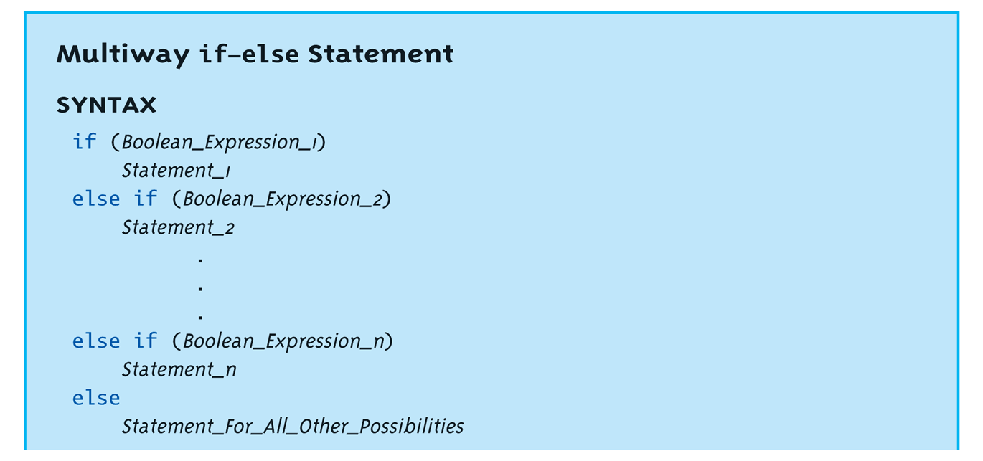
Multiway if-else
Not new, just different indenting
Avoids "excessive" indenting
  Syntax:
Copyright © 2010 Pearson Addison-Wesley. All rights reserved.
2-<number>

Slide 19
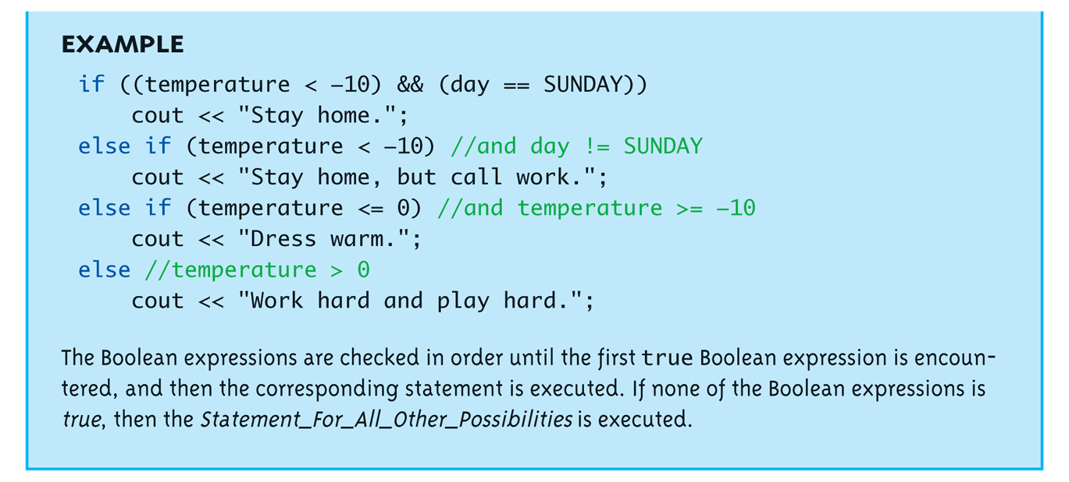
Multiway if-else Example
Copyright © 2010 Pearson Addison-Wesley. All rights reserved.
2-<number>

Slide 20
실습예제
요일을 입력받아 숫자로 변환하는 프로젝트를 만들자
  DaysToInt 라는 프로젝트를 생성하고
  #include <Iostream>, <string>, 그리고 using namespace std
  사용자 입력받아 string 변수 strDays에 넣음
  입력받은 요일과 일요일부터 비교해서 순서대로 1,2,… 로 출력
    오늘은 2 번째 요일
    If –else 문을 사용
Copyright © 2010 Pearson Addison-Wesley. All rights reserved.
2-<number>

Slide 21
The switch Statement
A new stmt for controlling
multiple branches
Uses controlling expression which returns bool data type (true or false)
Syntax:
  Next slide
Copyright © 2010 Pearson Addison-Wesley. All rights reserved.
2-<number>

Slide 22
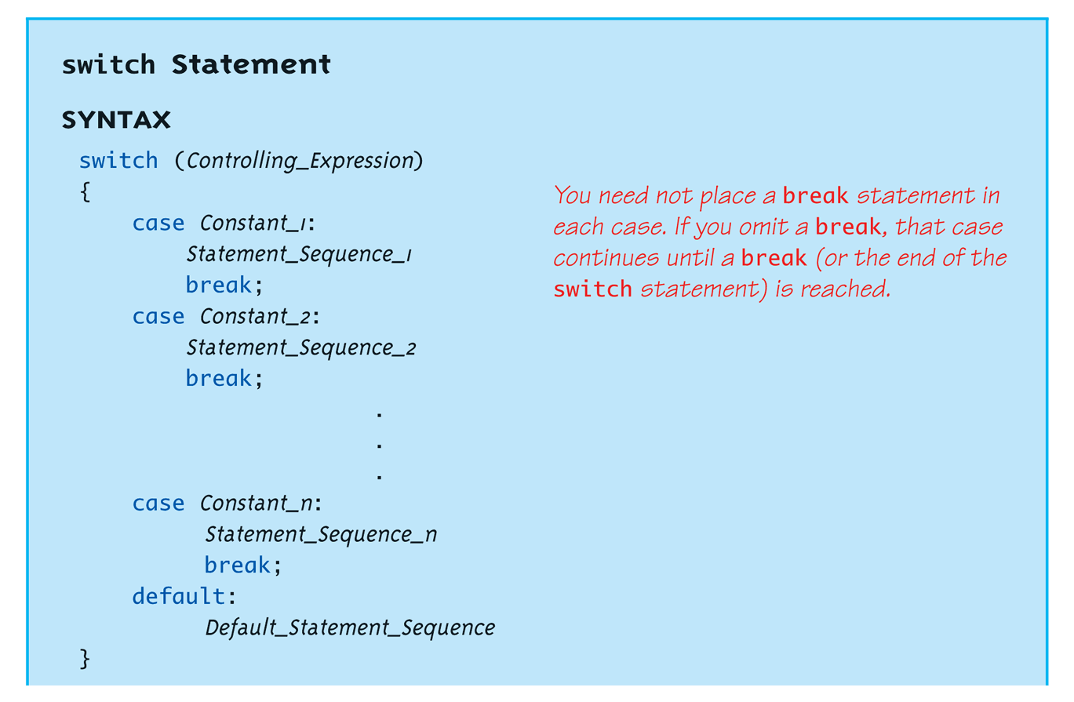
switch Statement Syntax
Copyright © 2010 Pearson Addison-Wesley. All rights reserved.
2-<number>

Slide 23
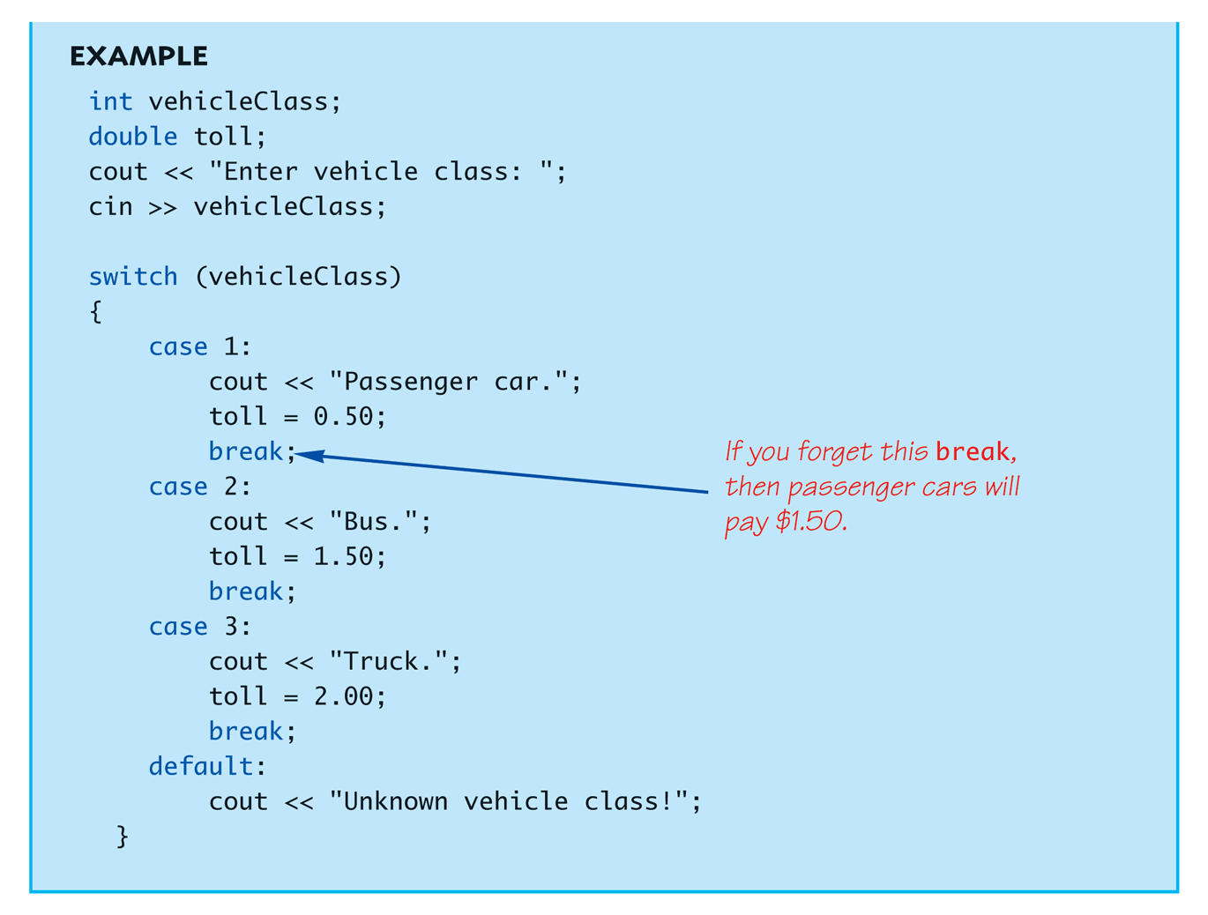
The switch Statement in Action
Copyright © 2010 Pearson Addison-Wesley. All rights reserved.
2-<number>

Slide 24
The switch: multiple case labels
Execution "falls thru" until break
  switch provides a "point of entry"
  Example:
  case "A":
  case "a":
  cout << "Excellent: you got an "A"!\n";
  break;
  case "B":
  case "b":
  cout << "Good: you got a "B"!\n";
  break;
  Note multiple labels provide same "entry"
Copyright © 2010 Pearson Addison-Wesley. All rights reserved.
2-<number>

Slide 25
switch Pitfalls/Tip
Forgetting the break;
  No compiler error
  Execution simply "falls thru" other cases until break;
Biggest use: MENUs
  Provides clearer "big-picture" view
  Shows menu structure effectively
  Each branch is one menu choice
Copyright © 2010 Pearson Addison-Wesley. All rights reserved.
2-<number>

Slide 26
switch Menu Example
Switch stmt "perfect" for menus:
switch (response)
{
case "1":
// Execute menu option 1
break;
case "2":
// Execute menu option 2
break;
case 3":
// Execute menu option 3
break;
default:
cout << "Please enter valid response.";
}
Copyright © 2010 Pearson Addison-Wesley. All rights reserved.
2-<number>

Slide 27
실습예제
앞의 실습(DaysToInt) 뒤로 계속해서 프로그램한다. Switch case문을 이용해서 월요일부터 금요일까지 이면 “주중엔 열심히” 토요일 일요일 이면 “주말엔 즐겁게” 라고 출력한다.
단 위의 출력문은 각각 한번씩만 사용한다.
Copyright © 2010 Pearson Addison-Wesley. All rights reserved.
2-<number>

Slide 28
Conditional Operator
Also called "ternary operator"
  Allows embedded conditional in expression
  Essentially "shorthand if-else" operator
  Example:
  if (n1 > n2)
  max = n1;
  else
  max = n2;
  Can be written:
  max = (n1 > n2) ? N1 : n2;
    "?" and ":" form this "ternary" operator
Copyright © 2010 Pearson Addison-Wesley. All rights reserved.
2-<number>

Slide 29
Loops
3 Types of loops in C++
  while
    Most flexible
    No "restrictions"
  do-while
    Least flexible
    Always executes loop body at least once
  for
    Natural "counting" loop
Copyright © 2010 Pearson Addison-Wesley. All rights reserved.
2-<number>

Slide 30
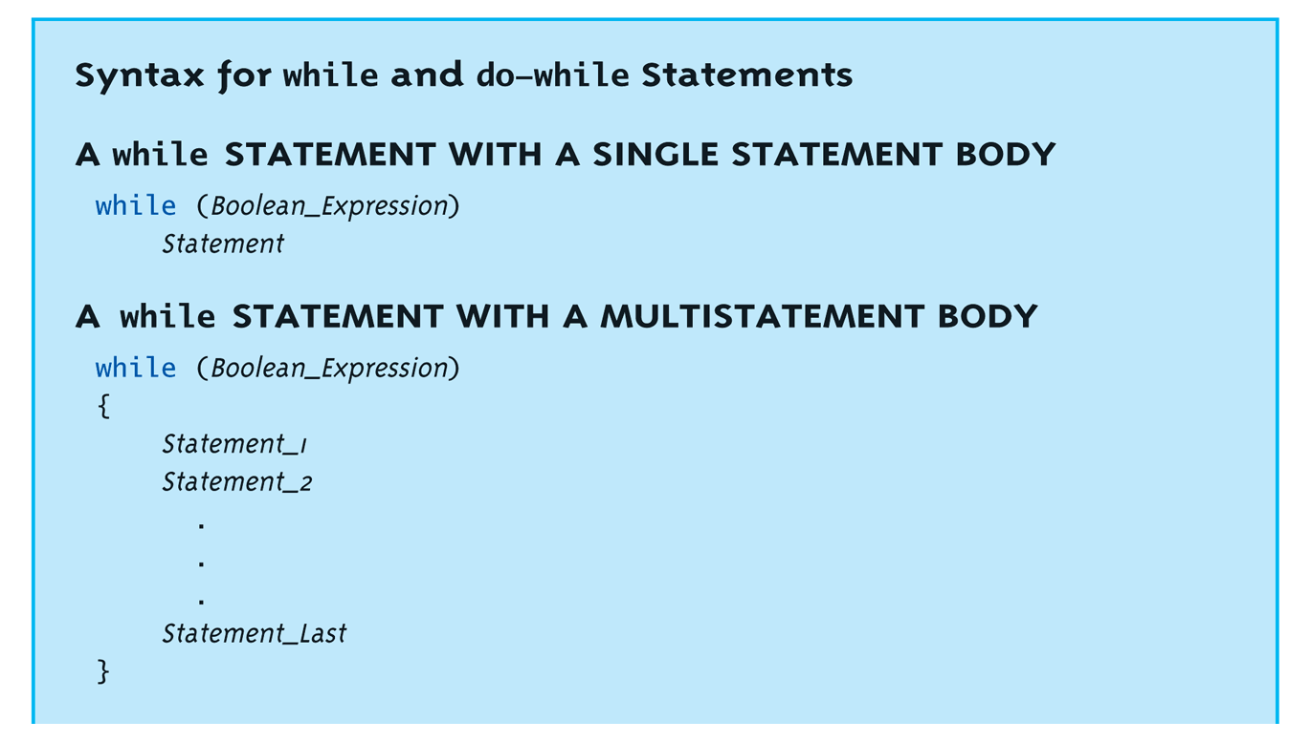
while Loops Syntax
Copyright © 2010 Pearson Addison-Wesley. All rights reserved.
2-<number>

Slide 31
while Loop Example
Consider:
count = 0; // Initialization
while (count < 3) // Loop Condition
{
cout << "Hi "; // Loop Body
count++; // Update expression
}
  Loop body executes how many times?
Copyright © 2010 Pearson Addison-Wesley. All rights reserved.
2-<number>

Slide 32
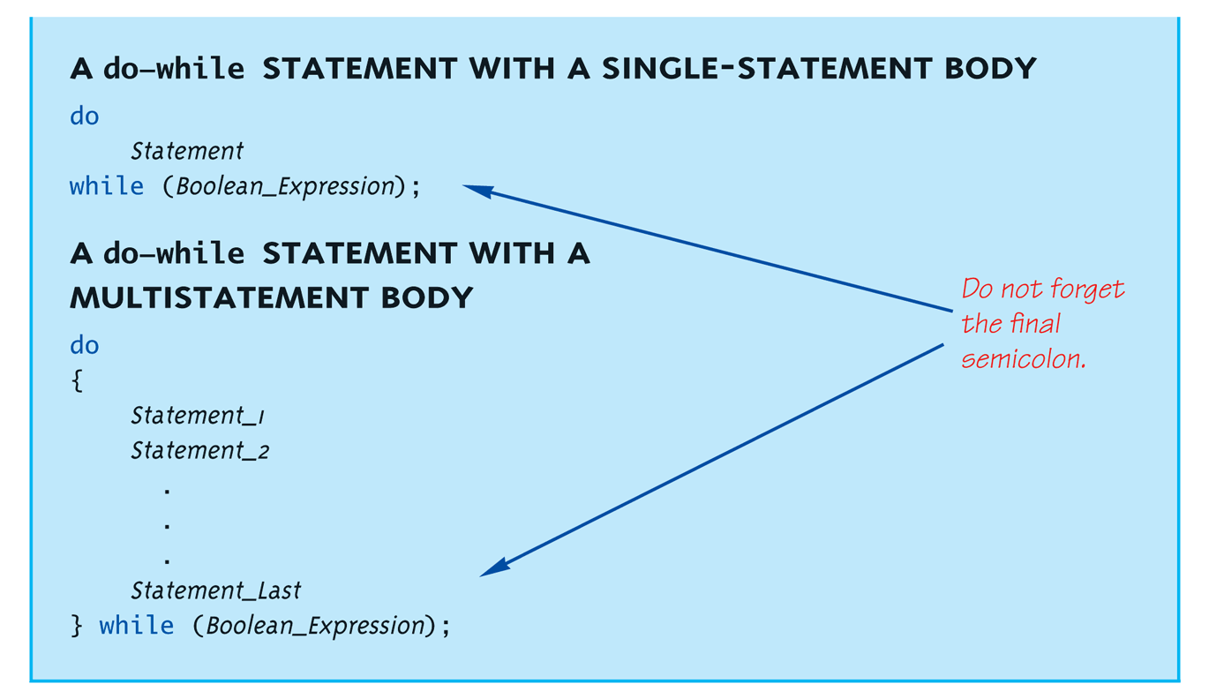
do-while Loop Syntax
Copyright © 2010 Pearson Addison-Wesley. All rights reserved.
2-<number>

Slide 33
do-while Loop Example
count = 0; // Initialization
do
{
cout << "Hi "; // Loop Body
count++; // Update expression
} while (count < 3); // Loop Condition
  Loop body executes how many times?
  do-while loops always execute body at least once!
Copyright © 2010 Pearson Addison-Wesley. All rights reserved.
2-<number>

Slide 34
while vs. do-while
Very similar, but…
  One important difference
    Issue is "WHEN" boolean expression is checked
    while: checks BEFORE body is executed
    do-while: checked AFTER body is executed
After this difference, they’re
essentially identical!
while is more common, due to it’s
ultimate "flexibility"
Copyright © 2010 Pearson Addison-Wesley. All rights reserved.
2-<number>

Slide 35
Comma Operator
Evaluate list of expressions, returning
value of the last expression
Most often used in a for-loop
Example:
first = (first = 2, second = first + 1);
  first gets assigned the value 3
  second gets assigned the value 3
No guarantee what order expressions will
be evaluated.
Copyright © 2010 Pearson Addison-Wesley. All rights reserved.
2-<number>

Slide 36
for Loop Syntax
for (Init_Action; Bool_Exp; Update_Action)
Body_Statement
Like if-else, Body_Statement can be
a block statement
  Much more typical
Copyright © 2010 Pearson Addison-Wesley. All rights reserved.
2-<number>

Slide 37
for Loop Example
for (count=0;count<3;count++)
{
cout << "Hi "; // Loop Body
}
How many times does loop body execute?
Initialization, loop condition and update all
"built into" the for-loop structure!
A natural "counting" loop
Copyright © 2010 Pearson Addison-Wesley. All rights reserved.
2-<number>

Slide 38
Loop Issues
Loop’s condition expression can be ANY boolean expression
Examples:
  while (count<3 && done!=0)
  {
  // Do something
  }
  for (index=0;index<10 && entry!=-99)
  {
  // Do something
  }
Copyright © 2010 Pearson Addison-Wesley. All rights reserved.
2-<number>

Slide 39
Loop Pitfalls: Misplaced ;
Watch the misplaced ; (semicolon)
  Example:
  while (response != 0) ;←
  {
  cout << "Enter val: ";
  cin >> response;
  }
  Notice the ";" after the while condition!
Result here: INFINITE LOOP!
Copyright © 2010 Pearson Addison-Wesley. All rights reserved.
2-<number>

Slide 40
Loop Pitfalls: Infinite Loops
Loop condition must evaluate to false at
some iteration through loop
  If not → infinite loop.
  Example:
  while (1)
  {
  cout << "Hello ";
  }
  A perfectly legal C++ loop → always infinite!
Infinite loops can be desirable
  e.g., "Embedded Systems"
Copyright © 2010 Pearson Addison-Wesley. All rights reserved.
2-<number>

Slide 41
The break and continue Statements
Flow of Control
  Recall how loops provide "graceful" and clear flow of control in and out
  In RARE instances, can alter natural flow
break;
  Forces loop to exit immediately.
continue;
  Skips rest of loop body
These statements violate natural flow
  Only used when absolutely necessary!
Copyright © 2010 Pearson Addison-Wesley. All rights reserved.
2-<number>

Slide 42
Nested Loops
Recall: ANY valid C++ statements can be
inside body of loop
This includes additional loop statements!
  Called "nested loops"
Requires careful indenting:
for (outer=0; outer<5; outer++)
for (inner=7; inner>2; inner--)
cout << outer << inner;
  Notice no { } since each body is one statement
  Good style dictates we use { } anyway
Copyright © 2010 Pearson Addison-Wesley. All rights reserved.
2-<number>

Slide 43
실습예제
ForLoopEx 라는 프로젝트를 만든다.
  int pWaiting[7]={22, 21, 24, 20, 18, 25, 23};
  For 문을 이용해서 최대값(nMax)과 위치(nPosMax)를 찾는다
  첫번째 값을 최대로 놓고 둘째 부터 비교해서 찾는다. 물론 출력하시고
    Iostream, std 잊지 마시고
  짝수 중에서만 최대값을 찾는다
    홀수면 continue 로 건너뜀.
  21이 나오기 전까지에서 짝수 최대값을 찾는다
Copyright © 2010 Pearson Addison-Wesley. All rights reserved.
2-<number>

Slide 44
Summary 1
Boolean expressions
  Similar to arithmetic → results in true or false
C++ branching statements
  if-else, switch
  switch statement great for menus
C++ loop statements
  while
  do-while
  for
Copyright © 2010 Pearson Addison-Wesley. All rights reserved.
2-<number>

Slide 45
Summary 2
do-while loops
  Always execute their loop body at least once
for-loop
  A natural "counting" loop
Loops can be exited early
  break statement
  continue statement
  Usage restricted for style purposes
Copyright © 2010 Pearson Addison-Wesley. All rights reserved.
2-<number>

