Slide 1
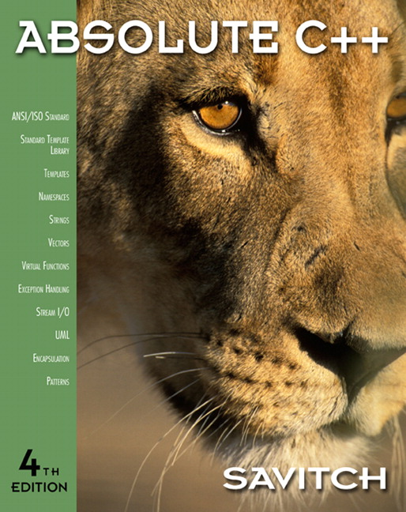

Chapter 3
Function Basics
Copyright © 2010 Pearson Addison-Wesley. All rights reserved

Slide 2
Learning Objectives
Predefined Functions
  Those that return a value and those that don’t
Programmer-defined Functions
  Defining, Declaring, Calling
  Recursive Functions
Scope Rules
  Local variables
  Global constants and global variables
  Blocks, nested scopes
Copyright © 2010 Pearson Addison-Wesley. All rights reserved.
3-<number>

Slide 3
Introduction to Functions
Building Blocks of Programs
Other terminology in other languages:
  Procedures, subprograms, methods
  In C++: functions
I-P-O
  Input – Process – Output
  Basic subparts to any program
  Use functions for these "pieces"
Copyright © 2010 Pearson Addison-Wesley. All rights reserved.
3-<number>

Slide 4
Predefined Functions
Libraries full of functions for our use!
Two types:
  Those that return a value
  Those that do not (void)
Must "#include" appropriate library
  e.g.,
    <cmath>, <cstdlib> (Original "C" libraries)
    <iostream> (for cout, cin)
Copyright © 2010 Pearson Addison-Wesley. All rights reserved.
3-<number>

Slide 5
Using Predefined Functions
Math functions very plentiful
  Found in library <cmath.h>
  Most return a value (the "answer")
Example: theRoot = sqrt(9.0);
  Components:
  sqrt = name of library function
  theRoot = variable used to assign "answer" to
  9.0 = argument or "starting input" for function
  In I-P-O:
    I = 9.0
    P = "compute the square root"
    O = 3, which is returned & assigned to theRoot
Copyright © 2010 Pearson Addison-Wesley. All rights reserved.
3-<number>

Slide 6
The Function Call
Back to this assignment:
theRoot = sqrt(9.0);
  The expression "sqrt(9.0)" is known as a
  function call, or function invocation
  The argument in a function call (9.0) can be a
  literal, a variable, or an expression
  The call itself can be part of an expression:
    bonus = sqrt(sales)/10;
    A function call is allowed wherever it’s legal to use
    an expression of the function’s return type
Copyright © 2010 Pearson Addison-Wesley. All rights reserved.
3-<number>

Slide 7
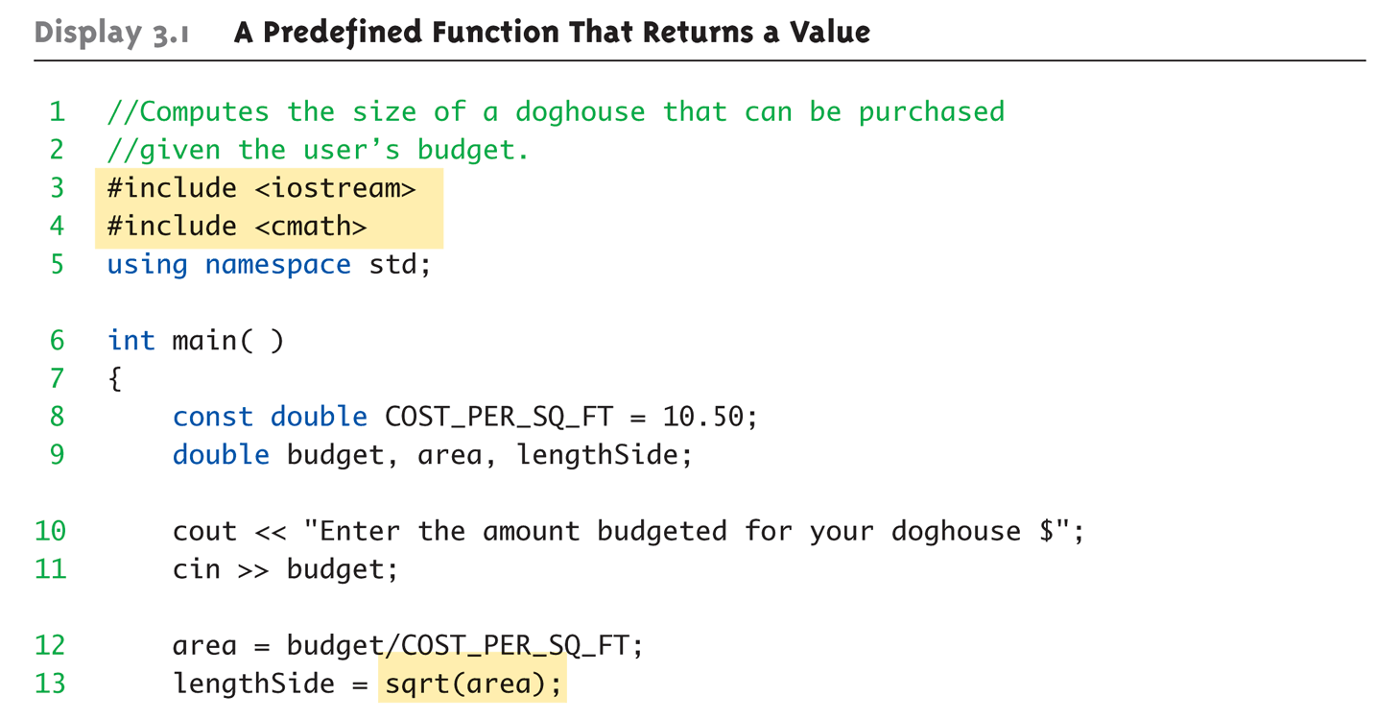
A Larger Example:
Display 3.1 A Predefined Function That Returns a Value (1 of 2)
Copyright © 2010 Pearson Addison-Wesley. All rights reserved.
3-<number>

Slide 8
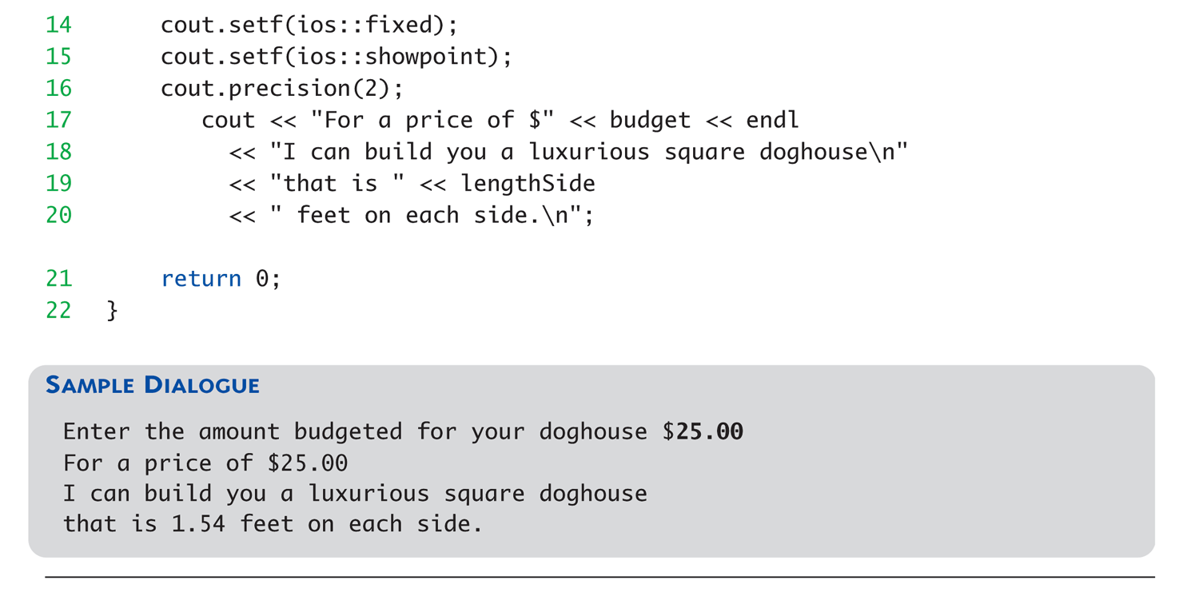
A Larger Example:
Display 3.1 A Predefined Function That Returns a Value (2 of 2)
Copyright © 2010 Pearson Addison-Wesley. All rights reserved.
3-<number>

Slide 9
More Predefined Functions
#include <cstdlib>
  Library contains functions like:
    abs() // Returns absolute value of an int
    labs() // Returns absolute value of a long int
    *fabs() // Returns absolute value of a float
  *fabs() is actually in library <cmath>!
    Can be confusing
    Remember: libraries were added after C++ was
    "born," in incremental phases
    Refer to appendices/manuals for details
Copyright © 2010 Pearson Addison-Wesley. All rights reserved.
3-<number>

Slide 10
More Math Functions
pow(x, y)
  Returns x to the power y
  double result, x = 3.0, y = 2.0;
  result = pow(x, y);
  cout << result;
    Here 9.0 is displayed since 3.0^{2.0} = 9.0
Notice this function receives two arguments
  A function can have any number of arguments, of varying data types
Copyright © 2010 Pearson Addison-Wesley. All rights reserved.
3-<number>

Slide 11
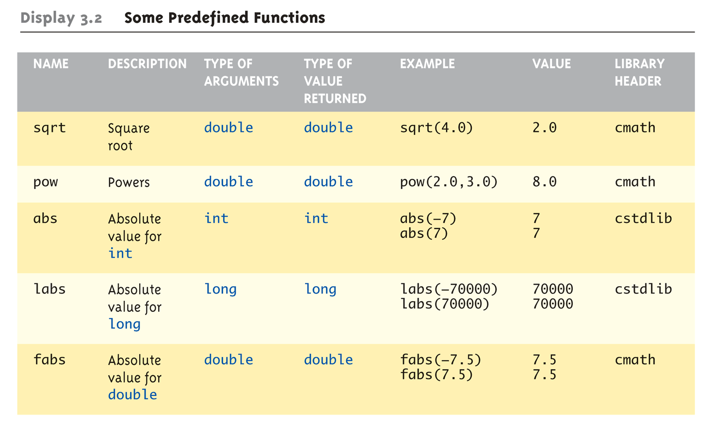
Even More Math Functions:
Display 3.2 Some Predefined
Functions (1 of 2)
Copyright © 2010 Pearson Addison-Wesley. All rights reserved.
3-<number>

Slide 12
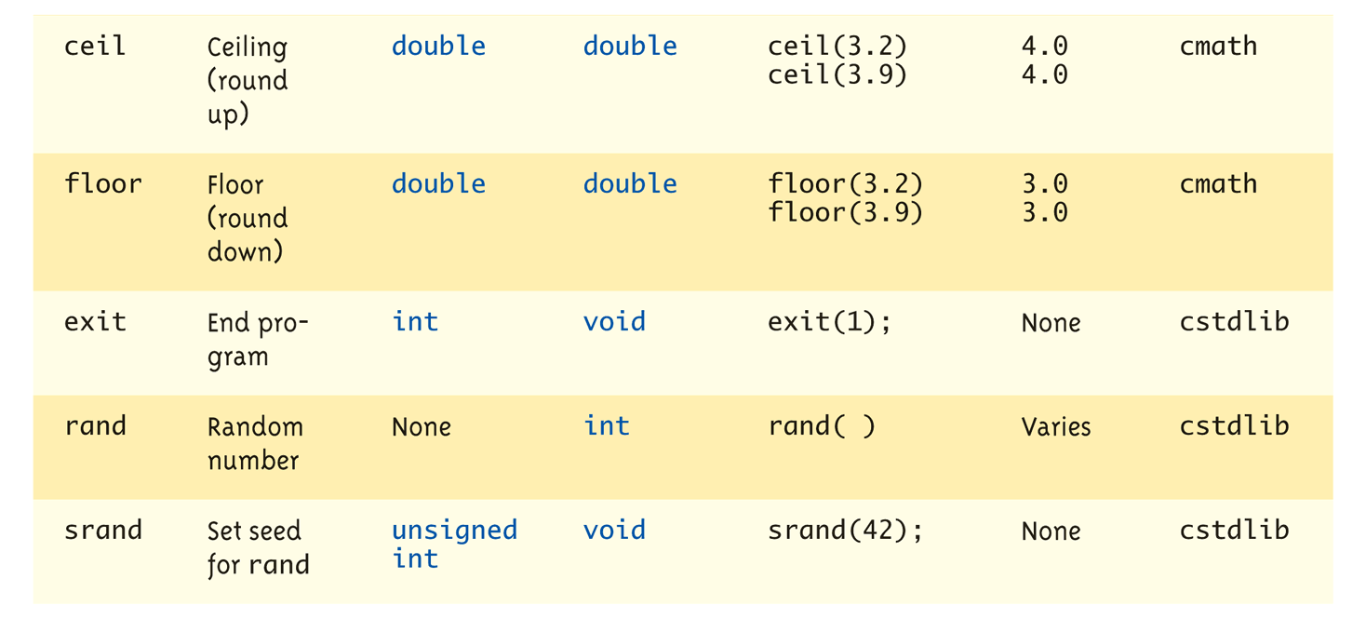
Even More Math Functions:
Display 3.2 Some Predefined
Functions (2 of 2)
Copyright © 2010 Pearson Addison-Wesley. All rights reserved.
3-<number>

Slide 13
Predefined Void Functions
No returned value
Performs an action, but sends no "answer"
When called, it’s a statement itself
  exit(1); // No return value, so not assigned
    This call terminates program
    void functions can still have arguments
All aspects same as functions that "return
a value"
  They just don’t return a value!
Copyright © 2010 Pearson Addison-Wesley. All rights reserved.
3-<number>

Slide 14
Random Number Generator
Return "randomly chosen" number
Used for simulations, games
  rand()
    Takes no arguments
    Returns value between 0 & RAND_MAX
  Scaling
    Squeezes random number into smaller range
    rand() % 6
    Returns random value between 0 & 5
  Shifting
  rand() % 6 + 1
    Shifts range between 1 & 6 (e.g., die roll)
Copyright © 2010 Pearson Addison-Wesley. All rights reserved.
3-<number>

Slide 15
Random Number Seed
Pseudorandom numbers
  Calls to rand() produce given "sequence"
  of random numbers
Use "seed" to alter sequence
srand(seed_value);
  void function
  Receives one argument, the "seed"
  Can use any seed value, including system time:
  srand(time(0));
  time() returns system time as numeric value
  Library <time> contains time() functions
Copyright © 2010 Pearson Addison-Wesley. All rights reserved.
3-<number>

Slide 16
Random Examples
Random double between 0.0 & 1.0:
(RAND_MAX – rand())/static_cast<double>(RAND_MAX)
  Type cast used to force double-precision division
Random int between 1 & 6:
rand() % 6 + 1
  "%" is modulus operator (remainder)
Random int between 10 & 20:
rand() % 10 + 10
Copyright © 2010 Pearson Addison-Wesley. All rights reserved.
3-<number>

Slide 17
실습예제
가위 바위 보 게임을 만들어 보자
  사용자가 가위 바위 보 중에 하나를 내면
  프로그램이 랜덤으로 다른 하나를 내고
  이기면 "축하" 지면 "분발" 출력
  먼저 입력 받기
  Random 숫자 0,1,2 발생해서 이를 가위 바위 보에 대응함. <cmath>의 rand(), switch 문 사용
  사용자입력과 비교해서(문자열) 승부에 따라 출력
  srand (time(0))를 맨 앞에 넣음
    <time.h> 를 첨부해야함
Copyright © 2010 Pearson Addison-Wesley. All rights reserved.
3-<number>

Slide 18
Programmer-Defined Functions
Write your own functions!
Building blocks of programs
  Divide & Conquer
  Readability
  Re-use
Your "definition" can go in either:
  Same file as main()
  Separate file so others can use it, too
Copyright © 2010 Pearson Addison-Wesley. All rights reserved.
3-<number>

Slide 19
Components of Function Use
3 Pieces to using functions:
  Function Declaration/prototype
    Information for compiler
    To properly interpret calls
  Function Definition
    Actual implementation/code for what
    function does
  Function Call
    Transfer control to function
Copyright © 2010 Pearson Addison-Wesley. All rights reserved.
3-<number>

Slide 20
Function Declaration
Also called function prototoype
An "informational" declaration for compiler
Tells compiler how to interpret calls
  Syntax:
  <return_type> FnName(<formal-parameter-list>);
  Example:
  double totalCost( int numberParameter,
  double priceParameter);
Placed before any calls
  In declaration space of main()
  Or above main() in global space
Copyright © 2010 Pearson Addison-Wesley. All rights reserved.
3-<number>

Slide 21
Function Definition
Implementation of function
Just like implementing function main()
Example:
double totalCost( int numberParameter,
double priceParameter)
{
const double TAXRATE = 0.05;
double subTotal;
subtotal = priceParameter * numberParameter;
return (subtotal + subtotal * TAXRATE);
}
Notice proper indenting
Copyright © 2010 Pearson Addison-Wesley. All rights reserved.
3-<number>

Slide 22
Function Definition Placement
Placed after function main()
  NOT "inside" function main()!
Functions are "equals"; no function is ever
"part" of another
Formal parameters in definition
  "Placeholders" for data sent in
    "Variable name" used to refer to data in definition
return statement
  Sends data back to caller
Copyright © 2010 Pearson Addison-Wesley. All rights reserved.
3-<number>

Slide 23
Function Call
Just like calling predefined function
bill = totalCost(number, price);
Recall: totalCost returns double value
  Assigned to variable named "bill"
Arguments here: number, price
  Recall arguments can be literals, variables,
  expressions, or combination
  In function call, arguments often called
  "actual arguments"
    Because they contain the "actual data" being sent
Copyright © 2010 Pearson Addison-Wesley. All rights reserved.
3-<number>

Slide 24
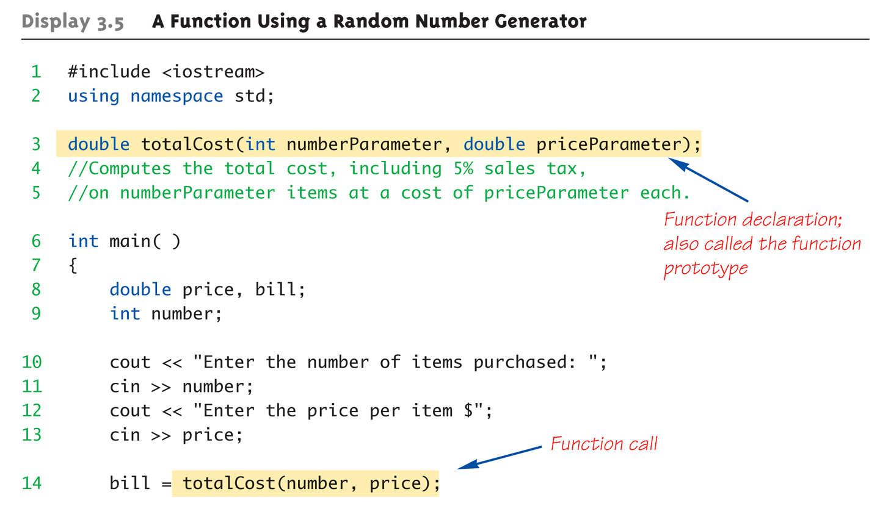
Function Example:
Display 3.5 A Function Using a Random Number Generator (1 of 2)
Copyright © 2010 Pearson Addison-Wesley. All rights reserved.
3-<number>

Slide 25
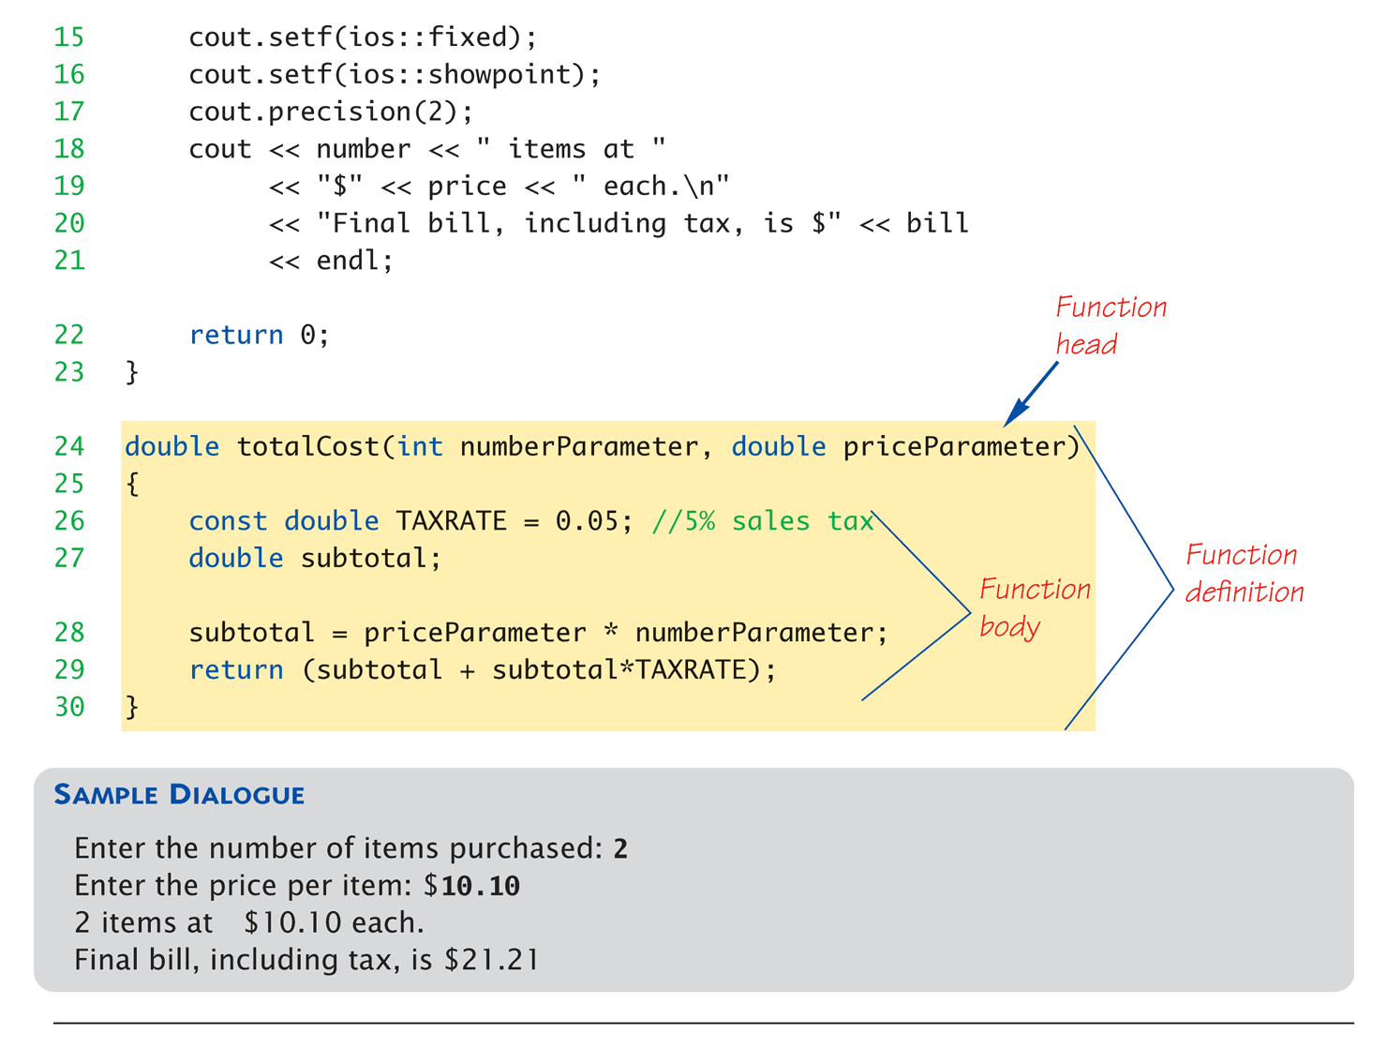
Function Example:
Display 3.5 A Function Using a Random Number Generator (2 of 2)
Copyright © 2010 Pearson Addison-Wesley. All rights reserved.
3-<number>

Slide 26
Alternative Function Declaration
Recall: Function declaration is "information"
for compiler
Compiler only needs to know:
    Return type
    Function name
    Parameter list
Formal parameter names not needed:
double totalCost(int, double);
  Still "should" put in formal parameter names
    Improves readability
Copyright © 2010 Pearson Addison-Wesley. All rights reserved.
3-<number>

Slide 27
Parameter vs. Argument
Terms often used interchangeably
Formal parameters/arguments
  In function declaration
  In function definition’s header
Actual parameters/arguments
  In function call
Technically parameter is "formal" piece
while argument is "actual" piece*
  *Terms not always used this way
Copyright © 2010 Pearson Addison-Wesley. All rights reserved.
3-<number>

Slide 28
Functions Calling Functions
We’re already doing this!
  main() IS a function!
Only requirement:
  Function’s declaration must appear first
Function’s definition typically elsewhere
  After main()"s definition
  Or in separate file
Common for functions to call many other
functions
Function can even call itself → "Recursion"
Copyright © 2010 Pearson Addison-Wesley. All rights reserved.
3-<number>

Slide 29
Boolean Return-Type Functions
Return-type can be any valid type
  Given function declaration/prototype:
  bool appropriate(int rate);
  And function’s definition:
  bool appropriate (int rate)
  {
  return (((rate>=10)&&(rate<20))||(rate==0);
  }
  Returns "true" or "false"
  Function call, from some other function:
  if (appropriate(entered_rate))
  cout << "Rate is valid\n";
Copyright © 2010 Pearson Addison-Wesley. All rights reserved.
3-<number>

Slide 30
Declaring Void Functions
Similar to functions returning a value
Return type specified as "void"
Example:
  Function declaration/prototype:
  void showResults( double fDegrees,
  double cDegrees);
    Return-type is "void"
    Nothing is returned
Copyright © 2010 Pearson Addison-Wesley. All rights reserved.
3-<number>

Slide 31
Declaring Void Functions
Function definition:
void showResults(double fDegrees, double cDegrees)
{
cout.setf(ios::fixed);
cout.setf(ios::showpoint);
cout.precision(1);
cout << fDegrees
<< " degrees fahrenheit equals \n"
<< cDegrees << " degrees celsius.\n";
}
Notice: no return statement
  Optional for void functions
Copyright © 2010 Pearson Addison-Wesley. All rights reserved.
3-<number>

Slide 32
Calling Void Functions
Same as calling predefined void functions
From some other function, like main():
  showResults(degreesF, degreesC);
  showResults(32.5, 0.3);
Notice no assignment, since no
value returned
Actual arguments (degreesF, degreesC)
  Passed to function
  Function is called to "do it’s job" with the
  data passed in
Copyright © 2010 Pearson Addison-Wesley. All rights reserved.
3-<number>

Slide 33
More on Return Statements
Transfers control back to "calling" function
  For return type other than void, MUST have
  return statement
  Typically the LAST statement in
  function definition
return statement optional for void functions
  Closing } would implicitly return control from
  void function
Copyright © 2010 Pearson Addison-Wesley. All rights reserved.
3-<number>

Slide 34
Preconditions and Postconditions
Similar to "I-P-O" discussion
Comment function declaration:
void showInterest(double balance, double rate);
//Precondition: balance is nonnegative account balance
// rate is interest rate as percentage
//Postcondition: amount of interest on given balance,
// at given rate …
Often called Inputs & Outputs
Copyright © 2010 Pearson Addison-Wesley. All rights reserved.
3-<number>

Slide 35
실습예제
앞서 만든 가위바위보 게임에서 이기고 비기는 것에 따라 출력하는 부분을 함수로 만들고자 한다.
  int AmIWin(string strRPCInput,string strRPCCom)
    이 함수에서는 이전의 조건문을 그대로 가져오지만, 출력 부분에는 단순하게 이기면 nWin=1; 지면 nWin = -1; 비기면 nWin =0; 바보면 nWin=-8;
  이 함수 값에 따라 main 함수에서 switch 로 출력함
Copyright © 2010 Pearson Addison-Wesley. All rights reserved.
3-<number>

Slide 36
main(): "Special"
Recall: main() IS a function
"Special" in that:
  One and only one function called main()
  will exist in a program
Who calls main()?
  Operating system
  Tradition holds it should have return statement
    Value returned to "caller" → Here: operating system
  Should return "int" or "void"
Copyright © 2010 Pearson Addison-Wesley. All rights reserved.
3-<number>

Slide 37
Scope Rules
Local variables
  Declared inside body of given function
  Available only within that function
Can have variables with same names declared in different functions
  Scope is local: "that function is it’s scope"
Local variables preferred
  Maintain individual control over data
  Need to know basis
  Functions should declare whatever local data needed to "do their job"
Copyright © 2010 Pearson Addison-Wesley. All rights reserved.
3-<number>

Slide 38
Procedural Abstraction
Need to know "what" function does, not
"how" it does it!
Think "black box"
  Device you know how to use, but not it’s
  method of operation
Implement functions like black box
  User of function only needs: declaration
  Does NOT need function definition
    Called Information Hiding
    Hide details of "how" function does it’s job
Copyright © 2010 Pearson Addison-Wesley. All rights reserved.
3-<number>

Slide 39
Global Constants and Global Variables
Declared "outside" function body
  Global to all functions in that file
Declared "inside" function body
  Local to that function
Global declarations typical for constants:
  const double TAXRATE = 0.05;
  Declare globally so all functions have scope
Global variables?
  Possible, but SELDOM-USED
  Dangerous: no control over usage!
Copyright © 2010 Pearson Addison-Wesley. All rights reserved.
3-<number>

Slide 40
Blocks
Declare data inside compound statement
  Called a "block"
  Has "block-scope"
Note: all function definitions are blocks!
  This provides local "function-scope"
Loop blocks:
for (int ctr=0;ctr<10;ctr++)
{
sum+=ctr;
}
  Variable ctr has scope in loop body block only
Copyright © 2010 Pearson Addison-Wesley. All rights reserved.
3-<number>

Slide 41
Nested Scope
Same name variables declared in
multiple blocks
Very legal; scope is "block-scope"
  No ambiguity
  Each name is distinct within its scope
Copyright © 2010 Pearson Addison-Wesley. All rights reserved.
3-<number>

Slide 42
Summary 1
Two kinds of functions:
  "Return-a-value" and void functions
Functions should be "black boxes"
  Hide "how" details
  Declare own local data
Function declarations should self-document
  Provide pre- & post-conditions in comments
  Provide all "caller" needs for use
Copyright © 2010 Pearson Addison-Wesley. All rights reserved.
3-<number>

Slide 43
Summary 2
Local data
  Declared in function definition
Global data
  Declared above function definitions
  OK for constants, not for variables
Parameters/Arguments
  Formal: In function declaration and definition
    Placeholder for incoming data
  Actual: In function call
    Actual data passed to function
Copyright © 2010 Pearson Addison-Wesley. All rights reserved.
3-<number>

