Slide 1
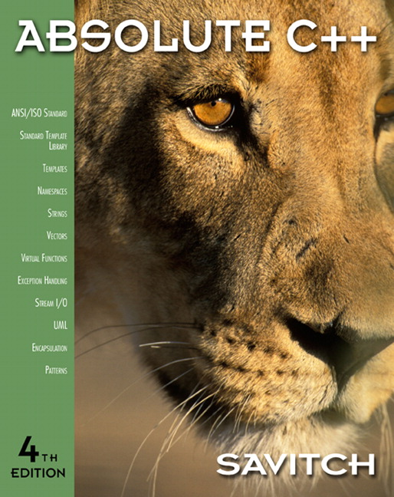

Chapter 4
Parameters
and Overloading
Copyright © 2010 Pearson Addison-Wesley. All rights reserved

Slide 2
Learning Objectives
Parameters
  Call-by-value
  Call-by-reference
  Mixed parameter-lists
Overloading and Default Arguments
  Examples, Rules
Testing and Debugging Functions
  assert Macro
  Stubs, Drivers
Copyright © 2010 Pearson Addison-Wesley. All rights reserved.
4-<number>

Slide 3
Parameters
Two methods of passing arguments
as parameters
Call-by-value
  "copy" of value is passed
Call-by-reference
  "address of" actual argument is passed
Copyright © 2010 Pearson Addison-Wesley. All rights reserved.
4-<number>

Slide 4
Call-by-Value Parameters
Copy of actual argument passed
Considered "local variable" inside function
If modified, only "local copy" changes
  Function has no access to "actual argument"
  from caller
This is the default method
  Used in all examples thus far
Copyright © 2010 Pearson Addison-Wesley. All rights reserved.
4-<number>

Slide 5
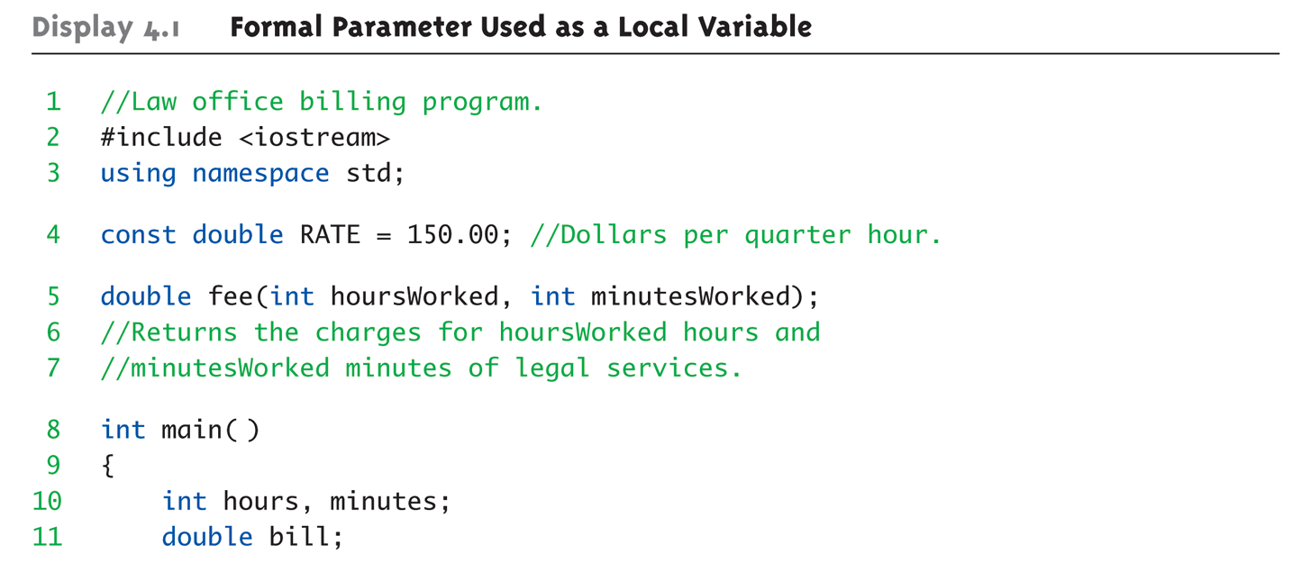
Call-by-Value Example:
Display 4.1 Formal Parameter Used as a Local Variable (1 of 3)
Copyright © 2010 Pearson Addison-Wesley. All rights reserved.
4-<number>

Slide 6
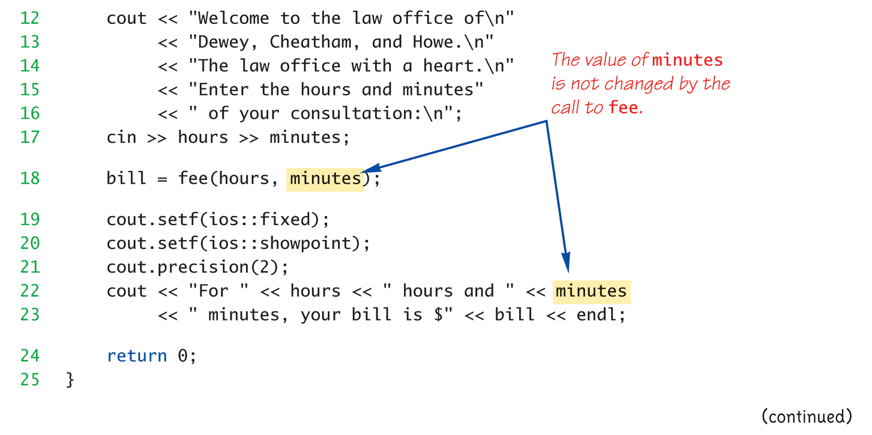
Call-by-Value Example:
Display 4.1 Formal Parameter Used as a Local Variable (2 of 3)
Copyright © 2010 Pearson Addison-Wesley. All rights reserved.
4-<number>

Slide 7
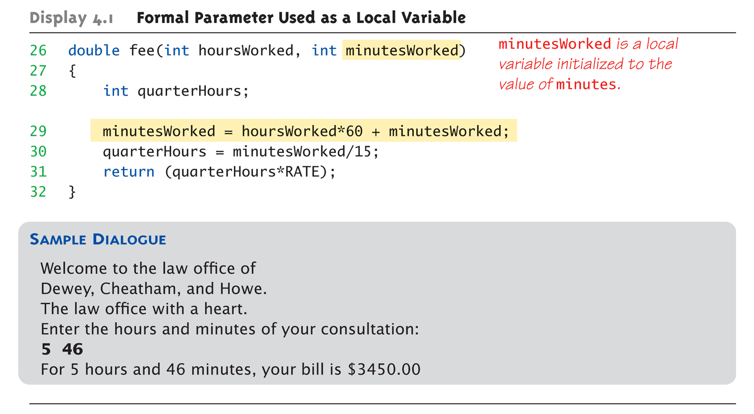
Call-by-Value Example:
Display 4.1 Formal Parameter Used as a Local Variable (3 of 3)
Copyright © 2010 Pearson Addison-Wesley. All rights reserved.
4-<number>

Slide 8
Call-by-Value Pitfall
Common Mistake:
  Declaring parameter "again" inside function:
  double fee(int hoursWorked, int minutesWorked)
  {
  int quarterHours; // local variable
  int minutesWorked // NO!
  }
  Compiler error results
    "Redefinition error…"
Value arguments ARE like "local variables"
  But function gets them "automatically"
Copyright © 2010 Pearson Addison-Wesley. All rights reserved.
4-<number>

Slide 9
Call-By-Reference Parameters
Used to provide access to caller’s
actual argument
Caller’s data can be modified by called function!
Typically used for input function
  To retrieve data for caller
  Data is then "given" to caller
Specified by ampersand, &, after type
in formal parameter list
Copyright © 2010 Pearson Addison-Wesley. All rights reserved.
4-<number>

Slide 10
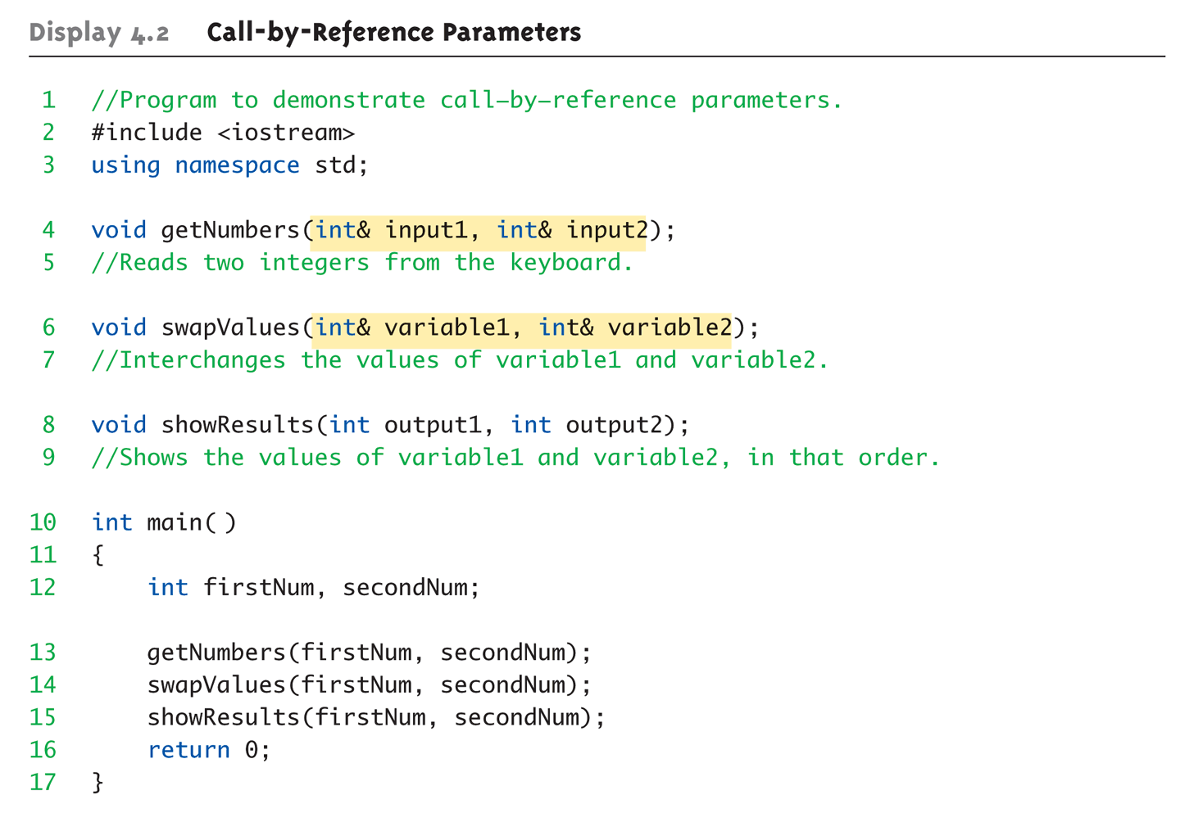
Call-By-Reference Example:
Display 4.1 Call-by-Reference Parameters (1 of 3)
Copyright © 2010 Pearson Addison-Wesley. All rights reserved.
4-<number>

Slide 11
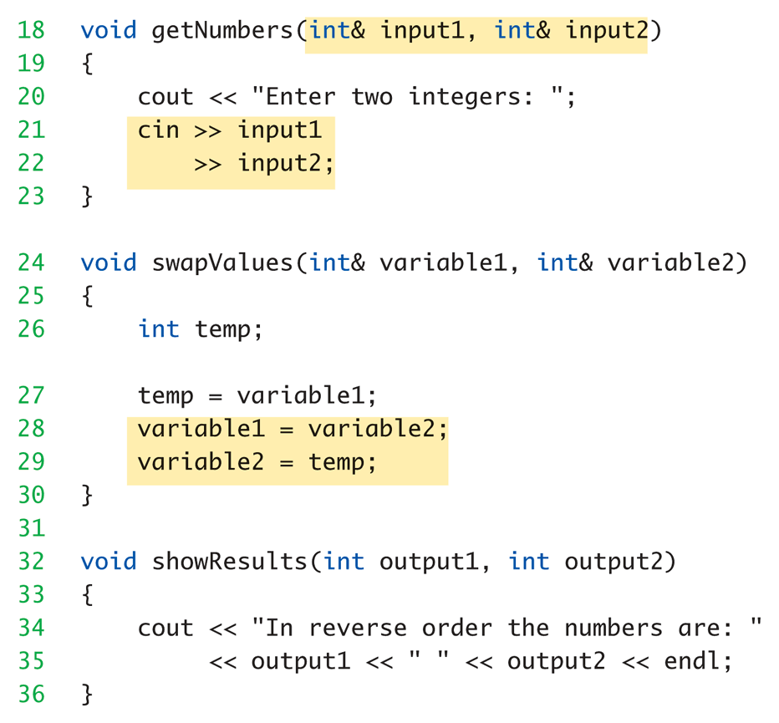
Call-By-Reference Example:
Display 4.1 Call-by-Reference Parameters (2 of 3)
Copyright © 2010 Pearson Addison-Wesley. All rights reserved.
4-<number>

Slide 12
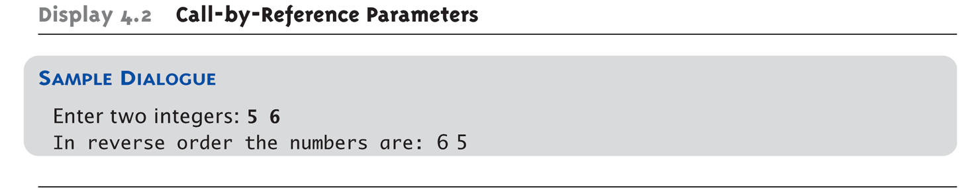
Call-By-Reference Example:
Display 4.1 Call-by-Reference Parameters (3 of 3)
Copyright © 2010 Pearson Addison-Wesley. All rights reserved.
4-<number>

Slide 13
Call-By-Reference Details
What’s really passed in?
A "reference" back to caller’s
actual argument!
  Refers to memory location of
  actual argument
  Called "address", which is a unique number
  referring to distinct place in memory
Copyright © 2010 Pearson Addison-Wesley. All rights reserved.
4-<number>

Slide 14
Constant Reference Parameters
Reference arguments inherently
"dangerous"
  Caller’s data can be changed
  Often this is desired, sometimes not
To "protect" data, & still pass by reference:
  Use const keyword
    void sendConstRef( const int &par1,
    const int &par2);
    Makes arguments "read-only" by function
    No changes allowed inside function body
Copyright © 2010 Pearson Addison-Wesley. All rights reserved.
4-<number>

Slide 15
Parameters and Arguments
Confusing terms, often used interchangeably
True meanings:
  Formal parameters
    In function declaration and function definition
  Arguments
    Used to "fill-in" a formal parameter
    In function call (argument list)
  Call-by-value & Call-by-reference
    Simply the "mechanism" used in plug-in process
Copyright © 2010 Pearson Addison-Wesley. All rights reserved.
4-<number>

Slide 16
Mixed Parameter Lists
Can combine passing mechanisms
Parameter lists can include pass-by-value
and pass-by-reference parameters
Order of arguments in list is critical:
void mixedCall(int & par1, int par2, double & par3);
  Function call:
  mixedCall(arg1, arg2, arg3);
    arg1 must be integer type, is passed by reference
    arg2 must be integer type, is passed by value
    arg3 must be double type, is passed by reference
Copyright © 2010 Pearson Addison-Wesley. All rights reserved.
4-<number>

Slide 17
Choosing Formal Parameter Names
Same rule as naming any identifier:
  Meaningful names!
Functions as "self-contained modules"
  Designed separately from rest of program
  Assigned to teams of programmers
  All must "understand" proper function use
  OK if formal parameter names are same
  as argument names
Choose function names with same rules
Copyright © 2010 Pearson Addison-Wesley. All rights reserved.
4-<number>

Slide 18
실습예제
유사한 값을 찾고 그 차이를 구하는 프로그램을 작성하자
  ClosestPoint라는 프로젝트를 만들고 double pSample[5]={0.3, 0.6, 0.1, 0.4, 0.8}; 를 생성하고, double 값 한 개를 입력받아
  diff = FindClosetPoint(pSample, nSizeOfArray, target, nearest) 라는 함수로 target과 가장 근접한 값 nearest를 찾고 그 차이를 diff에 return한다.
    Nearest는 call-by-reference 이다.
Copyright © 2010 Pearson Addison-Wesley. All rights reserved.
4-<number>

Slide 19
Overloading
Same function name
Different parameter lists
Two separate function definitions
Function "signature"
  Function name & parameter list
  Must be "unique" for each function definition
Allows same task performed on different data
Copyright © 2010 Pearson Addison-Wesley. All rights reserved.
4-<number>

Slide 20
Overloading Example: Average
Function computes average of 2 numbers:
double average(double n1, double n2)
{
return ((n1 + n2) / 2.0);
}
Now compute average of 3 numbers:
double average(double n1, double n2, double n3)
{
return ((n1 + n2+n3) / 3.0);
}
Same name, two functions
Copyright © 2010 Pearson Addison-Wesley. All rights reserved.
4-<number>

Slide 21
Overloaded Average() Cont’d
Which function gets called?
Depends on function call itself:
  avg = average(5.2, 6.7);
    Calls "two-parameter average()"
  avg = average(6.5, 8.5, 4.2);
    Calls "three-parameter average()"
Compiler resolves invocation based on
signature of function call
  "Matches" call with appropriate function
  Each considered separate function
Copyright © 2010 Pearson Addison-Wesley. All rights reserved.
4-<number>

Slide 22
Overloading Pitfall
Only overload "same-task" functions
  A mpg() function should always perform
  same task, in all overloads
  Otherwise, unpredictable results
C++ function call resolution:
  1st: looks for exact signature
  2nd: looks for "compatible" signature
Copyright © 2010 Pearson Addison-Wesley. All rights reserved.
4-<number>

Slide 23
Overloading Resolution
1st: Exact Match
  Looks for exact signature
    Where no argument conversion required
2nd: Compatible Match
  Looks for "compatible" signature where
  automatic type conversion is possible:
    1st with promotion (e.g., int→double)
      No loss of data
    2nd with demotion (e.g., double→int)
      Possible loss of data
Copyright © 2010 Pearson Addison-Wesley. All rights reserved.
4-<number>

Slide 24
Overloading Resolution Example
Given following functions:
  1. void f(int n, double m);
  2. void f(double n, int m);
  3. void f(int n, int m);
  These calls:
  f(98, 99); → Calls #3
  f(5.3, 4); → Calls #2
  f(4.3, 5.2); → Calls ???
Avoid such confusing overloading
Copyright © 2010 Pearson Addison-Wesley. All rights reserved.
4-<number>

Slide 25
Automatic Type Conversion and Overloading
Numeric formal parameters typically
made "double" type
Allows for "any" numeric type
  Any "subordinate" data automatically promoted
    int → double
    float → double
    char → double *More on this later!
Avoids overloading for different numeric types
Copyright © 2010 Pearson Addison-Wesley. All rights reserved.
4-<number>

Slide 26
Automatic Type Conversion and Overloading Example
double mpg(double miles, double gallons)
{
return (miles/gallons);
}
Example function calls:
  mpgComputed = mpg(5, 20);
    Converts 5 & 20 to doubles, then passes
  mpgComputed = mpg(5.8, 20.2);
    No conversion necessary
  mpgComputed = mpg(5, 2.4);
    Converts 5 to 5.0, then passes values to function
Copyright © 2010 Pearson Addison-Wesley. All rights reserved.
4-<number>

Slide 27
Default Arguments
Allows omitting some arguments
Specified in function declaration/prototype
  void showVolume( int length,
  int width = 1,
  int height = 1);
    Last 2 arguments are defaulted
  Possible calls:
    showVolume(2, 4, 6); //All arguments supplied
    showVolume(3, 5); //height defaulted to 1
    showVolume(7); //width & height defaulted to 1
Copyright © 2010 Pearson Addison-Wesley. All rights reserved.
4-<number>

Slide 28
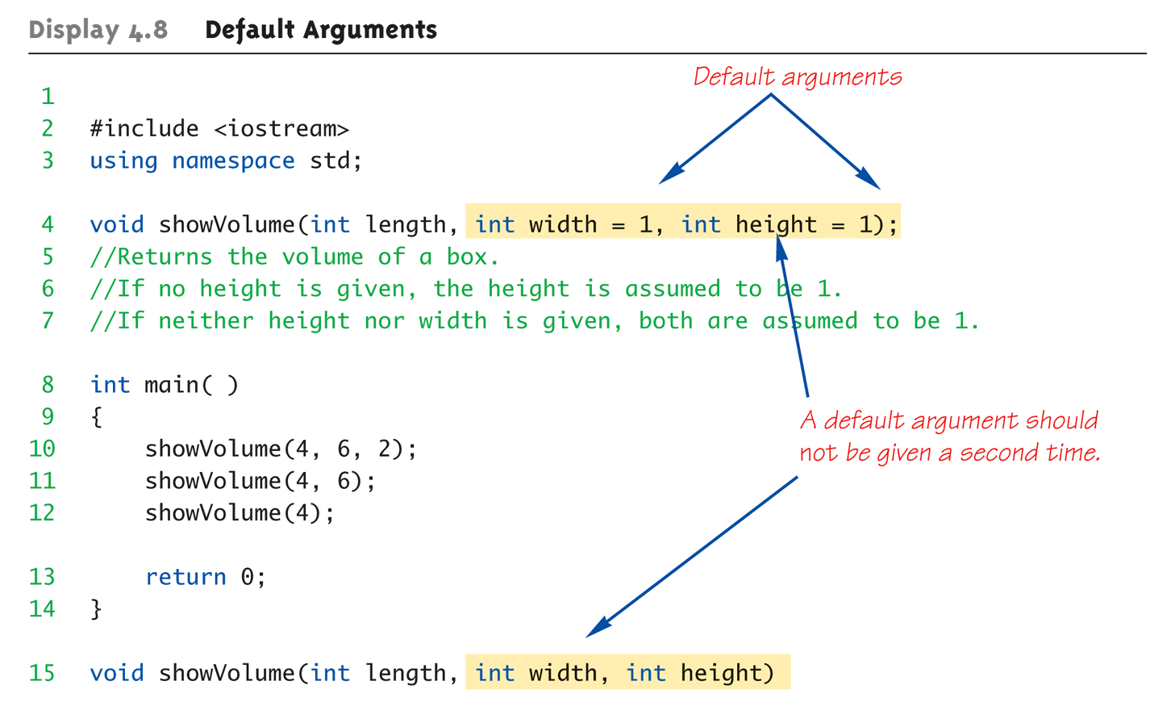
Default Arguments Example:
Display 4.1 Default Arguments (1 of 2)
Copyright © 2010 Pearson Addison-Wesley. All rights reserved.
4-<number>

Slide 29
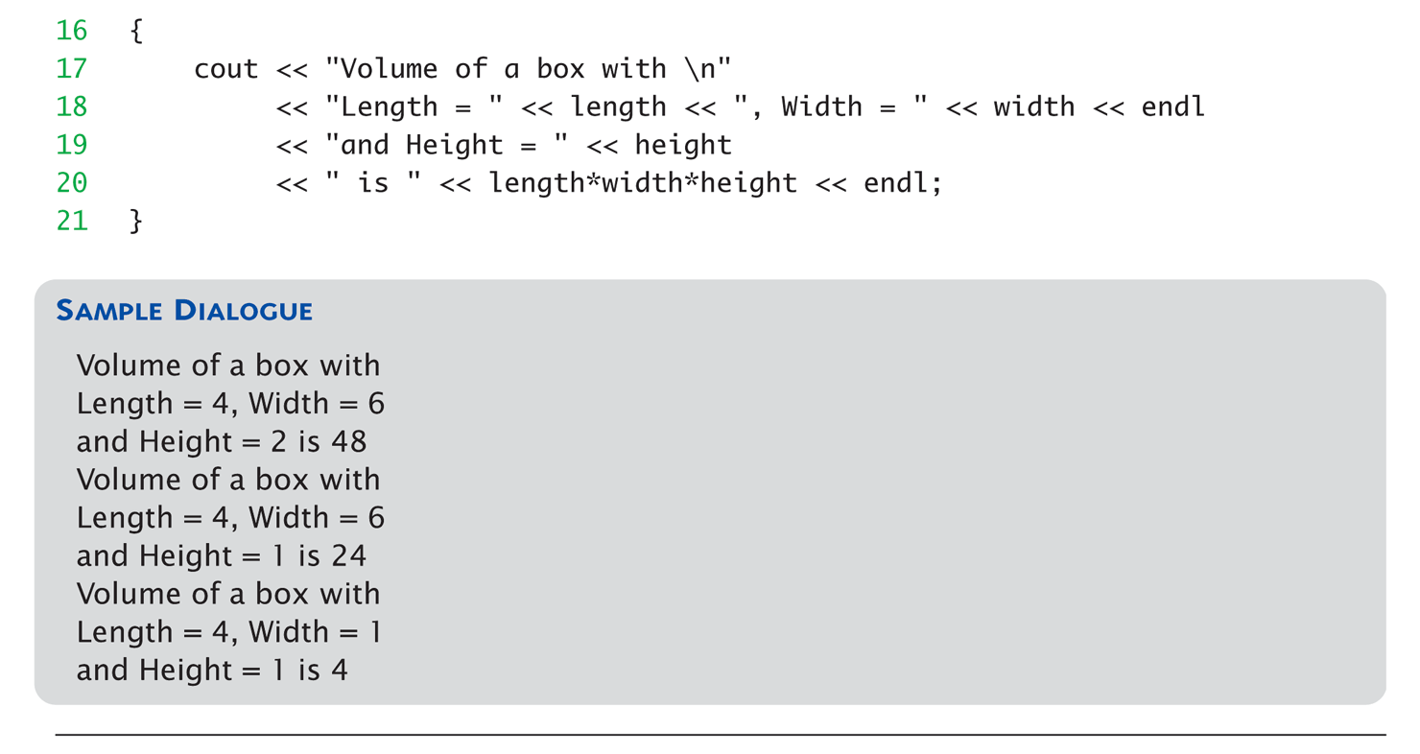
Default Arguments Example:
Display 4.1 Default Arguments (2 of 2)
Copyright © 2010 Pearson Addison-Wesley. All rights reserved.
4-<number>

Slide 30
실습예제
앞서 만든 프로젝트 ClosestPoint 에 int FindClosestPoint(int *pSample, int nSizeOfArray, int target, int &nearest) 를 구현한다.
  물론 main 함수에 int pSampleInt[5] = {3,6,1,4,8}; 을 넣고 다른 int 변수들도 넣어야죠.
  위 함수에 마지막에 default bool 변수 bAbsDiff 를 true로 놓고, 함수안에서 참일때는 절대값의 차이 거짓일때는 최소 차이의 큰 값만을 구하게 한다. 단순하게 int 에서만 해보자
Copyright © 2010 Pearson Addison-Wesley. All rights reserved.
4-<number>

Slide 31
Testing and Debugging Functions
Many methods:
  Lots of cout statements
    In calls and definitions
    Used to "trace" execution
  Compiler Debugger
    Environment-dependent
  assert Macro
    Early termination as needed
  Stubs and drivers
    Incremental development
Copyright © 2010 Pearson Addison-Wesley. All rights reserved.
4-<number>

Slide 32
The assert Macro
Assertion: a true or false statement
Used to document and check correctness
  Preconditions & Postconditions
    Typical assert use: confirm their validity
  Syntax:
  assert(<assert_condition>);
    No return value
    Evaluates assert_condition
    Terminates if false, continues if true
Predefined in library <cassert>
  Macros used similarly as functions
Copyright © 2010 Pearson Addison-Wesley. All rights reserved.
4-<number>

Slide 33
An assert Macro Example
Given Function Declaration:
void computeCoin( int coinValue,
int& number,
int& amountLeft);
//Precondition: 0 < coinValue < 100
0 <= amountLeft <100
//Postcondition: number set to max. number
of coins
Check precondition:
  assert ((0 < currentCoin) && (currentCoin < 100)
  && (0 <= currentAmountLeft) && (currentAmountLeft < 100));
  If precondition not satisfied → condition is false → program execution terminates!
Copyright © 2010 Pearson Addison-Wesley. All rights reserved.
4-<number>

Slide 34
An assert Macro Example Cont’d
Useful in debugging
Stops execution so problem can
be investigated
Copyright © 2010 Pearson Addison-Wesley. All rights reserved.
4-<number>

Slide 35
assert On/Off
Preprocessor provides means
#define NDEBUG
#include <cassert>
Add "#define" line before #include line
  Turns OFF all assertions throughout
  program
Remove "#define" line (or comment out)
  Turns assertions back on
Copyright © 2010 Pearson Addison-Wesley. All rights reserved.
4-<number>

Slide 36
Stubs and Drivers
Separate compilation units
  Each function designed, coded, tested
  separately
  Ensures validity of each unit
  Divide & Conquer
    Transforms one big task → smaller,
    manageable tasks
But how to test independently?
  Driver programs
Copyright © 2010 Pearson Addison-Wesley. All rights reserved.
4-<number>

Slide 37
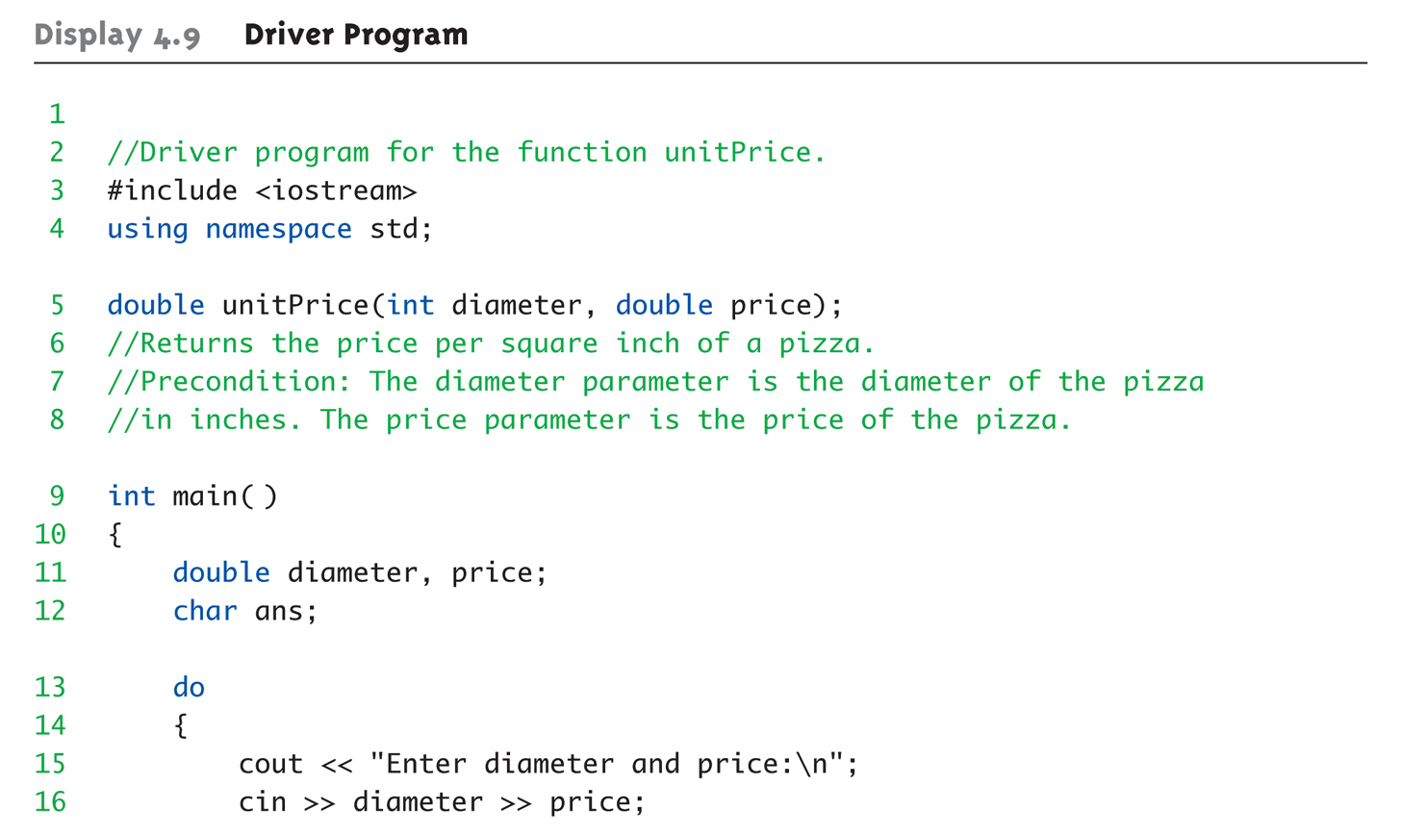
Driver Program Example:
Display 4.9 Driver Program (1 of 3)
Copyright © 2010 Pearson Addison-Wesley. All rights reserved.
4-<number>

Slide 38
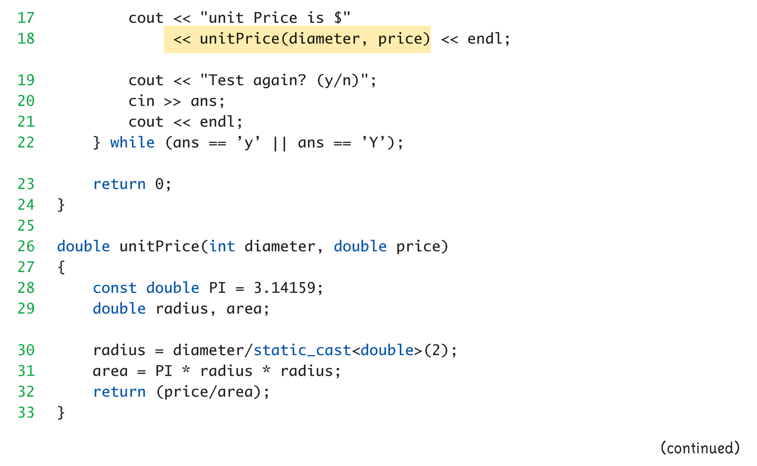
Driver Program Example:
Display 4.9 Driver Program (2 of 3)
Copyright © 2010 Pearson Addison-Wesley. All rights reserved.
4-<number>

Slide 39
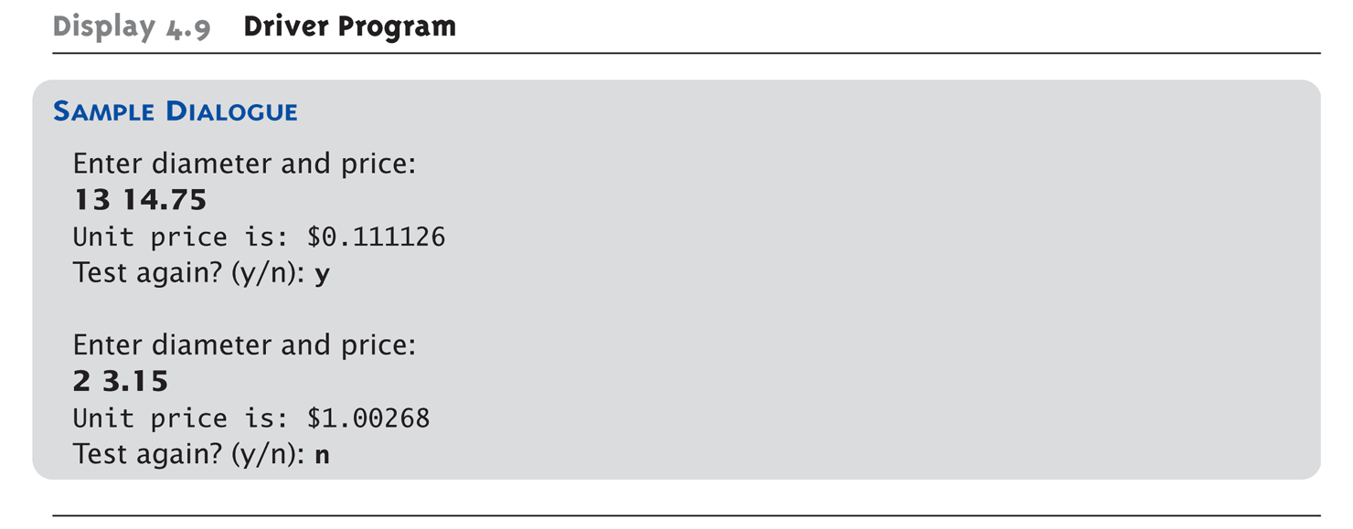
Driver Program Example:
Display 4.9 Driver Program (3 of 3)
Copyright © 2010 Pearson Addison-Wesley. All rights reserved.
4-<number>

Slide 40
Stubs
Develop incrementally
Write "big-picture" functions first
  Low-level functions last
  "Stub-out" functions until implementation
  Example:
  double unitPrice(int diameter, double price)
  {
  return (9.99); // not valid, but noticeably
  // a "temporary" value
  }
  Calls to function will still "work"
Copyright © 2010 Pearson Addison-Wesley. All rights reserved.
4-<number>

Slide 41
Fundamental Testing Rule
To write "correct" programs
Minimize errors, "bugs"
Ensure validity of data
  Test every function in a program where every other function has already been
  fully tested and debugged
  Avoids "error-cascading" &
  conflicting results
Copyright © 2010 Pearson Addison-Wesley. All rights reserved.
4-<number>

Slide 42
Summary 1
Formal parameter is placeholder, filled in with actual argument in function call
Call-by-value parameters are "local copies" in receiving function body
  Actual argument cannot be modified
Call-by-reference passes memory address of actual argument
  Actual argument can be modified
  Argument MUST be variable, not constant
Copyright © 2010 Pearson Addison-Wesley. All rights reserved.
4-<number>

Slide 43
Summary 2
Multiple definitions of same function name
possible: called overloading
Default arguments allow function call to
"omit" some or all arguments in list
  If not provided → default values assigned
assert macro initiates program
termination if assertions fail
Functions should be tested independently
  As separate compilation units, with drivers
Copyright © 2010 Pearson Addison-Wesley. All rights reserved.
4-<number>

