Slide 1
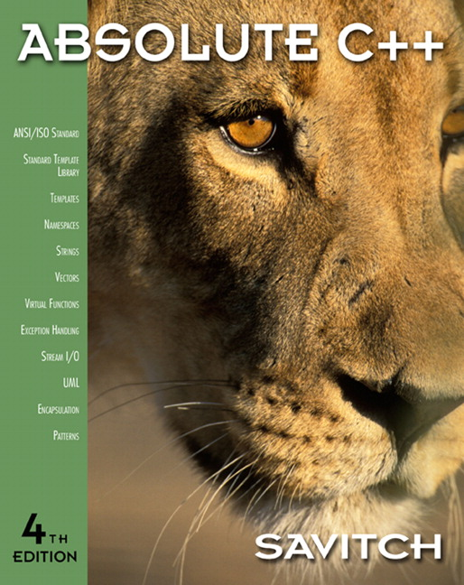

Chapter 9
Strings
Copyright © 2010 Pearson Addison-Wesley. All rights reserved

Slide 2
Learning Objectives
An Array Type for Strings
  C-Strings
Character Manipulation Tools
  Character I/O
  get, put member functions
  putback, peek, ignore
Standard Class string
  String processing
Copyright © 2010 Pearson Addison-Wesley. All rights reserved.
9-<number>

Slide 3
Introduction
Two string types:
C-strings
  Array with base type char
  End of string marked with null, ‘\0’
  "Older" method inherited from C
String class
  Uses templates
Copyright © 2010 Pearson Addison-Wesley. All rights reserved.
9-<number>

Slide 4
C-Strings
Array with base type char
  One character per indexed variable
  One extra character: ‘\0’
    Called "null character"
    End marker
We’ve used c-strings
  Literal "Hello" stored as c-string
Copyright © 2010 Pearson Addison-Wesley. All rights reserved.
9-<number>

Slide 5
C-String Variable
Array of characters:
char s[10];
  Declares a c-string variable to hold up to
  9 characters
  + one null character
Typically "partially-filled" array
  Declare large enough to hold max-size string
  Indicate end with null
Only difference from standard array:
  Must contain null character
Copyright © 2010 Pearson Addison-Wesley. All rights reserved.
9-<number>

Slide 6
C-String Storage
A standard array:
char s[10];
  If s contains string "Hi Mom", stored as:
Copyright © 2010 Pearson Addison-Wesley. All rights reserved.
9-<number>

Slide 7
C-String Initialization
Can initialize c-string:
char myMessage[20] = "Hi there.";
  Needn’t fill entire array
  Initialization places ‘\0’ at end
Can omit array-size:
char shortString[] = "abc";
  Automatically makes size one more than
  length of quoted string
  NOT same as:
  char shortString[] = {‘a’, ‘b’, ‘c’};
Copyright © 2010 Pearson Addison-Wesley. All rights reserved.
9-<number>

Slide 8
C-String Indexes
A c-string IS an array
Can access indexed variables of:
char ourString[5] = "Hi";
  ourString[0] is ‘H’
  ourString[1] is ‘I’
  ourString[2] is ‘\0’
  ourString[3] is unknown
  ourString[4] is unknown
Copyright © 2010 Pearson Addison-Wesley. All rights reserved.
9-<number>

Slide 9
C-String Index Manipulation
Can manipulate indexed variables
char happyString[7] = "DoBeDo";
happyString[6] = ‘Z’;
  Be careful!
  Here, ‘\0’ (null) was overwritten by a ‘Z’!
If null overwritten, c-string no longer "acts" like c-string!
  Unpredictable results!
Copyright © 2010 Pearson Addison-Wesley. All rights reserved.
9-<number>

Slide 10
Library
Declaring c-strings
  Requires no C++ library
  Built into standard C++
Manipulations
  Require library <cstring>
  Typically included when using c-strings
    Normally want to do "fun" things with them
Copyright © 2010 Pearson Addison-Wesley. All rights reserved.
9-<number>

Slide 11
= and == with C-strings
C-strings not like other variables
  Cannot assign or compare:
  char aString[10];
  aString = "Hello"; // ILLEGAL!
    Can ONLY use "=" at declaration of c-string!
Must use library function for assignment:
strcpy(aString, "Hello");
  Built-in function (in <cstring>)
  Sets value of aString equal to "Hello"
  NO checks for size!
    Up to programmer, just like other arrays!
Copyright © 2010 Pearson Addison-Wesley. All rights reserved.
9-<number>

Slide 12
Comparing C-strings
Also cannot use operator ==
char aString[10] = "Hello";
char anotherString[10] = "Goodbye";
  aString == anotherString; // NOT allowed!
Must use library function again:
if (strcmp(aString, anotherString))
cout << "Strings NOT same.";
else
cout << "Strings are same.";
Copyright © 2010 Pearson Addison-Wesley. All rights reserved.
9-<number>

Slide 13
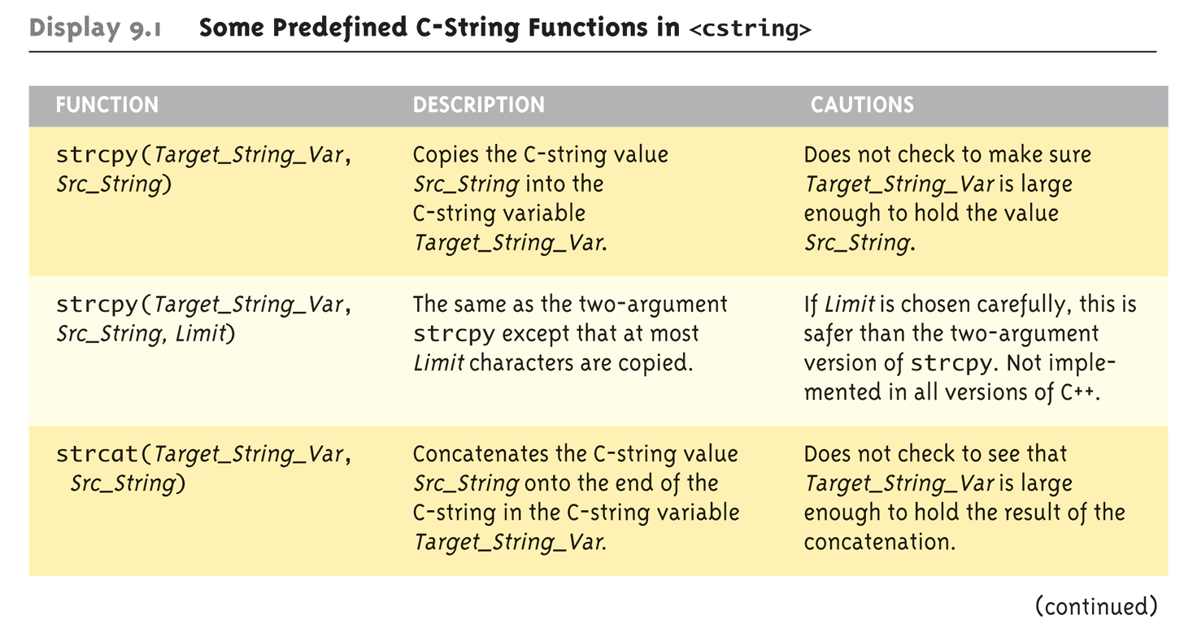
The <cstring> Library:
Display 9.1 Some Predefined C-String Functions in <cstring> (1 of 2)
Full of string manipulation functions
Copyright © 2010 Pearson Addison-Wesley. All rights reserved.
9-<number>

Slide 14
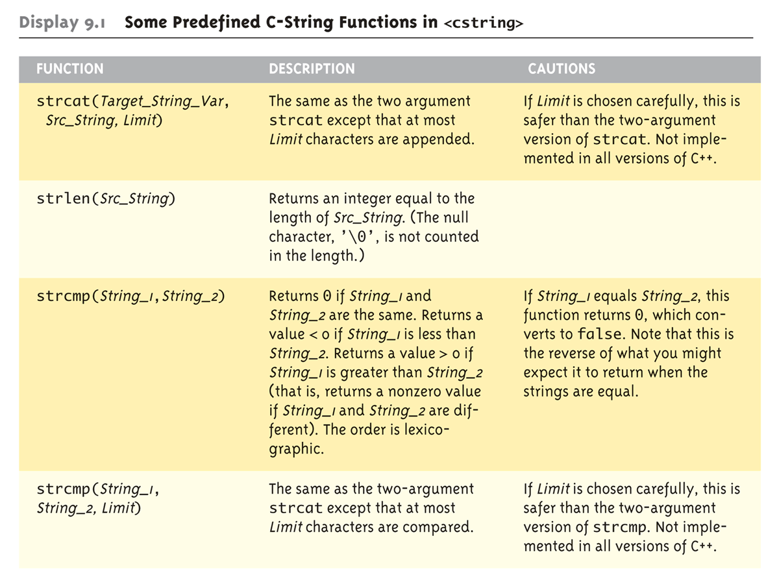
The <cstring> Library:
Display 9.1 Some Predefined C-String Functions in <cstring> (2 of 2)
Copyright © 2010 Pearson Addison-Wesley. All rights reserved.
9-<number>

Slide 15
C-string Functions: strlen()
"String length"
Often useful to know string length:
char myString[10] = "dobedo";
cout << strlen(myString);
  Returns number of characters
    Not including null
  Result here:
  6
Copyright © 2010 Pearson Addison-Wesley. All rights reserved.
9-<number>

Slide 16
C-string Functions: strcat()
strcat()
"String concatenate":
char stringVar[20] = "The rain";
strcat(stringVar, "in Spain");
  Note result:
  stringVar now contains "The rainin Spain"
  Be careful!
  Incorporate spaces as needed!
Copyright © 2010 Pearson Addison-Wesley. All rights reserved.
9-<number>

Slide 17
C-string Arguments and Parameters
Recall: c-string is array
So c-string parameter is array parameter
  C-strings passed to functions can be changed
  by receiving function!
Like all arrays, typical to send size as well
  Function "could" also use "\0" to find end
  So size not necessary if function won’t change
  c-string parameter
  Use "const" modifier to protect c-string arguments
Copyright © 2010 Pearson Addison-Wesley. All rights reserved.
9-<number>

Slide 18
C-String Output
Can output with insertion operator, <<
As we’ve been doing already:
cout << news << " Wow.\n";
  Where news is a c-string variable
Possible because << operator is
overloaded for c-strings!
Copyright © 2010 Pearson Addison-Wesley. All rights reserved.
9-<number>

Slide 19
C-String Input
Can input with extraction operator, >>
  Issues exist, however
Whitespace is "delimiter"
  Tab, space, line breaks are "skipped"
  Input reading "stops" at delimiter
Watch size of c-string
    Must be large enough to hold entered string!
    C++ gives no warnings of such issues!
Copyright © 2010 Pearson Addison-Wesley. All rights reserved.
9-<number>

Slide 20
C-String Input Example
char a[80], b[80];
cout << "Enter input: ";
cin >> a >> b;
cout << a << b << "END OF OUTPUT\n";
Dialogue offered:
Enter input: Do be do to you!
DobeEND OF OUTPUT
  Note: Underlined portion typed at keyboard
C-string a receives: "do"
C-string b receives: "be"
Copyright © 2010 Pearson Addison-Wesley. All rights reserved.
9-<number>

Slide 21
C-String Line Input
Can receive entire line into c-string
Use getline(), a predefined member function:
char a[80];
cout << "Enter input: ";
cin.getline(a, 80);
cout << a << "END OF OUTPUT\n";
  Dialogue:
  Enter input: Do be do to you!
  Do be do to you!END OF INPUT
Copyright © 2010 Pearson Addison-Wesley. All rights reserved.
9-<number>

Slide 22
Example: Command Line Arguments
Programs invoked from the command line (e.g. a UNIX shell, DOS command prompt) can be sent arguments
  Example: COPY C:\FOO.TXT D:\FOO2.TXT
    This runs the program named “COPY” and sends in two C-String parameters, “C:\FOO.TXT” and “D:\FOO2.TXT”
    It is up to the COPY program to process the inputs presented to it; i.e. actually copy the files
Arguments are passed as an array of C-Strings to the main function
Copyright © 2010 Pearson Addison-Wesley. All rights reserved.
9-<number>

Slide 23
Example: Command Line Arguments
Header for main
  int main(int argc, char *argv[])
  argc specifies how many arguments are supplied. The name of the program counts, so argc will be at least 1.
  argv is an array of C-Strings.
    argv[0] holds the name of the program that is invoked
    argv[1] holds the name of the first parameter
    argv[2] holds the name of the second parameter
    Etc.
Copyright © 2010 Pearson Addison-Wesley. All rights reserved.
9-<number>

Slide 24
Example: Command Line Arguments
// Echo back the input arguments
int main(int argc, char *argv[])
{
for (int i=0; i<argc; i++)
{
cout << "Argument " << i << " " << argv[i] << endl;
}
return 0;
}
Sample Execution
> Test hello world
Argument 0 Test
Argument 1 hello
Argument 2 world
Sample Execution
> Test
Argument 0 Test
Invoking Test
from command
prompt
Copyright © 2010 Pearson Addison-Wesley. All rights reserved.
9-<number>

Slide 25
More getline()
Can explicitly tell length to receive:
char shortString[5];
cout << "Enter input: ";
cin.getline(shortString, 5);
cout << shortString << "END OF OUTPUT\n";
  Results:
  Enter input: dobedowap
  dobeEND OF OUTPUT
  Forces FOUR characters only be read
    Recall need for null character!
Copyright © 2010 Pearson Addison-Wesley. All rights reserved.
9-<number>

Slide 26
Character I/O
Input and output data
  ALL treated as character data
  e.g., number 10 outputted as "1" and "0"
  Conversion done automatically
    Uses low-level utilities
Can use same low-level utilities ourselves as well
Copyright © 2010 Pearson Addison-Wesley. All rights reserved.
9-<number>

Slide 27
Member Function get()
Reads one char at a time
Member function of cin object:
char nextSymbol;
cin.get(nextSymbol);
  Reads next char & puts in variable
  nextSymbol
  Argument must be char type
    Not "string"!
Copyright © 2010 Pearson Addison-Wesley. All rights reserved.
9-<number>

Slide 28
Member Function put()
Outputs one character at a time
Member function of cout object:
Examples:
cout.put(‘a’);
  Outputs letter "a" to screen
char myString[10] = "Hello";
cout.put(myString[1]);
  Outputs letter ‘e’ to screen
Copyright © 2010 Pearson Addison-Wesley. All rights reserved.
9-<number>

Slide 29
More Member Functions
putback()
  Once read, might need to "put back"
  cin.putback(lastChar);
peek()
  Returns next char, but leaves it there
  peekChar = cin.peek();
ignore()
  Skip input, up to designated character
  cin.ignore(1000, ‘\n’);
    Skips at most 1000 characters until ‘\n’
Copyright © 2010 Pearson Addison-Wesley. All rights reserved.
9-<number>

Slide 30
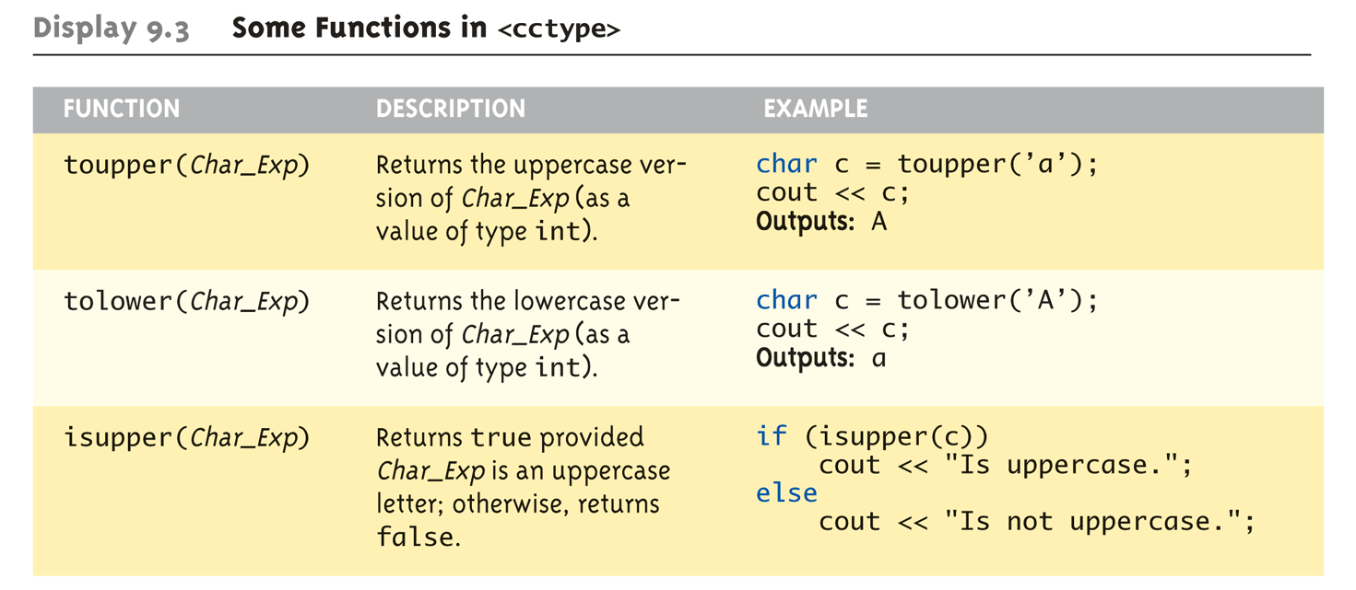
Character-Manipulating Functions:
Display 9.3 Some Functions in <cctype> (1 of 3)
Copyright © 2010 Pearson Addison-Wesley. All rights reserved.
9-<number>

Slide 31
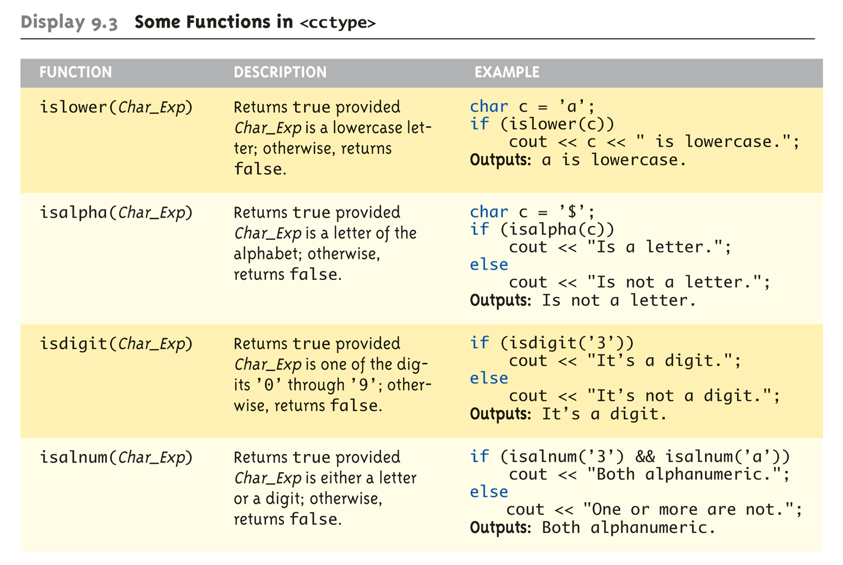
Character-Manipulating Functions:
Display 9.3 Some Functions in <cctype> (2 of 3)
Copyright © 2010 Pearson Addison-Wesley. All rights reserved.
9-<number>

Slide 32
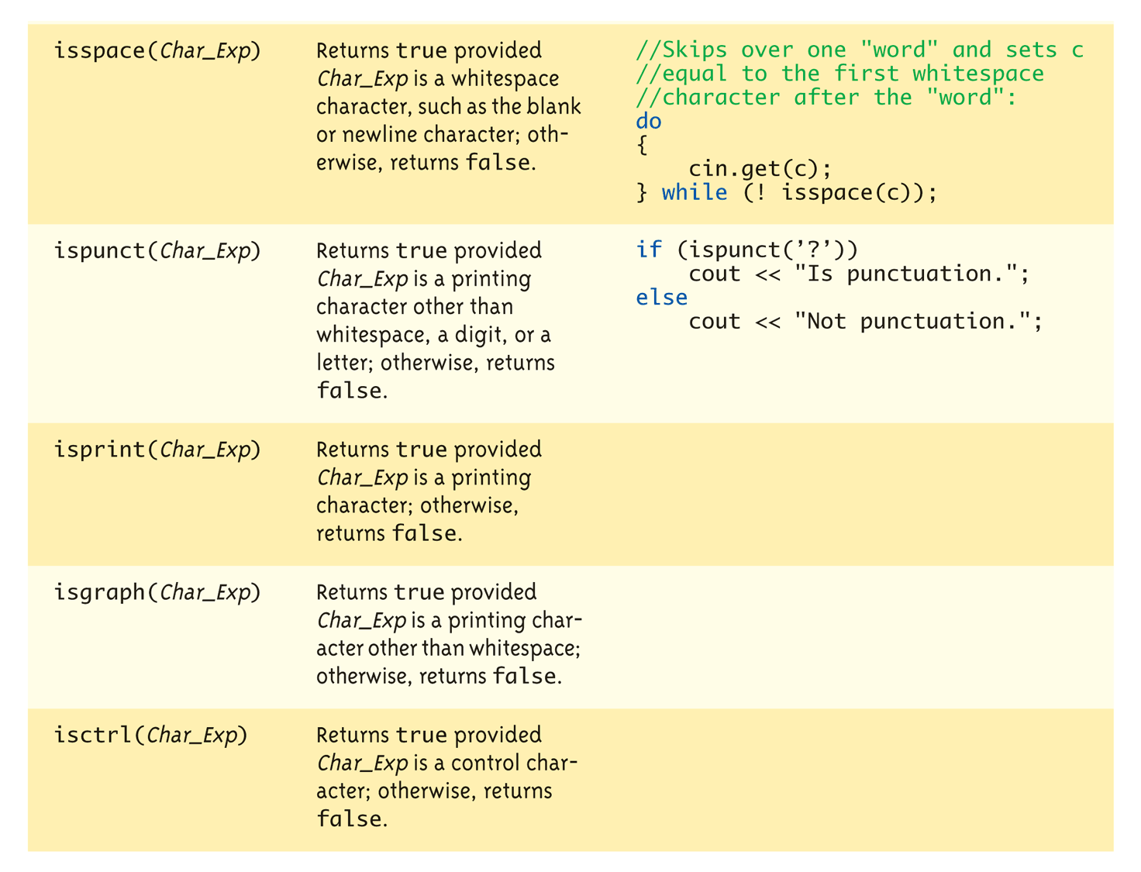
Character-Manipulating Functions:
Display 9.3 Some Functions in <cctype> (3 of 3)
Copyright © 2010 Pearson Addison-Wesley. All rights reserved.
9-<number>

Slide 33
실습예제
Chap 9 프로젝트를 만든다
String 기본 함수를 사용하기 위해서 #include <cstring>
char chString1[30]="Hello", chString2[30];
strcpy 이용하여 chString2에 "Kim" 넣기
두 개를 strcmp로 비교하고 출력
cin을 이용하여 chString2에 다른 이름 받기
strcat를 이용하여 chString1에 두 개를 합치고 출력
cin.getline 을 이용하여 문장을 받고 출력하기
  혹시 앞서 cin을 한번 수행했으면 ignore(30,'\n')
Copyright © 2010 Pearson Addison-Wesley. All rights reserved.
9-<number>

Slide 34
Standard Class string
Defined in library:
#include <string>
using namespace std;
String variables and expressions
  Treated much like simple types
Can assign, compare, add:
string s1, s2, s3;
s3 = s1 + s2; //Concatenation
s3 = "Hello Mom!" //Assignment
  Note c-string "Hello Mom!" automatically
  converted to string type!
Copyright © 2010 Pearson Addison-Wesley. All rights reserved.
9-<number>

Slide 35
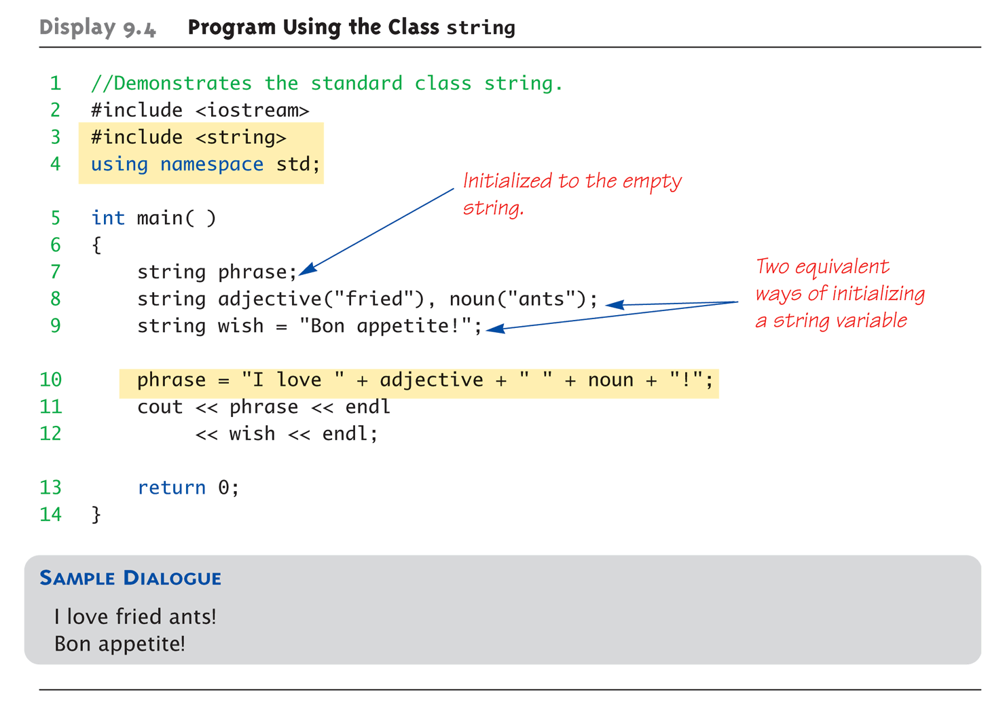
Display 9.4
Program Using the Class string
Copyright © 2010 Pearson Addison-Wesley. All rights reserved.
9-<number>

Slide 36
I/O with Class string
Just like other types!
string s1, s2;
cin >> s1;
cin >> s2;
Results:
User types in:
May the hair on your toes grow long and curly!
Extraction still ignores whitespace:
s1 receives value "May"
s2 receives value "the"
Copyright © 2010 Pearson Addison-Wesley. All rights reserved.
9-<number>

Slide 37
getline() with Class string
For complete lines:
string line;
cout << "Enter a line of input: ";
getline(cin, line);
cout << line << "END OF OUTPUT";
Dialogue produced:
Enter a line of input: Do be do to you!
Do be do to you!END OF INPUT
  Similar to c-string’s usage of getline()
Copyright © 2010 Pearson Addison-Wesley. All rights reserved.
9-<number>

Slide 38
Other getline() Versions
Can specify "delimiter" character:
string line;
cout << "Enter input: ";
getline(cin, line, ‘?’);
  Receives input until "?" encountered
getline() actually returns reference
  string s1, s2;
  getline(cin, s1) >> s2;
  Results in: (cin) >> s2;
Copyright © 2010 Pearson Addison-Wesley. All rights reserved.
9-<number>

Slide 39
Pitfall: Mixing Input Methods
Be careful mixing cin >> var and getline
  int n;
  string line;
  cin >> n;
  getline(cin, line);
  If input is: 42
  Hello hitchhiker.
    Variable n set to 42
    line set to empty string!
  cin >> n skipped leading whitespace, leaving
  "\n" on stream for getline()!
Copyright © 2010 Pearson Addison-Wesley. All rights reserved.
9-<number>

Slide 40
Class string Processing
Same operations available as c-strings
And more!
  Over 100 members of standard string class
Some member functions:
  .length()
    Returns length of string variable
  .at(i)
    Returns reference to char at position i
Copyright © 2010 Pearson Addison-Wesley. All rights reserved.
9-<number>

Slide 41
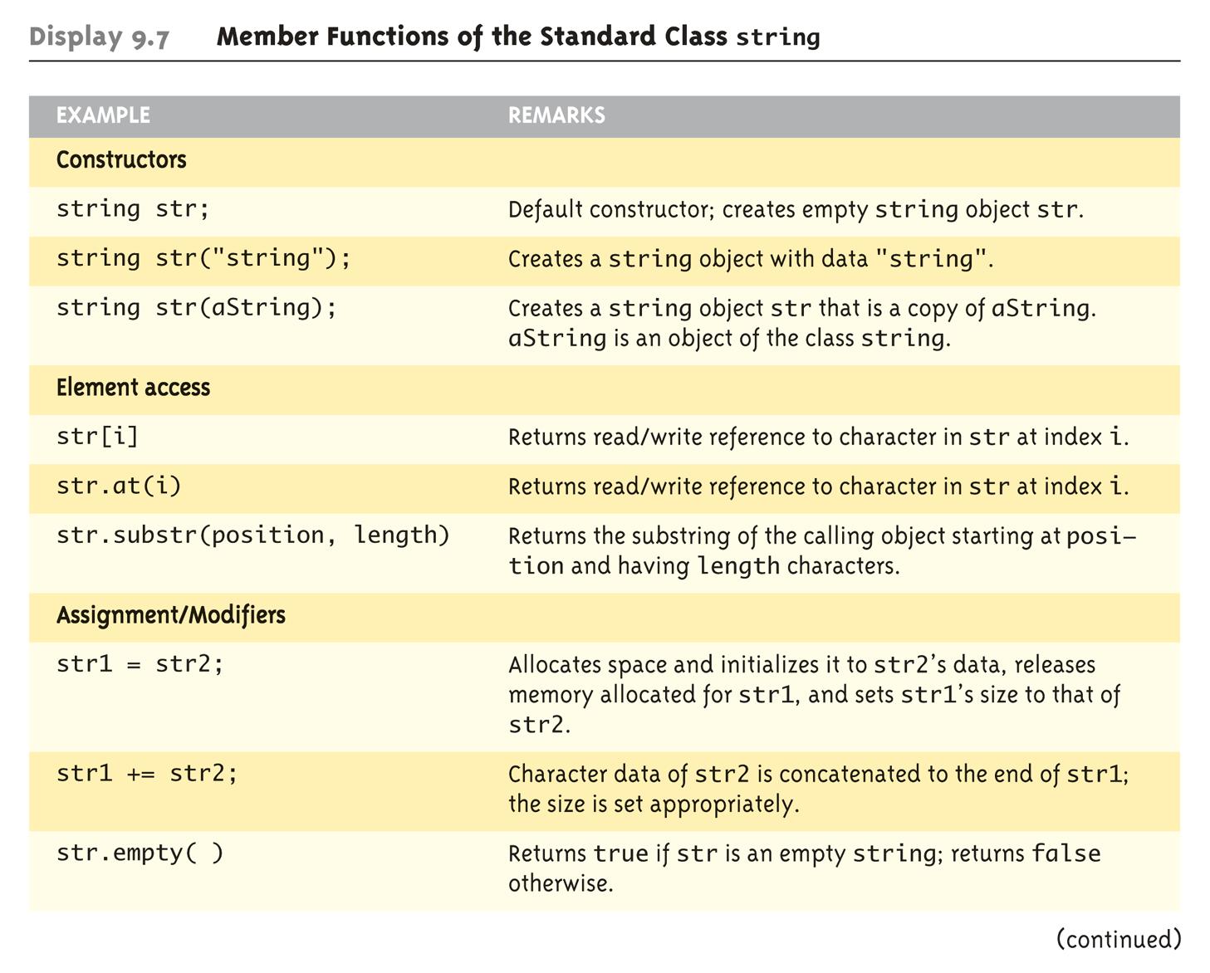
Display 9.7 Member Functions of the Standard Class string (1 of 2)
Copyright © 2010 Pearson Addison-Wesley. All rights reserved.
9-<number>

Slide 42
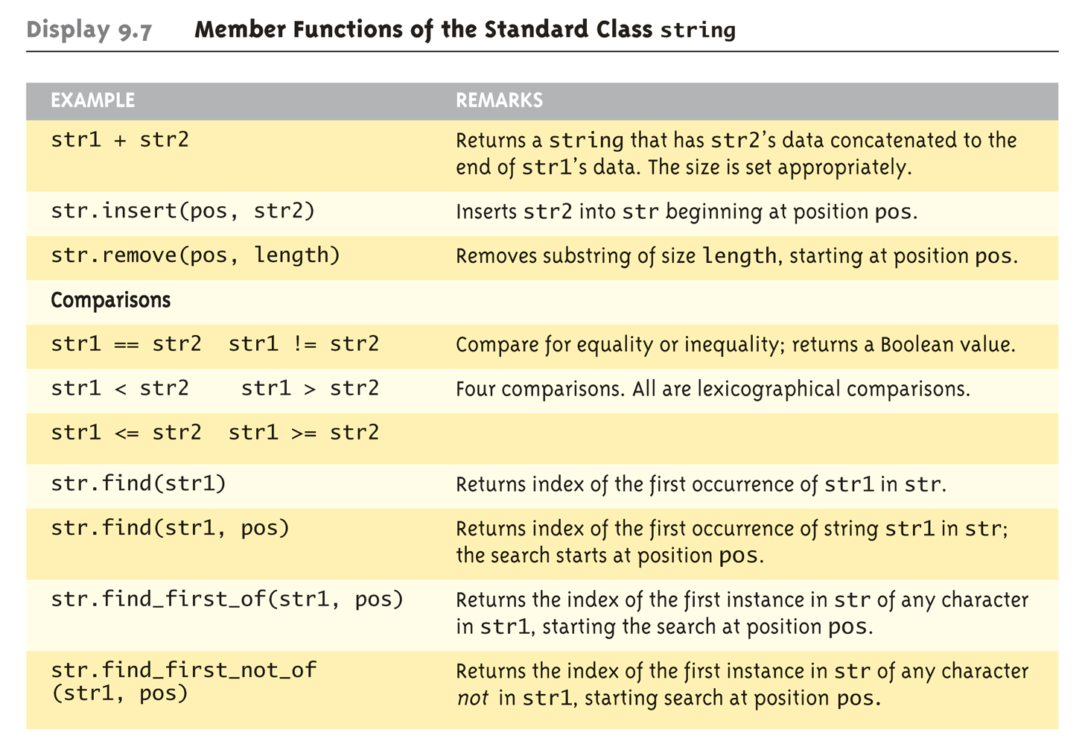
Display 9.7 Member Functions of the Standard Class string (2 of 2)
Copyright © 2010 Pearson Addison-Wesley. All rights reserved.
9-<number>

Slide 43
C-string and string
Object Conversions
Automatic type conversions
  From c-string to string object:
  char aCString[] = "My C-string";
  string stringVar;
  stringVar = aCstring;
    Perfectly legal and appropriate!
  aCString = stringVar;
    ILLEGAL!
    Cannot auto-convert to c-string
  Must use explicit conversion:
  strcpy(aCString, stringVar.c_str());
Copyright © 2010 Pearson Addison-Wesley. All rights reserved.
9-<number>

Slide 44
실습예제
앞서 수행한 프로젝트에 #include <string>
string stEx; 변수를 만들고
strEx ="How are you? " 입력하고 출력
find를 사용해서 strEx 에서 "are"를 찾아보기
strEx 를 chString1에 strcpy를 이용해서 복사
  strEx.c_str() 사용해야 함.
Copyright © 2010 Pearson Addison-Wesley. All rights reserved.
9-<number>

Slide 45
Summary
C-string variable is "array of characters"
  With addition of null character, "\0"
C-strings act like arrays
  Cannot assign, compare like simple variables
Libraries <cctype> & <string> have useful manipulating functions
cin.get() reads next single character
getline() versions allow full line reading
Class string objects are better-behaved than c-strings
Copyright © 2010 Pearson Addison-Wesley. All rights reserved.
9-<number>

