Slide 1
Opencv Introduction
Dongsung Kim

Slide 2
Opencv installation
Google 에서 opencv 검색
Opencv.org 에서
Download 에서 OS 선택(2018년11월현재: 4.0)
Visual studio 2017인 경우 vc15
C: 드라이브에 설치
프로그램 exe 실행하면서 디렉토리 선택
C:\ 로 선택하는 것이 일반적
C 아래에 opencv directory생성
컴퓨터 변수설정
컴퓨터속성->고급시스템설정->환경변수
사용자 변수에서 새로 추가
OPENCV_DIR 변수를 C:\opencv\build\x64\vc15 로 설정
64bit os, vc15는 visual studio 2017
시스템 변수에서 PATH 선택하고 편집
새로 만들기 눌러서 %OPENCV_DIR%\bin 추가후 확인

Slide 3
Visual studio 환경변수 설정
VS 2017 기준
vs project를 한 개 생성
Win32 project 를 새로 만들고 설정은 그냥 default로 함.
프로젝트에서 debug 탭 옆의 x64 탭으로 선택됐는지 확인
Solution 탐색기를 연다
보기->solution 탐색기 선택
우측버튼으로 속성
vc++ 디렉토리에서 포함디렉토리 선택
$(OPENCV_DIR)\..\..\include 넣음
링커에서
일반->추가라이브러리 에서 $(OPENCV_DIR)\lib
입력->추가 종속성에서
opencv_world400d.lib (디버그모드)
opencv_world400.lib (릴리즈모드)

Slide 4
영상 읽기 Project
ImageManipulator 프로젝트 생성
Visual studio 환경변수 설정(앞쪽)
main 함수에서
include 파일들 추가
using namespace cv;
영상읽고 화면에 보이기 실행
예제코드는 다음쪽에

Slide 5
예제코드
#include <opencv2/core.hpp>
#include <opencv2/imgcodecs.hpp>
#include <opencv2/highgui.hpp>
#include <iostream>
#include <string>
using namespace cv;
using namespace std;
int main(int argc, char** argv)
{
Mat image;
image = imread(“ImageEx.jpg”, IMREAD_COLOR); // Read the file
if (image.empty()) // Check for invalid input
{
cout << "Could not open or find the image" <<endl;
return -1;
}
namedWindow("Display window", WINDOW_AUTOSIZE); // Create a window for display.
imshow("Display window", image); // Show our image inside it.
waitKey(0); // Wait for a keystroke in the window
return 0;
}

Slide 6
예제코드 설명
imread 함수
Mat imread(const String& filename, int flags=IMREAD_COLOR )
parameters
filename – Name of file to be loaded.
flags –Flags specifying the color type of a loaded image:
CV_LOAD_IMAGE_ANYDEPTH - If set, return 16-bit/32-bit image when the input has the corresponding depth, otherwise convert it to 8-bit.
CV_LOAD_IMAGE_COLOR - If set, always convert image to the color one
CV_LOAD_IMAGE_GRAYSCALE - If set, always convert image to the grayscale one

Slide 7
예제코드 설명(2)
namedWindow 함수
void namedWindow(const String& winname, int flags=WINDOW_AUTOSIZE )
parameters
name – Name of the window in the window caption that may be used as a window identifier.
flags –Flags of the window. The supported flags are:
WINDOW_NORMAL If this is set, the user can resize the window (no constraint).
WINDOW_AUTOSIZE If this is set, the window size is automatically adjusted to fit the displayed image (see imshow() ), and you cannot change the window size manually.
WINDOW_OPENGL If this is set, the window will be created with OpenGL support.

Slide 8
예제코드 설명(3)
imshow 함수
void imshow(const String& winname, InputArray mat)
parameters
winname – Name of the window.
image – Image to be shown.

Slide 9
Mat 클래스
class Mat is dense numerical n-dimensional single-channel or multi-channel array
Mat 로는 vectors, matrices, grayscale 또는 color images, voxel vloumes, vector fields, point clouds, tensors, histograms 을 저장할 수 있다.
Mat object 생성
Mat(nRows, nCols, type [, fillvalue]) constructor
// make a 7x7 complex matrix filled with 1+3j.
Mat M(7,7,CV_32FC2,Scalar(1,3));
create(nrows, ncols, type)
// and now turn M to a 100x60 15-channel 8-bit matrix.
// The old content will be deallocated
M.create(100,60,CV_8UC(15));

Slide 10
Mat 클래스(2)
multi-dimensional array
// create a 100x100x100 8-bit array
int sz[] = {100, 100, 100};
Mat bigCube(3, sz, CV_8U, Scalar::all(0));
Row 나 col 연산도 가능하고 영역 일부로 새로운 Mat를 만들수 있다.
M.row(3) = M.row(3) + M.row(5)*3
Mat roi(img, Rect(10,10,100,100))

Slide 11
Mat.at
특정 위치의 값을 access
Mat.at<type>(location)[channel]
ex) img.at<uchar>(y,x)
type
if matrix is of type CV_8U then use Mat.at<uchar>(y,x).
If matrix is of type CV_8S then use Mat.at<schar>(y,x).
If matrix is of type CV_16U then use Mat.at<ushort>(y,x).
If matrix is of type CV_16S then use Mat.at<short>(y,x).
If matrix is of type CV_32S then use Mat.at<int>(y,x).
If matrix is of type CV_32F then use Mat.at<float>(y,x).
If matrix is of type CV_64F then use Mat.at<double>(y,x).

Slide 12
color image pixel access
Mat src1;
src1 = imread("lena.jpg", CV_LOAD_IMAGE_COLOR);
// 3 channel image with BGR color (type 8UC3)
// the values can be stored in "int" or in "uchar". Here int is used.
Vec3b intensity2 = src1.at<Vec3b>(10,15);
int blue = intensity2.val[0];
int green = intensity2.val[1];
int red = intensity2.val[2];
cout << "Intensity = " << endl << " " << blue << " " << green << " " << red << endl << endl;
// Modify the pixels of the BGR image
for (int i=100; i<src1.rows; i++)
{
for (int j=100; j<src1.cols; j++)
{
src1.at<Vec3b>(i,j)[0] = 0;
src1.at<Vec3b>(i,j)[1] = 200;
src1.at<Vec3b>(i,j)[2] = 0;
}
}

Slide 13
Histogram
color image의 B,G,R 각각의 histogram 계산하고 화면에 보인다
#include "opencv2/highgui/highgui.hpp"
#include "opencv2/imgproc/imgproc.hpp"
#include <iostream>
#include <stdio.h>
using namespace std;
using namespace cv;
/** * @function main */
int main(int argc, char** argv)
{
Mat src, dst;
/// Load image
src = imread(argv[1], 1);
if (!src.data)
{
return -1;
}

Slide 14
Histogram(2)
/// Separate the image in 3 places ( B, G and R )
vector<Mat> bgr_planes;
split(src, bgr_planes);
/// Establish the number of bins
int histSize = 256;
/// Set the ranges ( for B,G,R) )
float range[] = { 0, 256 };
const float* histRange = { range };
bool uniform = true; bool accumulate = false;
Mat b_hist, g_hist, r_hist;
/// Compute the histograms:
calcHist(&bgr_planes[0], 1, 0, Mat(), b_hist, 1, &histSize, &histRange, uniform, accumulate);
calcHist(&bgr_planes[1], 1, 0, Mat(), g_hist, 1, &histSize, &histRange, uniform, accumulate);
calcHist(&bgr_planes[2], 1, 0, Mat(), r_hist, 1, &histSize, &histRange, uniform, accumulate);

Slide 15
Histogram(3)
// Draw the histograms for B, G and R
int hist_w = 512; int hist_h = 400;
int bin_w = cvRound((double)hist_w / histSize);
Mat histImage(hist_h, hist_w, CV_8UC3, Scalar(0, 0, 0));
/// Normalize the result to [ 0, histImage.rows ]
normalize(b_hist, b_hist, 0, histImage.rows, NORM_MINMAX, -1, Mat());
normalize(g_hist, g_hist, 0, histImage.rows, NORM_MINMAX, -1, Mat());
normalize(r_hist, r_hist, 0, histImage.rows, NORM_MINMAX, -1, Mat());
/// Draw for each channel
for (int i = 1; i < histSize; i++)
{
line(histImage, Point(bin_w*(i - 1), hist_h - cvRound(b_hist.at<float>(i - 1))),
Point(bin_w*(i), hist_h - cvRound(b_hist.at<float>(i))),
Scalar(255, 0, 0), 2, 8, 0);
line(histImage, Point(bin_w*(i - 1), hist_h - cvRound(g_hist.at<float>(i - 1))),
Point(bin_w*(i), hist_h - cvRound(g_hist.at<float>(i))),
Scalar(0, 255, 0), 2, 8, 0);
line(histImage, Point(bin_w*(i - 1), hist_h - cvRound(r_hist.at<float>(i - 1))),
Point(bin_w*(i), hist_h - cvRound(r_hist.at<float>(i))),
Scalar(0, 0, 255), 2, 8, 0);
}

Slide 16
Histogram(4)
/// Display
namedWindow("calcHist Demo", CV_WINDOW_AUTOSIZE);
imshow("calcHist Demo", histImage);
waitKey(0);
return 0;
}

Slide 17
Histogram equalization
영상의 contrast를 높히는 효과
어둔 밤의 사진을 좀더 명확하게 보이게함
histogram을 mapping해서 모든 밝기값에서 균등한 개수로 만든다.
color 영상을 gray 영상으로 변경한다.
qualizeHist(src,dst) 함수를 이용한다.

Slide 18
Histogram equalization(2)
#include "opencv2/imgcodecs.hpp"
#include "opencv2/highgui.hpp"
#include "opencv2/imgproc.hpp"
#include <iostream>
using namespace cv;
using namespace std;
int main(int argc, char** argv)
{
Mat src = imread("lena.jpg", IMREAD_COLOR);
if (src.empty())
{
cout << "Could not open or find the image!\n" << endl;
return -1;
}
cvtColor(src, src, COLOR_BGR2GRAY);
Mat dst;
equalizeHist(src, dst);
imshow("Source image", src);
imshow("Equalized Image", dst);
waitKey();
return 0;
}

Slide 19
filtering
영상에 mask 를 적용해서 filtering을 함.
mask의 내용에 따라
low pass, high pass filtering등이 됨.
mask(또는 kernel) 만드는 법
Kernel is essentially a fixed size array
ex) Mat Kernel
You can determine size later
Kernel = (Mat_<double>(3,3) <<1,-2,1,-2,4,-2,1,-2,1);

Slide 20
기본 제공되는 Kernel 만들기
void getDerivKernels(OutputArray kx, OutputArray ky, int dx, int dy, int ksize, bool normalize=false, int ktype=CV_32F )
Mat getGaussianKernel(int ksize, double sigma, int ktype=CV_64F )
ksize – Aperture size. It should be odd ( ) and positive.
sigma – Gaussian standard deviation. If it is non-positive, it is computed from ksize as sigma =0.3*((ksize-1)*0.5 - 1) + 0.8 .
ktype – Type of filter coefficients. It can be CV_32F or CV_64F .
Mat getGaborKernel(Size ksize, double sigma, double theta, double lambd, double gamma, double psi=CV_PI*0.5, int ktype=CV_64F )
ksize – Size of the filter returned.
sigma – Standard deviation of the gaussian envelope.
theta – Orientation of the normal to the parallel stripes of a Gabor function.
lambd – Wavelength of the sinusoidal factor.
gamma – Spatial aspect ratio.
psi – Phase offset.
ktype – Type of filter coefficients. It can be CV_32F or CV_64F .

Slide 21
filter2D 함수
void filter2D(InputArray src, OutputArray dst, int ddepth, InputArray kernel, Point anchor=Point(-1,-1), double delta=0, int borderType=BORDER_DEFAULT )
ddepth
src.depth() = CV_8U, ddepth = -1/CV_16S/CV_32F/CV_64F
src.depth() = CV_16U/CV_16S, ddepth = -1/CV_32F/CV_64F
src.depth() = CV_32F, ddepth = -1/CV_32F/CV_64F
src.depth() = CV_64F, ddepth = -1/CV_64F
anchor point: typically center
ex) Point anchor;
anchor = Point(-1,-1) for center
delta: optional value added to the filtered pixels before storing them in dst

Slide 22
Filter 예제
#include "opencv2/imgproc/imgproc.hpp"
#include "opencv2/highgui/highgui.hpp"
#include <stdlib.h>
#include <stdio.h>
using namespace cv;
/** @function main */
int main(int argc, char** argv)
{
/// Declare variables
Mat src, dst;
Mat kernel;
Point anchor;
double delta;
int ddepth;
int kernel_size;
char* window_name = "filter2D Demo";
int c;
/// Load an image
src = imread(argv[1]);
if (!src.data)
{
return -1;
}

Slide 23
Filter 예제(2)
/// Create window
namedWindow(window_name, CV_WINDOW_AUTOSIZE);
/// Initialize arguments for the filter
anchor = Point(-1, -1);
delta = 0;
ddepth = -1;
/// Loop - Will filter the image with different kernel sizes each 0.5 seconds
int ind = 0;
while (true)
{
c = waitKey(500);
/// Press 'ESC' to exit the program
if ((char)c == 27)
{
break;
}
/// Update kernel size for a normalized box filter
kernel_size = 3 + 2 * (ind % 5);
kernel = Mat::ones(kernel_size, kernel_size, CV_32F) / (float)(kernel_size*kernel_size);
/// Apply filter
filter2D(src, dst, ddepth, kernel, anchor, delta, BORDER_DEFAULT);
imshow(window_name, dst);
ind++;
}
return 0;
}

Slide 24
filtering 함수
void GaussianBlur(InputArray src, OutputArray dst, Size ksize, double sigmaX, double sigmaY=0, int borderType=BORDER_DEFAULT )
src – input image; the image can have any number of channels, which are processed independently, but the depth should be CV_8U, CV_16U, CV_16S, CV_32F or CV_64F.
dst – output image of the same size and type as src.
ksize – Gaussian kernel size. ksize.width and ksize.height can differ but they both must be positive and odd. Or, they can be zero’s and then they are computed from sigma* .
sigmaX – Gaussian kernel standard deviation in X direction.
sigmaY – Gaussian kernel standard deviation in Y direction; if sigmaY is zero, it is set to be equal to sigmaX, if both sigmas are zeros, they are computed from ksize.width andksize.height , respectively (see getGaussianKernel() for details); to fully control the result regardless of possible future modifications of all this semantics, it is recommended to specify all of ksize, sigmaX, and sigmaY.
borderType – pixel extrapolation method (see borderInterpolate for details).
void medianBlur(InputArray src, OutputArray dst, int ksize)
src – input 1-, 3-, or 4-channel image; when ksize is 3 or 5, the image depth should be CV_8U, CV_16U, or CV_32F, for larger aperture sizes, it can only be CV_8U.
dst – destination array of the same size and type as src.
ksize – aperture linear size; it must be odd and greater than 1, for example: 3, 5, 7 ...

Slide 25
실습
filter 예제에서 kernel을 만들고 filter2D 를 적용하는 대신 앞에 있는 GaussianBlur 함수 만을 사용해서 같은 동작을 수행한다.
medianBlur 역시 GaussianBlur 대신 적용해 본다.
GaussianBlur 는 영상에 있는 Gaussian noise를 제거하기에 적당하다
medianBlur 는 pepper and salt noise를 제거하기에 적당하다. 영상 데이터를 채널에서 전송할때 값이 변경될때 이런 노이즈가 발생한다.

Slide 26
Laplacian 필터
앞의 Gaussian filter는 low pass filtering 이고 high pass filter으로 Laplacian filter가 있다.
이는 변화가 급격한 곳을 강조한다.
void Laplacian(InputArray src, OutputArray dst, int ddepth, int ksize=1, double scale=1, double delta=0, int borderType=BORDER_DEFAULT )
src – Source image.
dst – Destination image of the same size and the same number of channels as src .
ddepth – Desired depth of the destination image.
ksize – Aperture size used to compute the second-derivative filters. See getDerivKernels() for details. The size must be positive and odd.
scale – Optional scale factor for the computed Laplacian values. By default, no scaling is applied. See getDerivKernels() for details.
delta – Optional delta value that is added to the results prior to storing them in dst .
borderType – Pixel extrapolation method. See borderInterpolate for details

Slide 27
sobel filter
1차, 2차, 또는 3차 미분 값을 계산한다.
void Sobel(InputArray src, OutputArray dst, int ddepth, int dx, int dy, int ksize=3, double scale=1, double delta=0, int borderType=BORDER_DEFAULT )
src – input image.
dst – output image of the same size and the same number of channels as src .
ddepth –output image depth; the following combinations of src.depth() and ddepth are supported:
src.depth() = CV_8U, ddepth = -1/CV_16S/CV_32F/CV_64F
src.depth() = CV_16U/CV_16S, ddepth = -1/CV_32F/CV_64F
src.depth() = CV_32F, ddepth = -1/CV_32F/CV_64F
src.depth() = CV_64F, ddepth = -1/CV_64F
when ddepth=-1, the destination image will have the same depth as the source; in the case of 8-bit input images it will result in truncated derivatives.
xorder – order of the derivative x.
yorder – order of the derivative y.
ksize – size of the extended Sobel kernel; it must be 1, 3, 5, or 7.
scale – optional scale factor for the computed derivative values; by default, no scaling is applied (see getDerivKernels() for details).
delta – optional delta value that is added to the results prior to storing them in dst.
borderType – pixel extrapolation method (see borderInterpolate for details)

Slide 28
sobel 예제
#include "opencv2/imgproc/imgproc.hpp" #include "opencv2/highgui/highgui.hpp" #include <stdlib.h> #include <stdio.h> using namespace cv; /
** @function main */ int main( int argc, char** argv )
{ Mat src, src_gray;
Mat grad; c
har* window_name = "Sobel Demo - Simple Edge Detector";
int scale = 1;
int delta = 0;
int ddepth = CV_16S;
int c;
/// Load an image src = imread( argv[1] );
if( !src.data )
{ return -1; }

Slide 29
sobel 예제(2)
GaussianBlur( src, src, Size(3,3), 0, 0, BORDER_DEFAULT );
/// Convert it to gray
cvtColor( src, src_gray, CV_BGR2GRAY );
/// Create window namedWindow( window_name, CV_WINDOW_AUTOSIZE );
/// Generate grad_x and grad_y
Mat grad_x, grad_y;
Mat abs_grad_x, abs_grad_y;
/// Gradient X
//Scharr( src_gray, grad_x, ddepth, 1, 0, scale, delta, BORDER_DEFAULT );
Sobel( src_gray, grad_x, ddepth, 1, 0, 3, scale, delta, BORDER_DEFAULT );
convertScaleAbs( grad_x, abs_grad_x );
/// Gradient Y
//Scharr( src_gray, grad_y, ddepth, 0, 1, scale, delta, BORDER_DEFAULT );
Sobel( src_gray, grad_y, ddepth, 0, 1, 3, scale, delta, BORDER_DEFAULT );
convertScaleAbs( grad_y, abs_grad_y );
/// Total Gradient (approximate)
addWeighted( abs_grad_x, 0.5, abs_grad_y, 0.5, 0, grad );
imshow( window_name, grad );
waitKey(0);
return 0;
}

Slide 30
Canny Edge
Noise reduction
Finding Intensity Gradient of the image
Non-maximum suppression
Hysteresis Thresholding

Slide 31
Canny 함수
void Canny(InputArray image, OutputArray edges, double threshold1, double threshold2, int apertureSize=3, bool L2gradient=false )
image – single-channel 8-bit input image.
edges – output edge map; it has the same size and type as image .
threshold1 – first threshold for the hysteresis procedure.
threshold2 – second threshold for the hysteresis procedure.
apertureSize – aperture size for the Sobel() operator.
L2gradient – a flag, indicating whether a more accurate norm should be used to calculate the image gradient magnitude ( L2gradient=true ), or whether the default norm is enough ( L2gradient=false ).

Slide 32
Canny 예제
#include "opencv2/imgproc/imgproc.hpp"
#include "opencv2/highgui/highgui.hpp"
#include <stdlib.h>
#include <stdio.h>
using namespace cv;
/// Global variables
Mat src, src_gray;
Mat dst, detected_edges;
int edgeThresh = 1;
int lowThreshold;
int const max_lowThreshold = 100;
int ratio = 3;
int kernel_size = 3;
char* window_name = "Edge Map";
/**
* @function CannyThreshold
* @brief Trackbar callback - Canny thresholds input with a ratio 1:3
*/
void CannyThreshold(int, void*)
{
/// Reduce noise with a kernel 3x3
blur(src_gray, detected_edges, Size(3, 3));

Slide 33
Canny 예제(2)
/// Canny detector
Canny(detected_edges, detected_edges, lowThreshold, lowThreshold*ratio, kernel_size);
/// Using Canny's output as a mask, we display our result
dst = Scalar::all(0);
src.copyTo(dst, detected_edges);
imshow(window_name, dst);
}
/** @function main */
int main(int argc, char** argv)
{
/// Load an image
src = imread(argv[1]);
if (!src.data)
{
return -1;
}

Slide 34
Canny 예제(3)
/// Create a matrix of the same type and size as src (for dst)
dst.create(src.size(), src.type());
/// Convert the image to grayscale
cvtColor(src, src_gray, CV_BGR2GRAY);
/// Create a window
namedWindow(window_name, CV_WINDOW_AUTOSIZE);
/// Create a Trackbar for user to enter threshold
createTrackbar("Min Threshold:", window_name, &lowThreshold, max_lowThreshold, CannyThreshold);
/// Show the image
CannyThreshold(0, 0);
/// Wait until user exit program by pressing a key
waitKey(0);
return 0;
}

Slide 35
Canny 예제 설명
영상을 읽어서 canny 함수를 적용한다
컬러 영상을 gray 영상으로 변환해서 적용한다.
물론 각 컬러에 대해서 적용할 수 도 있다.
Track bar를 생성해서 화면에서 보여준다.
low threshold를 GUI 를 통해서 사용자에게서 얻는다.
얻어진 low threshold 와 high threshold = ㅣlow threshold * ratio 로 정한다.
물론 high threshold도 trackbar를 만들어서 얻어도 좋다
sobel의 크기는 3으로 사용했다

Slide 36
Harris corner detector
어떤 물체는 특징점들이 있어서 이것이 해당 물체를 구별해 주는 역할을 한다.
이런 특징점(features)중에서 가장 쉽게 생각할 수 있는 것이 corner이다.
corners are junctions of contours
corners are stable over changes of viewpoint
contours 를 찾지 않고(예를 들면 canny edge 같은 것을 찾지 않고) 어떻게 corners를 찾을 수 있을까?
작은 윈도우를 만들어서 밝기값을 살펴보면 corners에서는 어떤 방향으로 이동을 하면 그 밝기값의 형태가 급격하게 변하게 된다

Slide 37
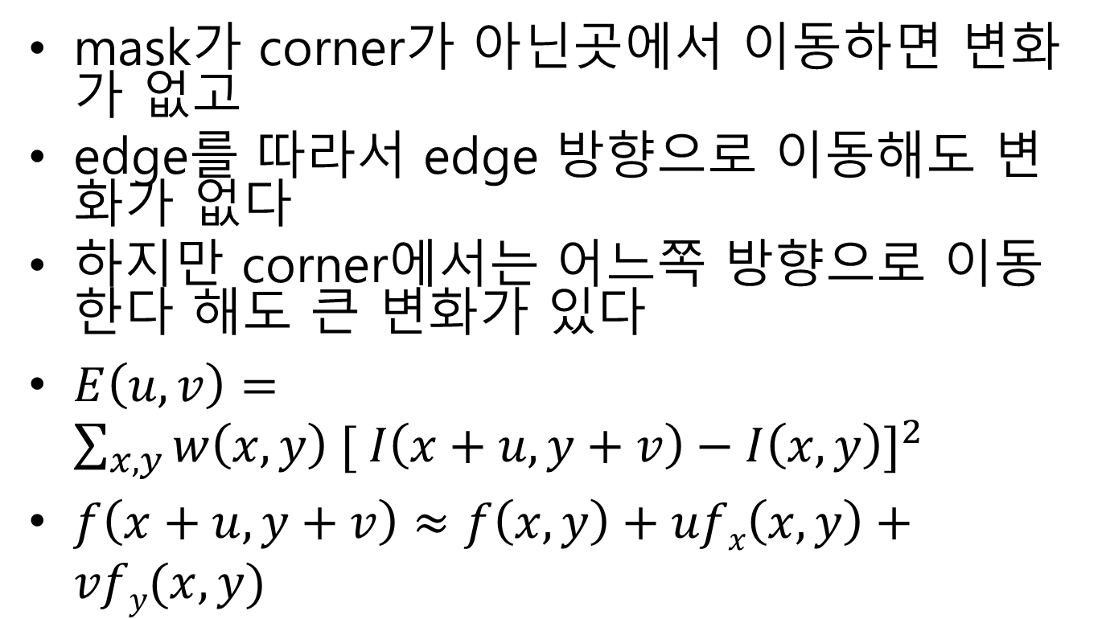
Harris corners
mask가 corner가 아닌곳에서 이동하면 변화가 없고
edge를 따라서 edge 방향으로 이동해도 변화가 없다
하지만 corner에서는 어느쪽 방향으로 이동한다 해도 큰 변화가 있다
$E\left(u,v\right)=\sum_{x,y}{w\left(x,y\right) {[ I\left(x+u,y+v\right)−I\left(x,y\right)]}^{2}}$
$f\left(x+u,y+v\right)≈f\left(x,y\right)+ufx\left(x,y\right)+vfy(x,y)$

Slide 38
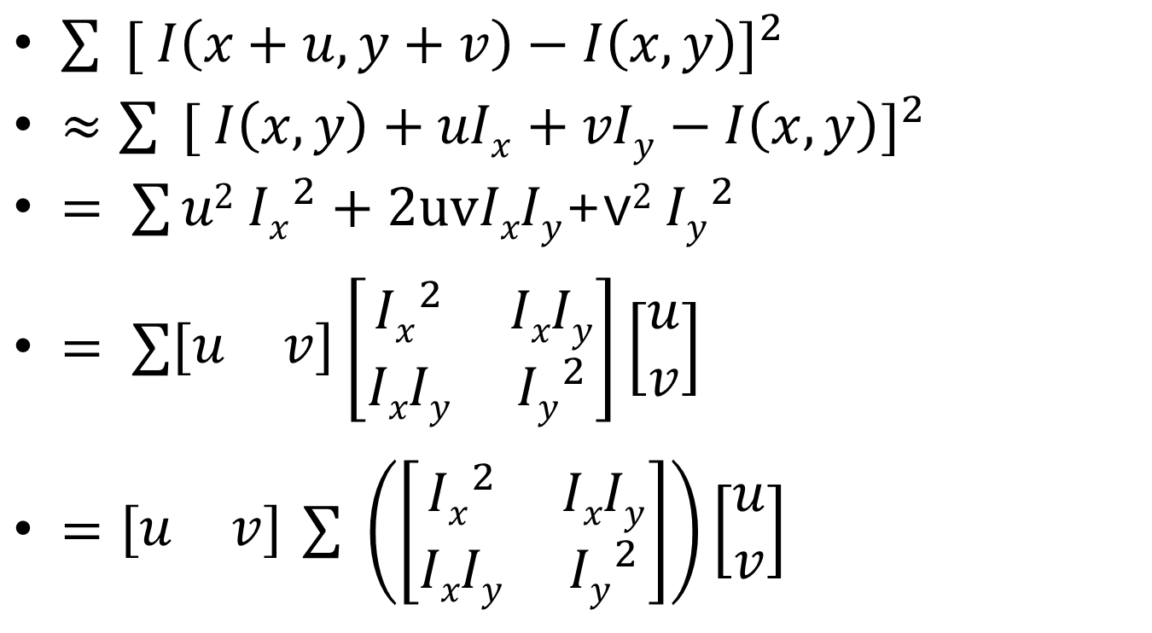
Harris corner 미분
$\sum{{ [ I\left(x+u,y+v\right)−I\left(x,y\right)]}^{2}}$
$≈\sum{{ [ I\left(x,y\right)+uIx+vIy−I\left(x,y\right)]}^{2}}$
$= \sum{u2 {Ix}_{}^{2}}+2uvIxIy$+v$2 {Iy}_{}^{2}$
$= \sum{\left[\begin{matrix}u & v\end{matrix}\right]\left[\begin{matrix}{Ix}_{}^{2} & IxIy \\ IxIy & {Iy}_{}^{2}\end{matrix}\right]\left[\begin{matrix}u \\ v\end{matrix}\right]}$
$=\left[\begin{matrix}u & v\end{matrix}\right]$ $\sum{ \left(\left[\begin{matrix}{Ix}_{}^{2} & IxIy \\ IxIy & {Iy}_{}^{2}\end{matrix}\right]\right)\left[\begin{matrix}u \\ v\end{matrix}\right]}$

Slide 39
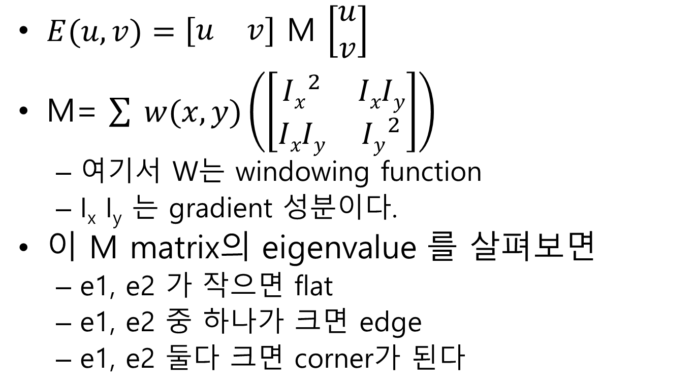
Harris corner 미분
$E(u,v)=\left[\begin{matrix}u & v\end{matrix}\right]$ M $\left[\begin{matrix}u \\ v\end{matrix}\right]$
M= $\sum{ w(x,y)\left(\left[\begin{matrix}{Ix}_{}^{2} & IxIy \\ IxIy & {Iy}_{}^{2}\end{matrix}\right]\right)}$
여기서 W는 windowing function
I_{x} I_{y} 는 gradient 성분이다.
이 M matrix의 eigenvalue 를 살펴보면
e1, e2 가 작으면 flat
e1, e2 중 하나가 크면 edge
e1, e2 둘다 크면 corner가 된다

Slide 40
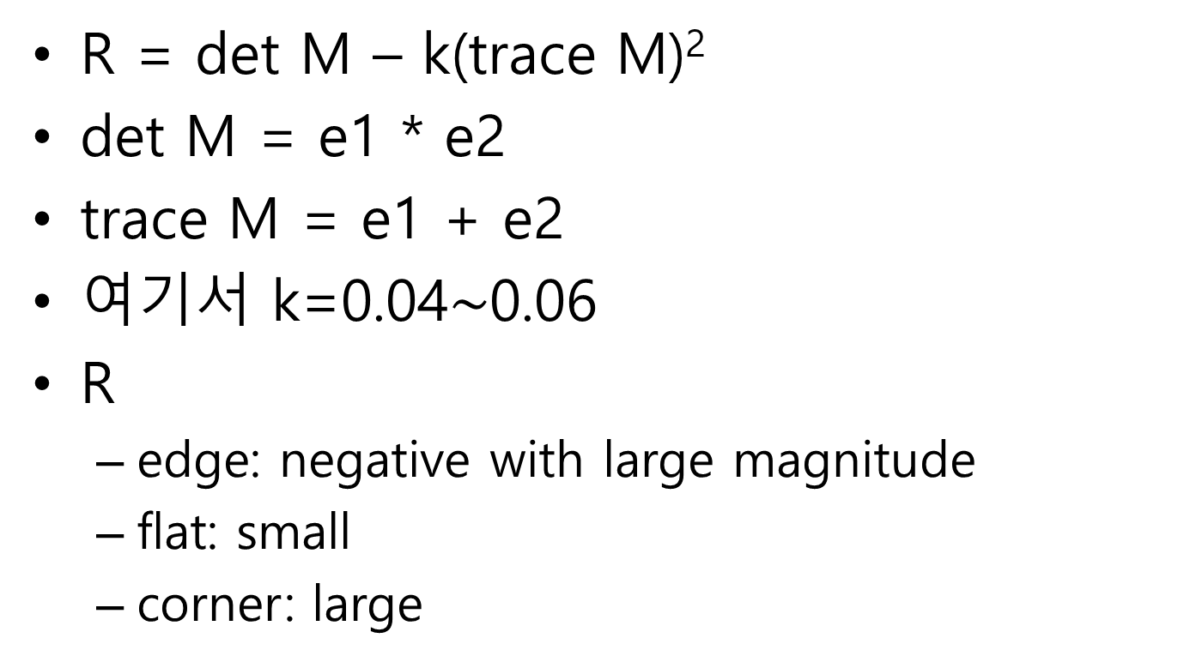
Harris corner response
R = det M – k(trace M)²
det M = e1 * e2
trace M = e1 + e2
여기서 k=0.04$\sim$0.06
R
edge: negative with large magnitude
flat: small
corner: large

Slide 41
cornerHarris 함수
void cornerHarris(InputArray src, OutputArray dst, int blockSize, int ksize, double k, int borderType=BORDER_DEFAULT )
src – Input single-channel 8-bit or floating-point image.
dst – Image to store the Harris detector responses. It has the type CV_32FC1 and the same size as src .
blockSize – Neighborhood size (see the details on cornerEigenValsAndVecs() ).
ksize – Aperture parameter for the Sobel() operator.
k – Harris detector free parameter. See the formula below.
borderType – Pixel extrapolation method. See borderInterpolate() .

Slide 42
harris corner example
#include "stdafx.h"
#include "opencv2/highgui/highgui.hpp"
#include "opencv2/imgproc/imgproc.hpp"
#include <iostream>
#include <stdio.h>
#include <stdlib.h>
#include <string>
using namespace cv;
using namespace std;
/// Global variables
Mat src, src_gray;
int thresh = 200;
int max_thresh = 255;
string source_window = "Source image";
string corners_window = "Corners detected";
/// Function header
void cornerHarris_demo(int, void*);

Slide 43
harris corner example(2)
/** @function main */
int main()
{
/// Load source image and convert it to gray
src = imread("Yosemite1.jpg", 1);
cvtColor(src, src_gray, CV_BGR2GRAY);
/// Create a window and a trackbar
namedWindow(source_window, CV_WINDOW_AUTOSIZE);
createTrackbar("Threshold: ", source_window, &thresh, max_thresh, cornerHarris_demo);
imshow(source_window, src);
cornerHarris_demo(0, 0);
waitKey(0);
return(0);
}

Slide 44
harris corner example(3)
/** @function cornerHarris_demo */
void cornerHarris_demo(int, void*)
{
Mat dst, dst_norm, dst_norm_scaled;
dst = Mat::zeros(src.size(), CV_32FC1);
/// Detector parameters
int blockSize = 2;
int apertureSize = 3;
double k = 0.04;
/// Detecting corners
cornerHarris(src_gray, dst, blockSize, apertureSize, k, BORDER_DEFAULT);
/// Normalizing
normalize(dst, dst_norm, 0, 255, NORM_MINMAX, CV_32FC1, Mat());
convertScaleAbs(dst_norm, dst_norm_scaled);

Slide 45
harris corner example(4)
/// Drawing a circle around corners
for (int j = 0; j < dst_norm.rows; j++)
{
for (int i = 0; i < dst_norm.cols; i++)
{
if ((int)dst_norm.at<float>(j, i) > thresh)
{
circle(dst_norm_scaled, Point(i, j), 5, Scalar(0), 2, 8, 0);
}
}
}
/// Showing the result
namedWindow(corners_window, CV_WINDOW_AUTOSIZE);
imshow(corners_window, dst_norm_scaled);
}

Slide 46
예제 설명
영상을 읽는다.
영상은 가급적이면 corner가 있는 인공 구조물을 담고 있는 영상을 선택하는 것이 결과를 보기에 좋다.
물론 자연 영상도 corner가 있지만 그렇게 눈에 드러나지 않을 수 있다.
임계값을 설정하는 trackbar를 만든다
cornerHarris의 반응값을 normalize했을때 임계값 이상의 반응을 갖는 것만을 corner라고 결정한다
cornerHarris 을 수행하고 임계값 이상인 지점을 화면에 보인다

