Slide 1
Animation recommender using content-based methods
2021.06.07.
20171219 Sujin Jeon
20161396 Youngbin Lee
20161200 Yeongho Lee

Slide 2
Contents
Introduction
Method
3. Data pre-processing
4. Implementation 5. Results and Conclusion

Slide 3
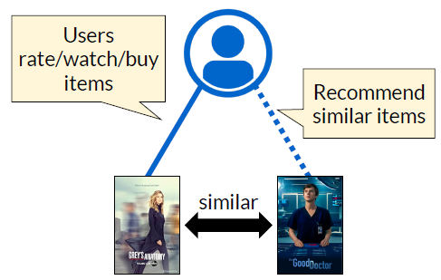






1
Introduction
Recommender system [1]
Information filtering system that seeks to predict the rating a user would give to an item
Content-based recommendation on animations [2]
Content analysis + User preference analysis
User-independent recommendations

Slide 4
2
Method
1. Vector space model
Vectorize features
Calculate similarity
Find similar animations
Predict ratings
[dataset example for a user]
Animation | Feature_1 | Feature_2 | Feature_3 | Rating (predict)
A | 5 | 3 | 0 | 10
B | 8 | 0 | 0 | 5
C | 0 | 0 | 2 | 9
D | 0 | 0 | 2 | 9
E | 0 | 0 | 2 | 9
F | 0 | 0 | 2 | 5
… | … | … | … | …
Text features (Genres, Synopsis)
Cosine similarity
10-Nearest neighbors
Weighted average rating of nearest neighbors
2. Regression model
Feature engineering
Train XGBoost model
Optimize parameters
Predict ratings
Meta features (e.g., Date, Duration, Rank, Type)
Text features (Genres, Synopsis)
Ensemble
Optuna
Model predictions

Slide 5

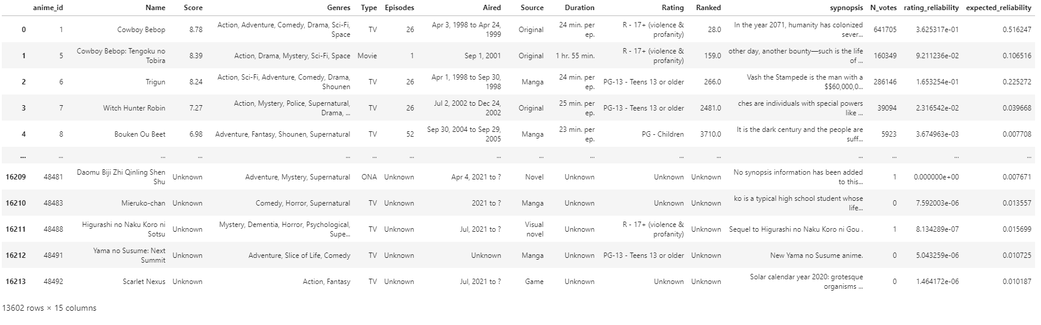
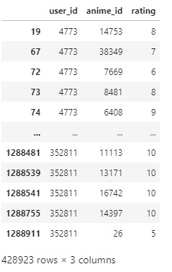
3
Preprocessing
Dataset: Anime recommendation database 2020 (Kaggle)
16K animations
1.9M ratings from 320K users
Animations
ratings

Slide 6
3
Preprocessing
1. Imputation of missing values
Naïve Bayes classifier: Source (20%)
2. Preprocessing
Numeric: Date, Duration
Text: Genres, Synopsis, Type, Source, Rating
3. Feature engineering
N_votes, rating_reliability, expected_reliability
1. Select users
Who rated more than 5000
Animations
ratings

Slide 7
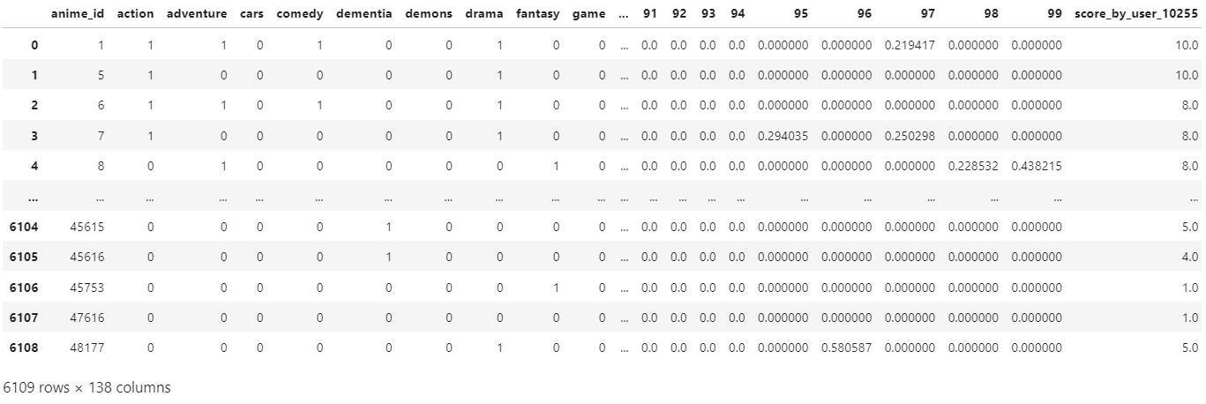

3
Preprocessing
Genres
36 genres
Frequency matrix (BoW)
Synopsis
100 TF-IDFs (max_features=100)
Range [0.1]
More important as value goes to 1
1) Vector Space model

Slide 8
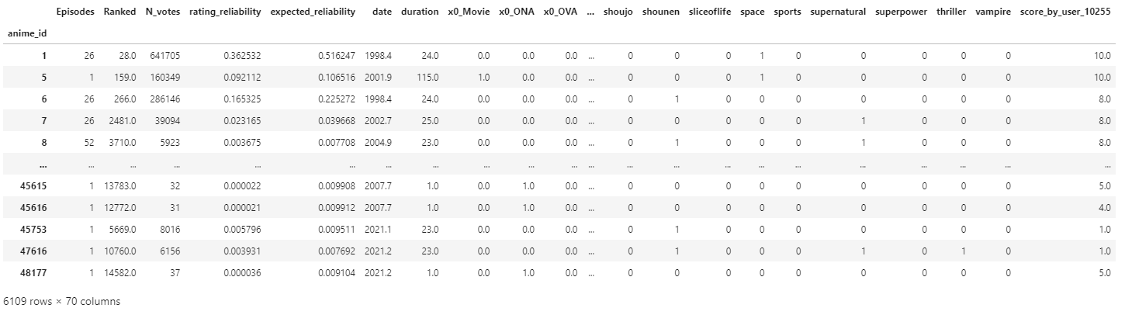

3
Preprocessing
Meta features
33 features
E.g., Episodes, Rank, …
Genres
36 genres
Frequency matrix (BoW)
Synopsis
100 TF-IDFs (max_features=100)
Range [0.1]
More important as value goes to 1
2) Regression model

Slide 9
4-1
Vector Space model
- Approach and assumption
User’s preference to new animation will be close to other similar animation’s preference.
Similarity of animation is mostly determined by genre and synopsis of it.
→ Can predict rating to new animation from other animations’ rating based on similarity of genre and synopsis.
Animation | genre | synopsis | Rating
Frozen 1 | Musical/fantasy | Princess Elsa of Arendelle … | 10
Frozen 2 | Musical/fantasy | King Agnarr of Arendelle … | ?
Notes:
Vector space model is built with this two assumption.
First, user’s preference to new animation will be close to similar animations’ preference.
Second, similarity of animation is mostly determined by genre and synopsis.
So, built model which predict rating from other animations rating based on similarity of genre and synopsis

Slide 10
4-1
Vector Space Model
- How we measure similarity among animations?
Express each animation’s genres and synopsis as ‘Vector’ [3]
Genres : Each animations have several genres as their attributes → Bag Of Words
Synopsis : Each animations have several sentences of story as their attributes. That sentences must include ‘stop words’, the common words. Some words shown many times only in some specific animations’ synopsis can be regarded as that animations’ important attributes.
→ Tf-Idf
Notes:
So, to implement model, how we measured similarity?
First, we transformed animation’s genres and synopsis attributes to vector for mathematical methods.
Each animations have several genres so it was processed by bag of words
And synopsis is processed by tf-idf method to only consider important words for comparing

Slide 11

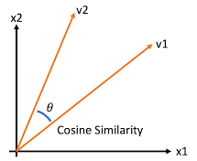

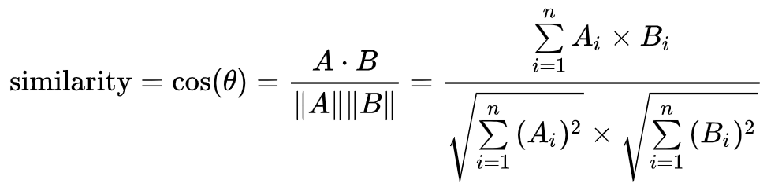
4-1
Vector Space Model – Cosine Similarity
- How measure similarity?
Cosine similarity is used for measuring similarity which has merits in that it is efficient for sparse matrix and measure by direction, not the distance size.
Notes:
And we used cosine similarity for similarity measure
Because it has merits in that it’s efficient for our sparse matrix and it measures by direction, not the distance size like Euclidean distance.

Slide 12
4-1
Vector Space Model - Weight
- Genre vs Synopsis
For calculating similarity, can give more importance by give weight to features.
For example, if synopsis is more important for similarity measure, give more weight to synopsis vectors.
Can find optimal weight by calculating MSE value of predicted rating with train set of all users by changing weights.
As a result, got the weight ratio genre : synopsis = 0.5 : 0.5.
Genre : synopsis | 0.3:0.7 | 0.5:0.5 | 0.7:0.3
MSE | 2.2565 | 2.2278 | 2.3361
Notes:
Also, we considered the weight for genres and synopsis because for calculating similarity, genres or synopsis can be more important than another.
By multiplying all genres vectors and synopsis vectors with some ratio, can give weight.
To find optimal weight, predicted rating with each weights from train set of each users and averaged mse.
Chose optimal weight with smaller mse value, 0.5 to 0.5.

Slide 13
4-1
Vector Space Model - Prediction
Split train and test set into test_size = 0.2 with each users
Find optimal weight with train set of all users
(based on top 10 similar animations)
Predict rating of test set with optimal weight
(based on top 10 similar animations)
Predict rating giving weight with similarity
Get evaluation metrics
Notes:
So the overall procedure is from preprocessed data, split each users data into test size 0.2 and find optimal weight with train set.
And then find optimal weight, And using that weight, predict rating of test set of each users.
Here rating was calculated with giving weight based on their similarity with target,
which means more similar animations’ rating more affect the prediction.
And then got evaluation metrics

Slide 14
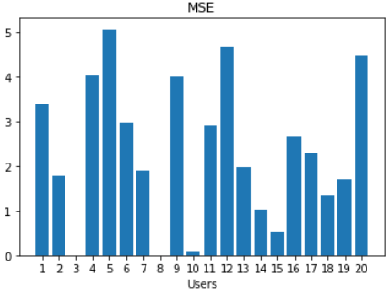
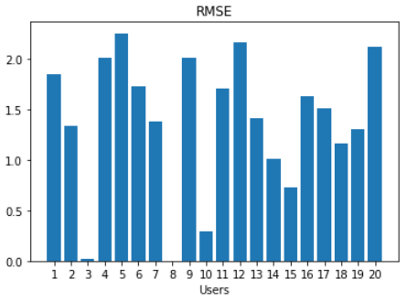
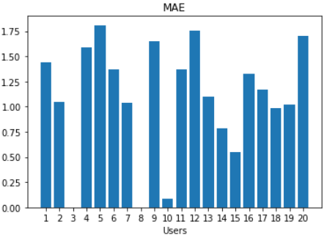
4-1
Vector Space Model - Prediction
 | mean | std
MSE | 2.3411 | 1.5491
RMSE | 1.3799 | 0.6611
MAE | 1.0907 | 0.5489
Show not good performance generally and big variance
→ Only some users’ preference is highly affected by genres and synopsis.
Only tested with 20 users and number of rated animations is different with users.
Notes:
Evaluated with mse, rmse, and Coefficient of determination.
This table is mean value from all users. Bar plots are each evaluation metrics of all users.
Can see that only show good performance on specific users (big variance)
It can be understood as only some users’ preference is highly affected by genres and synopsis
And only tested with 20 users and number of rated animations is different with users.
Also may not enough number of words was considered for synopsis comparing.

Slide 15
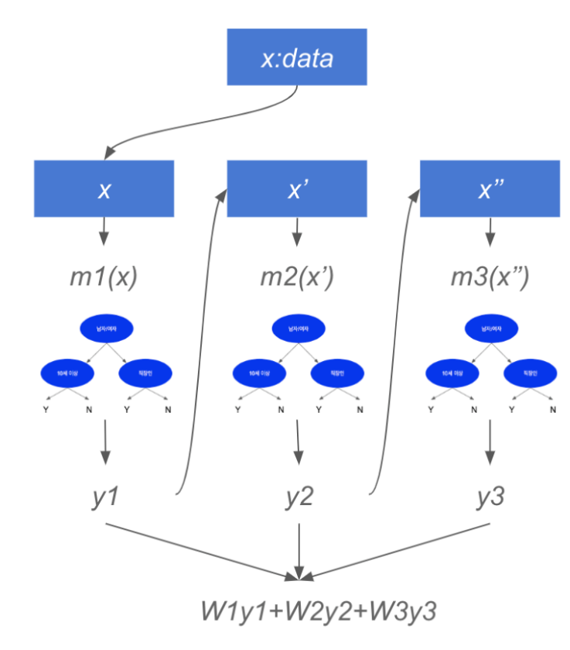
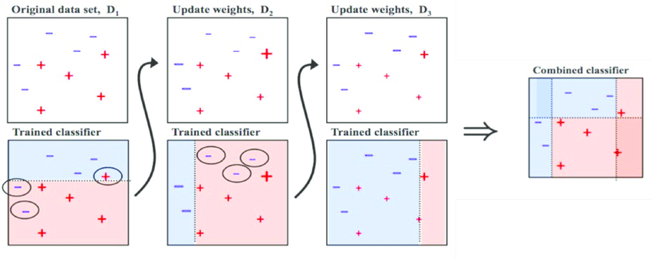
4-2
XGBoost
What is Boosting?
Boosting takes place between models. When the first model predicts, the data is weighted according to its prediction results, and the weights given affect the next model. Repeat the steps for creating new classification rules by focusing misclassified data.

Slide 16
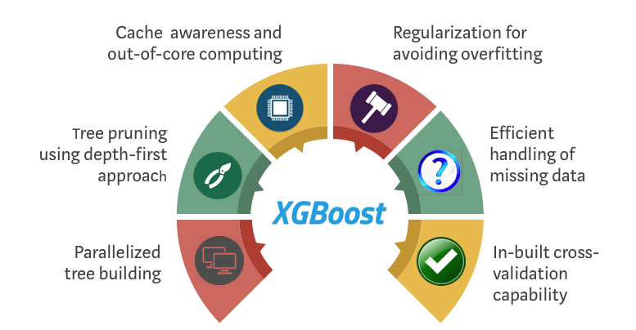
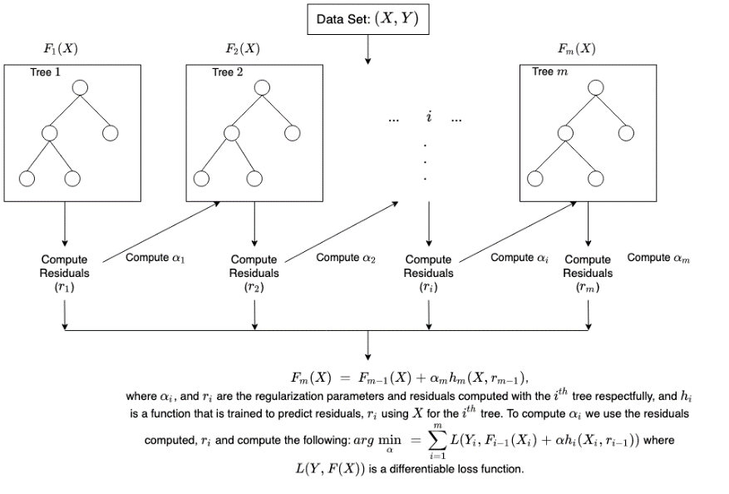
4-2
XGBoost
XGBoost = eXtreme Gradient Boosting
A machine learning library built around an efficient implementation of boosting for tree models (like GBM)
Developed by Tianqi Chen (Uni. Washington) i 2014 [4]
Core library in C++, with interfaces for many languages/platforms
C++, Python, R, Julia, Java, etc.
Distributed version for Hadoop + Spark
Engineering goal: “Push the limit of computational resources for
boosted tree algorithms”
Parallelizable, cheap on memory, scales to large data sets
Very powerful and flexible – lots of (hyper)parameters
Huge succsess
«Winning practically every prediction competiton on Kaggle»

Slide 17
4-2
XGBoost
Meta features
33 features
E.g., Episodes, Rank, …
Genres
36 genres
Frequency matrix (BoW)
Synopsis
100 TF-IDFs (max_features=100)
Range [0.1]
More important as value goes to 1

Slide 18
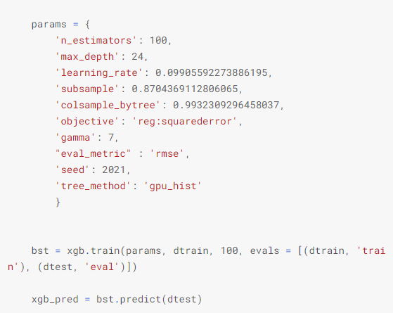

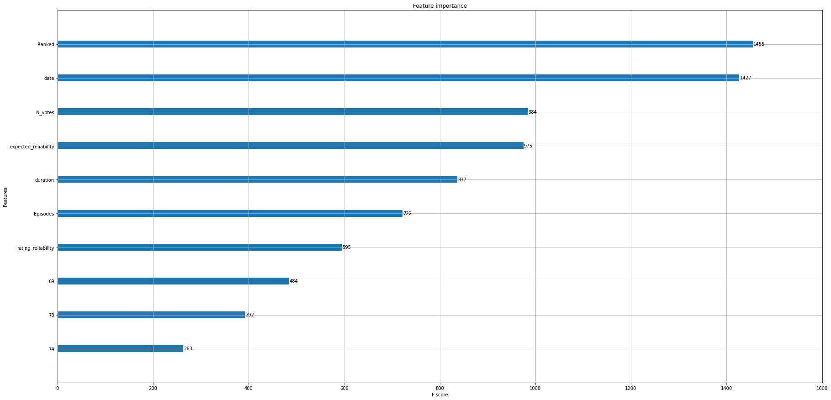
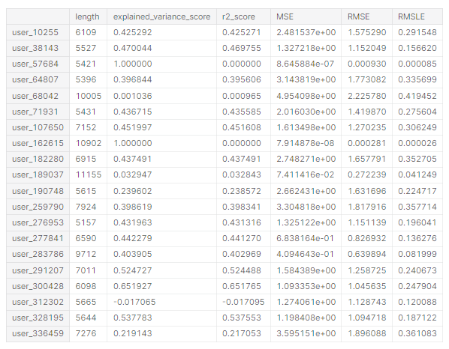
4-2
XGBoost
RANKED
[7]
DATE
N_VOTES
Expected_reliability
duration
[6]
Parameter Type General Parameter: relate to which booster we are using to do boosting, commonly tree or linear model Boost Parameter: depend on which booster you have chosen Learning Task Parameter: decide on the learning scenario. For example, regression tasks may use different parameters with ranking tasks.
General Parameter nthread: Number of parallel threads used to run XGBoost.
Boost Parameter Learning rate: Step size shrinkage used in update to prevents overfitting max_depth: Maximum depth of a tree. Increasing this value will make the model more complex and more likely to overfit. gamma: Minimum loss reduction required to make a further partition on a leaf node of the tree. subsample: Subsample ratio of the training instances.
colsample_bytree: is the subsample ratio of columns when constructing each tree.
Learning Task Parameter objective: object function type eval_metric: Evaluation metrics for validation data, a default metric will be assigned according to objective seed: Random number seed
Tree_method: The tree construction algorithm used in XGBoost.
Episodes
rating_reliability

Slide 19
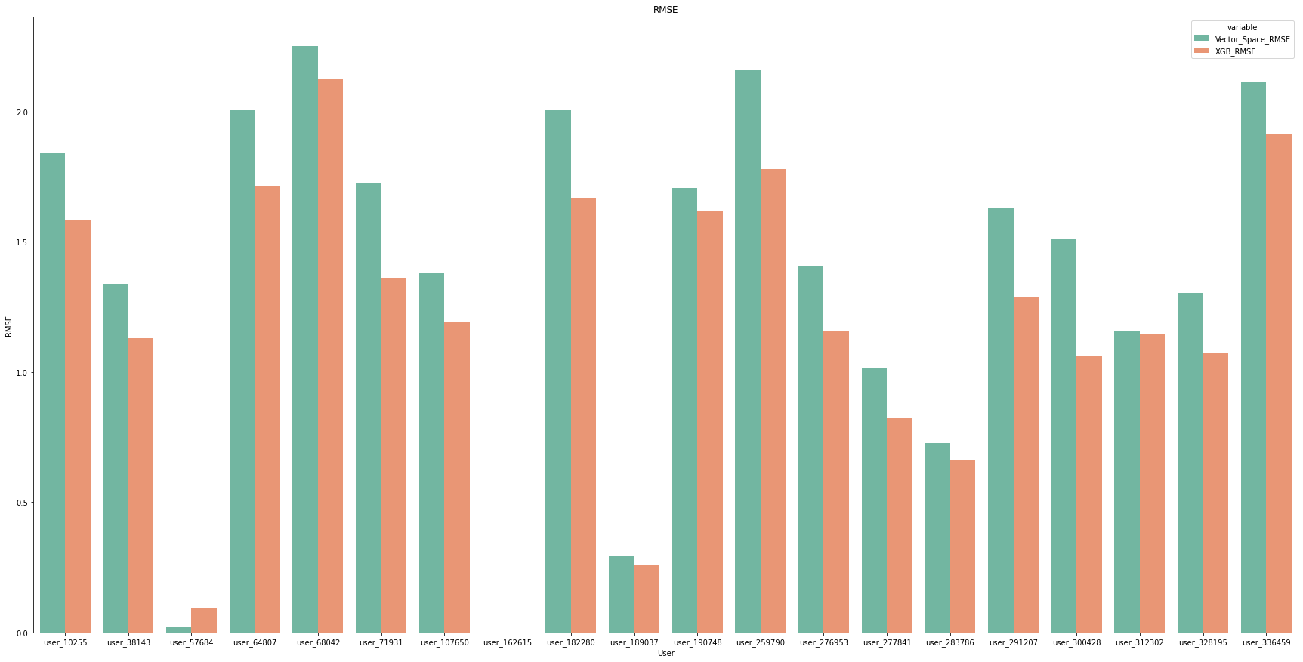
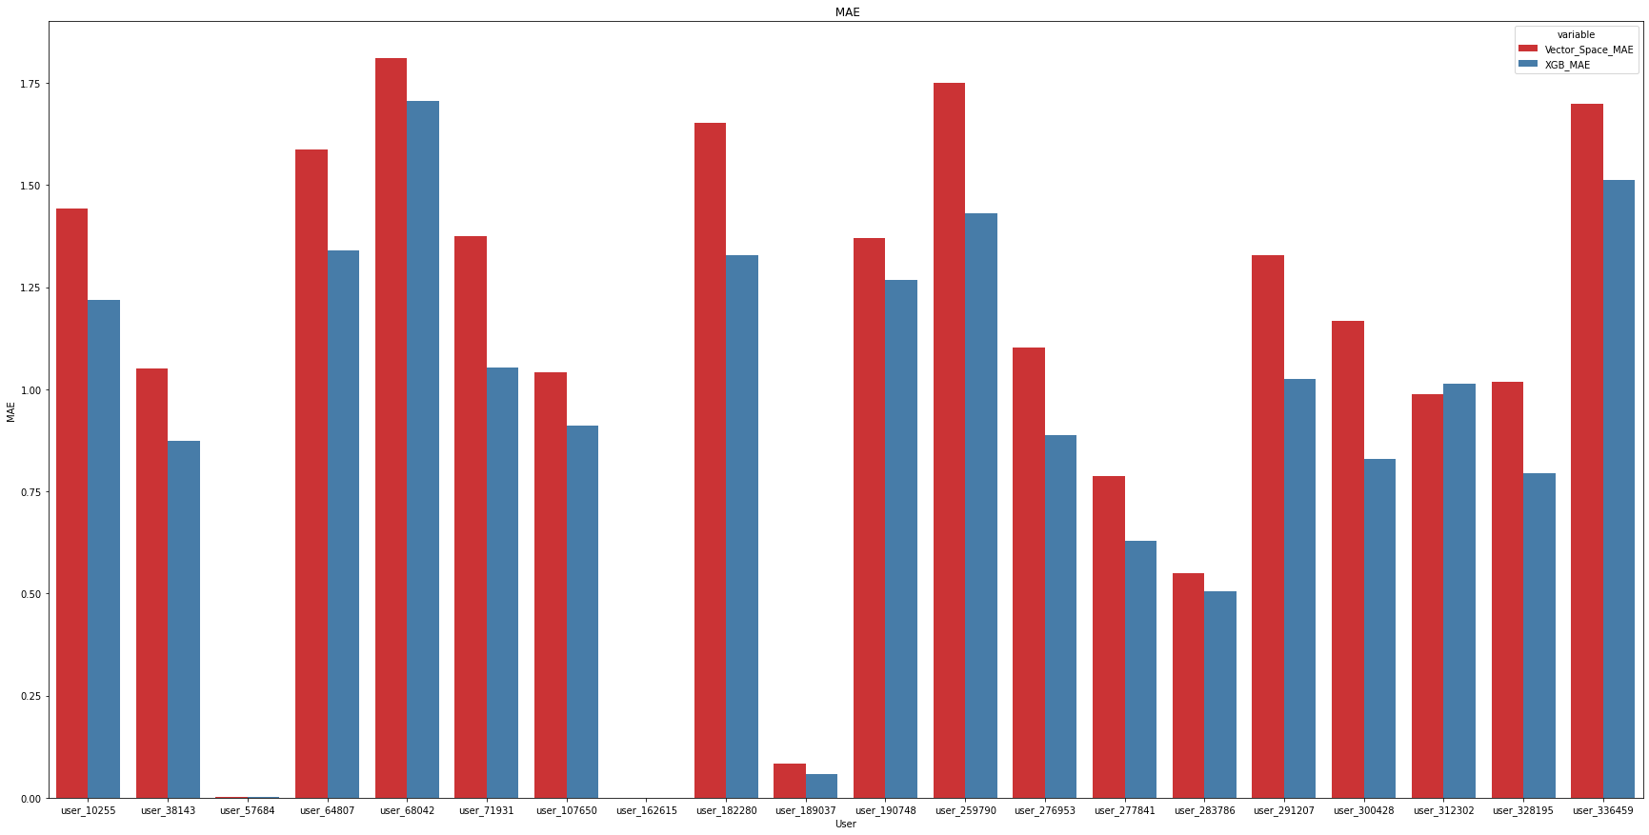
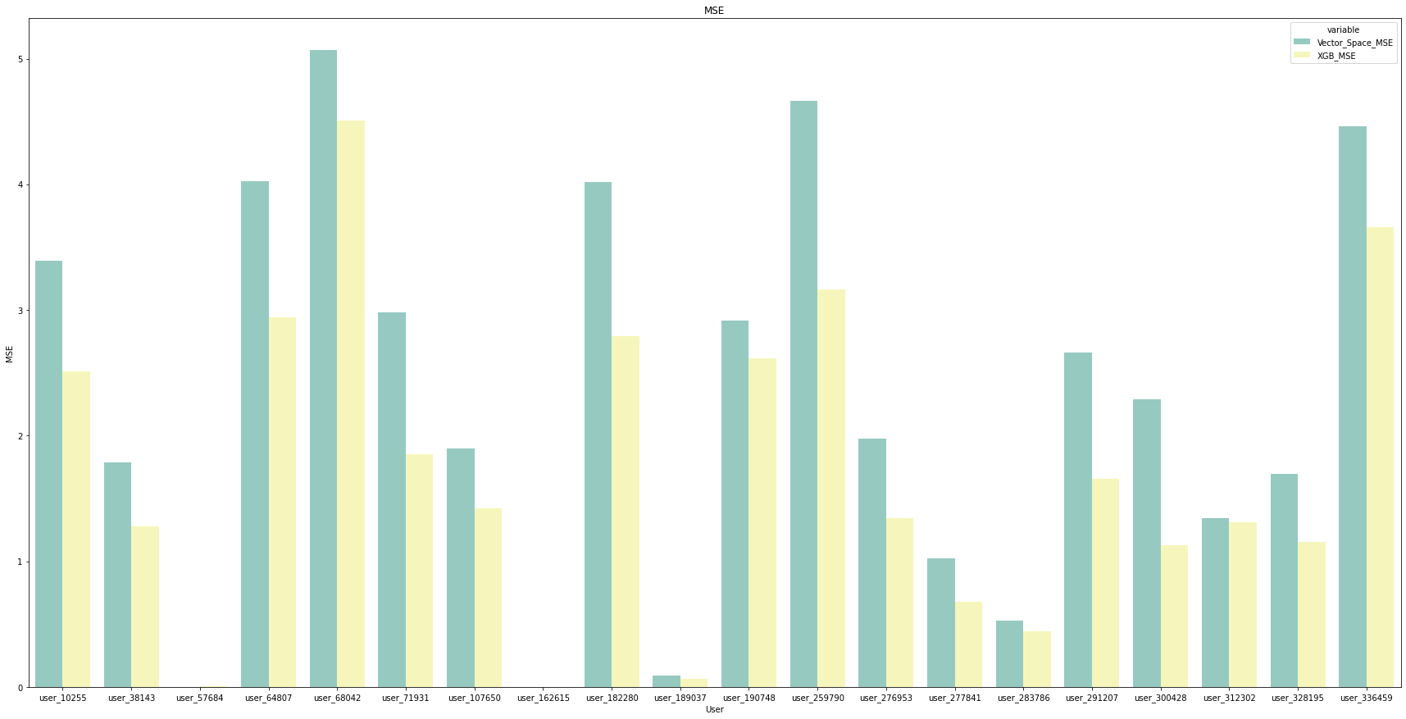
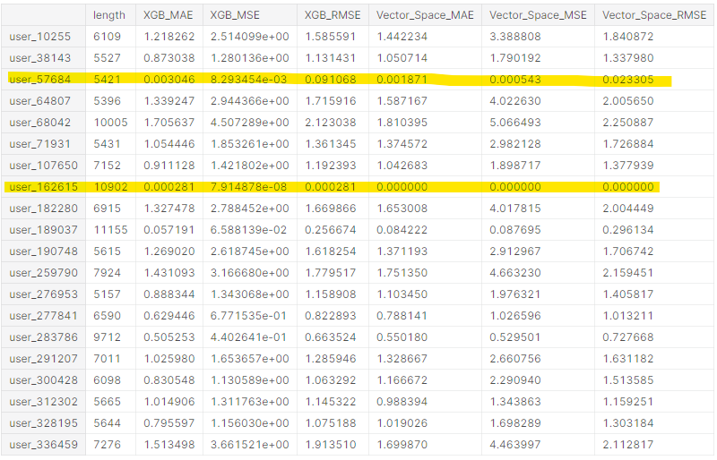



5
Results
LEFT : Vector Space Model
RIGHT : XGB Model
RMSE
MAE
MSE

Slide 20

5
Conclusion
XGB outperform
The Vector-space model uses only genre and synopsis, while the XGB uses all features.
We use only 100 words out of 30,000 words for synopsis.
The feature that influenced the results the most is ‘Ranked’ feature.
Because vector-space model didn’t use features include ‘Ranked’, XGB performs better

Slide 21
Reference
[1] Resnick, Paul, and Hal R. Varian. "Recommender systems." Communications of the ACM 40.3 (1997): 56-58.
[2] Pazzani, Michael J., and Daniel Billsus. "Content-based recommendation systems." The adaptive web. Springer, Berlin, Heidelberg, 2007. 325-341.
[3] Salton, Gerard, Anita Wong, and Chung-Shu Yang. "A vector space model for automatic indexing." Communications of the ACM 18.11 (1975): 613-620.
[4]Chen, Tianqi, and Carlos Guestrin. "XGBoost: A scalable tree boosting system." Proceedings of the 22nd acm sigkdd international conference on knowledge discovery and data mining. 2016.
[5] https://docs.aws.amazon.com/sagemaker/latest/dg/sagemaker-dg.pdf#xgboost-HowItWorks
[6] https://xgboost.readthedocs.io/en/latest/parameter.html
[7]Akiba, Takuya, et al. "Optuna: A next-generation hyperparameter optimization framework." Proceedings of the 25th ACM SIGKDD international conference on knowledge discovery & data mining. 2019.

Slide 22
Thank you
Notes:
And Thank you for listening

Slide 23
Q&A
Notes:
And Thank you for listening

