Slide 1

StrokeShield
A two-minute stroke check that talks you through it.
Sathvik S. · Fatih C. · Yeongsu K. · Leo Y.
Johns Hopkins University · HopHacks 2026
Notes:
Introduce yourselves and the one-line idea. StrokeShield: a two-minute stroke check on a webcam that talks you through it and decides whether to call for help.

Slide 2
1.9 million
The treatments that can reverse a stroke only work in the first hours.
neurons lost every minute a stroke goes untreated.
Saver, Stroke (2006)
StrokeShield | HopHacks 2026
2 / 12
Notes:
The hook. Nearly two million neurons die every minute a stroke goes untreated (Saver, 2006). Add your own story here if you have one; a real personal moment lands harder than any number.

Slide 3
When a stroke starts, most people are unsure, and they wait.
Treatment only works if they don't.
StrokeShield | HopHacks 2026
3 / 12
Notes:
State the problem in one sentence. The point is not that strokes are rare or mysterious; it is that the person living it is alone and unsure, and hesitates.

Slide 4
Time is short, and the usual screen misses strokes
4.5 hours
24 hours
14% → 4%
The clot-dissolving window, counted from the last moment the person was known to be well.
The outer limit for mechanical clot removal, and only for carefully selected patients.
Strokes missed when the screen adds Balance and Eyes to the classic FAST checks.
AHA/ASA guideline, 2019
AHA/ASA guideline, 2019
Aroor et al., Stroke, 2017
StrokeShield | HopHacks 2026
4 / 12
Notes:
Three numbers. The windows are counted from the last time the person was known to be well, not from when they noticed. And the classic FAST screen misses strokes that a better screen catches.

Slide 5
How might we…
help someone alone, with only a webcam, tell in two minutes whether what they feel needs an ambulance?
StrokeShield | HopHacks 2026
5 / 12
Notes:
Frame it as a question. Emphasize: alone, only a webcam, and two minutes.

Slide 6
Meet StrokeShield
1
Eyes
A calm guide for the first two minutes.
2
Face
Four short checks
3
Arms
Eyes, face, arms and speech: the same signs paramedics ask about.
A voice that guides you
4
Speech
It talks you through each step. It never diagnoses.
Then a decision
A clear decision
Strong signs start a 10-second countdown, then a text with your location.
StrokeShield | HopHacks 2026
6 / 12
Notes:
Introduce the product in three ideas. The important design decision: the voice only guides. The app decides, and the agent is never allowed to diagnose.

Slide 7
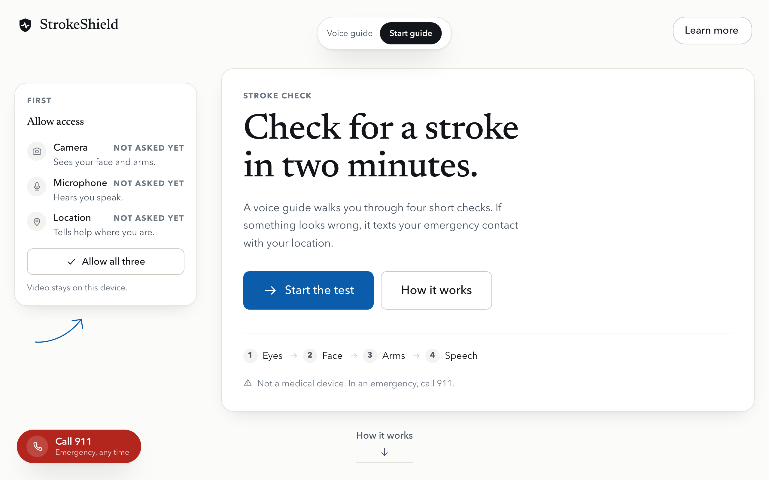
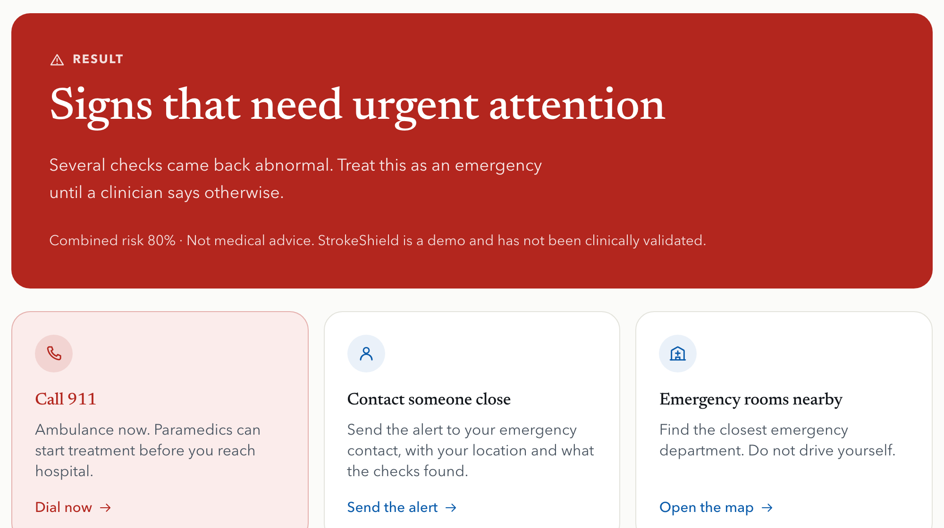
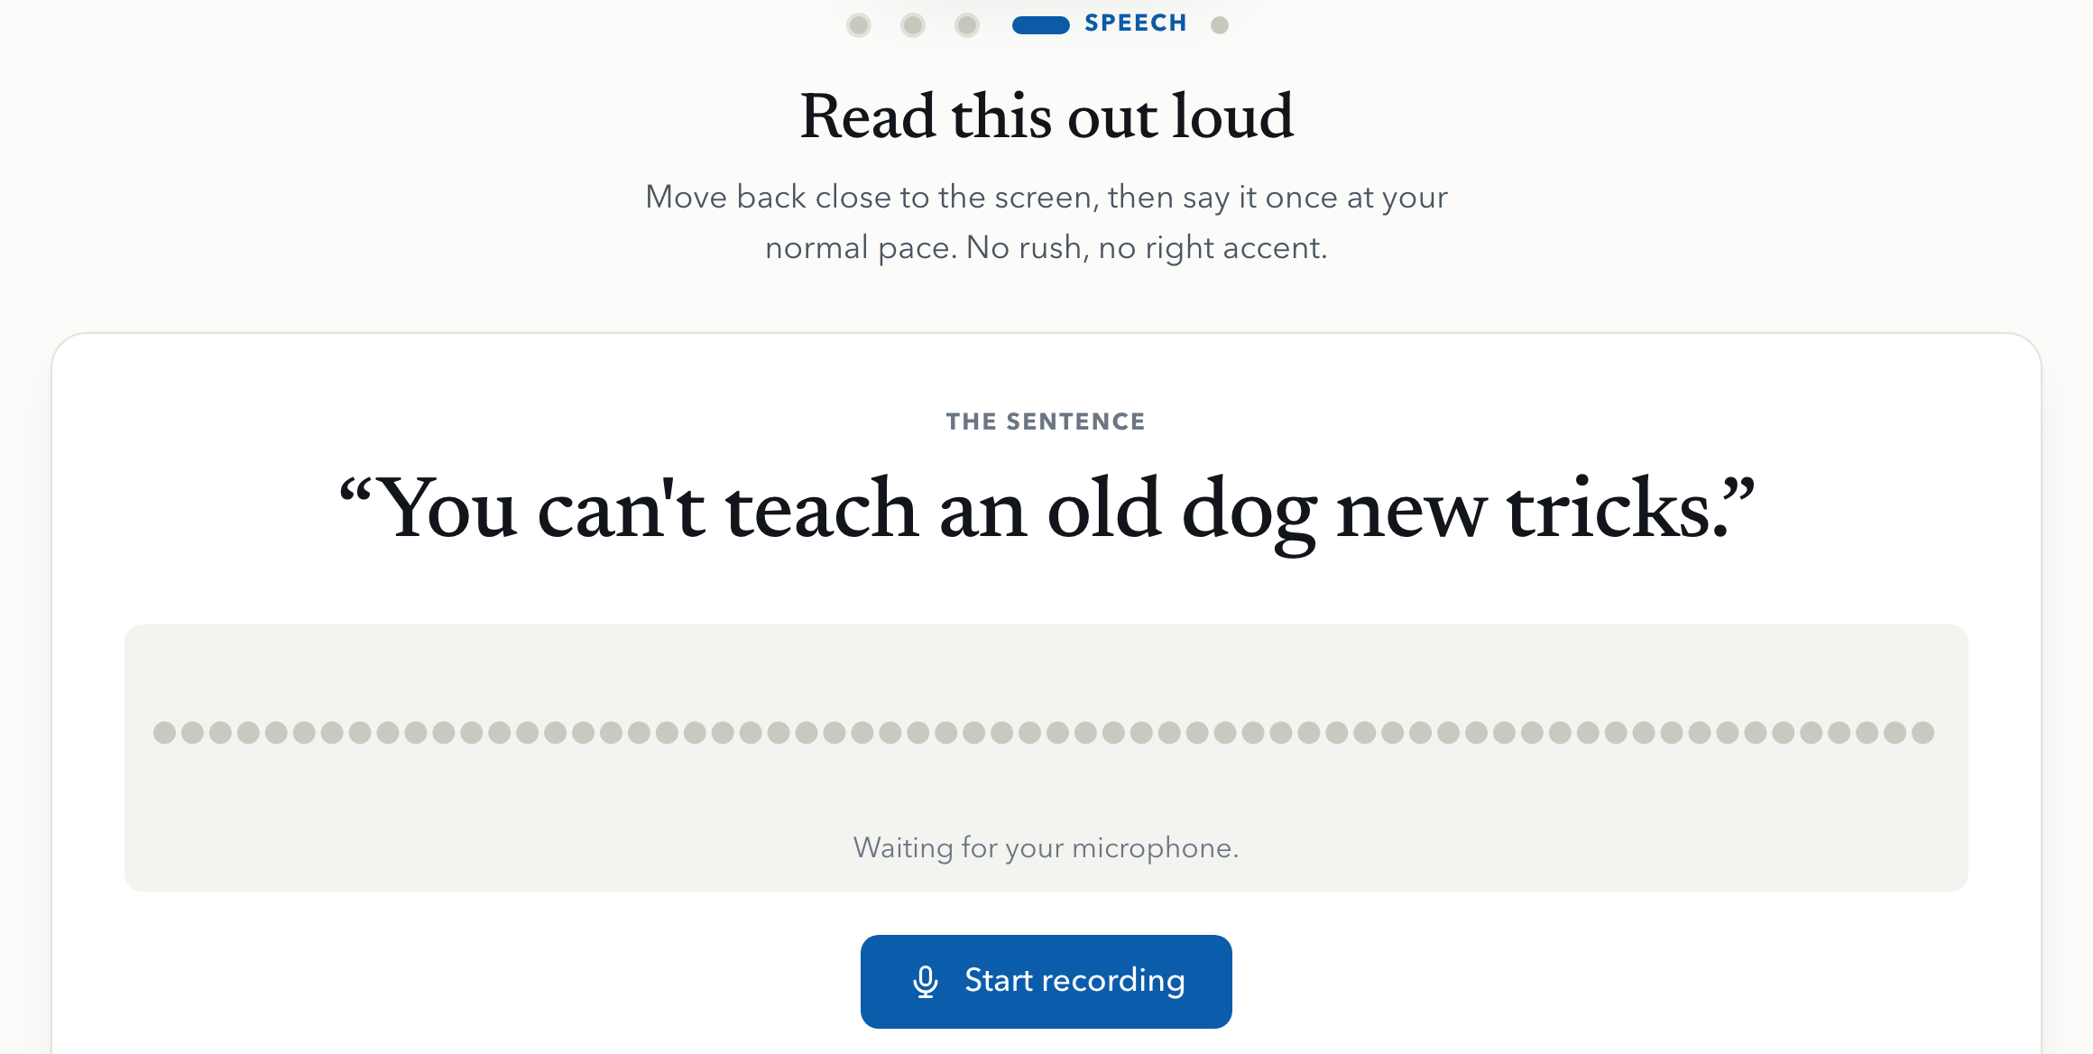
What it looks like
Start
Check
Decide
Allow camera, microphone and location once, then press one button.
Each check gives one plain instruction first. Speech: read a single sentence aloud.
A plain result and three things to do next. Shown here with a simulated high-risk run.
Alerts can only ever reach the one demo phone number.
StrokeShield | HopHacks 2026
7 / 12
Notes:
Walk the flow: allow camera, mic and location on the first screen, then the four checks, then the result. The result shown is a simulated high-risk run; alerts can only ever go to the one demo phone number.

Slide 8
How it fits together
The browser
Our server
ElevenLabs
React and TypeScript
MediaPipe reads the face, eyes and arms right on the device
The video never leaves the browser
Plays the voice guide and shows what it says as captions
FastAPI (Python)
Analyzes the speech clip: pitch, pauses, timing
Combines every check into one score
Holds the safety rule: it only ever texts the demo number
The voice guide: it speaks to the patient and listens to them
Twilio
Sends the text message with your location to the emergency contact
Camera analysis stays in the browser. Only the short speech clip goes to our server.
StrokeShield | HopHacks 2026
8 / 12
Notes:
The camera analysis runs in the browser, so video never leaves the device. Only the short speech clip goes to our server. The server is also where the safety rule lives: it can only ever text the one demo number.

Slide 9
How we use ElevenLabs
A voice that guides
ONE STEP, START TO FINISH
A conversational agent walks the patient through each step in plain words, and can be interrupted. What it says also appears as captions on screen.
1
The website says: "now on the face step"
It can act, not just talk
2
The agent tells the patient what to do
It has a small set of tools: start a check, save when symptoms began, look at the current step, or start the emergency countdown when someone asks for help.
3
The agent calls start_face_test
The app stays in charge
4
The website runs the check and reports back
The website tells the agent which step is active. The agent never gives a score or a diagnosis, and it goes quiet while the speech check records.
8 tools: three checks, speech, save start time, check status, start and cancel emergency.
StrokeShield | HopHacks 2026
9 / 12
Notes:
Explain what the agent does and, just as important, what it is not allowed to do. It has tools to start each check and to start the emergency countdown, but the website decides everything and the agent never states a score or a diagnosis. Note: speech-to-text (Scribe) is not built yet; only the voice agent is.

Slide 10
Next: a second opinion from Gemini
PLANNED. NOT BUILT YET.
Our checks measure the face and arms with landmark math. Gemini would look at the same moments as a picture, and give an independent reading.
1
2
3
Keep a few stills
Ask for a plain answer
Show it next to ours
During the face and arm checks we keep two or three frames, only if the patient agrees.
Gemini is asked one strict question: is there a droop or a drifting arm? Yes, no or unclear.
The answer appears beside our score as agrees or disagrees. If it fails or is unsure, it is ignored.
StrokeShield | HopHacks 2026
10 / 12
Notes:
Be upfront that this is planned, not built. The design rule we already wrote down: it can never block a check, and if it fails or is unsure it just says unclear and gets ignored.

Slide 11
Design system
Tiempos for titles
Page
Ink
#FBFBF9
#12161B
Avenir for everything else. Easy to read for anyone, on any screen.
Accent blue
Emergency red
#0B5CAB
#B3261E
One accent color. Red is kept for emergencies.
Flat fills, no gradients.
Text passes AA contrast; nothing under 13 px.
Big targets and plain words for someone in a hurry.
OK green
Attention amber
#1B6B48
#8A5A00
Camera stage
Soft blue
#0E1216
#EAF1F9
StrokeShield | HopHacks 2026
11 / 12
Notes:
Intentional choices. Red appears only for emergencies, so it never competes with anything else. One accent blue. No gradients. Every text and background pair passes accessibility contrast, and nothing is smaller than 13 px.

Slide 12
What it is not, and what comes next
LIMITS
NEXT STEPS
Not a medical device.
Test and tune on real cameras and microphones.
The scoring is still being tuned on real people, and is not clinically validated.
Find the nearest stroke center and hand the ambulance crew a one-page summary.
It can only ever text one demo number.
A Gemini second opinion on still frames.
StrokeShield | HopHacks 2026
12 / 12
Notes:
Be plain about the limits; judges trust that. Then name the three next steps that would make it real.

