Slide 1
R mlr3 w/ ChatGPT
feat. mlr3 Yeonhoon Jang

Slide 2
Contents
Introduction
Design & Syntax
Basic modeling
Resampling
Benchmarking

Slide 3
Introduction

Slide 4
Who am I?
Graduate School of Public Health, SNU (2019.03 ~ 2021.02)
Seoul National University Bundang Hospital (2021.06 ~ )
Data (NHIS, MIMIC-IV, Registry data, KNHNAES …)
Comento (2022.07 ~ )

Slide 5


ML in R

Slide 6
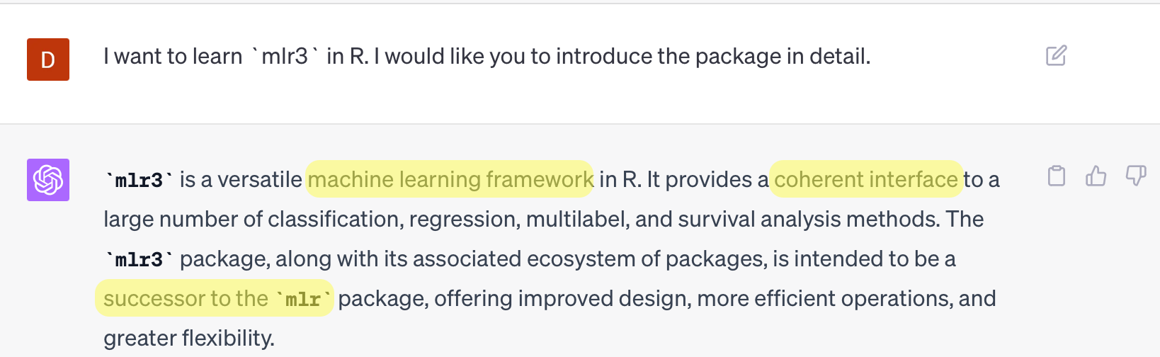
What is mlr3?
mlr3: Machine Learning in R 3

Slide 7
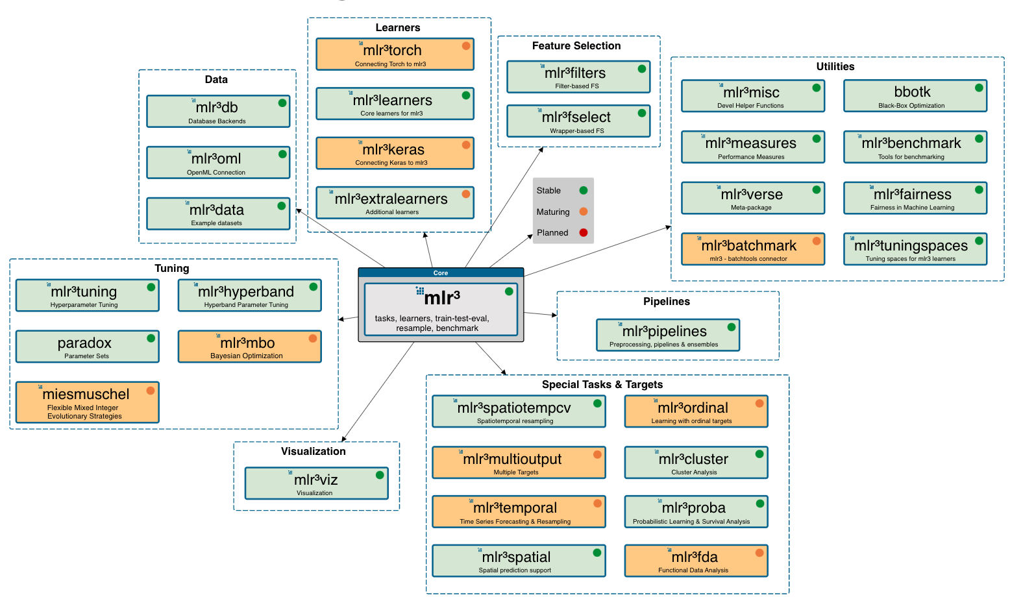
mlr3 & mlr3verse
source: https://mlr3.mlr-org.com

Slide 8
Why choose mlr3?
National Health Insurance System Data (NHIS-HEALS, NHIS-NSC)
dplyr $→$ data.table
Python : scikit-learn = R : ??
mlr3: data.table based package

Slide 9
Design & Syntax

Slide 10
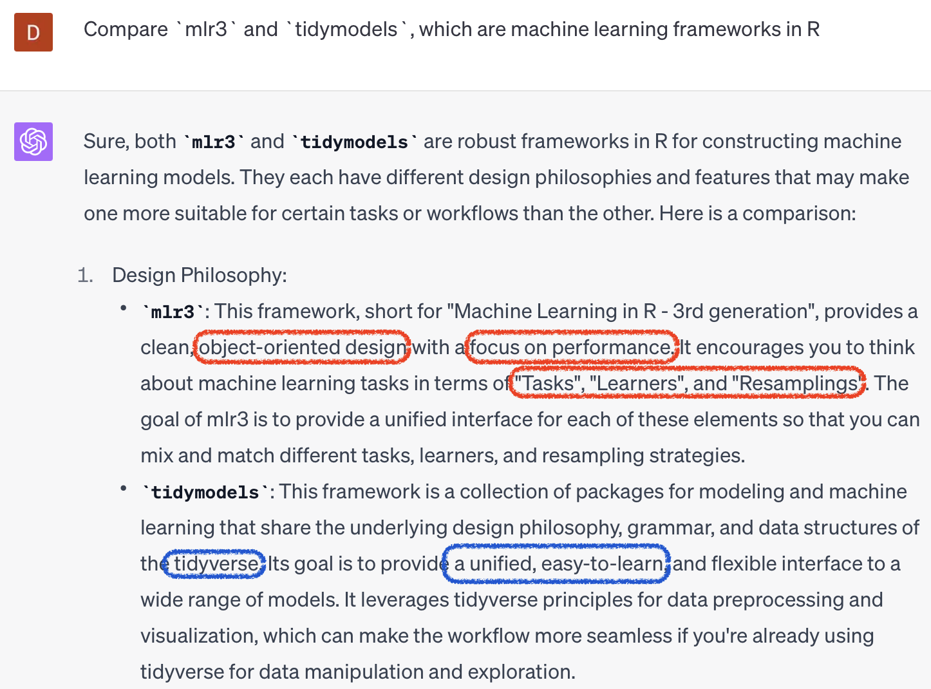
mlr3 vs tidymodels

Slide 11
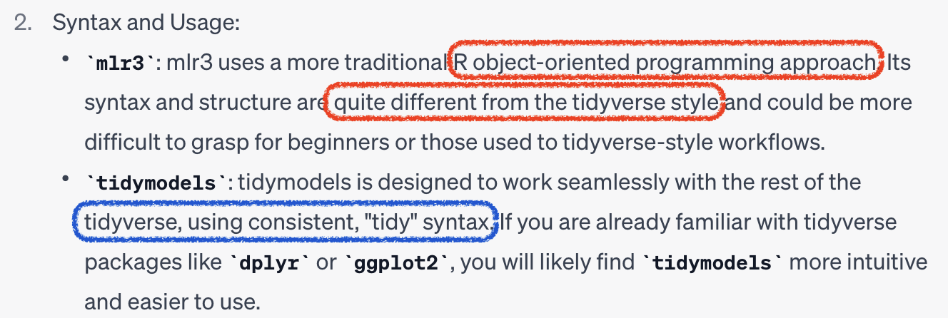

Slide 12
Core 1. R6
Object Oriented Programming (OOP)
Objects: foo = bar$new()
Methods: $new()
Fields: $baz
task = TaskClassif$new("xxx") # Objects task$new() # Methods task$feature_names # Fields

Slide 13
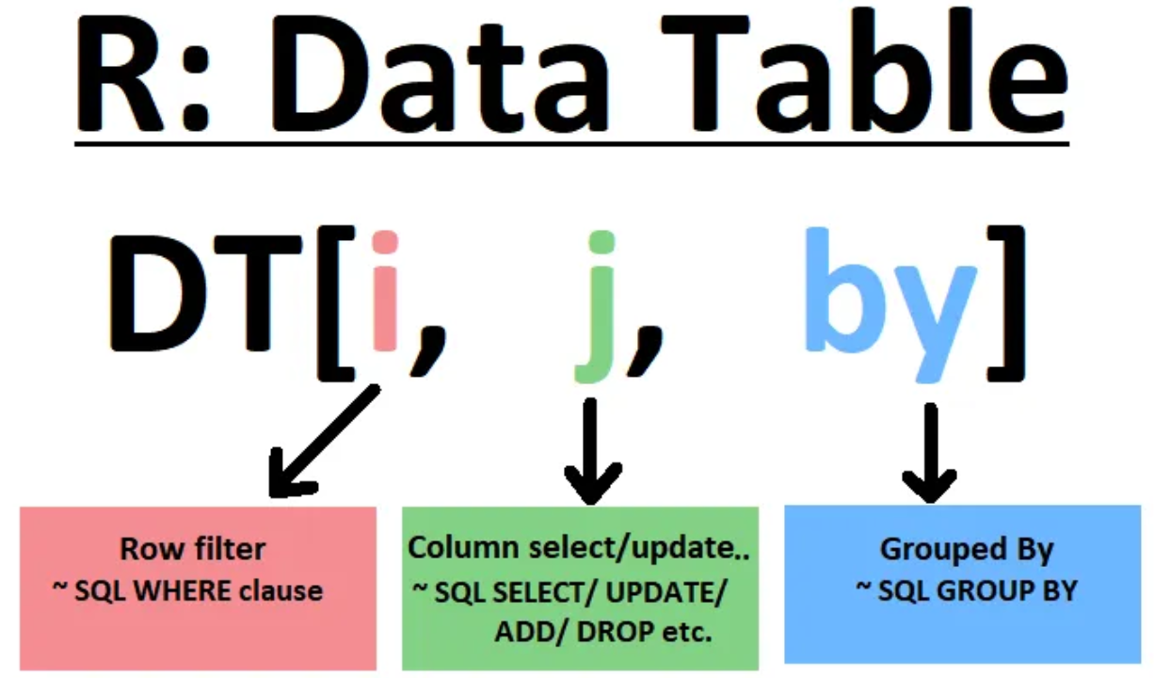
Core 2. data.table

Slide 14
DT[i >= 10] # filter rows DT[, .(X,Y)] # select columns DT[, mean(X), by=Y] # aggregate by group

Slide 15
Utils 1. Dictionary
# Getting a specific object with `$get(key)` mlr_learners$get("regr.rpart")
<LearnerRegrRpart:regr.rpart>: Regression Tree * Model: - * Parameters: xval=0 * Packages: mlr3, rpart * Predict Types: [response] * Feature Types: logical, integer, numeric, factor, ordered * Properties: importance, missings, selected_features, weights

Slide 16
Utils 1. Dictionary
# Searching objects with $keys() mlr_measures$keys() |> head()
[1] "aic" "bic" "classif.acc" "classif.auc" [5] "classif.bacc" "classif.bbrier"

Slide 17
Utils 1. Dictionary
# OR with `as.data.table()` as.data.table(mlr_learners) |> head()
# A tibble: 6 × 7 key label task_type feature_types packages properties predict_types <chr> <chr> <chr> <list> <list> <list> <list> 1 classif.cv_gl… <NA> classif <chr [3]> <chr> <chr [4]> <chr [2]> 2 classif.debug Debu… classif <chr [6]> <chr> <chr [4]> <chr [2]> 3 classif.featu… Feat… classif <chr [7]> <chr> <chr [6]> <chr [2]> 4 classif.glmnet <NA> classif <chr [3]> <chr> <chr [3]> <chr [2]> 5 classif.kknn <NA> classif <chr [5]> <chr> <chr [2]> <chr [2]> 6 classif.lda <NA> classif <chr [5]> <chr> <chr [3]> <chr [2]>

Slide 18
Utils 2. Sugar functions
R6 class $→$ S3 type functions
# No sugar LearnerClassifLogReg$new() # Sugar lrn("classif.log_reg")

Slide 19
Utils 3. mlr3viz
ggplot2, autoplot() visualization
autoplot(pred) autoplot(pred, type="roc")

Slide 20
Basic modeling

Slide 21
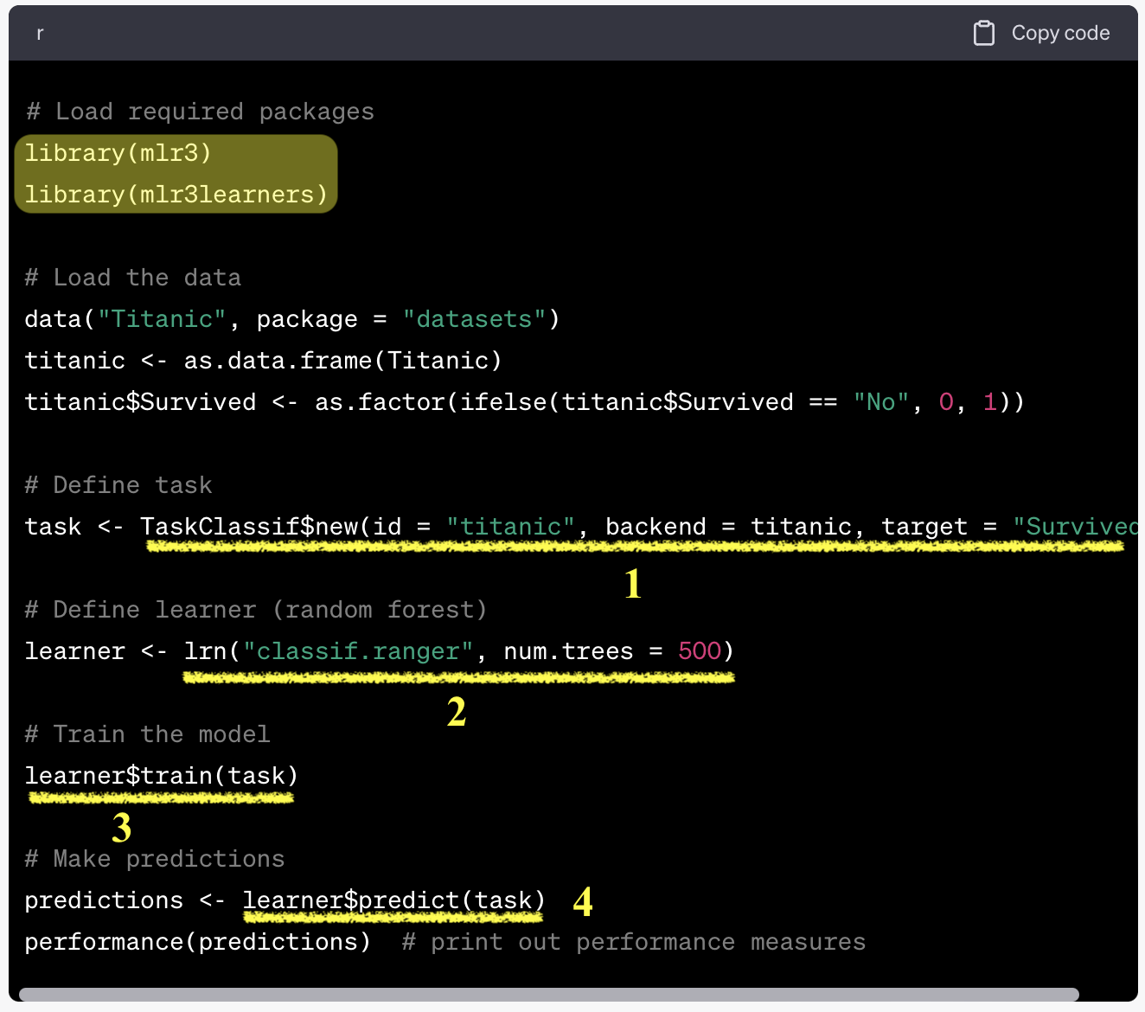
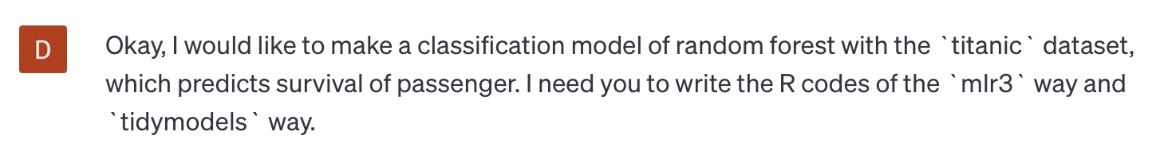
Ask ChatGPT!

Slide 22
1. Tasks
Objects with data and metadata
Default datasets
Dictionary: mlr_tasks
Sugar function: tsk()
# pre-defined tasks tsk("titanic")
<TaskClassif:titanic> (1309 x 11): Titanic * Target: survived * Properties: twoclass * Features (10): - chr (3): cabin, name, ticket - dbl (2): age, fare - fct (2): embarked, sex - int (2): parch, sib_sp - ord (1): pclass

Slide 23
1. Tasks
Or External data as task
as_task_regr() : regression
as_task_classif(): classification
as_task_clust(): clustering
task_mtcars = as_task_regr(mtcars, target = "mpg") task_mtcars
<TaskRegr:mtcars> (32 x 11) * Target: mpg * Properties: - * Features (10): - dbl (10): am, carb, cyl, disp, drat, gear, hp, qsec, vs, wt

Slide 24
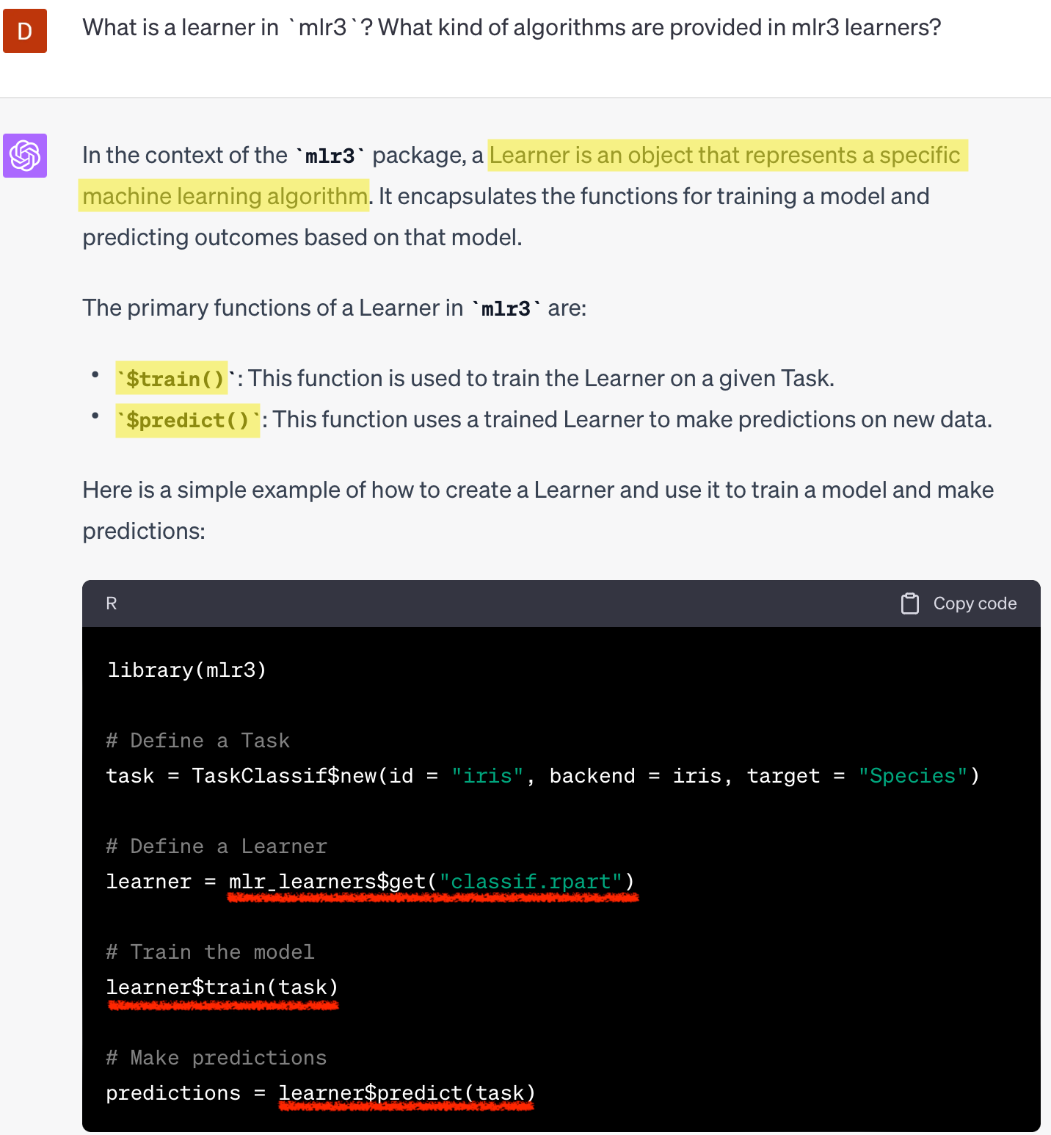
2. Learners

Slide 25
2. Learners
ML algorithms
Dictionary: mlr_learners
Sugar function: lrn()
regression (regr.~), classification(classif.~), and clustering (clust.~)
library(mlr3learners) + library(mlr3extralearners)

Slide 26
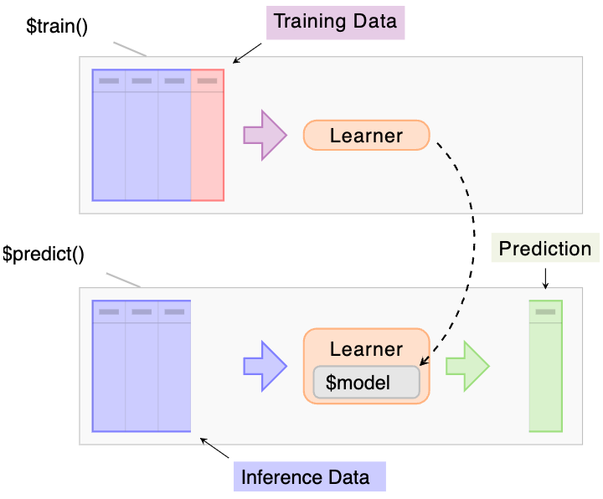
2. Learners
$train(), $predict()
source: mlr3books

Slide 27
task = tsk("german_credit") learner_dt = lrn("classif.rpart", predict_type="prob") split = partition(task, ratio=.3) learner_dt$train(task, row_ids = split$train) prediction = learner_dt$predict(task, row_ids = split$test)

Slide 28
2. Learners
confusion matrix
prediction$confusion
truth response good bad good 422 137 bad 68 73

Slide 29
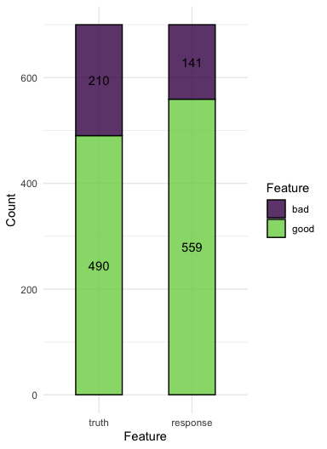
2. Learners
confusion matrix as a bar plot
autoplot(prediction)

Slide 30
Hyperparameter
learner = lrn("classif.rpart", maxdepth = 1) learner$param_set$set_values(xval = 2, maxdepth=3, cp=.5) learner$param_set$values
$xval [1] 2 $maxdepth [1] 3 $cp [1] 0.5

Slide 31
Hyperparameter
Parameter class | Description
ParamDbl | Numeric parameters
ParamInt | Integer parameters
ParamFct | Categorical parameters
ParamLgl | Logical / Boolean paramters
$param_set of learners
setting class, lower, upper
as.data.table(learner$param_set) |> head()
# A tibble: 6 × 11 id class lower upper levels nlevels is_bounded special_vals default <chr> <chr> <dbl> <dbl> <list> <dbl> <lgl> <list> <list> 1 cp Para… 0 1 <NULL> Inf TRUE <list [0]> <dbl [1]> 2 keep_model Para… NA NA <lgl> 2 TRUE <list [0]> <lgl [1]> 3 maxcompete Para… 0 Inf <NULL> Inf FALSE <list [0]> <int [1]> 4 maxdepth Para… 1 30 <NULL> 30 TRUE <list [0]> <int [1]> 5 maxsurrog… Para… 0 Inf <NULL> Inf FALSE <list [0]> <int [1]> 6 minbucket Para… 1 Inf <NULL> Inf FALSE <list [0]> <NoDefalt> # ℹ 2 more variables: storage_type <chr>, tags <list>

Slide 32
Measures
Evaluation of performances
Dictionary: mlr_measures
Sugar function: msr(), msrs()
classif.~, regr.~
$score()
# A tibble: 6 × 6 key label task_type packages predict_type task_properties <chr> <chr> <chr> <list> <chr> <list> 1 aic Akaike Informa… <NA> <chr> <NA> <chr [0]> 2 bic Bayesian Infor… <NA> <chr> <NA> <chr [0]> 3 classif.acc Classification… classif <chr> response <chr [0]> 4 classif.auc Area Under the… classif <chr> prob <chr [1]> 5 classif.bacc Balanced Accur… classif <chr> response <chr [0]> 6 classif.bbrier Binary Brier S… classif <chr> prob <chr [1]>

Slide 33
Measures
msr(): a single performance
measure = msr("classif.acc") prediction$score(measure)
classif.acc 0.7071429

Slide 34
Measures
msrs(): multiple performances
# Multiple measurements measures = msrs(c("classif.acc","classif.ppv","classif.npv","classif.auc")) prediction$score(measures)
classif.acc classif.ppv classif.npv classif.auc 0.7071429 0.7549195 0.5177305 0.6930175

Slide 35
Resampling

Slide 36
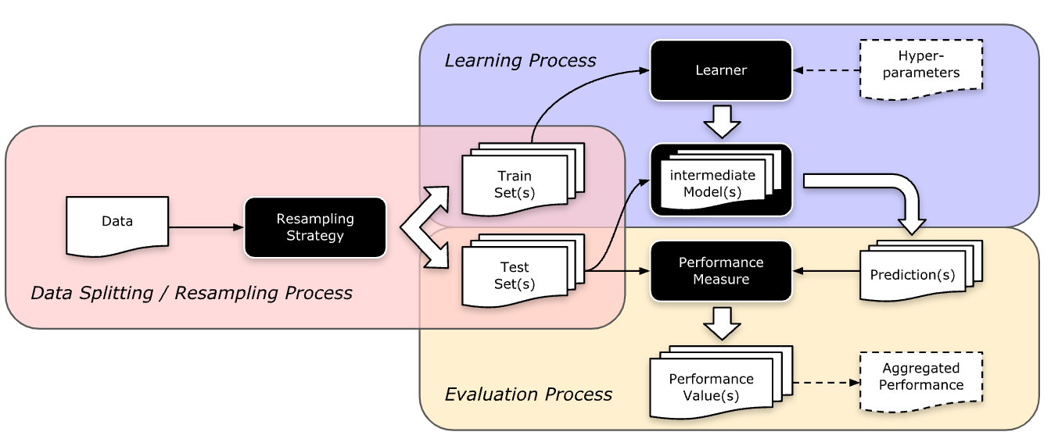
Resampling

Slide 37
Split available data into multiple training and test sets for generalization

Slide 38
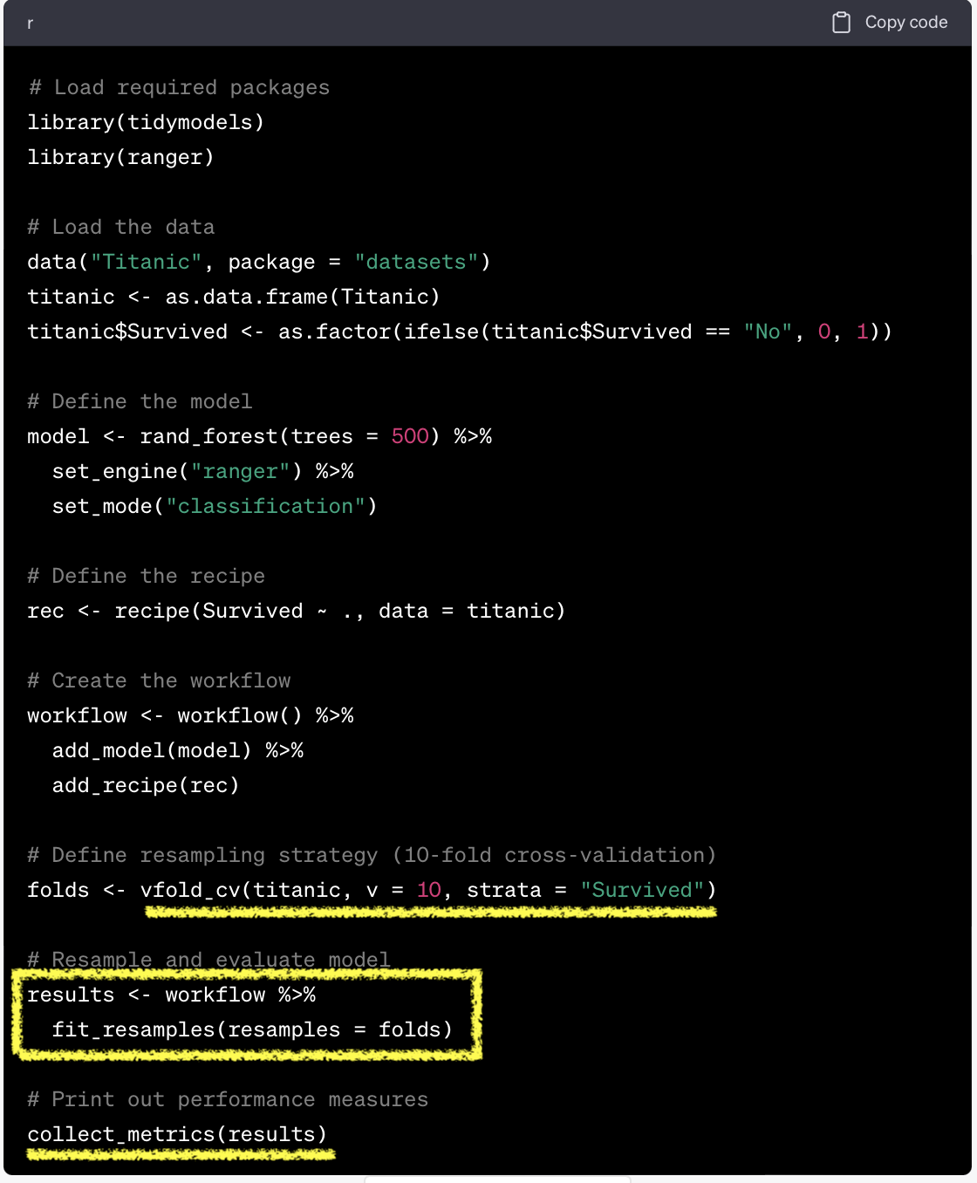
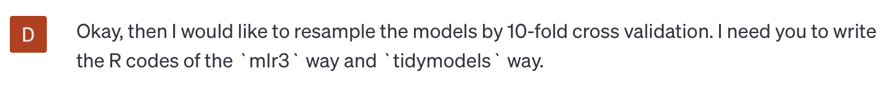
tidymodels vs mlr3

Slide 39
Resampling
Dictionary: mlr_resamplings
Sugar function: rsmp()
# A tibble: 9 × 4 key label params iters <chr> <chr> <list> <int> 1 bootstrap Bootstrap <chr [2]> 30 2 custom Custom Splits <chr [0]> NA 3 custom_cv Custom Split Cross-Validation <chr [0]> NA 4 cv Cross-Validation <chr [1]> 10 5 holdout Holdout <chr [1]> 1 6 insample Insample Resampling <chr [0]> 1 7 loo Leave-One-Out <chr [0]> NA 8 repeated_cv Repeated Cross-Validation <chr [2]> 100 9 subsampling Subsampling <chr [2]> 30
resample = rsmp("cv", folds=10)

Slide 40
Resampling
resample(): initiate resampling
$aggregate(): aggregate resampling performance
task = tsk("german_credit") learner = lrn("classif.ranger", predict_type="prob") resample = rsmp("cv", folds=10) rr = resample(task, learner, resample, store_model=T) measures = msrs(c("classif.acc","classif.ppv","classif.npv","classif.auc")) rr$aggregate(measures)
classif.acc classif.ppv classif.npv classif.auc 0.7610000 0.7818277 0.6598222 0.7952059

Slide 41
Resampling
plotting resampling results
autoplot(rr, type="boxplot", measure = msr("classif.acc")) autoplot(rr, type="histogram", measure = msr("classif.acc"))

Slide 42
Benchmarking

Slide 43
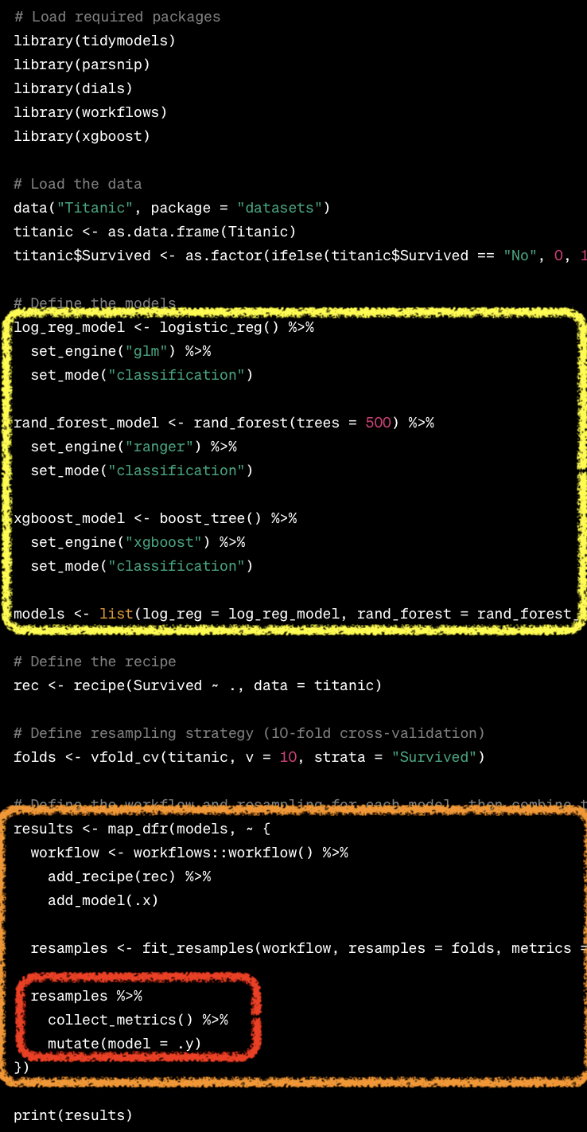
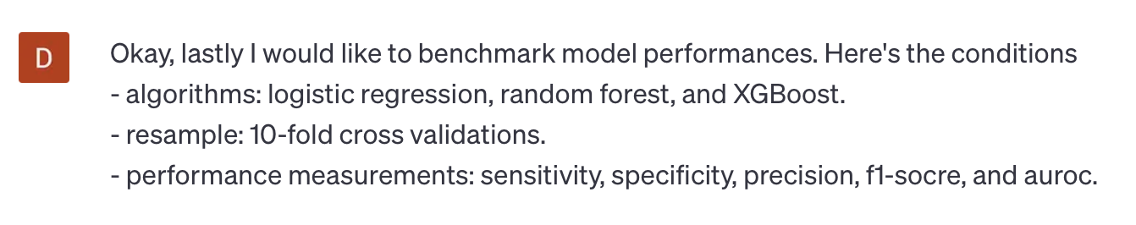
tidymodels vs mlr3

Slide 44
Benchmarking
Comparison of multiple learners on a single task (or multiple tasks).
benchmark_grid(): design a benchmarking
tasks = tsks(c("german_credit", "sonar", "breast_cancer")) learners = list( lrn("classif.log_reg", predict_type="prob", id="LR"), lrn("classif.rpart", predict_type="prob", id="DT"), lrn("classif.ranger", predict_type="prob", id="RF") ) rsmp = rsmp("cv", folds=5) design = benchmark_grid(tasks, learners, rsmp)

Slide 45
Benchmarking
benchmark(): execute benchmarking
bmr = benchmark(design) measures = msrs(c("classif.acc","classif.ppv", "classif.npv", "classif.auc")) as.data.table(bmr$aggregate(measures))
# A tibble: 9 × 10 nr resample_result task_id learner_id resampling_id iters classif.acc <int> <list> <chr> <chr> <chr> <int> <dbl> 1 1 <RsmplRsl> german_credit LR cv 5 0.746 2 2 <RsmplRsl> german_credit DT cv 5 0.736 3 3 <RsmplRsl> german_credit RF cv 5 0.759 4 4 <RsmplRsl> sonar LR cv 5 0.736 5 5 <RsmplRsl> sonar DT cv 5 0.702 6 6 <RsmplRsl> sonar RF cv 5 0.831 7 7 <RsmplRsl> breast_cancer LR cv 5 0.917 8 8 <RsmplRsl> breast_cancer DT cv 5 0.940 9 9 <RsmplRsl> breast_cancer RF cv 5 0.969 # ℹ 3 more variables: classif.ppv <dbl>, classif.npv <dbl>, classif.auc <dbl>

Slide 46
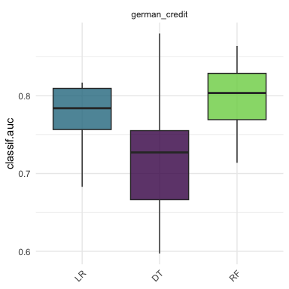
Benchmarking result
task = tsk("german_credit") learners = list( lrn("classif.log_reg", predict_type="prob", id = "LR"), lrn("classif.rpart", predict_type="prob", id = "DT"), lrn("classif.ranger", predict_type="prob", id = "RF") ) cv10 = rsmp("cv", folds=10) design = benchmark_grid(task, learners, cv10) bmr = benchmark(design) autoplot(bmr, measure =msr("classif.auc"))

Slide 47
Benchmarking result
autoplot(bmr, type = "roc") autoplot(bmr, type = "prc")

Slide 48
And so on
Hyperparameter tuning
Feature selection
ML pipelines

Slide 49
Summary
mlr3
R6, data.table based ML framework
Still in development
A great textbook: mlr3book

Slide 50
Thank you!

