Slide 1
Predictive modeling of perspective customers opening a bank account
Yeonjoo Smith
Notes:
Hello, my name is Yeonjoo and Today I would like to present a model that predicts if a client would subscribe a term deposit based on many different types of information using a machine learning technique.

Slide 2
Data and Motivation
Features
Personal information
Financial information
Information about if the bank contacted prior to or for the campaign
Economic situation at the time of the campaign
Outcome: Has the client subscribed a term deposit?
Notes:
The types of information given are 20 features
Features
Personal information --such as job, age, marital status, education,
Financial information --Default credit, owning a housing, having a personal loan
Information about if the bank contacted the client for the previous campaign or for the current campaign -- such as frequency and total number of time contacted, contact type
Economic situation at the time of the campaign – with different metrics representing employment rate, inflation, consumer optimism, average interest rate
Outcome: Has the client subscribed a term deposit?

Slide 3
Can we predict if a client is going to subscribe a term deposit using the information collected about the client?

Slide 4
If we can build such a model, can we have the insight of which features are more influential to decide the outcome?

Slide 5
Modeling Process
Preprocessing data
Machine Learning
Prediction & Evaluating Performance
Loading and cleaning data
Pick features that are relevant to the outcome and not strongly correlated to each other
Divide the data set into the train data set and the test data set
Test different models
Feed the training data set of features and outcomes into each models to “train”
Pick the optimal model and tune it for the best result for prediction
Feed a test feature data into the model
Compare the prediction with the corresponding output
Calculate the accuracy and other metrics to evaluate the performance
Notes:
Our process can be divided into three parts.
The second and third parts can go back and forth to choose and tune the optimal model for our specific situation.
First processing data:
Loading and cleaning data
Pick features that are relevant to the outcome and not strongly correlated to each other
Divide the data set into the train data set and the test data set
We use the train data to train the model what combinations of feature cause a success or a fail to make a client to subscribe
Then the test data is used to evaluate the model’s performance
Second Machine Learning
Test different models
Feed the training data set of features and outcomes into each models to “train”
and check the performance . Compare models to see the speed, performance, and how each one works to interpret the insights besides providing the predictions
(Then) Pick the optimal model and tune it for the best result for prediction,
Finally Prediction & Evaluating Performance
Using the optimal model chosen from the previous step,
Feed a test feature data into the model
Compare the prediction with the corresponding output
Calculate the accuracy and other metrics to evaluate the performance

Slide 6
Can we predict if a client is going to subscribe a term deposit using the information collected about the client?
Yes! For the test data, the prediction achieves over 90% accuracy.
Notes:
So to ask the same question from the beginning of the presentation: Can we predict if a client is going to subscribe a term deposit using the information collected about the client?
Yes, According to the prediction for the test data, the prediction achieves over 90% accuracy

Slide 7
If we can build such a model, can we have the insight of which features are more influential to decide the outcome?
Notes:
For the same question, the answer is yes as well.

Slide 8
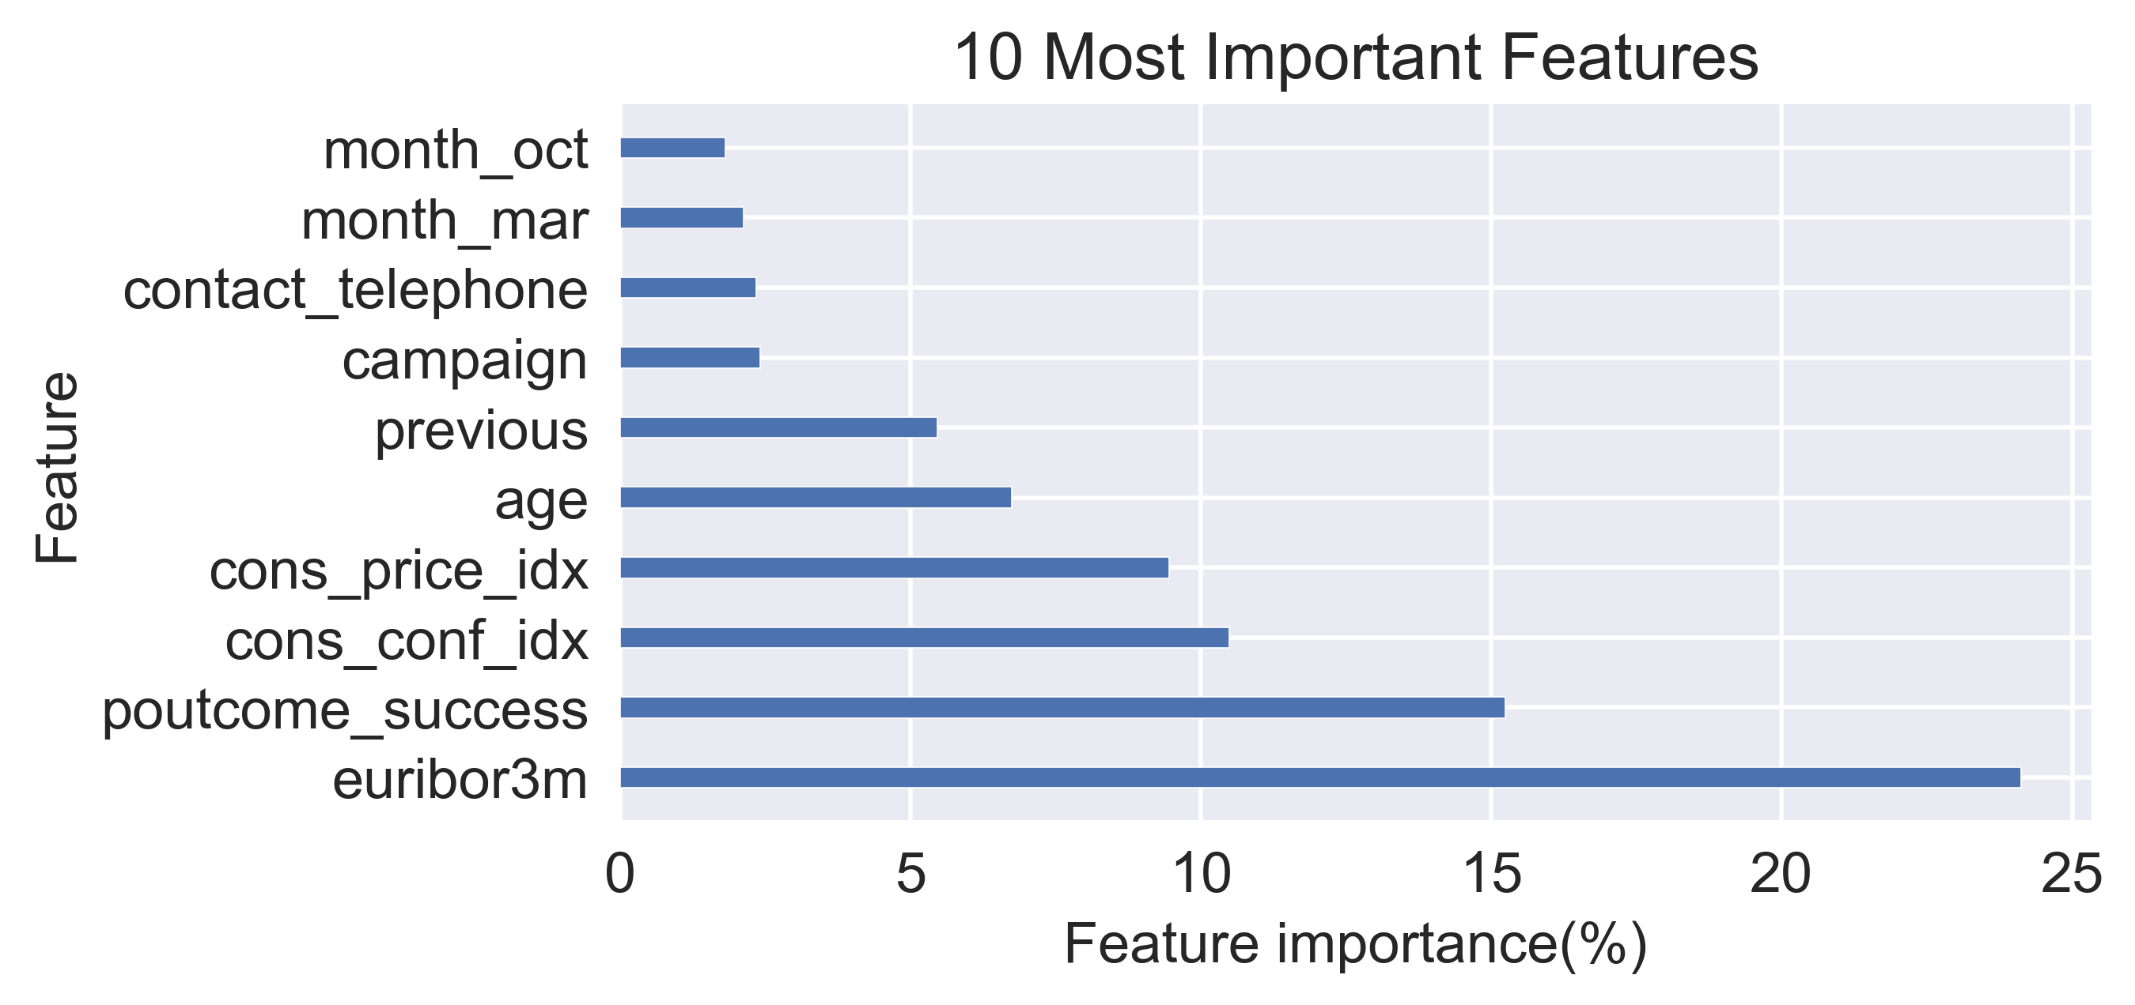
Feature importance
Economical/ social situations
euribor3m: 3 mon. maturity Euribor interest rate
cons_conf_idx: consumer confidence index
cons_price_idx: consumer price index
Previous experience
poutcome_success
previous
campaign
Communication type
contact_telephone
Time of the campaign
month_mar
month_oct
Personal information
age
Notes:
The type of the modeling technique we used is called random forest and it has a way to calculate the feature importance. It is to calculate the ratio in percentage that influence the decision of the outcome. The top 10 most important features are plotted in this graph.
The most influential category was for economical and social situations
Euribor3m(-): 3 mon. maturity Euribor interest rate
cons_conf_idx: consumer confidence which represent how optimistic consumers are for the economy based on the average shopping pattern
Cons_price_idx: consumer price index which reflects the inflation
The second category is for Previous experience
poutcome_success: successful outcome of previous campaign
previous: number of contact performed before this campaign
campaign: : number of contacts performed during this campaign
Then, only one personal information category made to top is Age group
Age
Further more, Communication type between cellphone and telephone mattered.
contact_telephone(-): telephone instead of cell phone
Finally the timing of the campaign influenced too.
month_mar(+)
month_oct(+)
Euribor3m(-):The 3 month maturity Euribor interest rate is the interest rate at which a selection of European banks lend one another funds denominated in euros whereby the loans have a maturity of 3 months.
Poutcome_success(+) success of the previous marketing campaign
Cons_price_idx(-) measure of inflation rate (monthly)
Cons_conf_idx(+), consumer confidence index (monthly)measure of if consumers are optimistic; if they tend to purchase more goods and survices to stimulate whole economy
Age(+)
Previous(+) # of contacts performed before this campaign

Slide 9
Limitations and Future Direction
The model predictions and feature importance should be used as clues not as the whole picture
Combine business ideas and feature importance to develop a plan to increase the success rate
Methods and frequency of contacting clients
Maintaining the connection with current/perspective clients
Campaign targeting timing and specific age groups
Notes:
Now what do we do with this model?
First we should keep in mind that
The model predictions and feature importance should be used as clues not as the whole picture
This model uses the technique solely focused on how to get the output correctly although the results could be related for applications. Therefore it should be combined with other knowledge such as marketing to make our findings more concrete.
Combine business ideas and feature importance to develop a plan to increase the success rate
For example,
Methods and frequency of contacting clients, how often should the bank contact a client for a successful campaign.
Maintaining the connection with current/perspective clients are important
Campaign targeting timing and specific age groups: plan a campaign to target specific time of the year or specific age group may be recommended.

Slide 10
Thank you!

Slide 11
SlidesCarnival icons are editable shapes.
This means that you can:
Resize them without losing quality.
Change line color, width and style.
Isn’t that nice? :)
Examples:

Slide 12
😉
Now you can use any emoji as an icon!
And of course it resizes without losing quality and you can change the color.
How? Follow Google instructions https://twitter.com/googledocs/status/730087240156643328
✋👆👉👍👤👦👧👨👩👪💃🏃💑❤😂😉😋😒😭👶😸🐟🍒🍔💣📌📖🔨🎃🎈🎨🏈🏰🌏🔌🔑 and many more...

