Slide 1
Exploring factors to increase sales
Yeonjoo Smith
Notes:
Good afternoon, my name is Yeonjoo
I would like to present what factors influenced sales in northwind database.

Slide 2
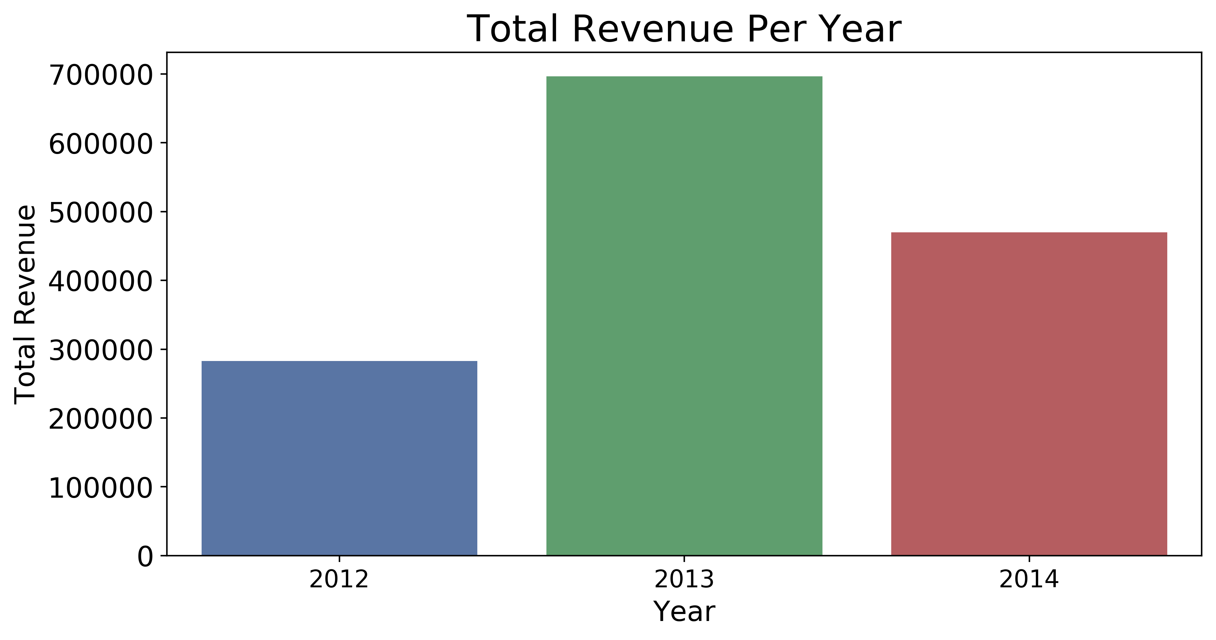
Motivation: Total Revenue Change Over Years
Finding factors that affect total revenue
Total spending per order
Quantity per order
Customer retention rate
Orders per client in a year
Suggestion
Discounts
Notes:
The motivation of the project is that
the total revenue per year drastically changed over three years from 2012 to 2014.
It increased from 2012 to 2013 then dropped in 2014.
So I investigated to find factors that can explain these changes.
We will look at changes in
total spending per order,
quantity per order
customer retention rate
number of orders per client in a year.
Then
as suggestion to increase the revenue,
we will discuss the effect of discounts on quantities per order

Slide 3
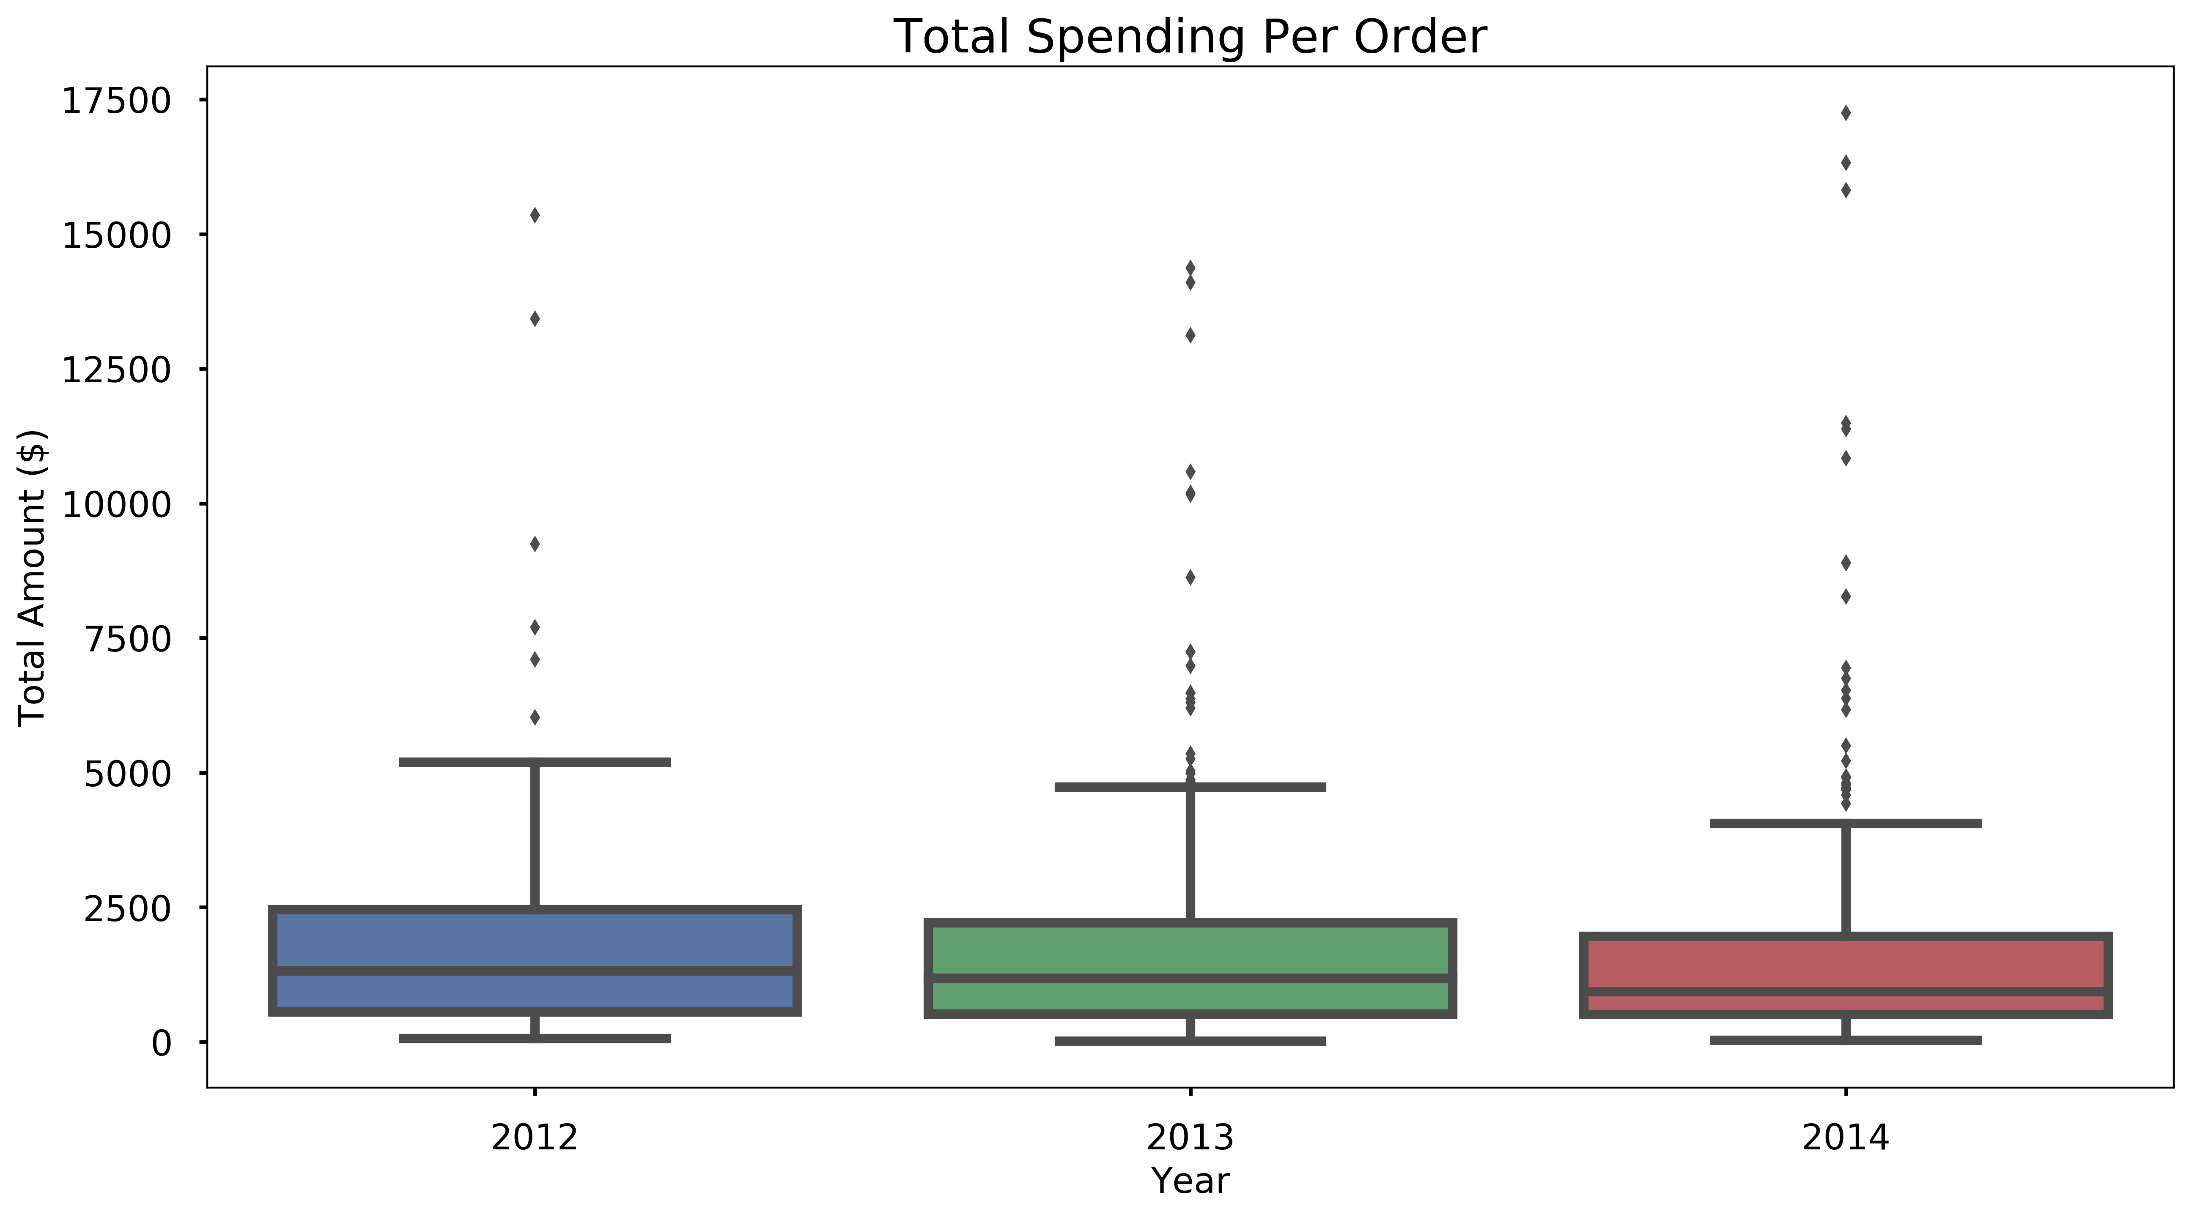
Total Spending per Order: Do customers spend more/less per order?
Average spending per each order
In 2012:$1862
In 2013:$1707
In 2014:$1740
Statistical testing* result:
Not significant
Amount of spending per order stayed consistent!
*:ANOVA test
Notes:
Studying total spending per order is to answer
whether or not customer spend more or less per order.
Average spending per order in each year was calculated that
In 2012 it is the highest and in 2013 it is the lowest
which does not reflect the total revenue data.
The distribution of total spending per orders shows very similar shape for those three years
And the ANOVA test to check the significance in difference between these average spending shows that amount of spending per order stayed consistent.
So the customer spends about the same per order and it did not drive the revenue change

Slide 4
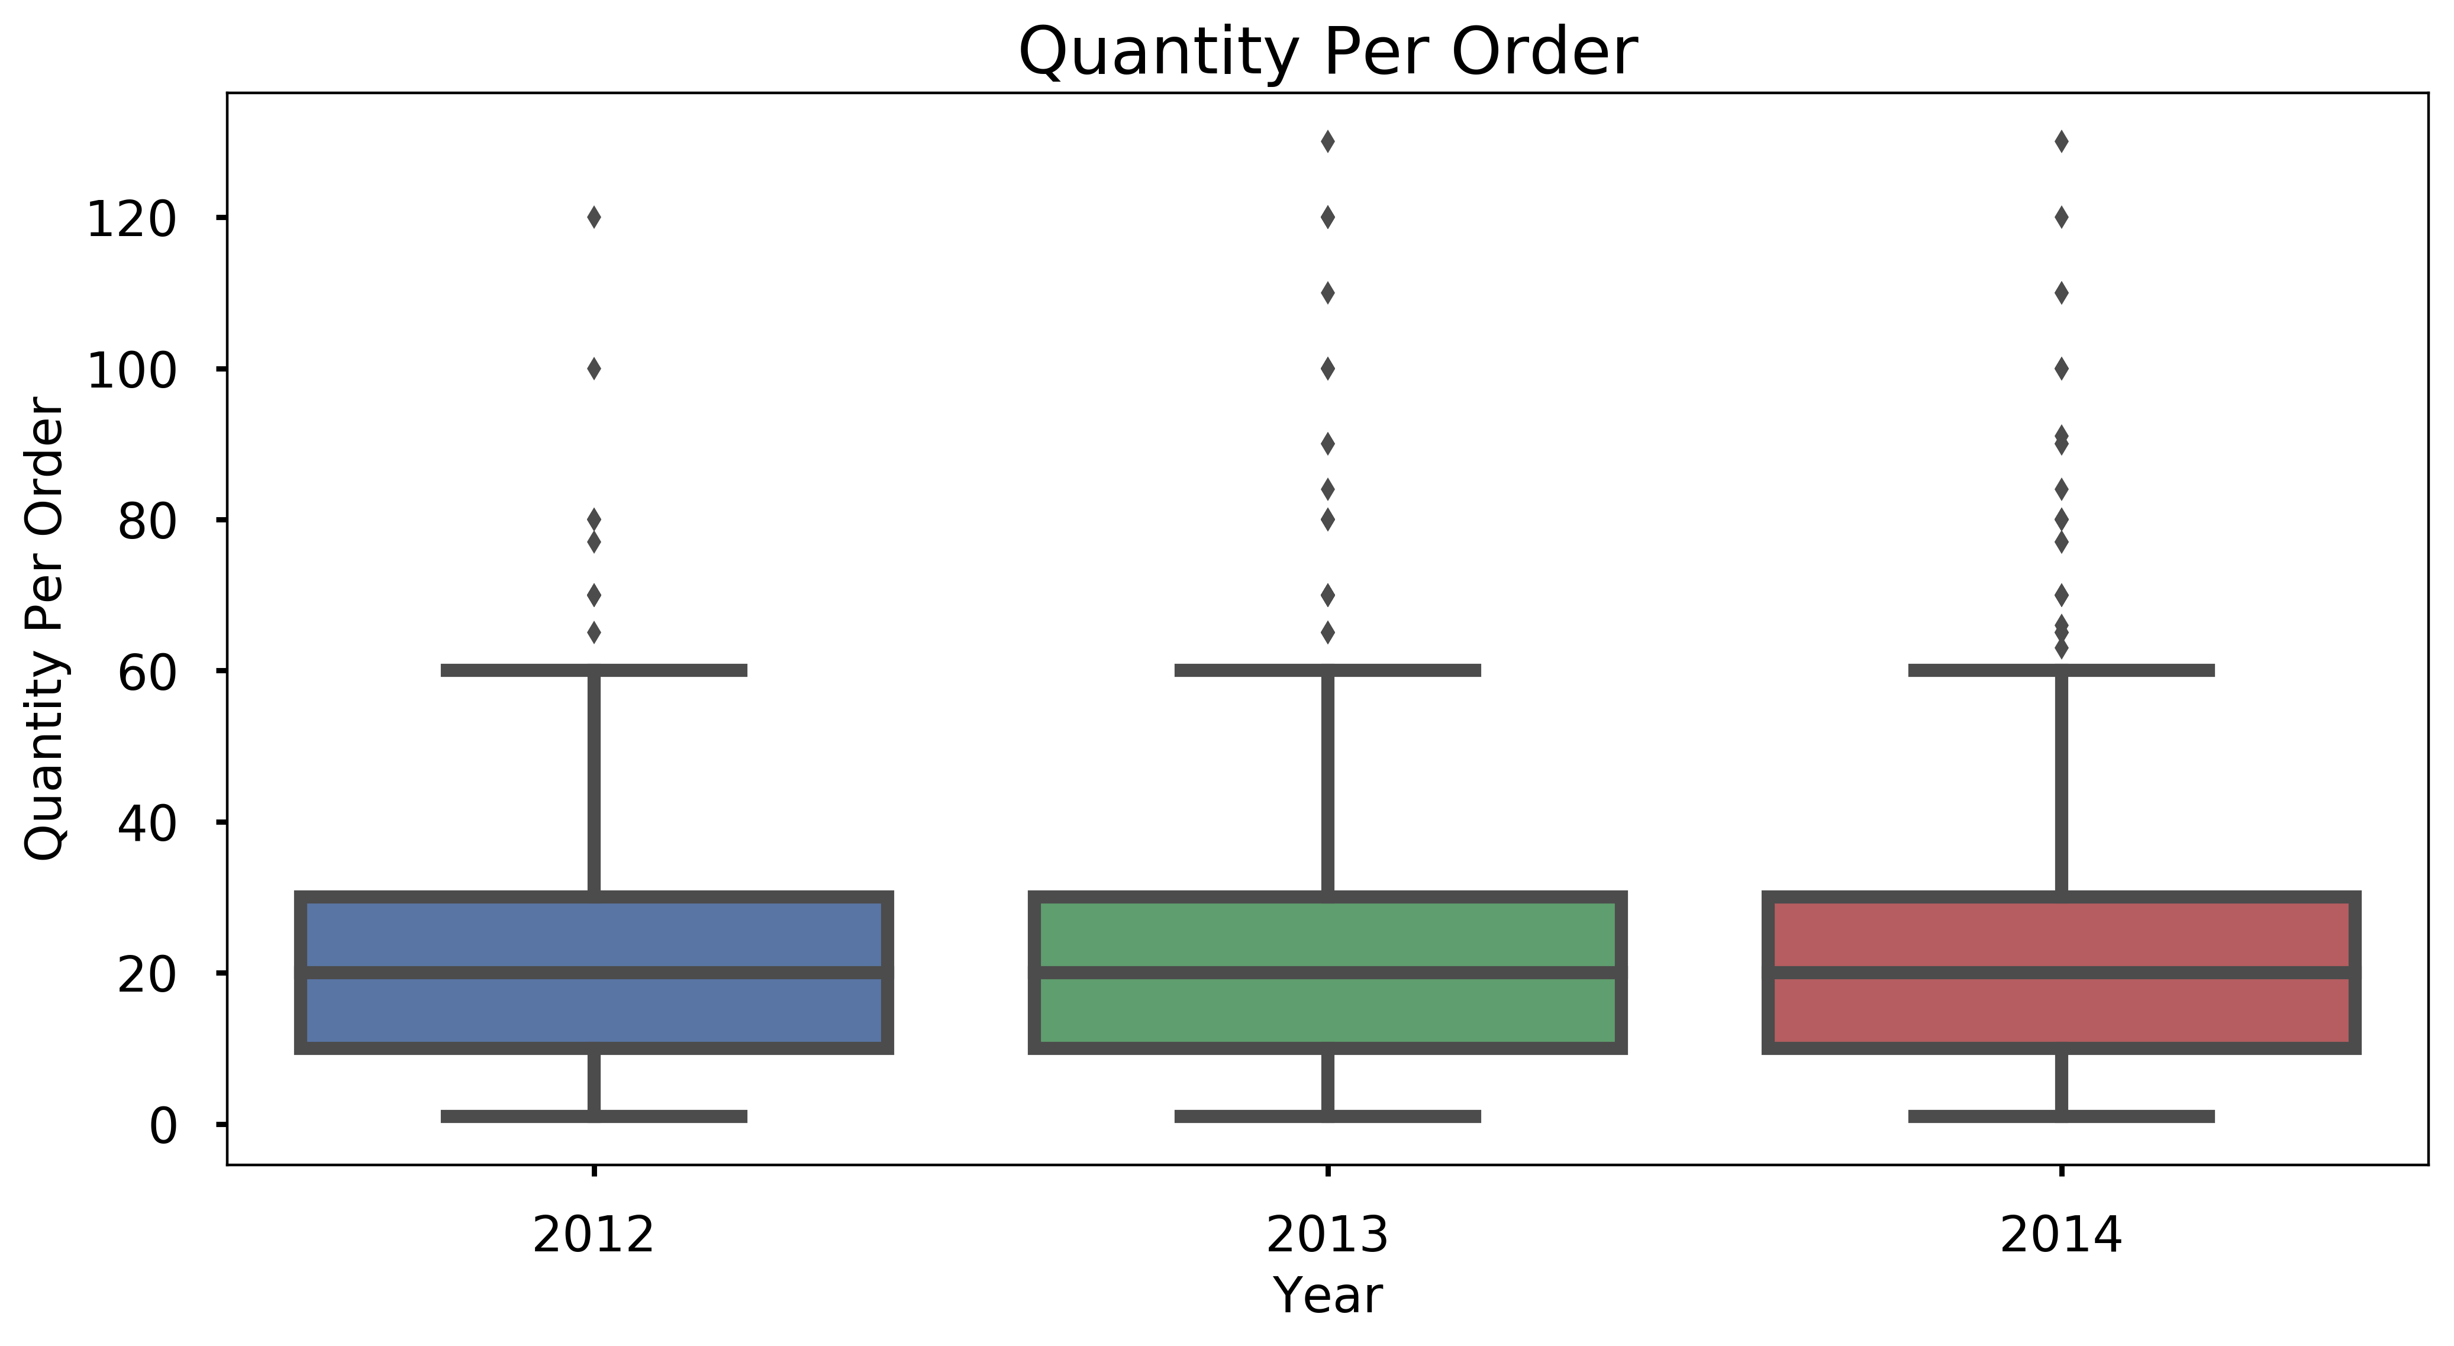
Quantity per Order: Do customers order more/less quantity of a product per order?
Average quantity per each order
In 2012: 23.66 units
In 2013: 24.07 units
In 2014:23.5 units
Statistical test* result:
Not significant
Amount of quantity per order stayed consistent!
*:ANOVA test
Notes:
How about Quantity per order? It is to ask if customers order more/less quantity of a product per order?
Again, the average values look similar and so does the distributions.
To check the significance of difference between the average quantity per order in those three years :
ANOVA testing shows no significance ;which means
the quantity per order hasn’t changed.

Slide 5
New Customers and Retention Rate
Answer for rapid revenue increase in 2013!
New customers:
In 2013: 19
In 2014:1
Retention rate:
In 2013:98%
In 2014: 100%
AWESOME!
But… What about the decrease in revenue for 2014?
Notes:
What about the retention rate?
There are 13 new customers in 2013 and one new customer in 2014 and that explains the rapid revenue growth in 2013.
Next, retention rate,
It is great to see that the retention rate being 98% and 100 % in 2013 and 2014
but we still need to find the factor for the decrease in revenue in 2014.

Slide 6
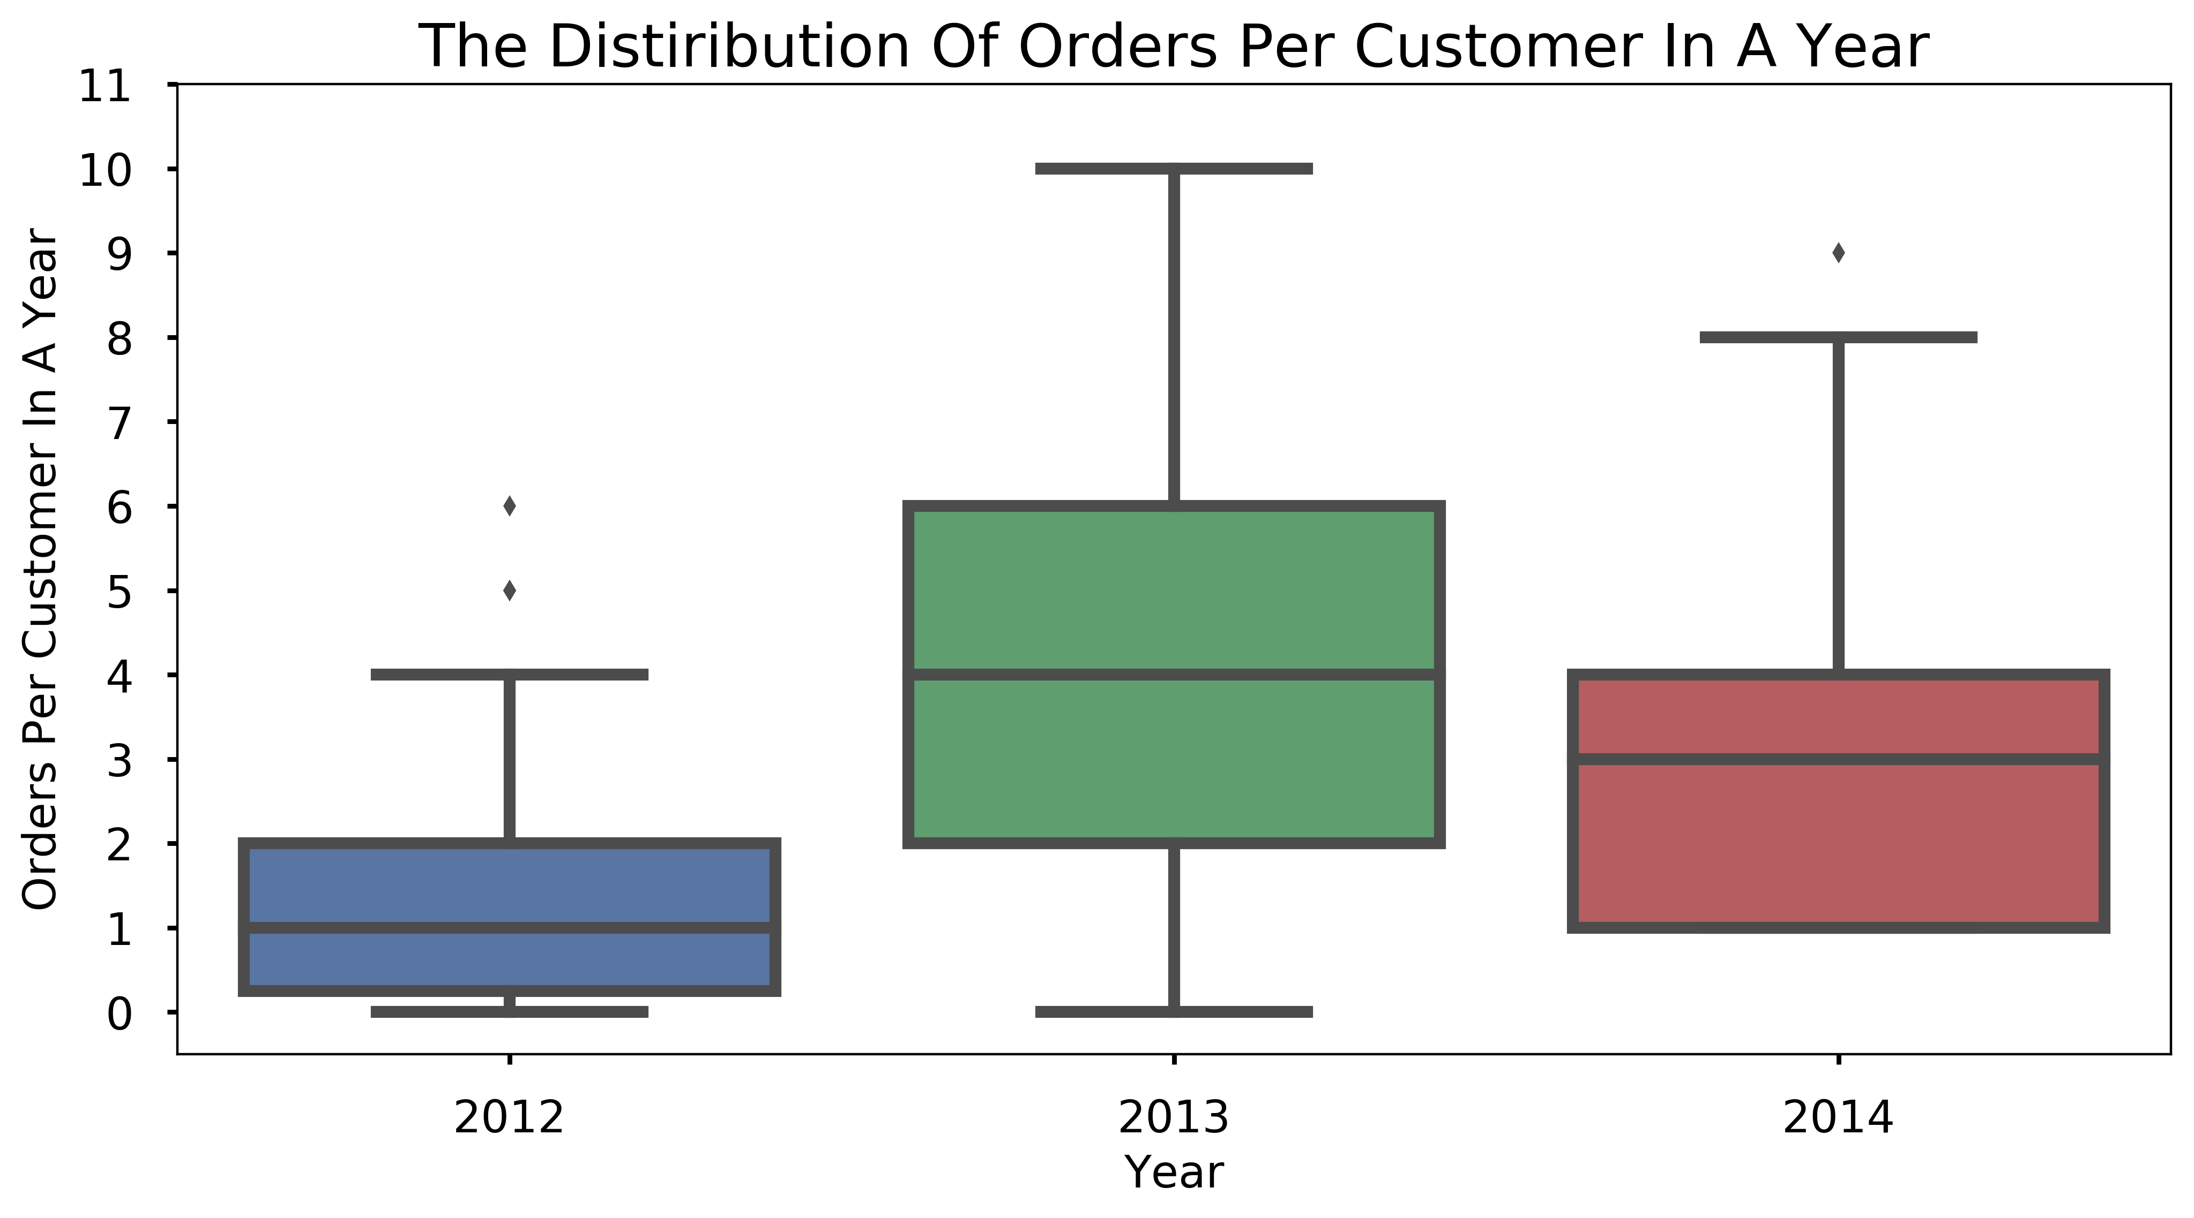
Frequency of Orders
Average orders per client in a year
In 2012:1.73 times
In 2013: 4.69 times
In 2014:3.33 times
Statistical test 1 * result:
SIGNIFICANT!!
The order frequency has changed!
Change from 2013 to 2014:
Statistical test2** result:
Customers shopped less frequently in 2014!
*:ANOVA test, **:Welch’s t-test
Notes:
Finally frequency of orders to answer how often customers made an order in each year.
The difference in average orders per client in each year seems apparent and the distribution seems to show the shifting up in 2013 and down in 2014 compare to the previous year.
ANOVA test confirms that these differences are significant moreover using welch’s t-test is conducted to conclude that customers shopped less frequently in 2014 which explain the decrease in revenue!

Slide 7
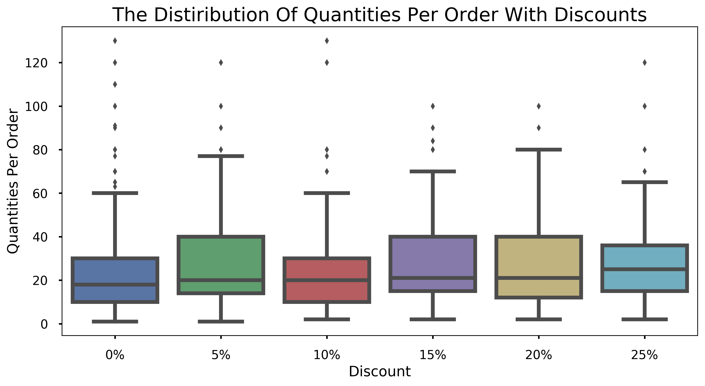
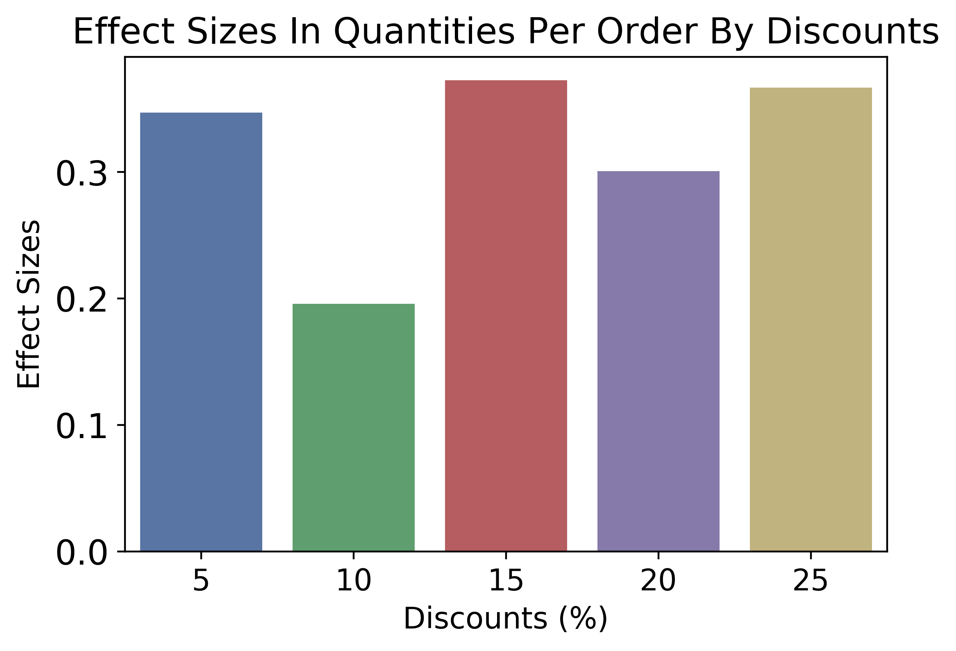
Do discounts make people buy more in general?
Average quantity per order:
0%:21.72 units
5% :28 units
15%:28.38 units
25%28.24 units
Statistical test* result:
SIGNIFICANT !!
The quantity per order increase with ANY discount!!
14% would order 6 more!
*:ANOVA test
Notes:
Now we know why the total revenue changed over years, we explore a way to increase sales.
We ask if giving a discount make people buy more.
Looking at quantity per order with varied level of discount, the distributions with all level of discounts were placed higher than the group without discount which is the red one in the first plot.
The ANOVA test to confirms that the quantity per order increase with any level of discount.
The effect size which is the measure of difference between no discount group and the group with each discount level shows that
5% discount group could have similar impact as the greater discounts on increase in quantity per order.
Moreover the effect size 0.35 showing as the red line can be translated as 14 % of orders would have more 6 units in quantity with the discount .

Slide 8
Summary
Total revenue increase in 2013
Increase of new customers in 2013
Total revenue decrease in 2014
Insignificant:
Total spending per order
Quantity per order
100% retention rate
Significant:
Frequency of orders per customer
Suggestion: Discount
Quantity in a order increase with discounts
Give 5% discount
Notes:
To summarize,
Total revenue increase 2013 is explained by the increase of new customers in 2013,
Total revenue decrease in 2014 is explained by decrease in number of orders per client in a year
and total spending per order and quantity per order stayed consistent.
For suggestion, discount make people order more and 5% discount could be good enough!

Slide 9
Suggestions for further investigation
Factors that drive new clients in 2013
Ideas for increasing frequency of orders such as coupons or events
Factors that lower order counts
Shipping process time
Sales divided into category
Sales divided into different regions
Notes:
Lastly, in future
We can investigate factors that drive new customers like in 2013
And
Ideas for increasing frequency of orders such as coupon or events
And we need to investigate the factors that may decrease number of orders
in shipping process time,
sales in different categories, and/or regions.

Slide 10
Notes:
Thank you.

