Slide 1
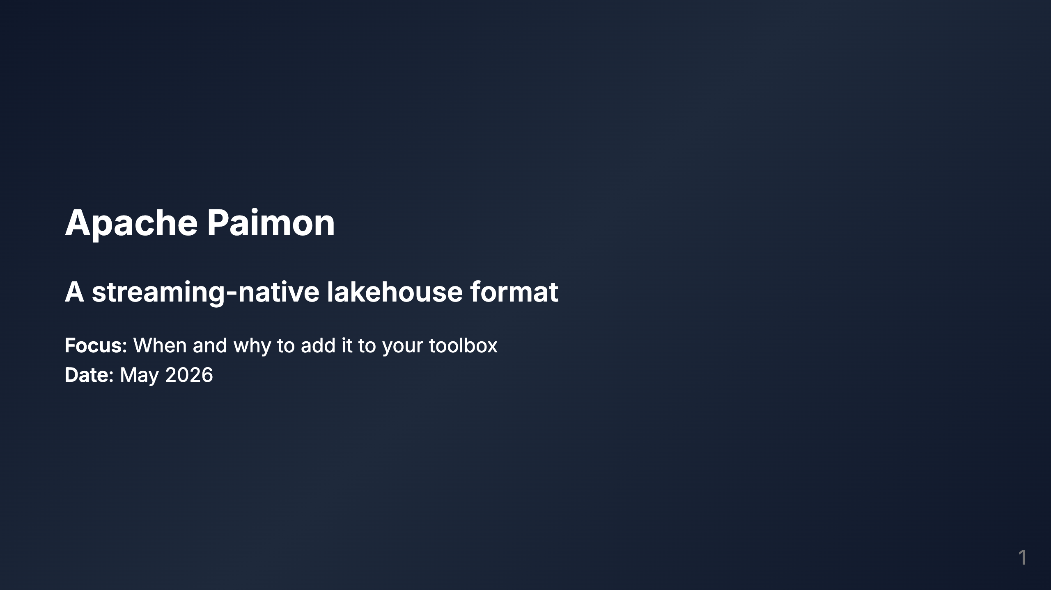

Slide 2

Notes:
SPEAKER NOTES: Recently, I attended a data conference where one particular presentation caught my eye: the speaker set out to demonstrate that Iceberg tables can effectively be used in high-scale streaming pipelines. He walked through various strategies, including tuning configurations, managing compaction, and deciding between Copy-On-Write and Merge-On-Read approaches. Great talk, I must say. I only have to agree with him. Yes, it is possible. I've worked in high-volume streaming architectures with Delta Lake, Iceberg's most direct competitor. It works, and it works great. However, it requires dedicated attention. Both will suffer from small file issues, and both will need specific tuning. I did it once, I would do it again. No regrets. Apache Paimon is a streaming-first Open Table Format that promises to alleviate streaming-first architecture pains. It's a good time to pick it up and see what this new kid in the neighborhood is about.

Slide 3
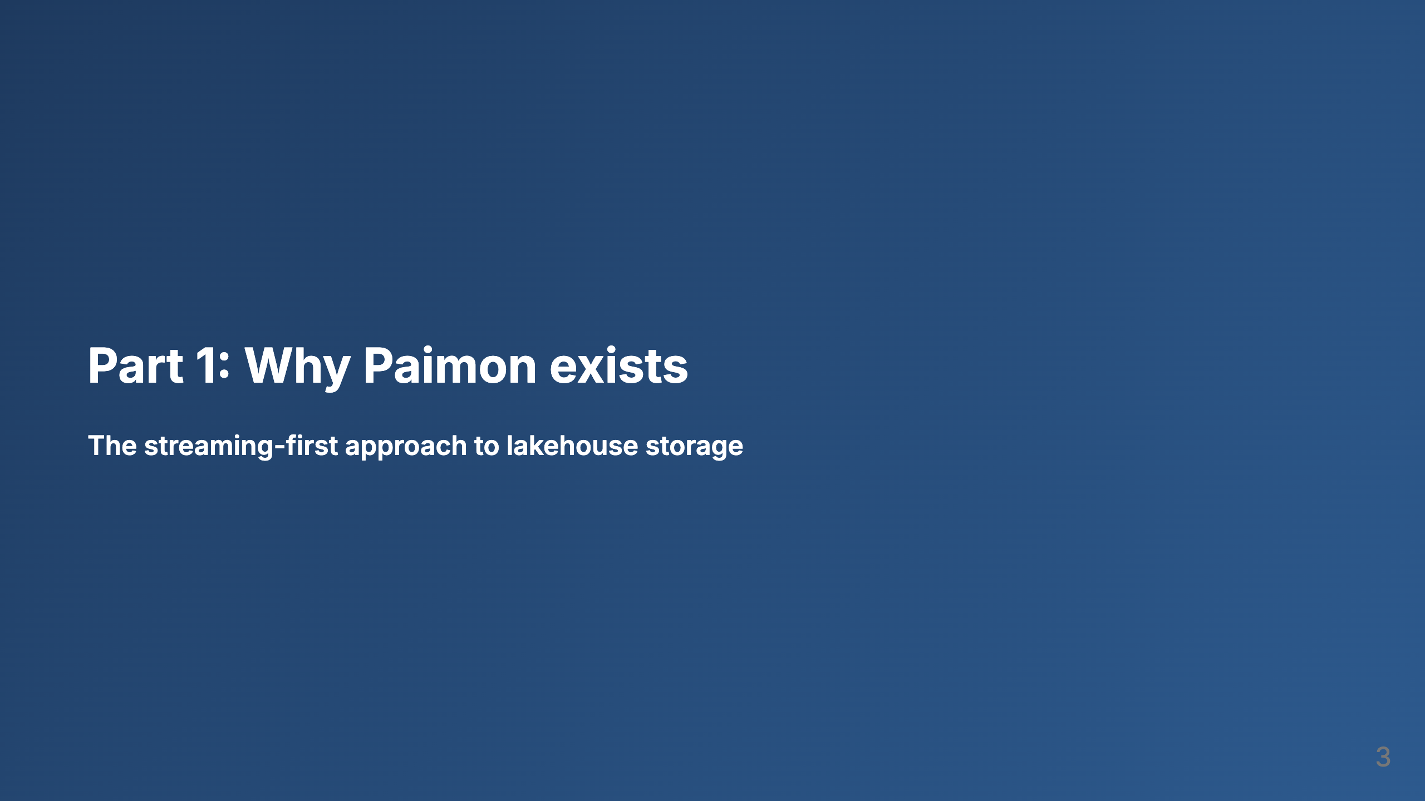

Slide 4
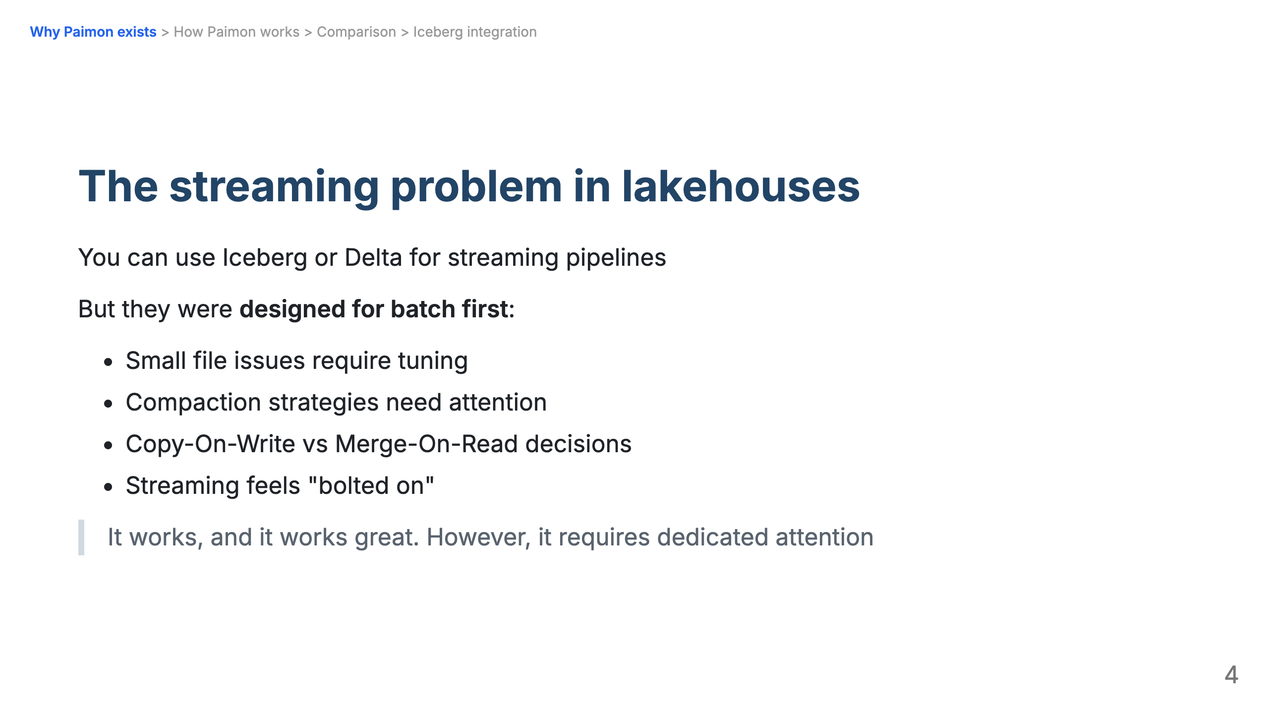

Slide 5
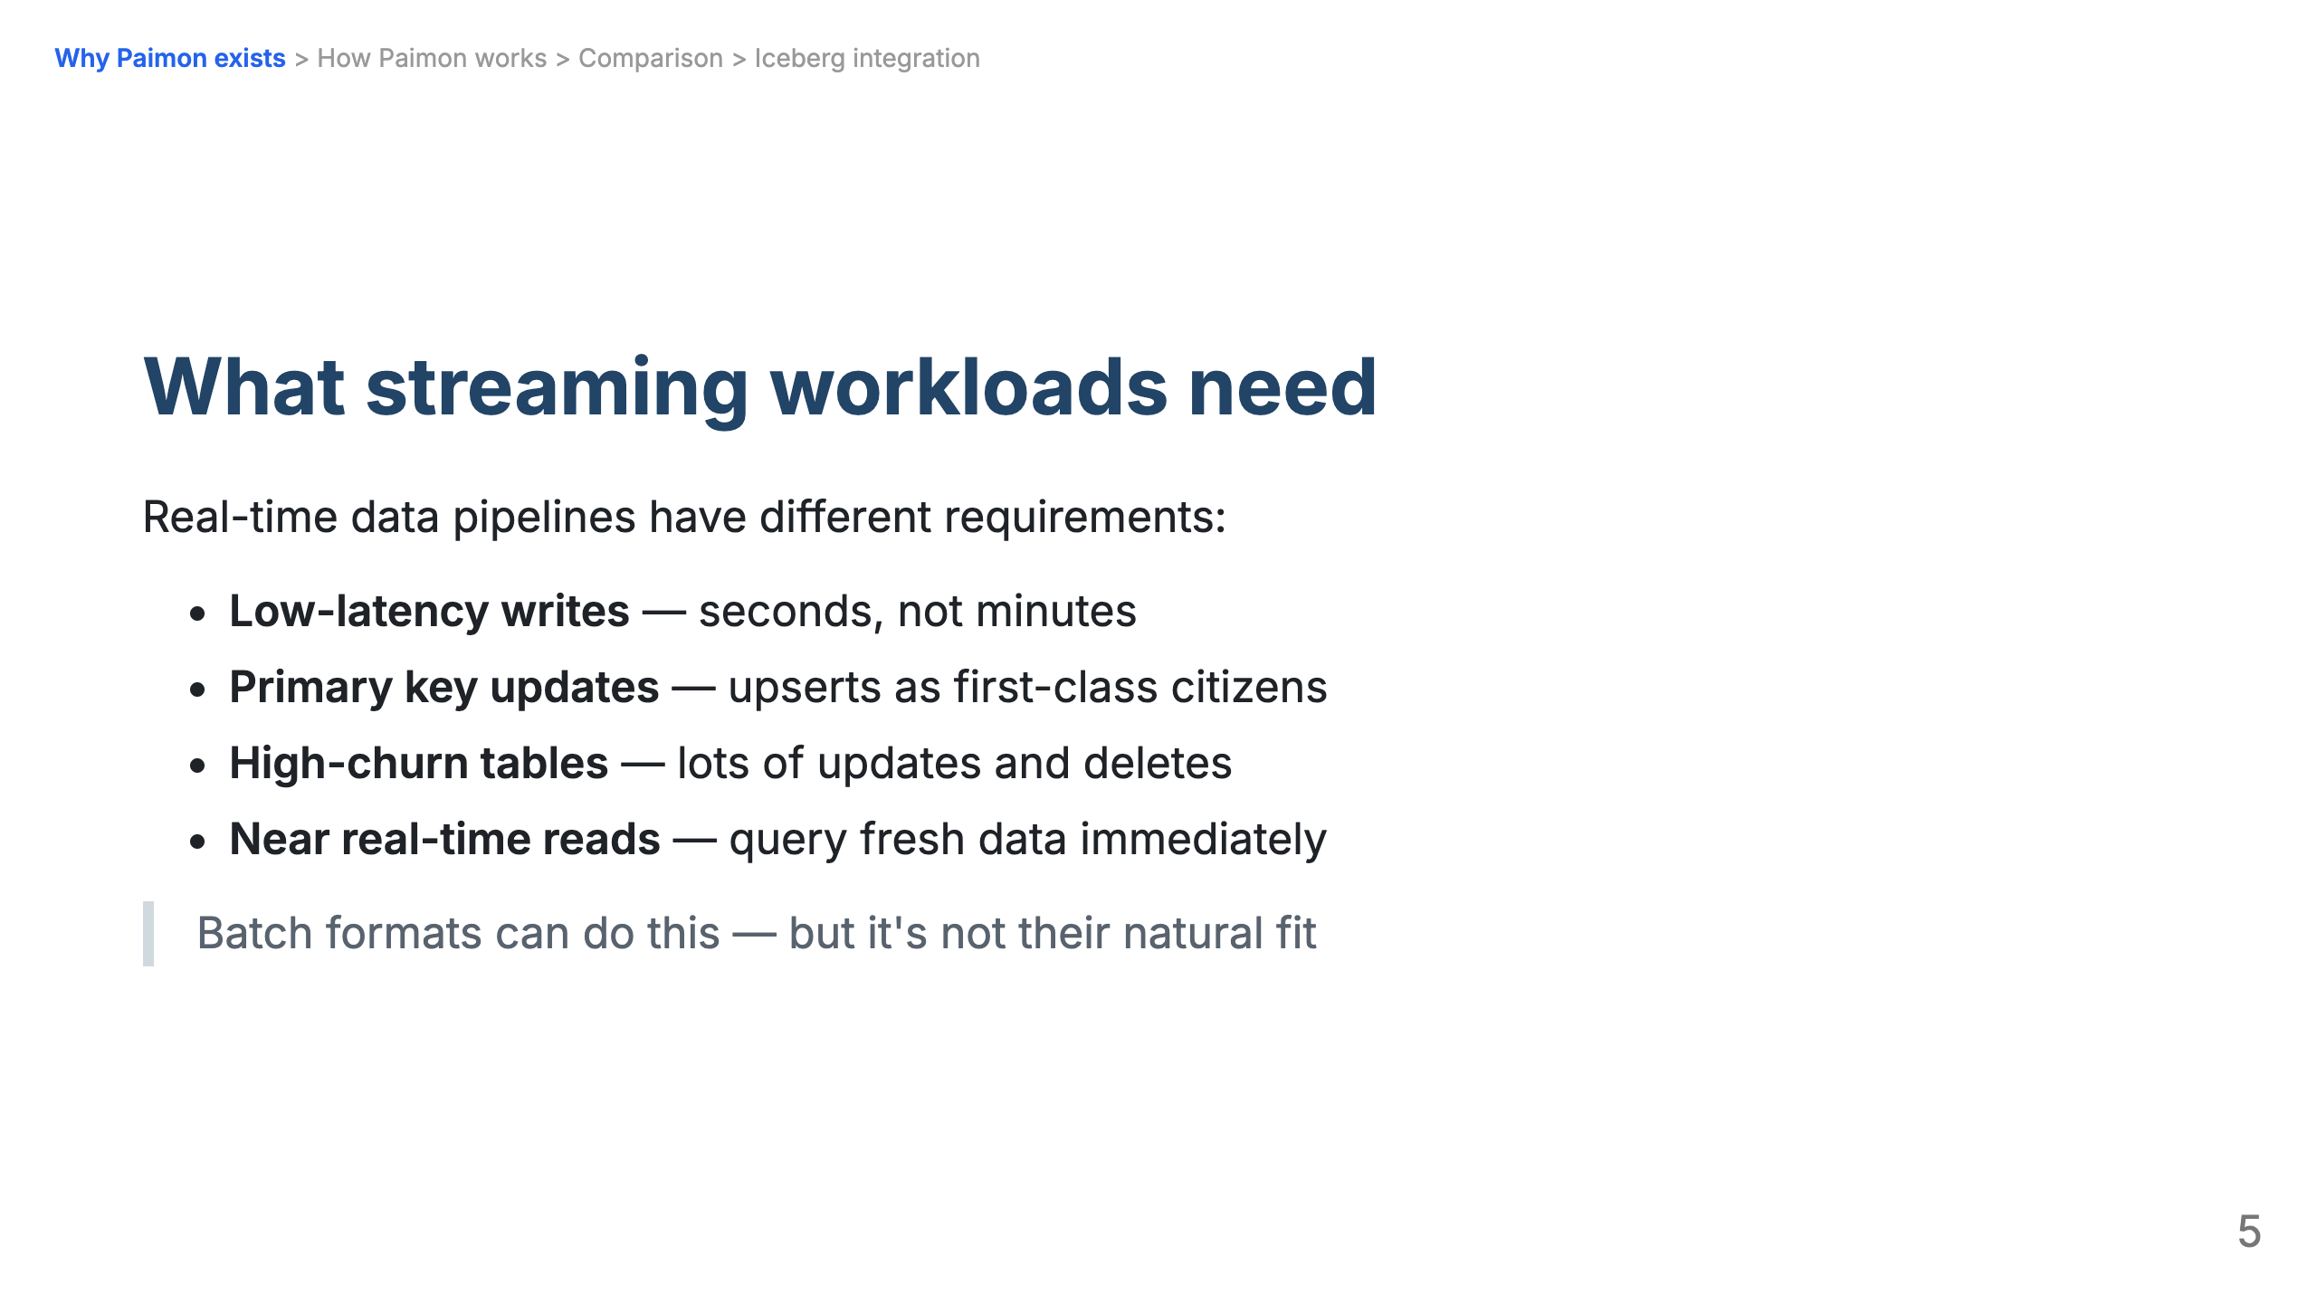

Slide 6
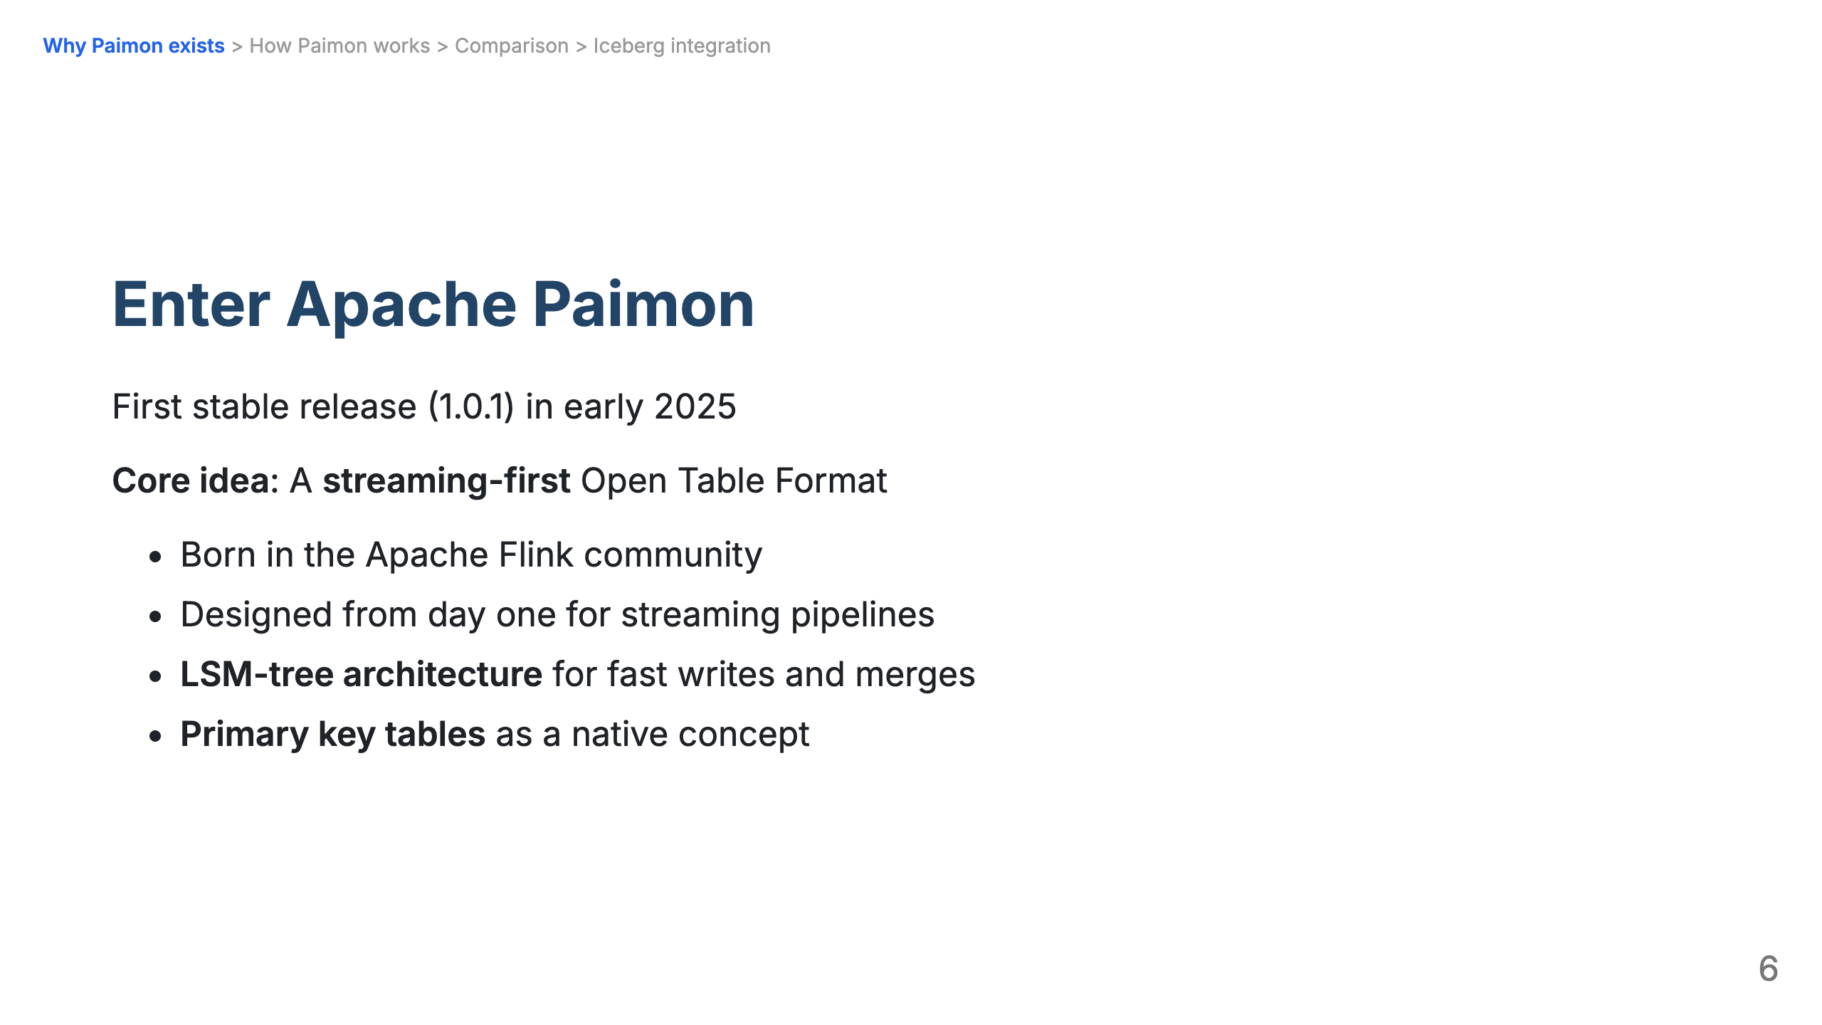

Slide 7
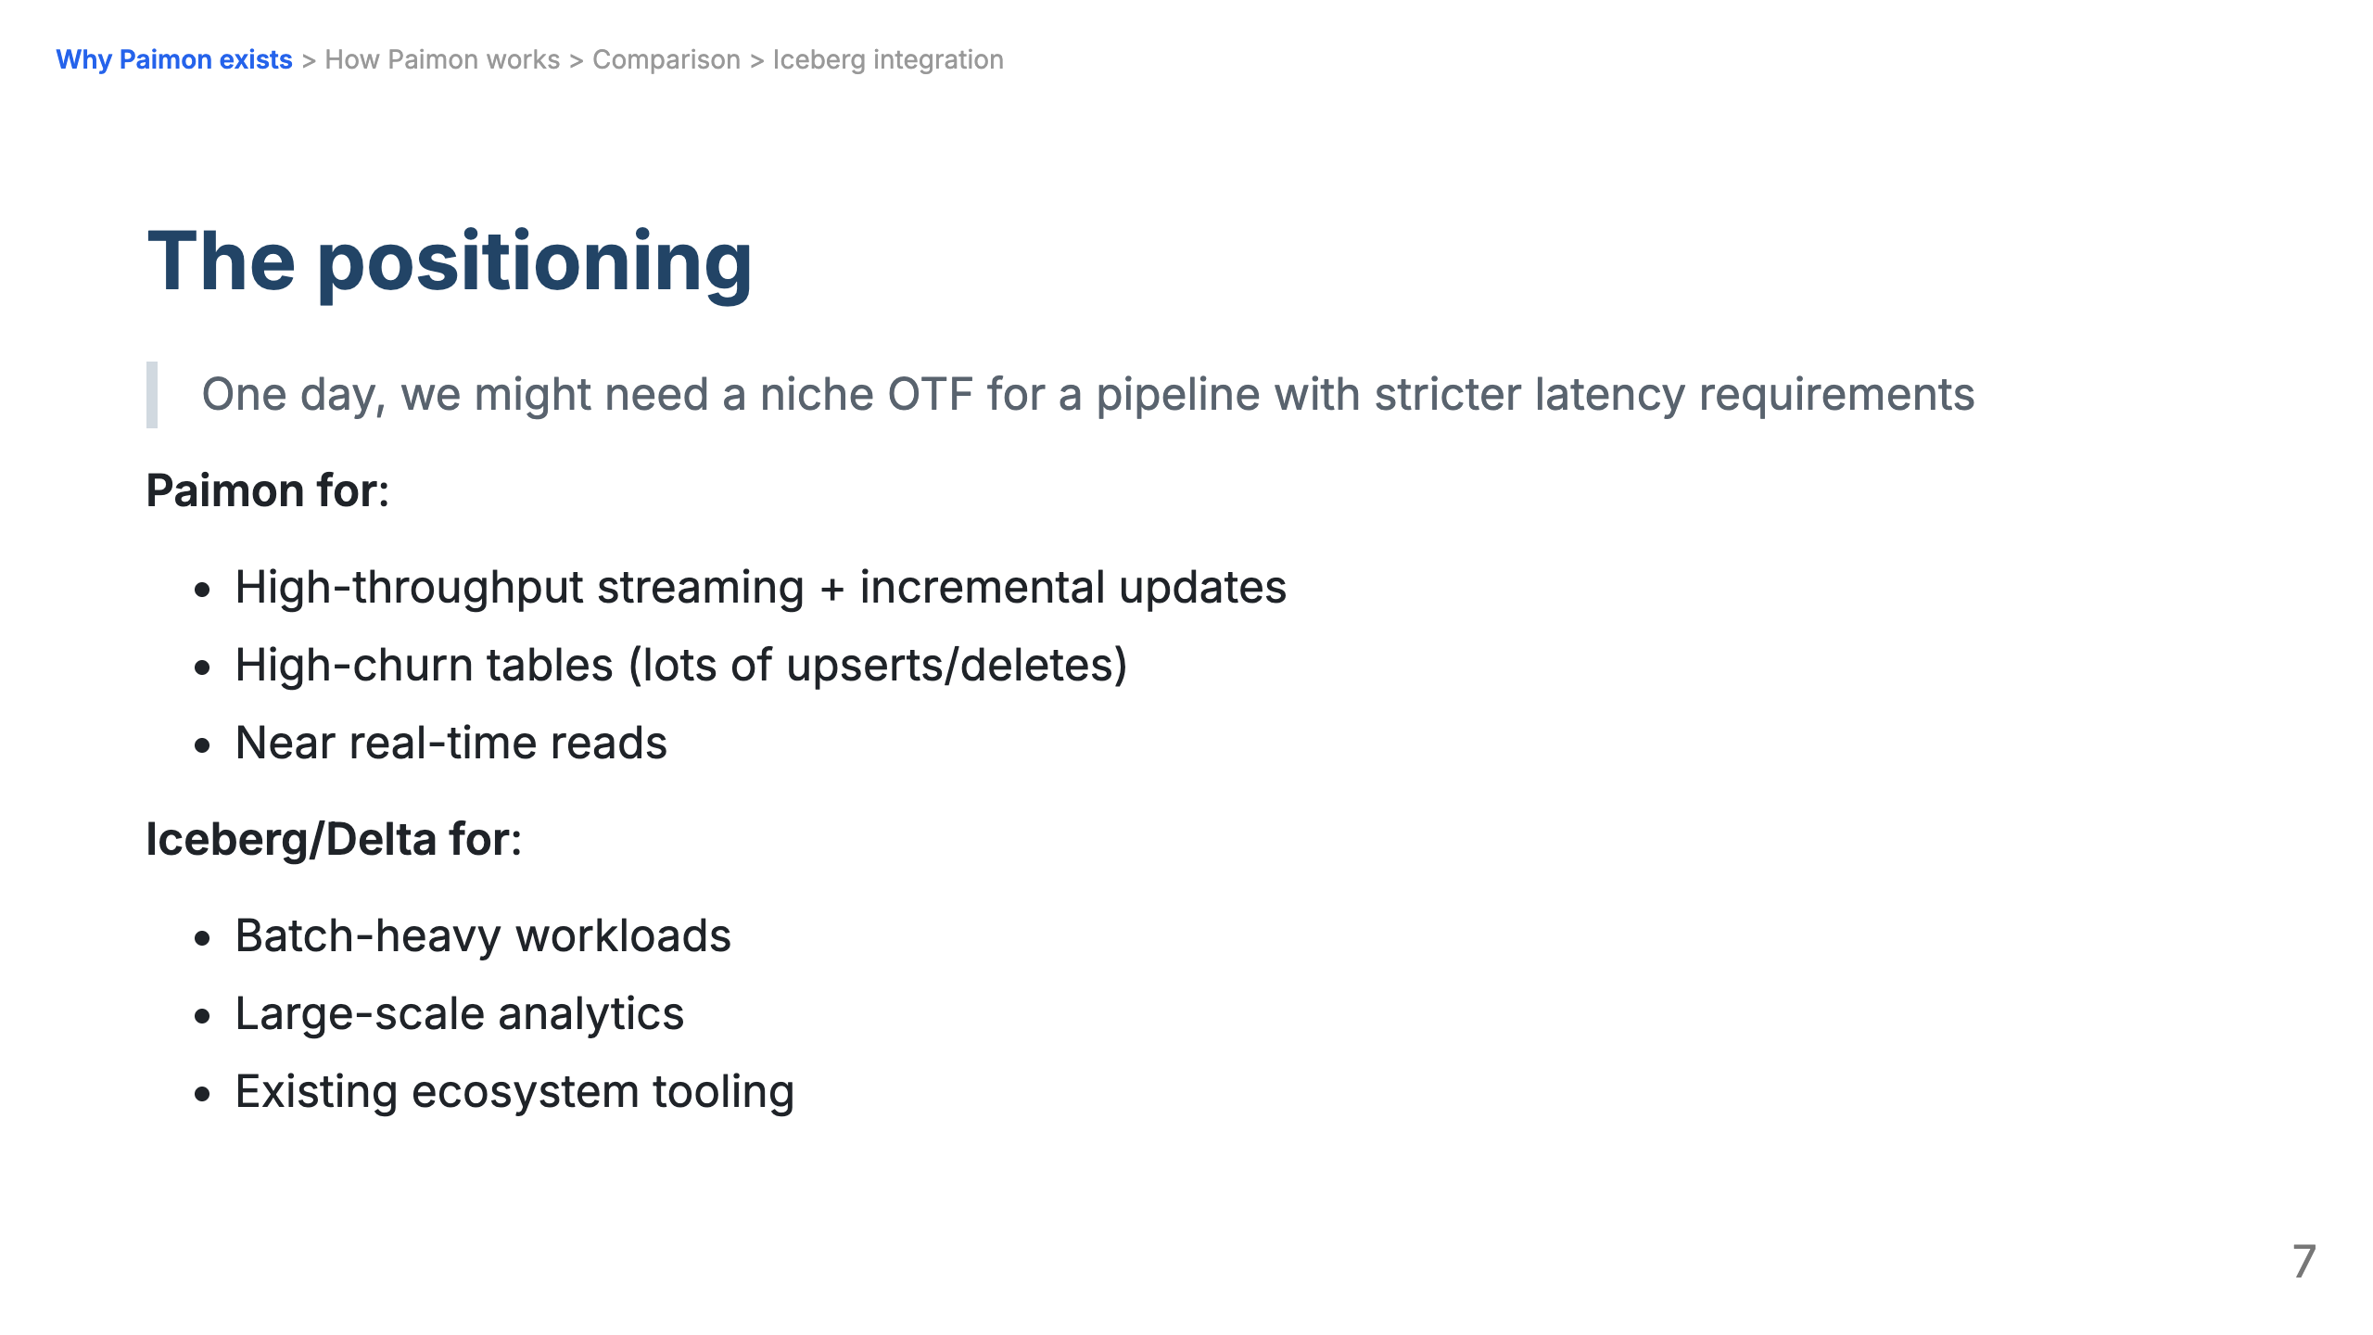

Slide 8
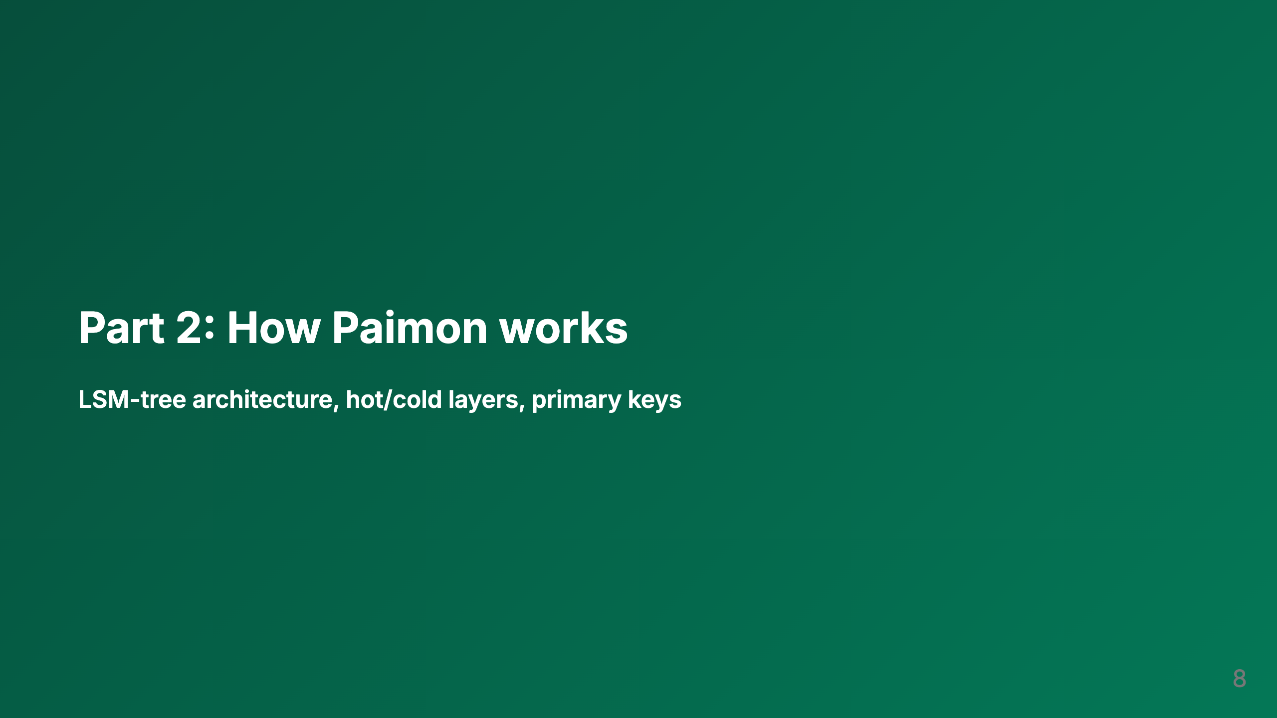

Slide 9
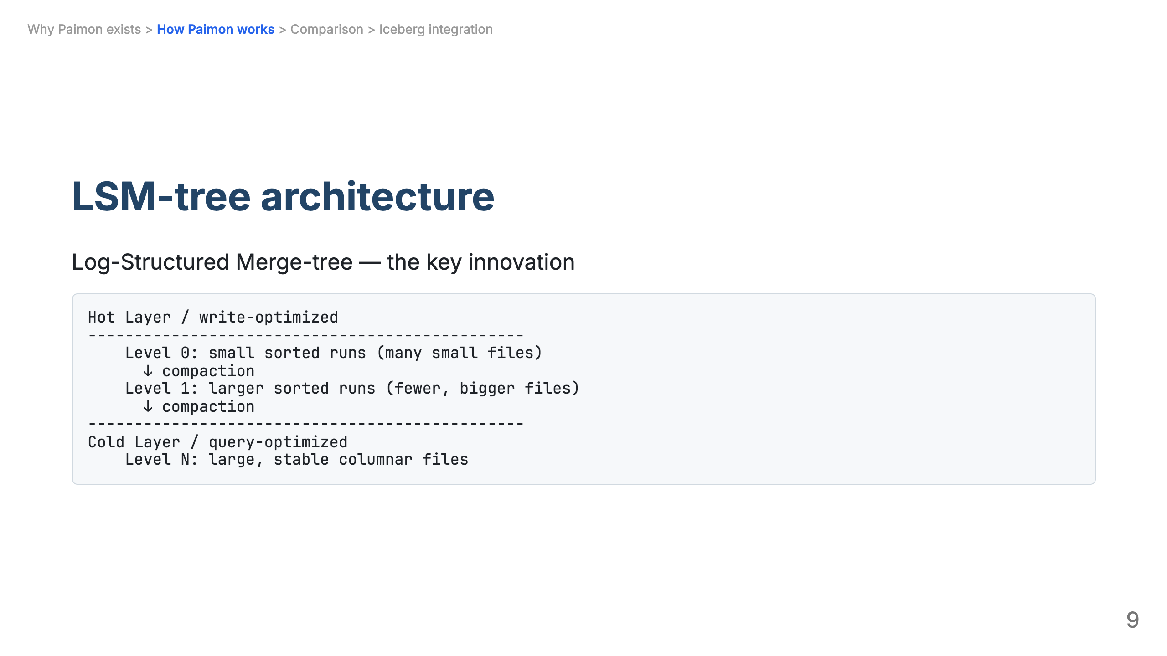

Slide 10
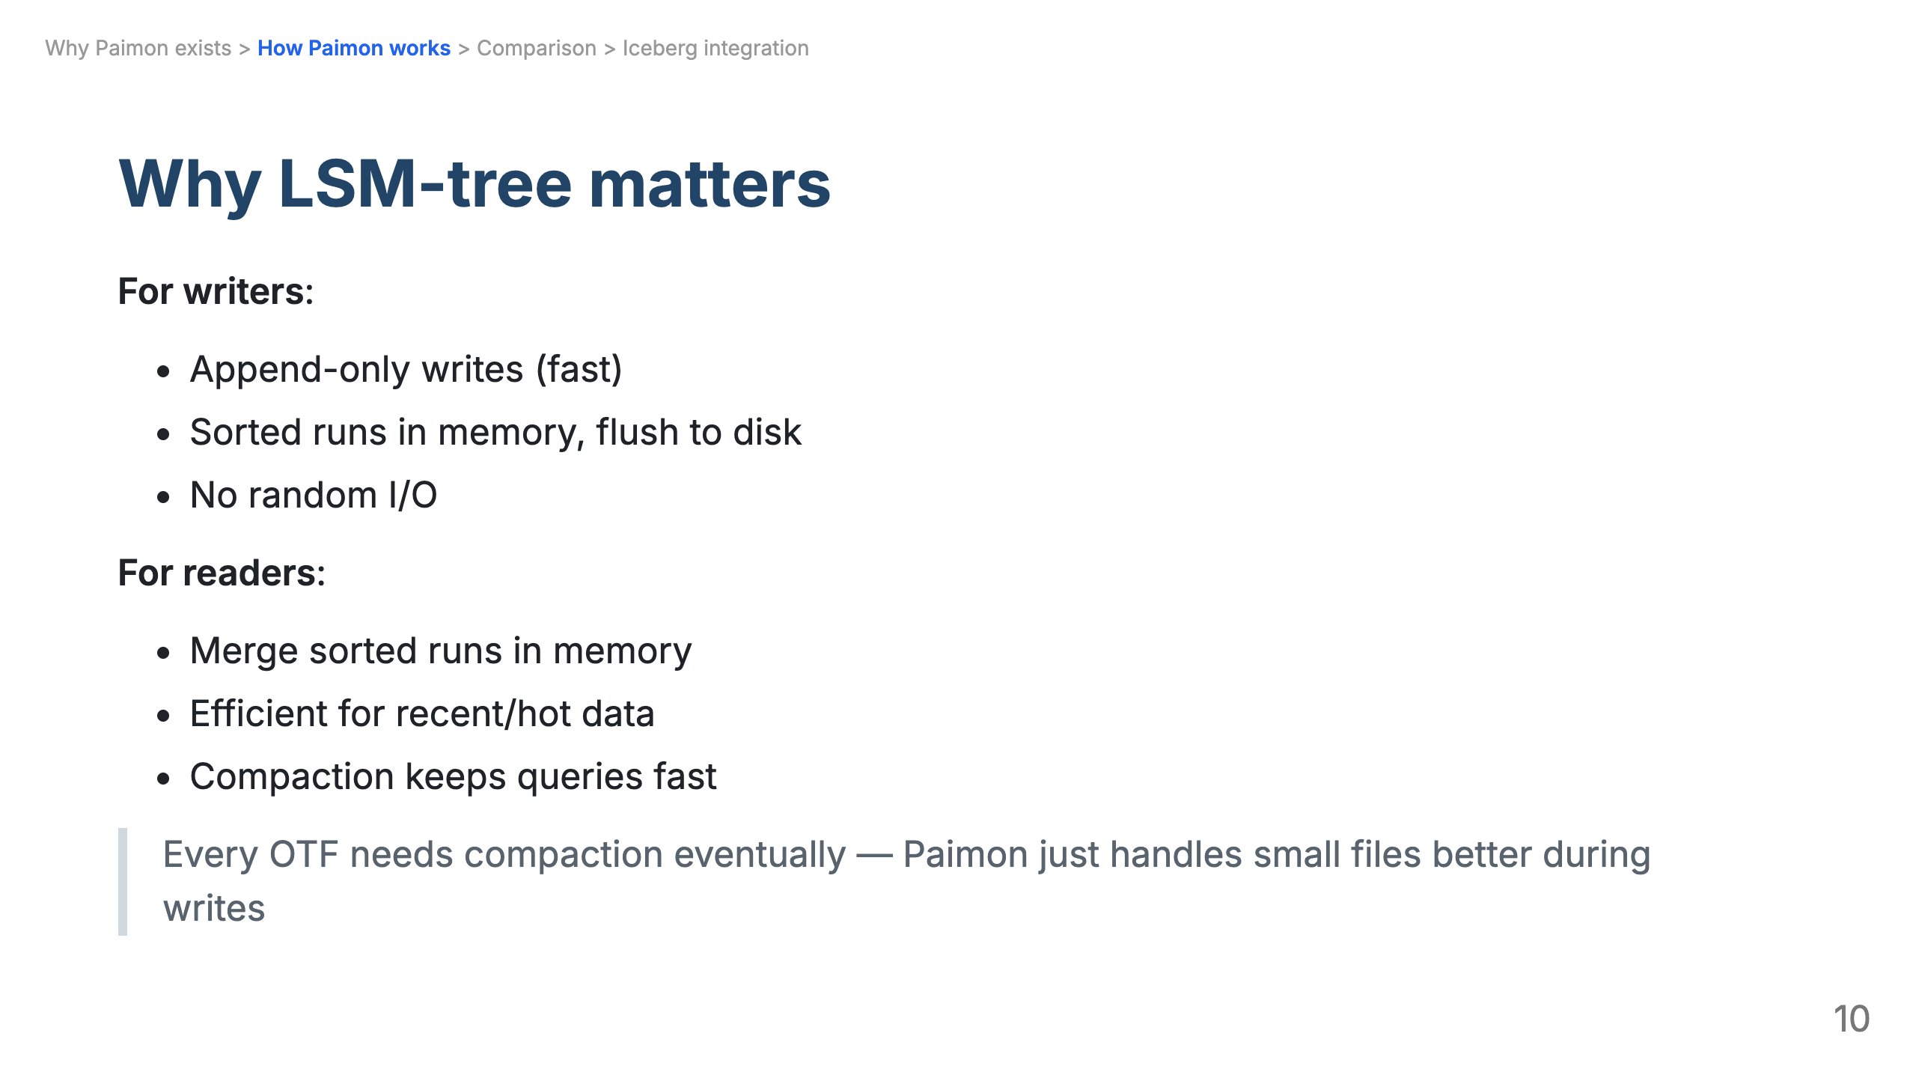

Slide 11
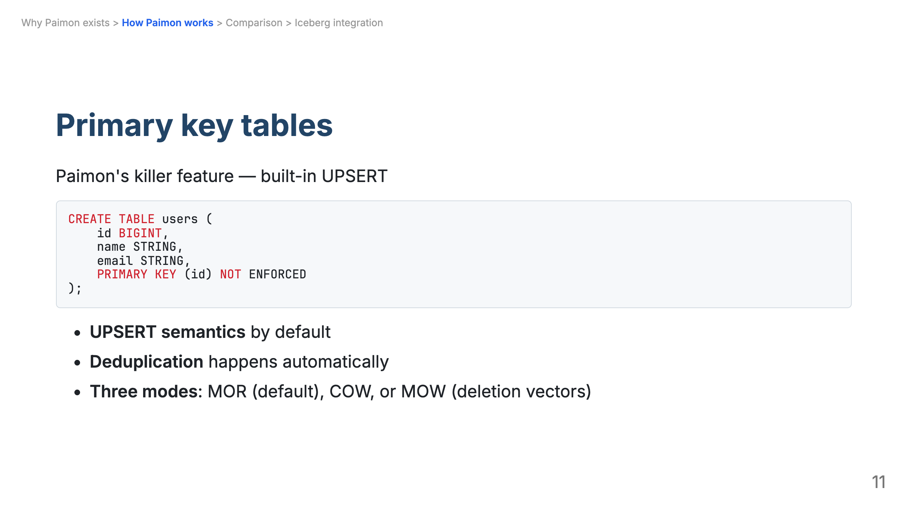

Slide 12
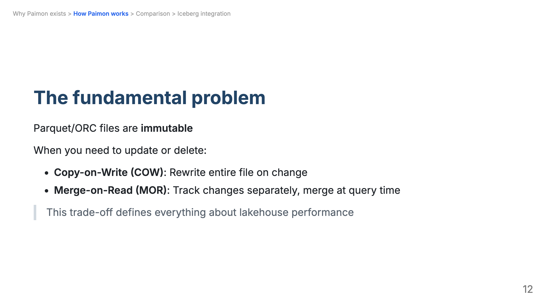

Slide 13
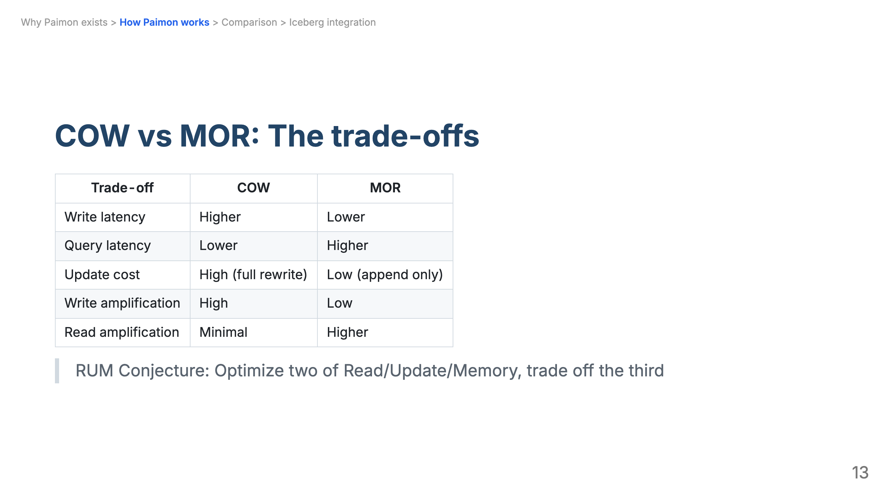

Slide 14
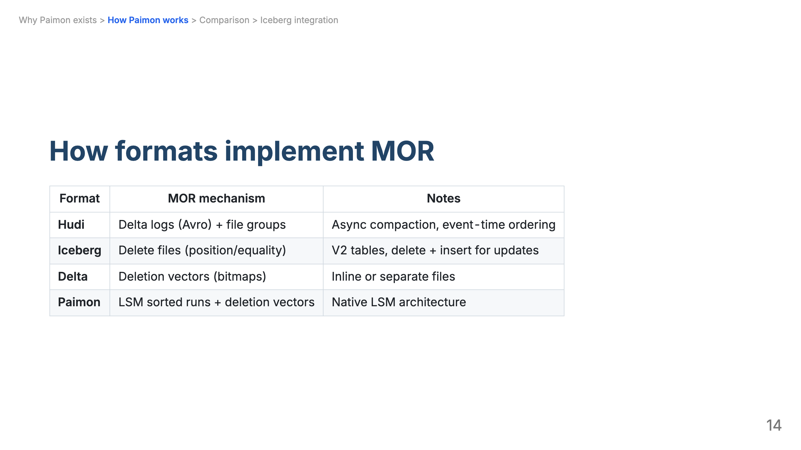

Slide 15
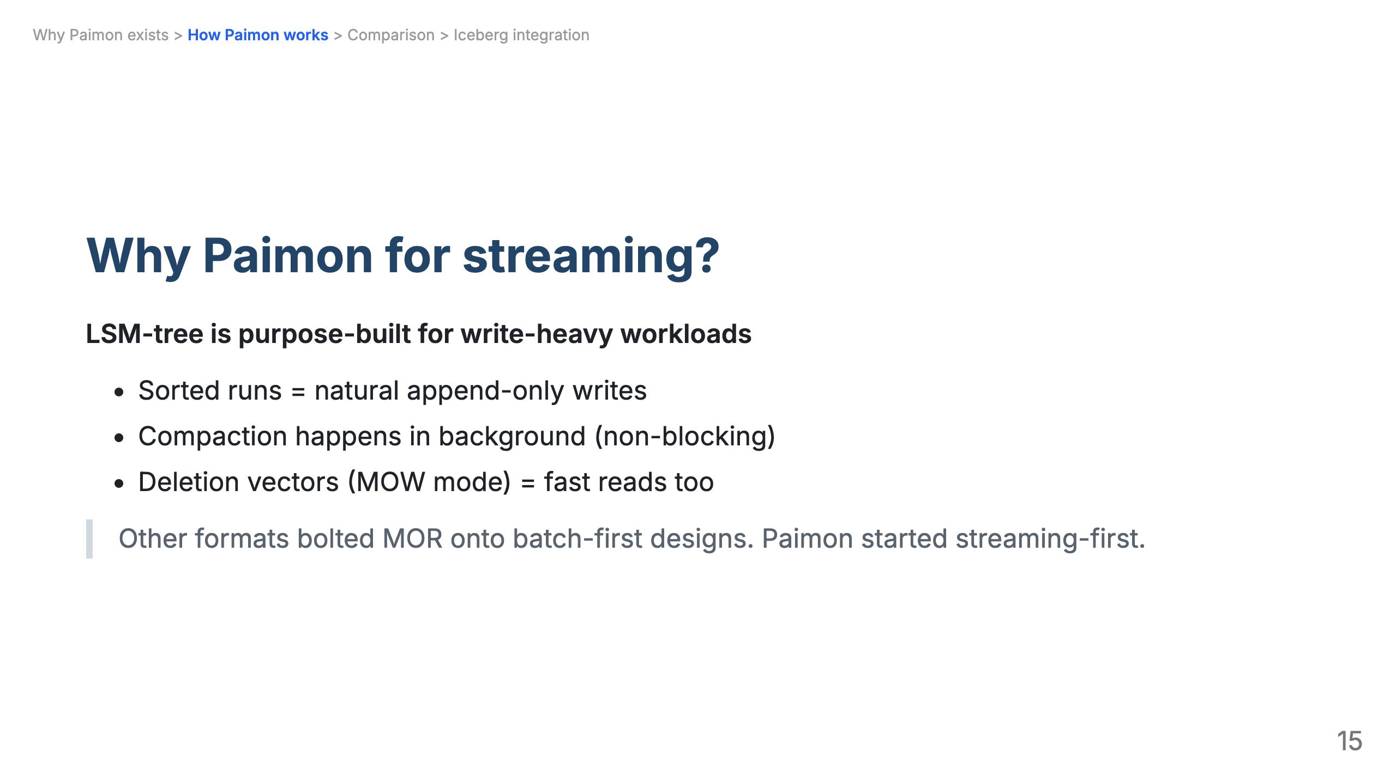

Slide 16
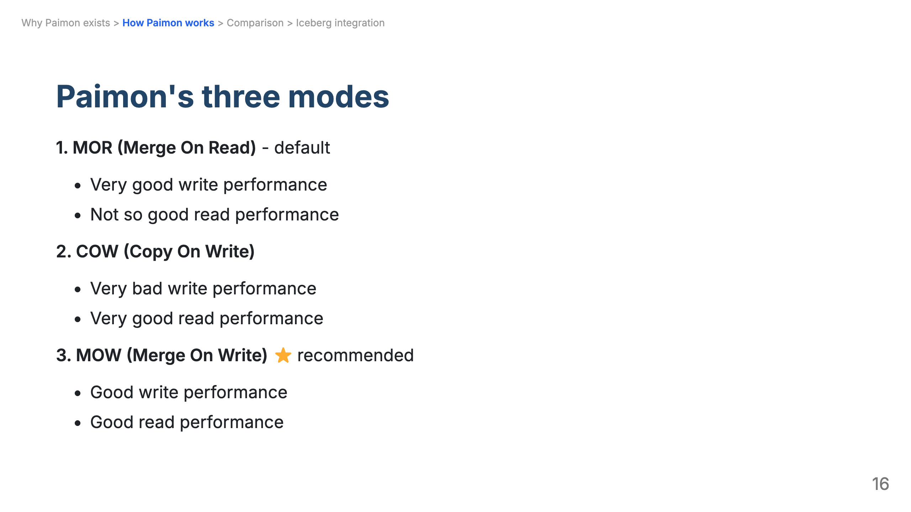

Slide 17
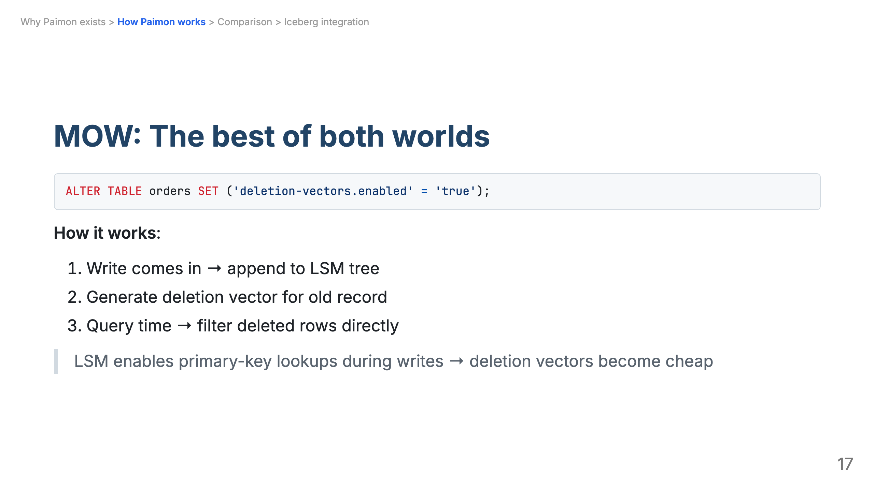

Slide 18
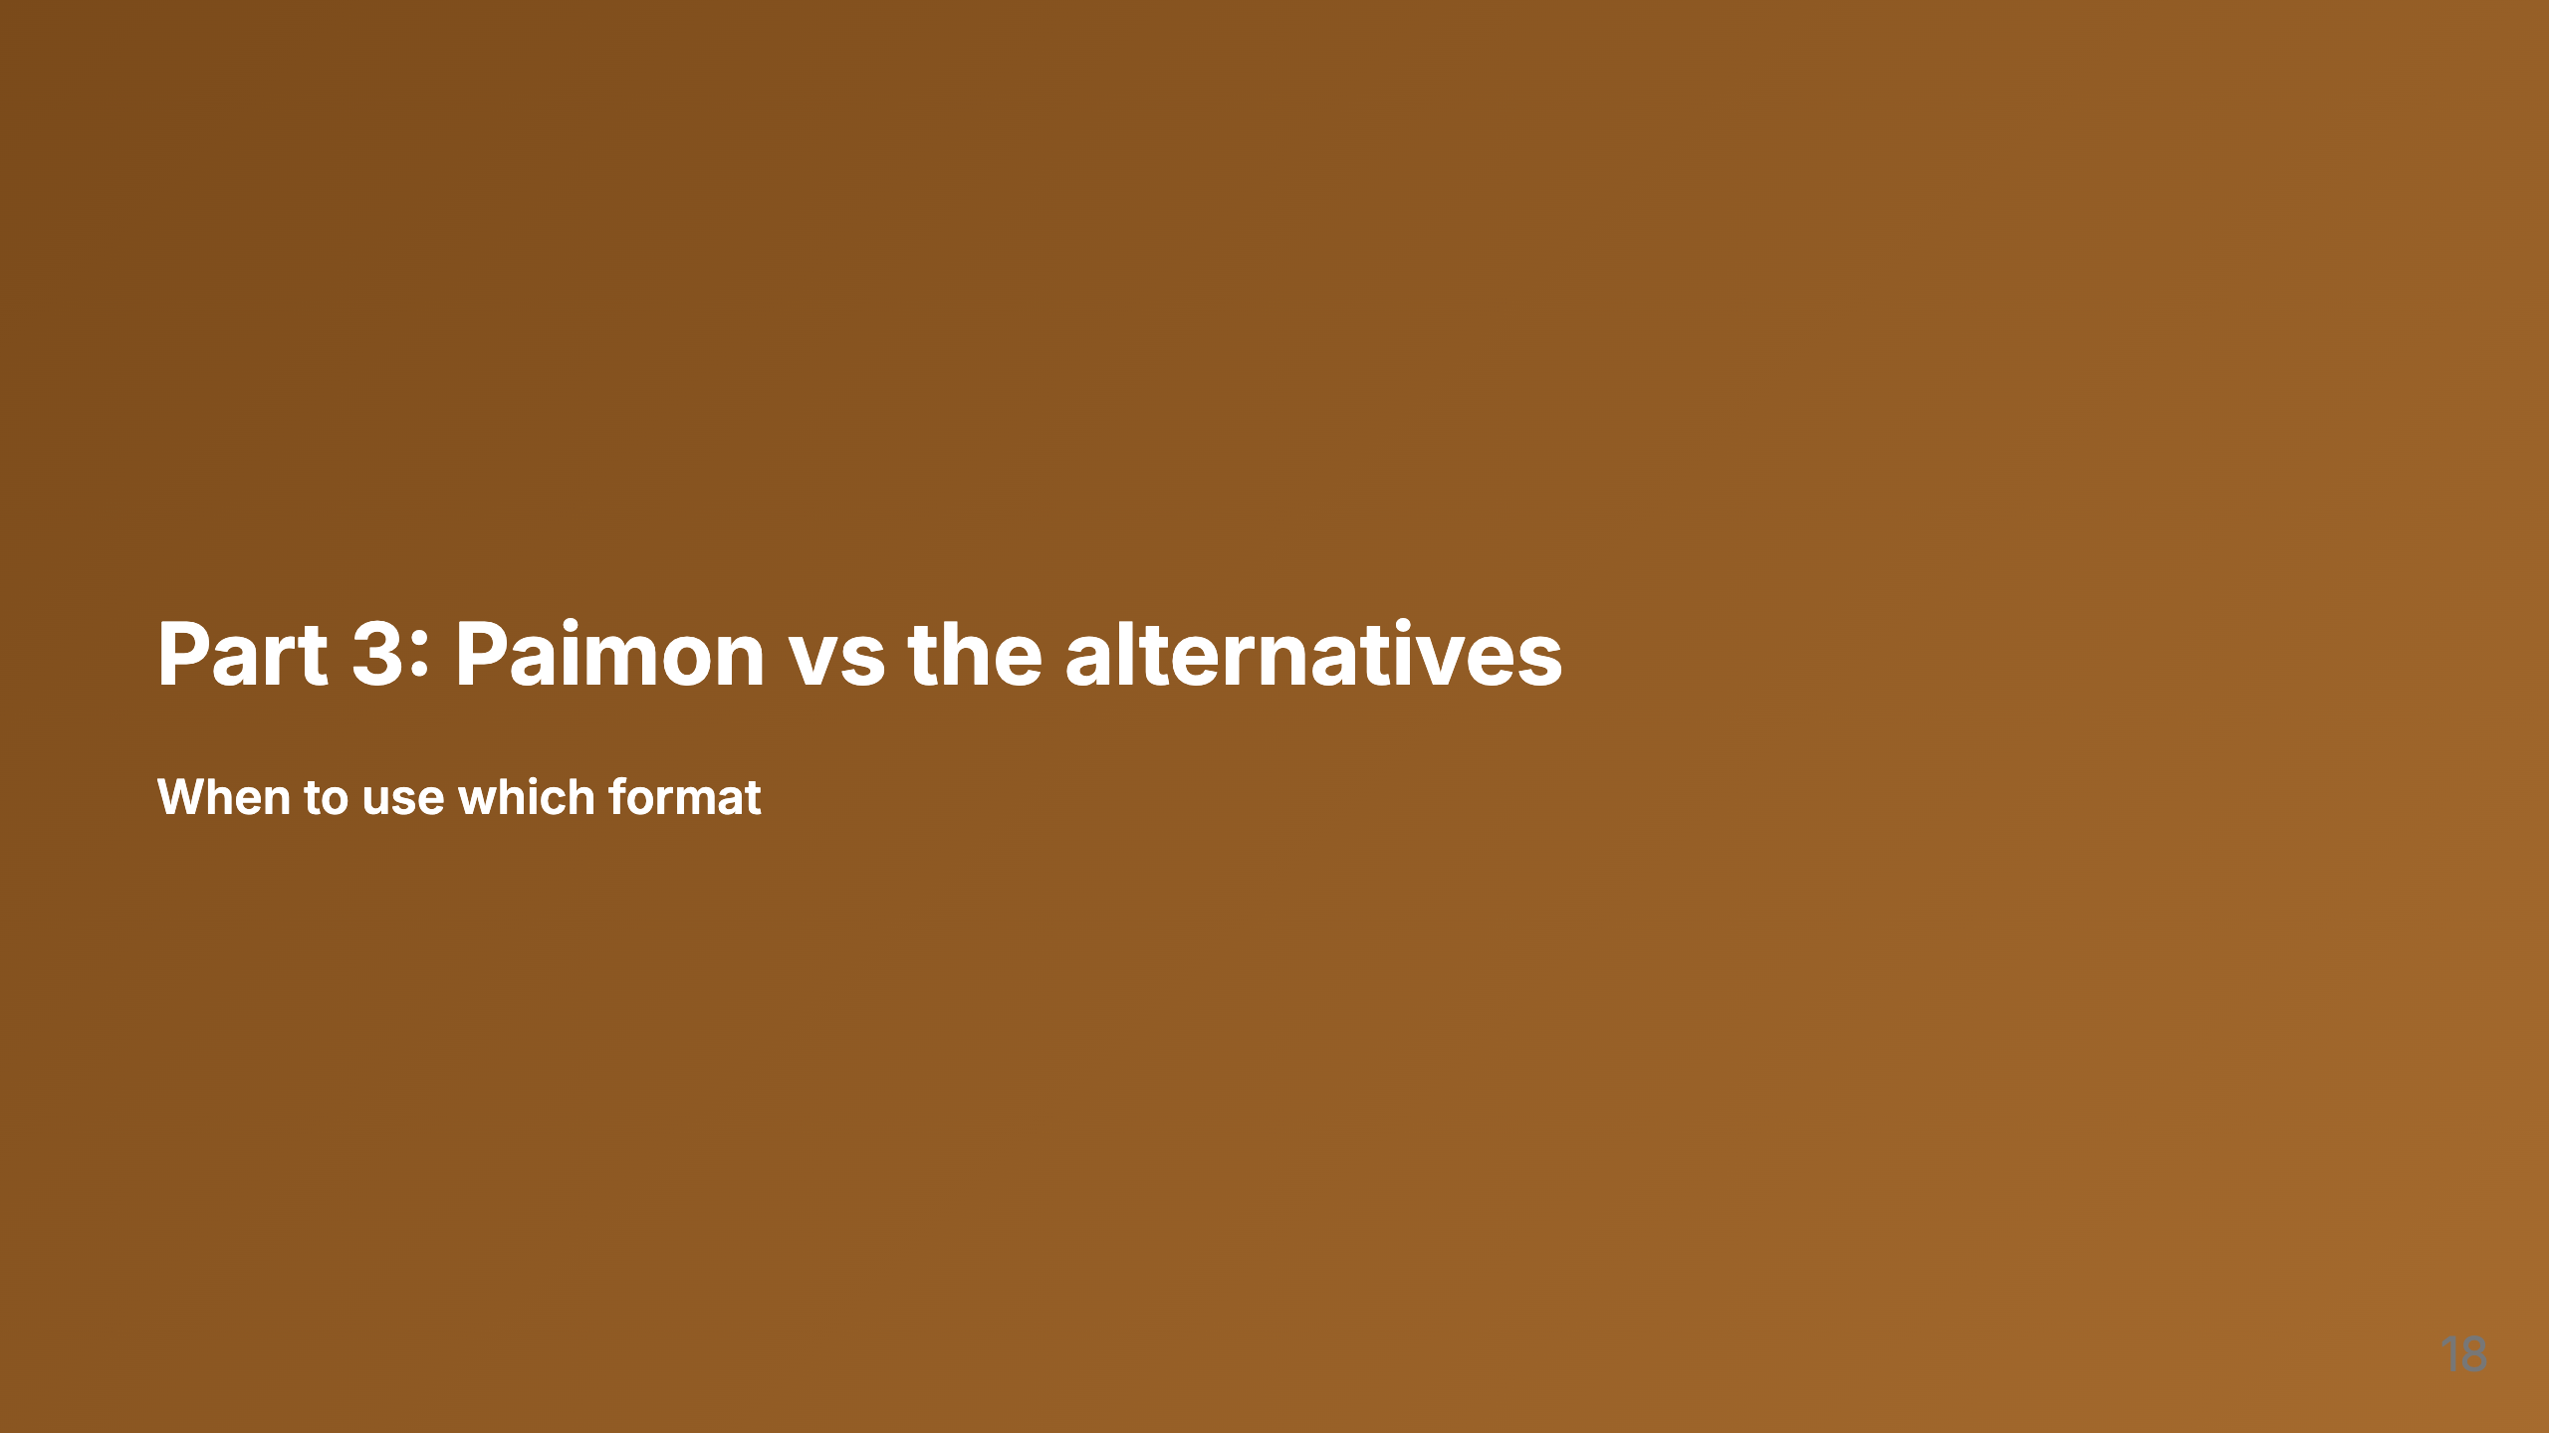

Slide 19
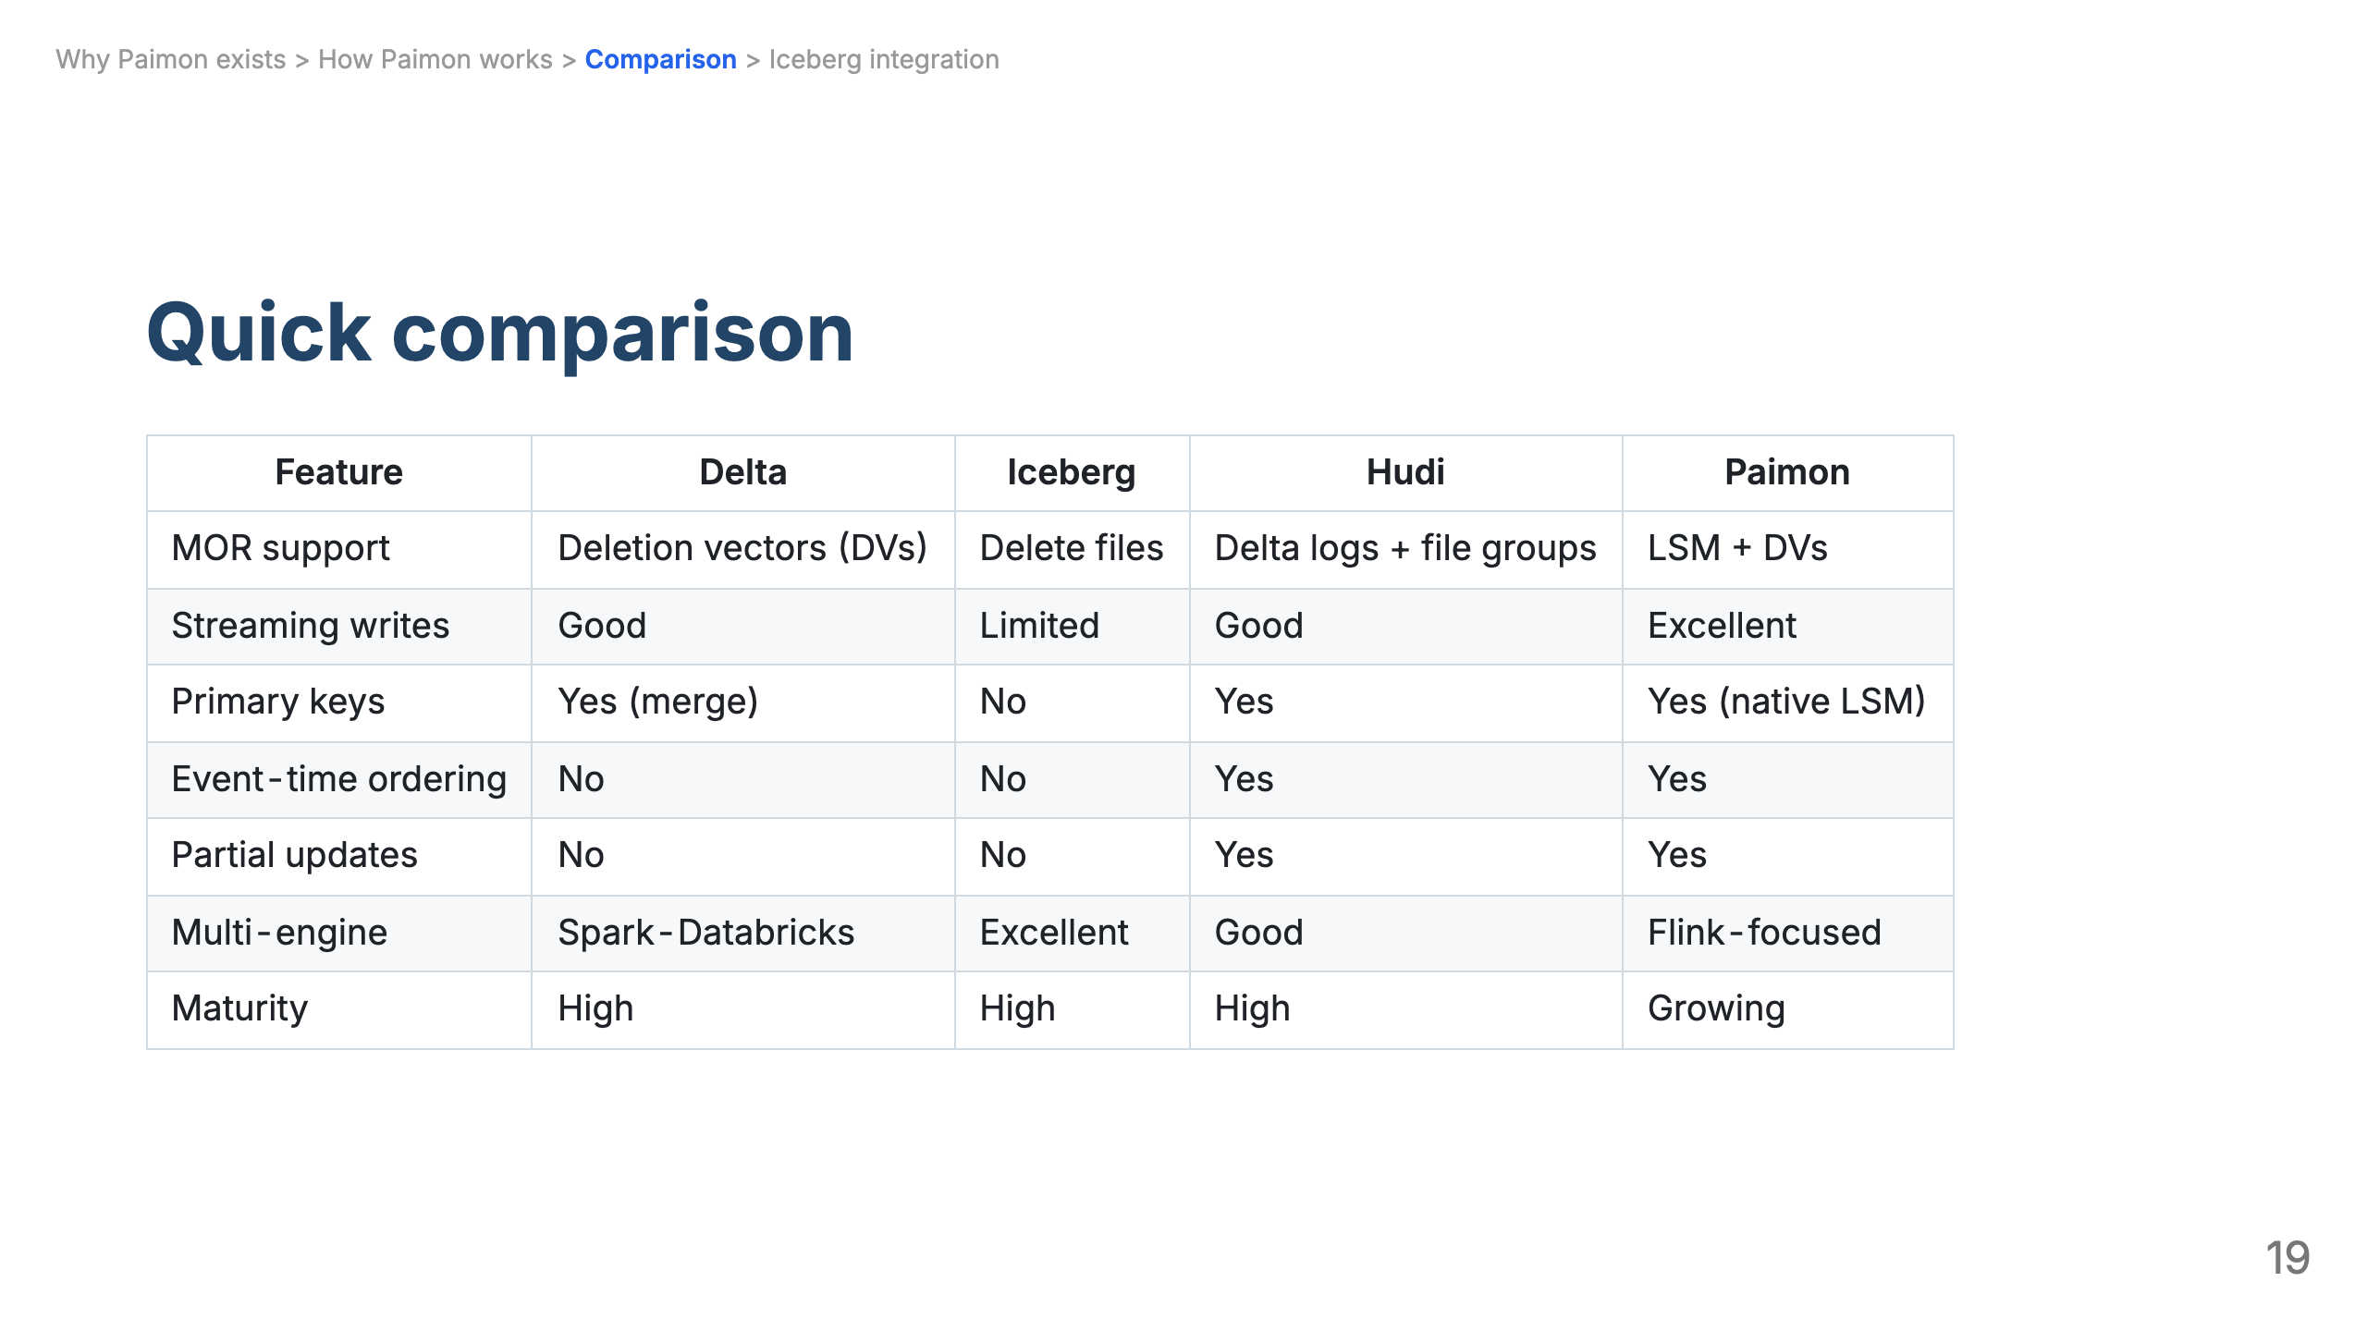

Slide 20
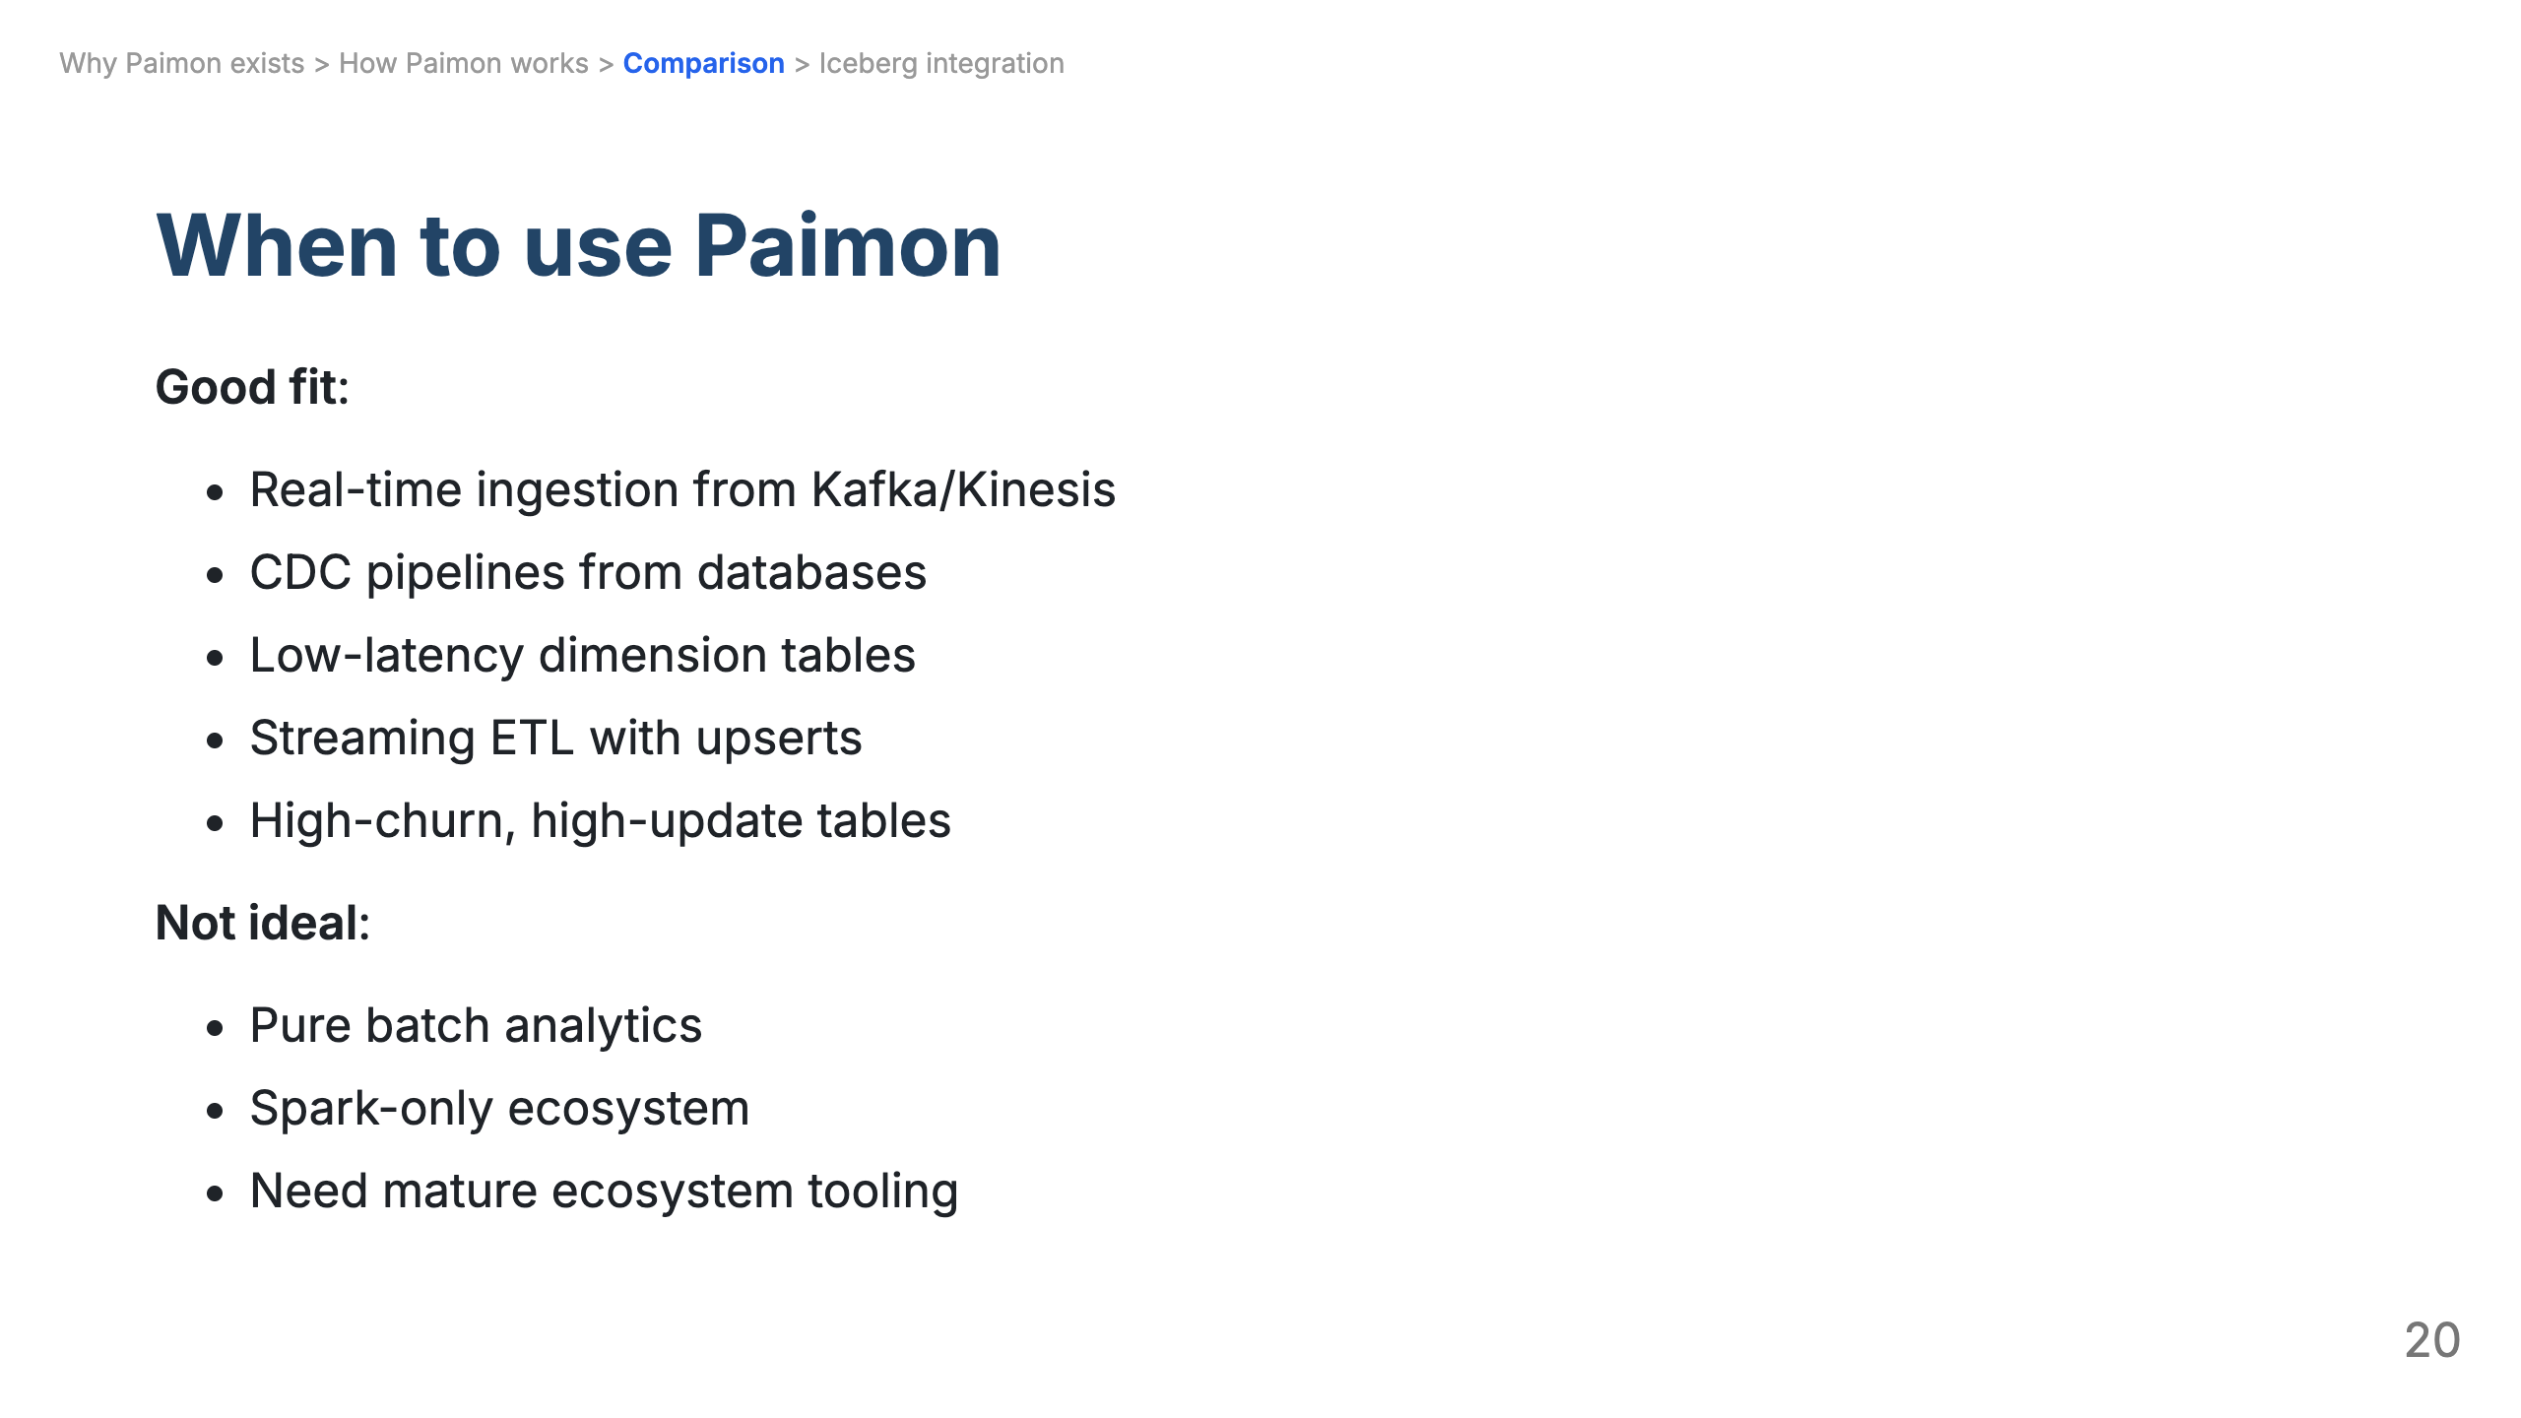

Slide 21
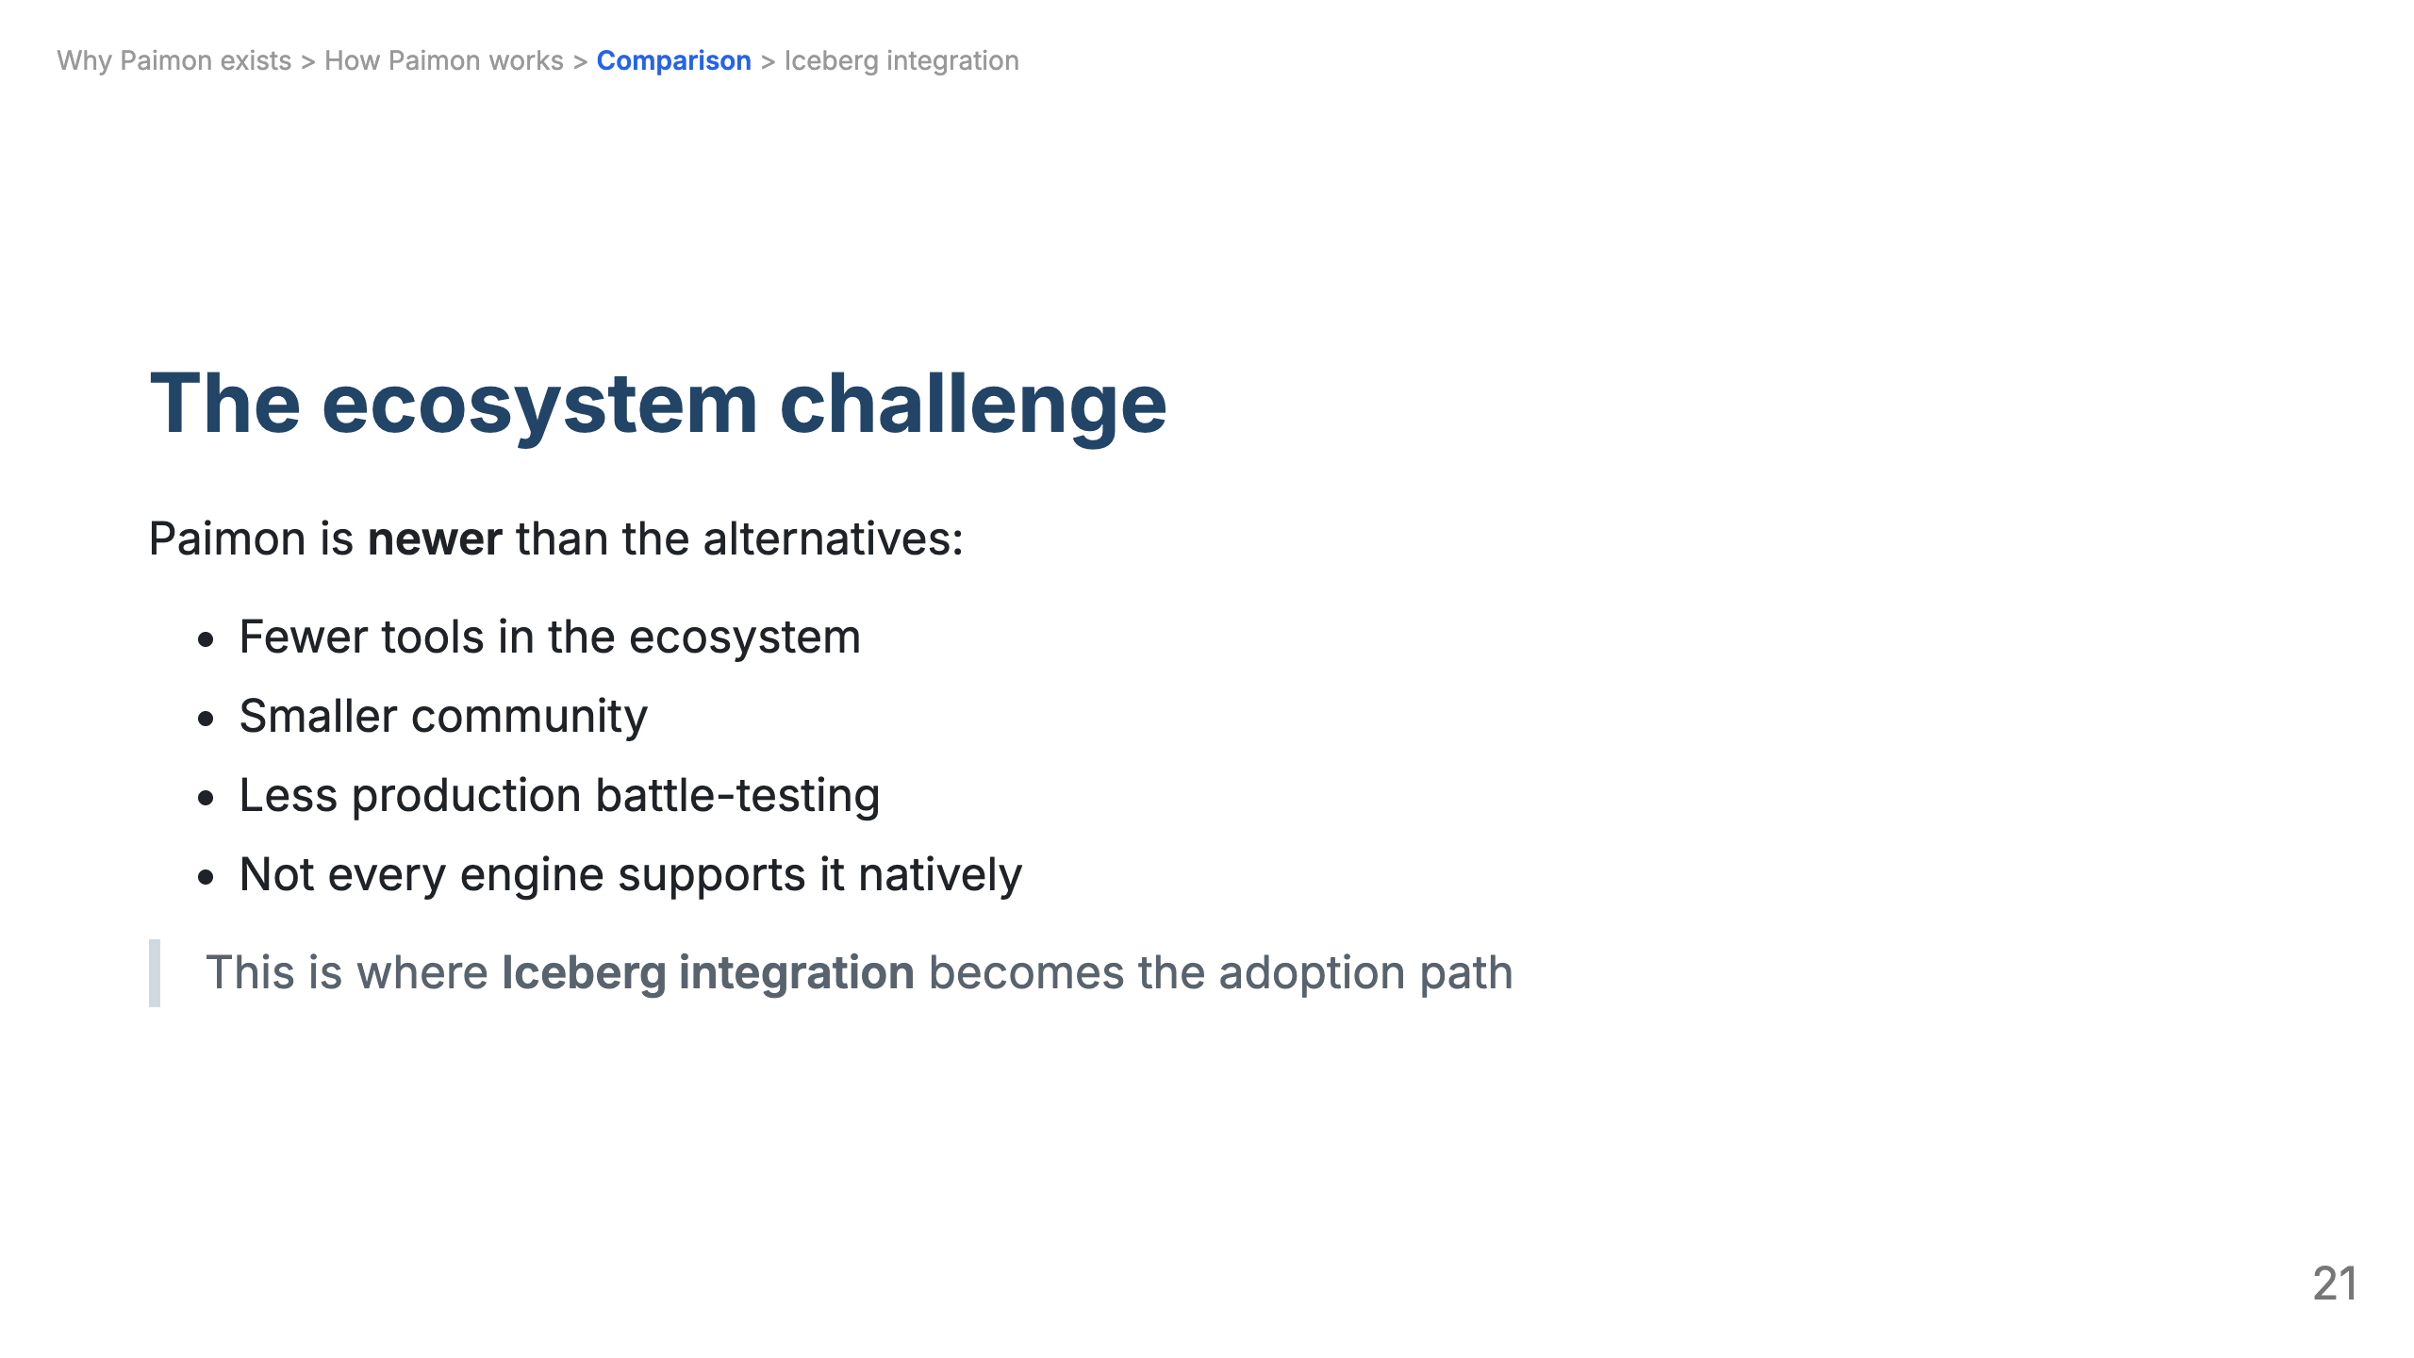

Slide 22
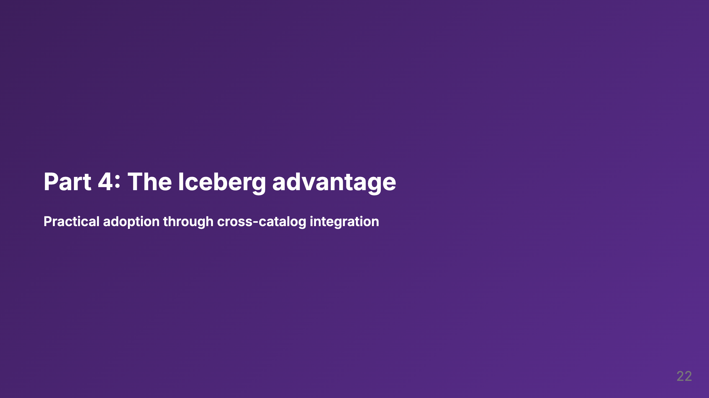

Slide 23
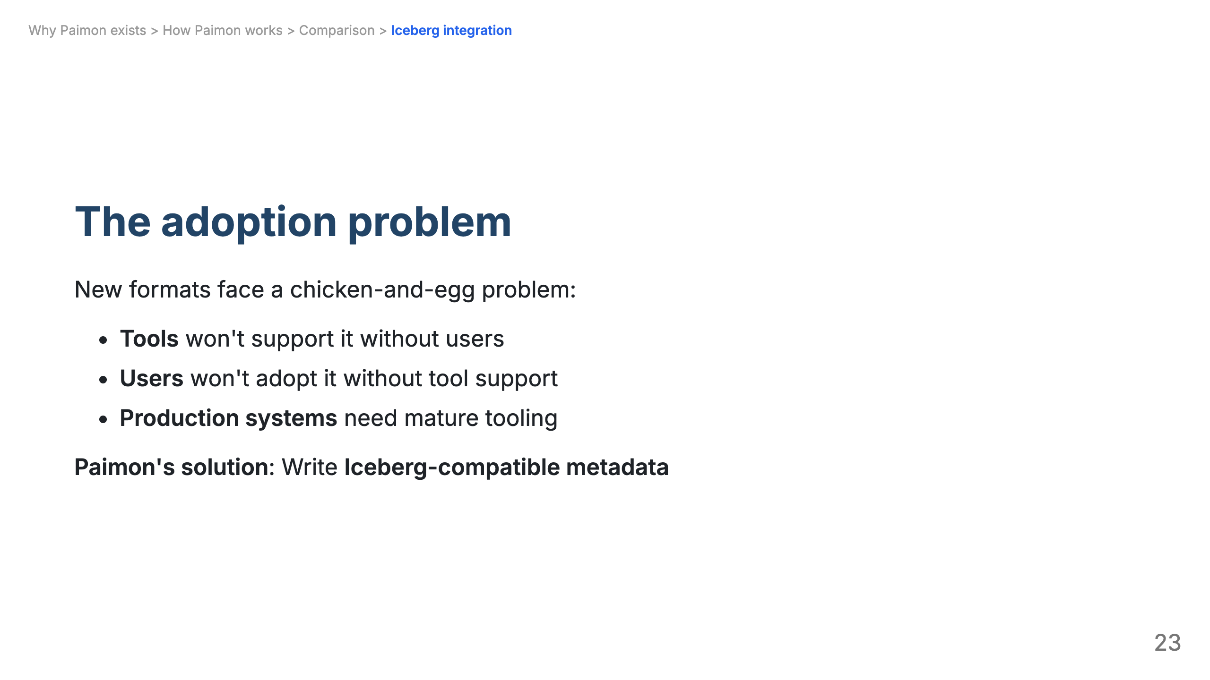

Slide 24
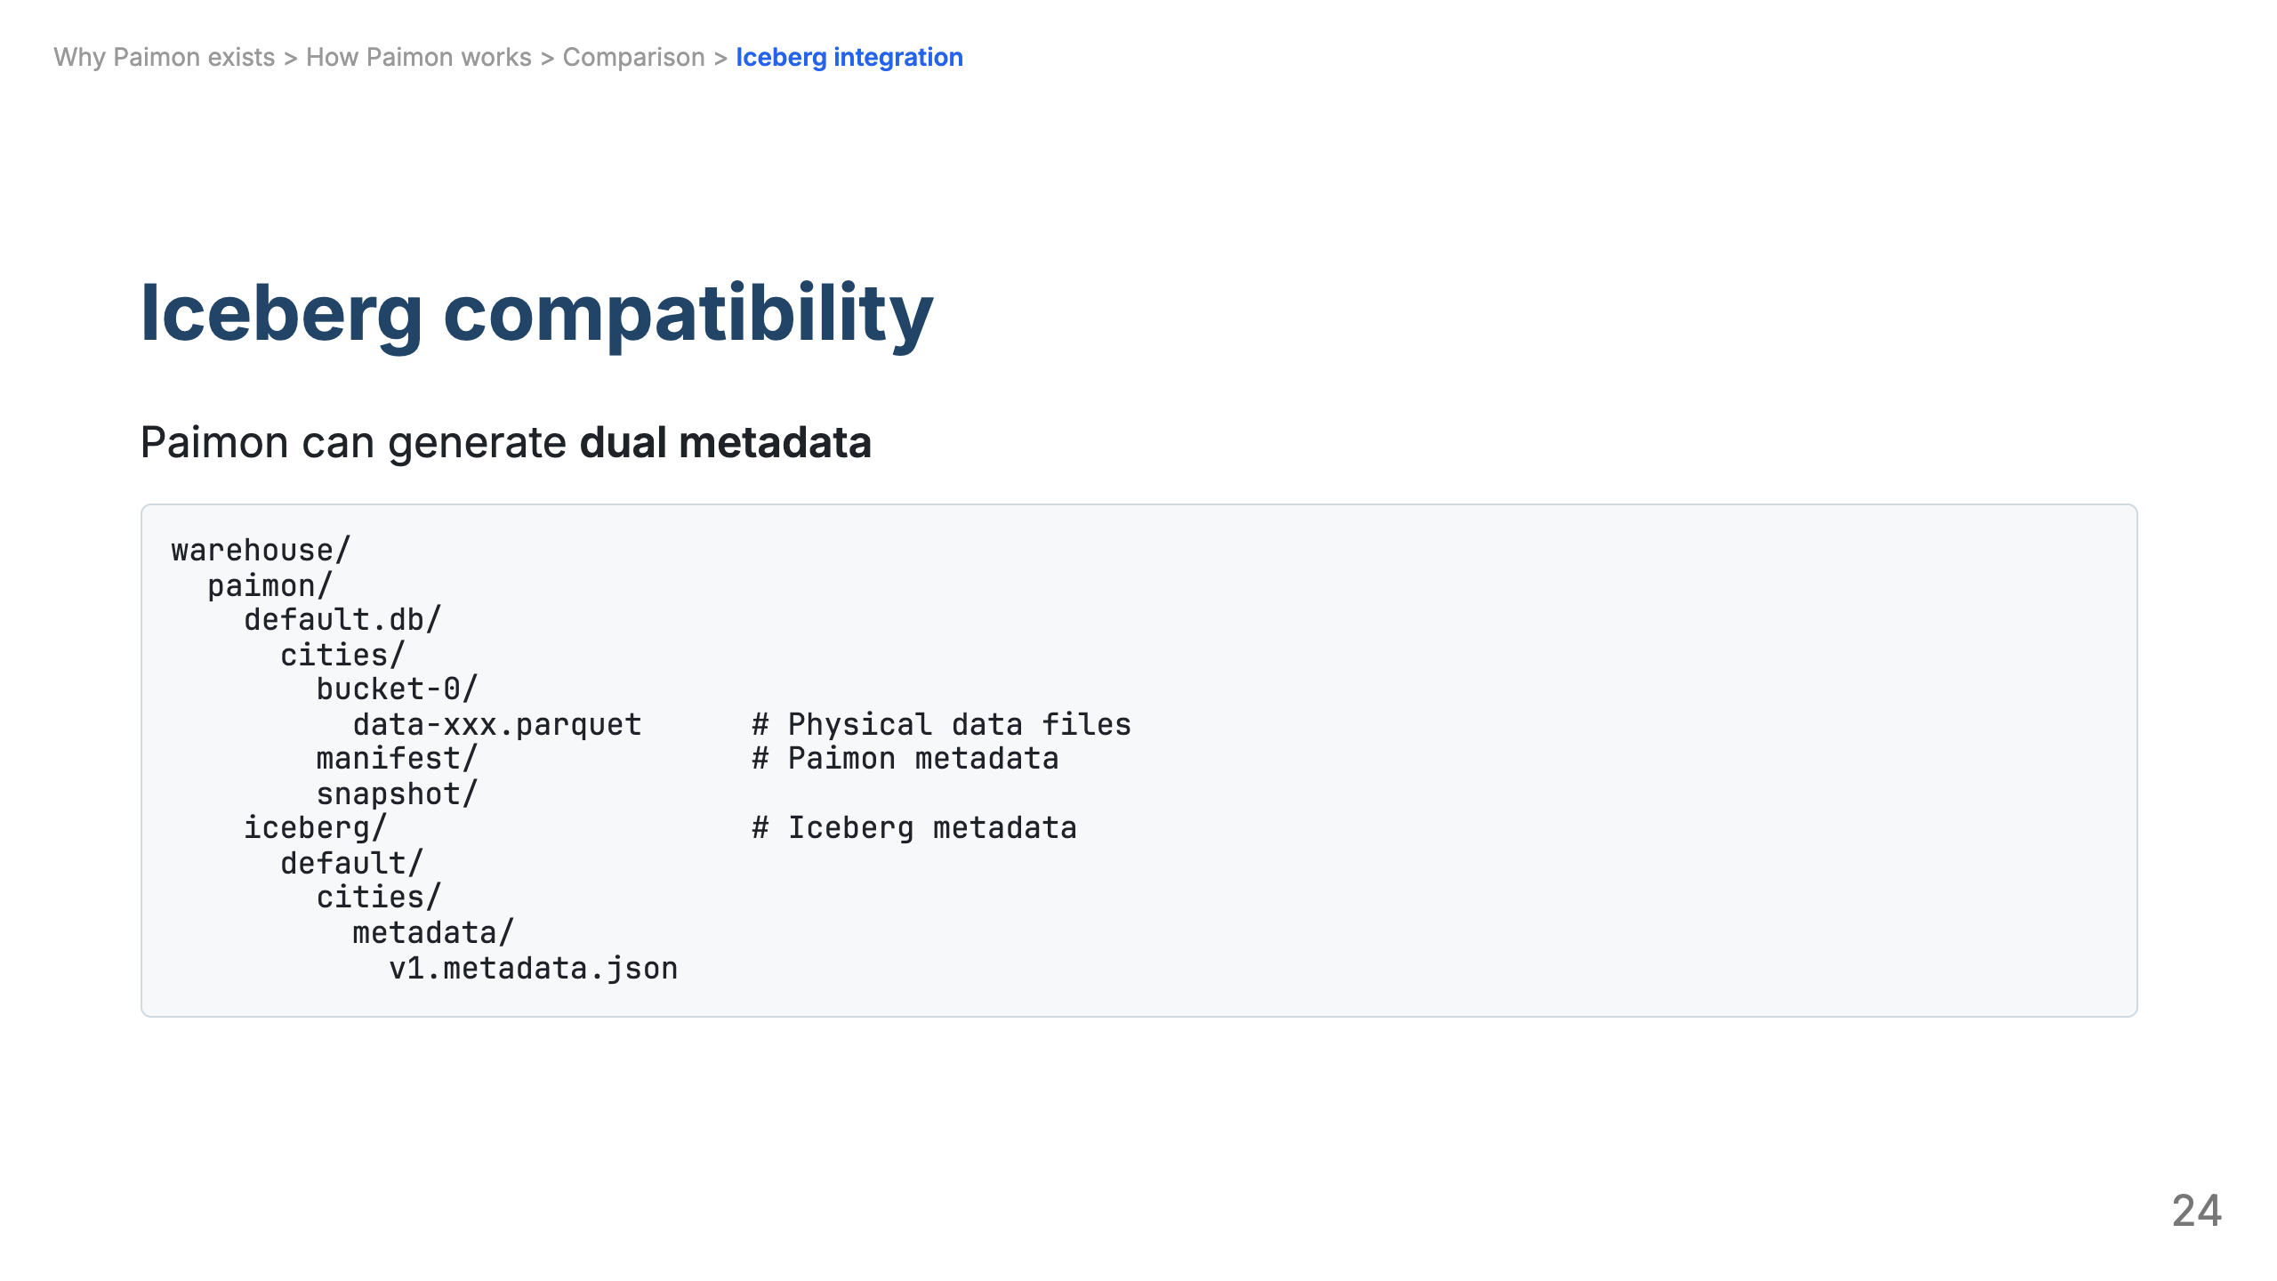

Slide 25
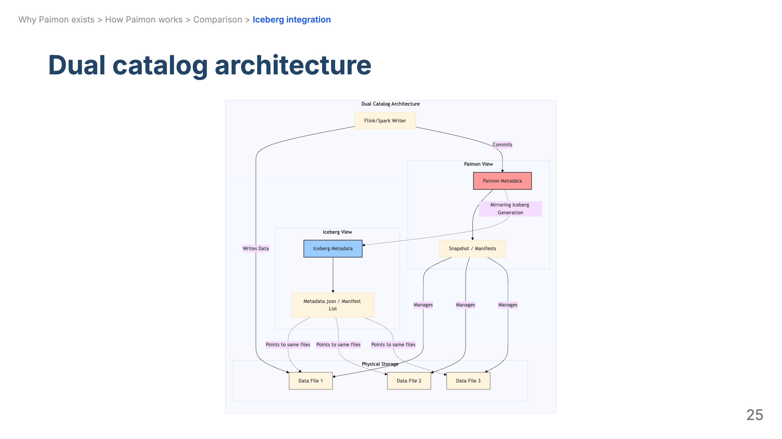

Slide 26
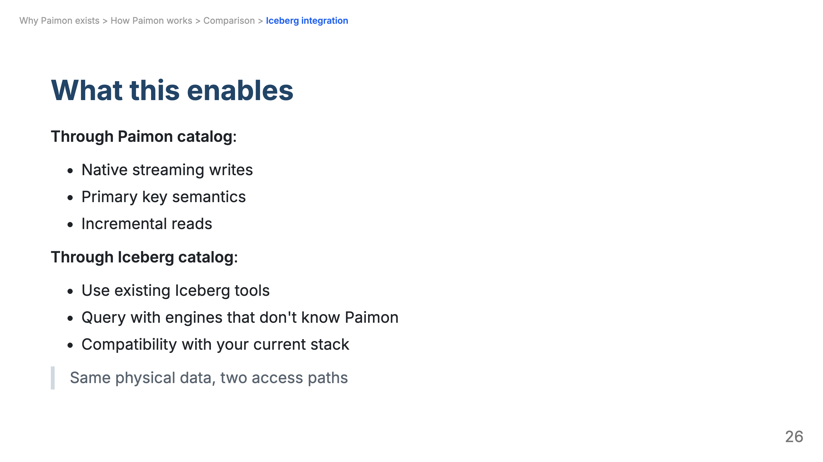

Slide 27
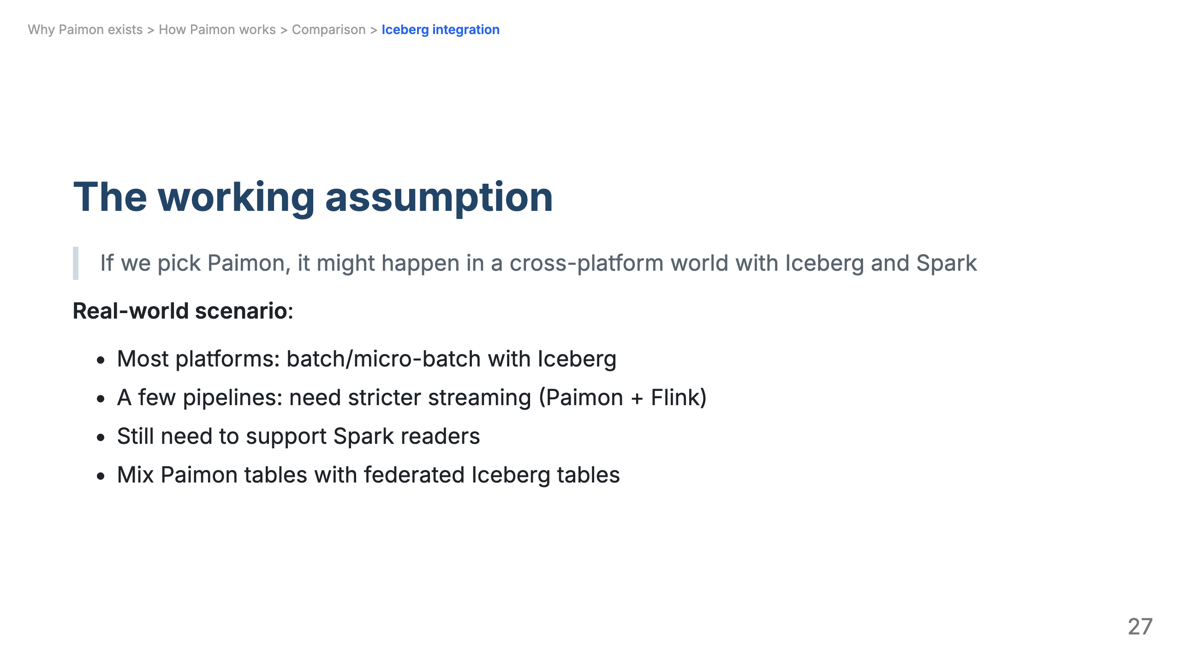

Slide 28
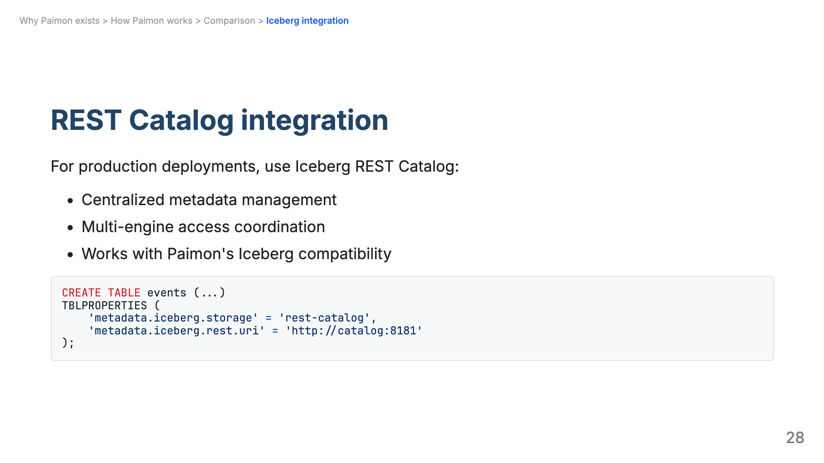

Slide 29
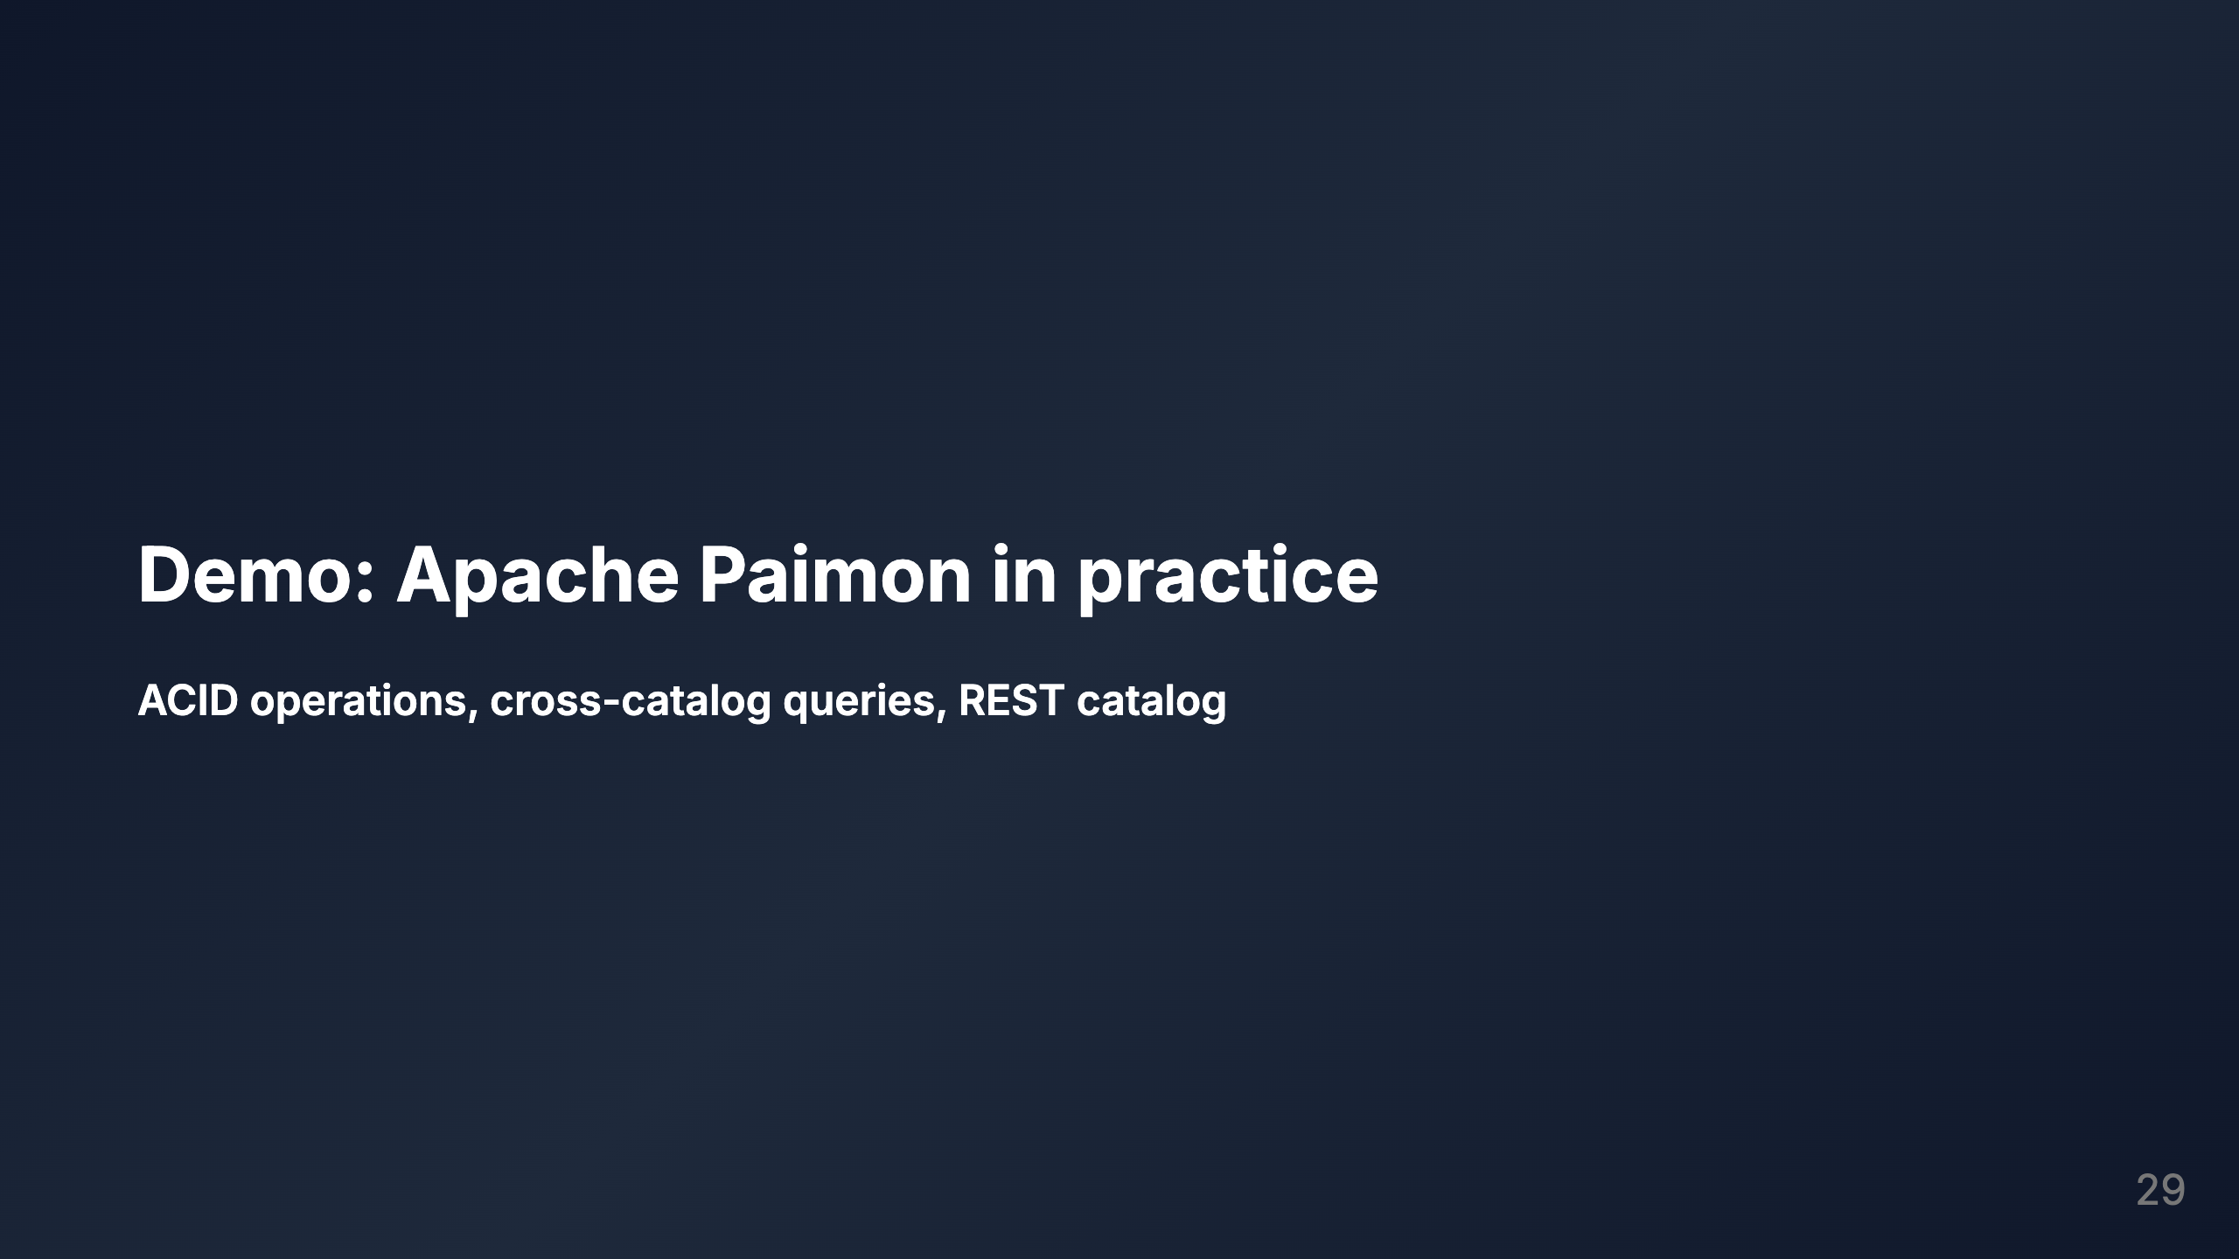

Slide 30
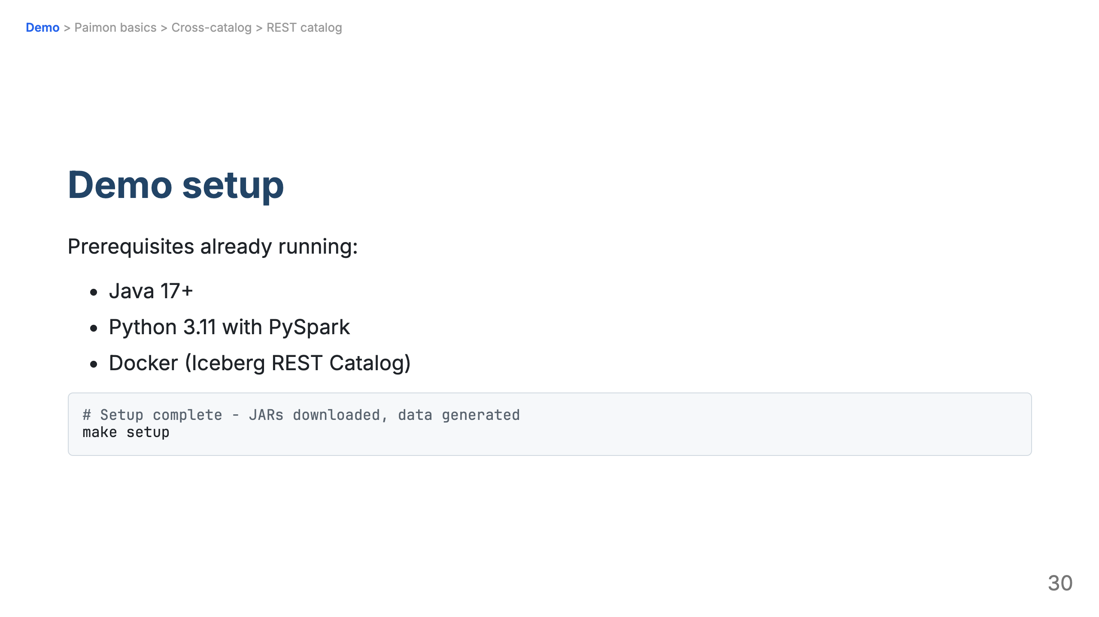

Slide 31
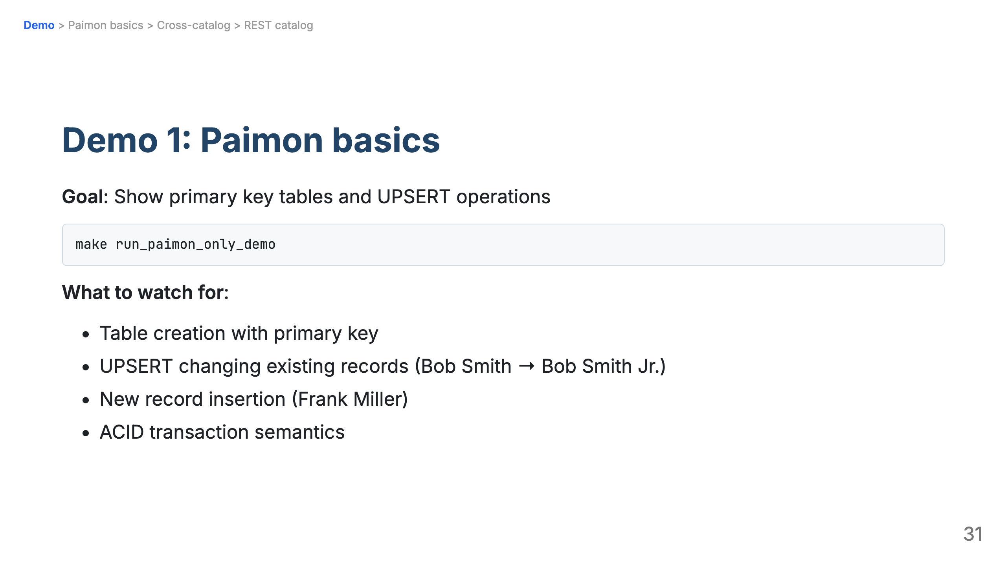

Slide 32
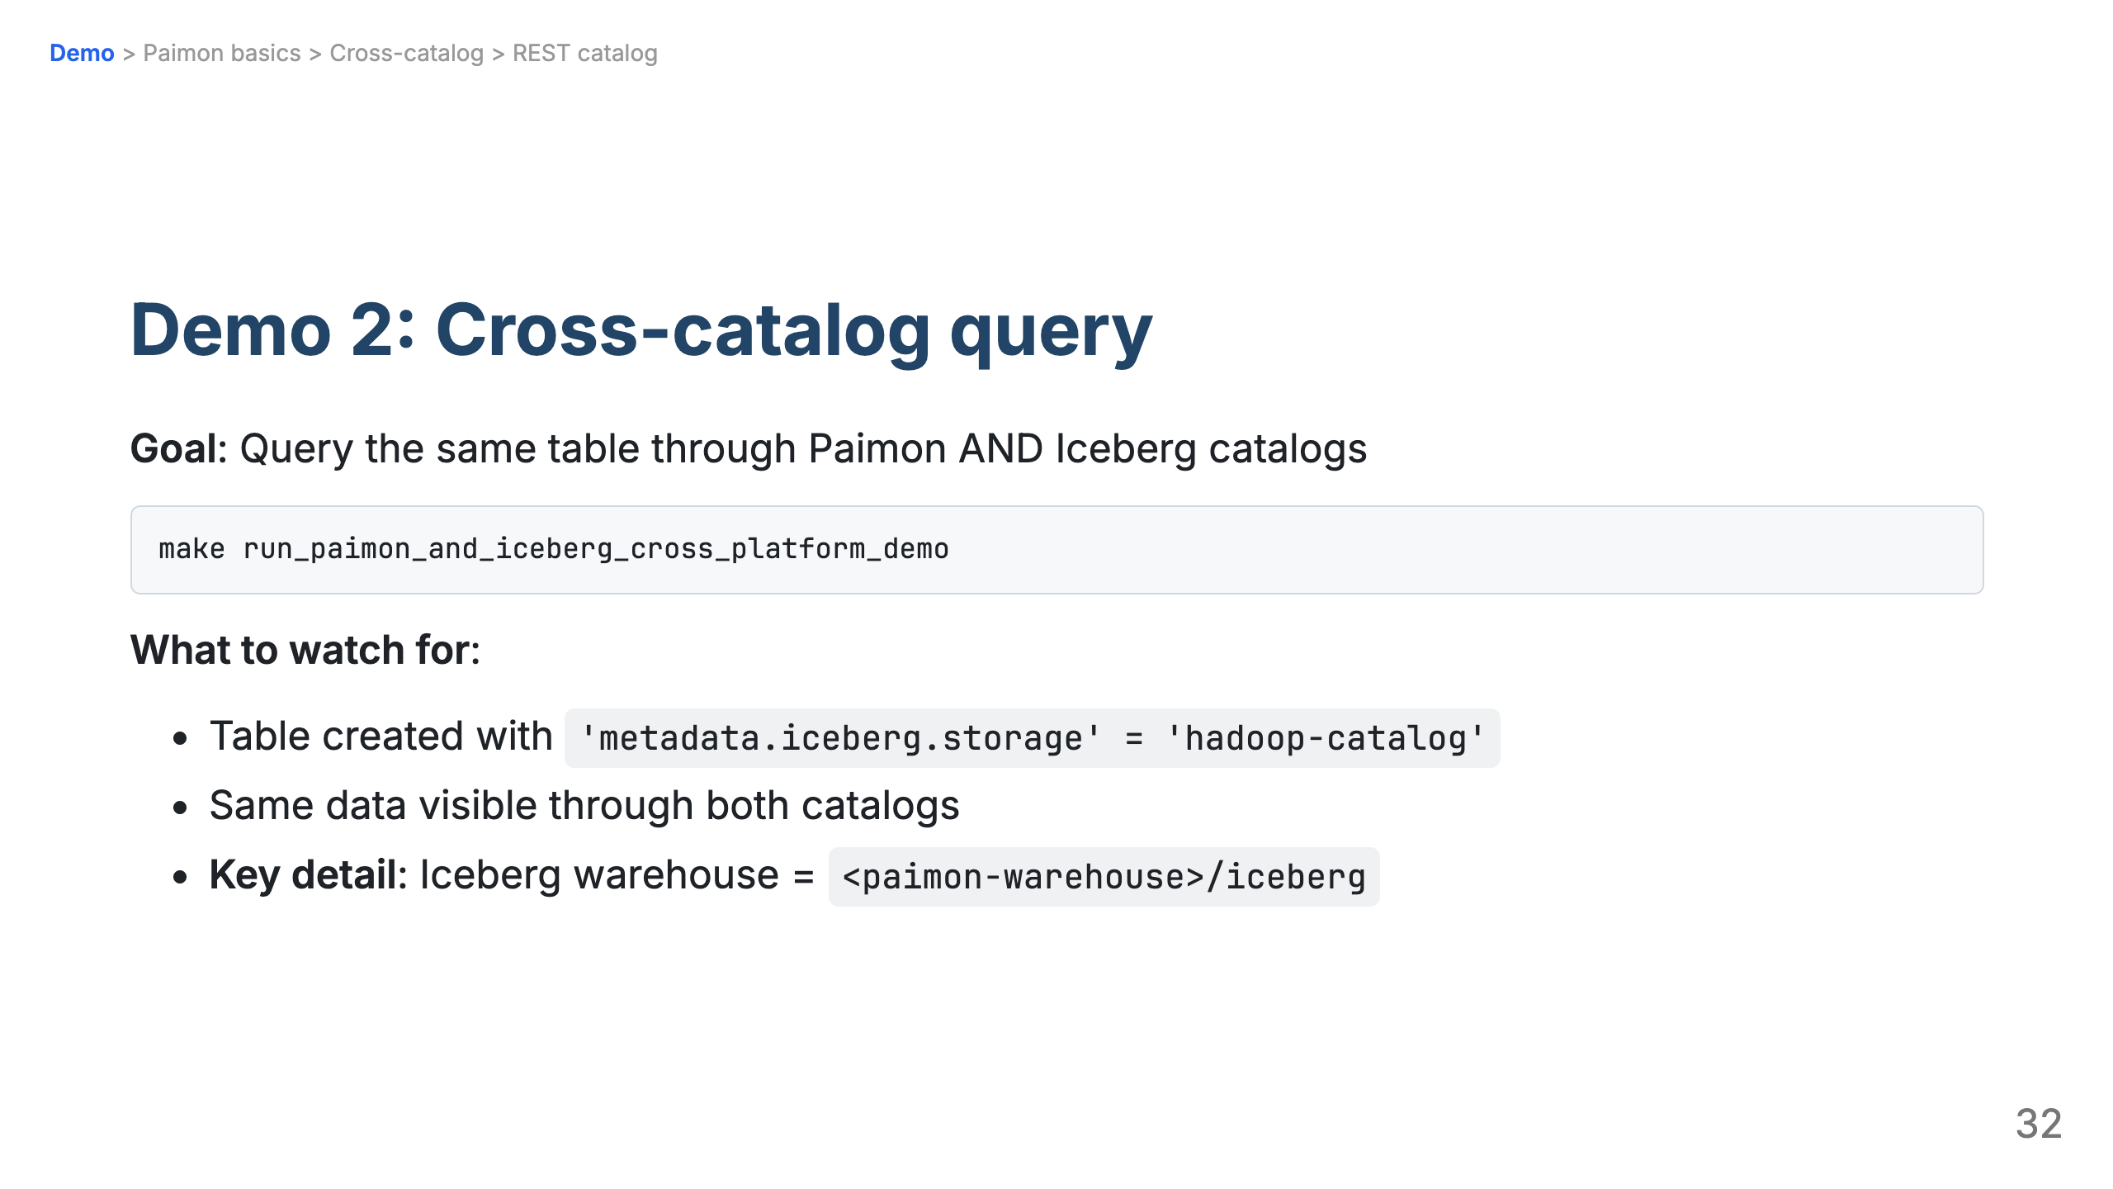

Slide 33
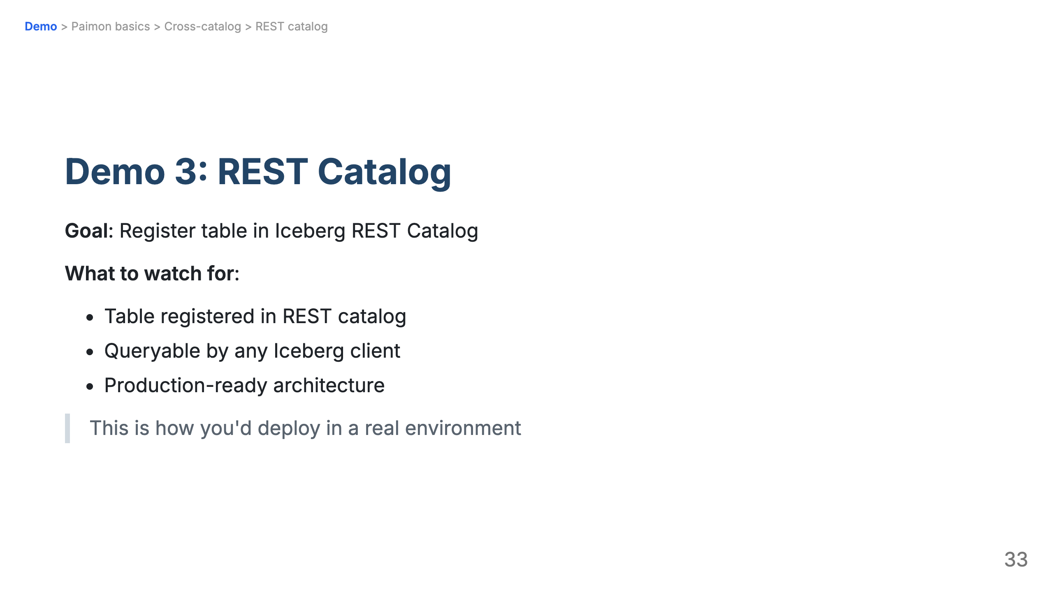

Slide 34
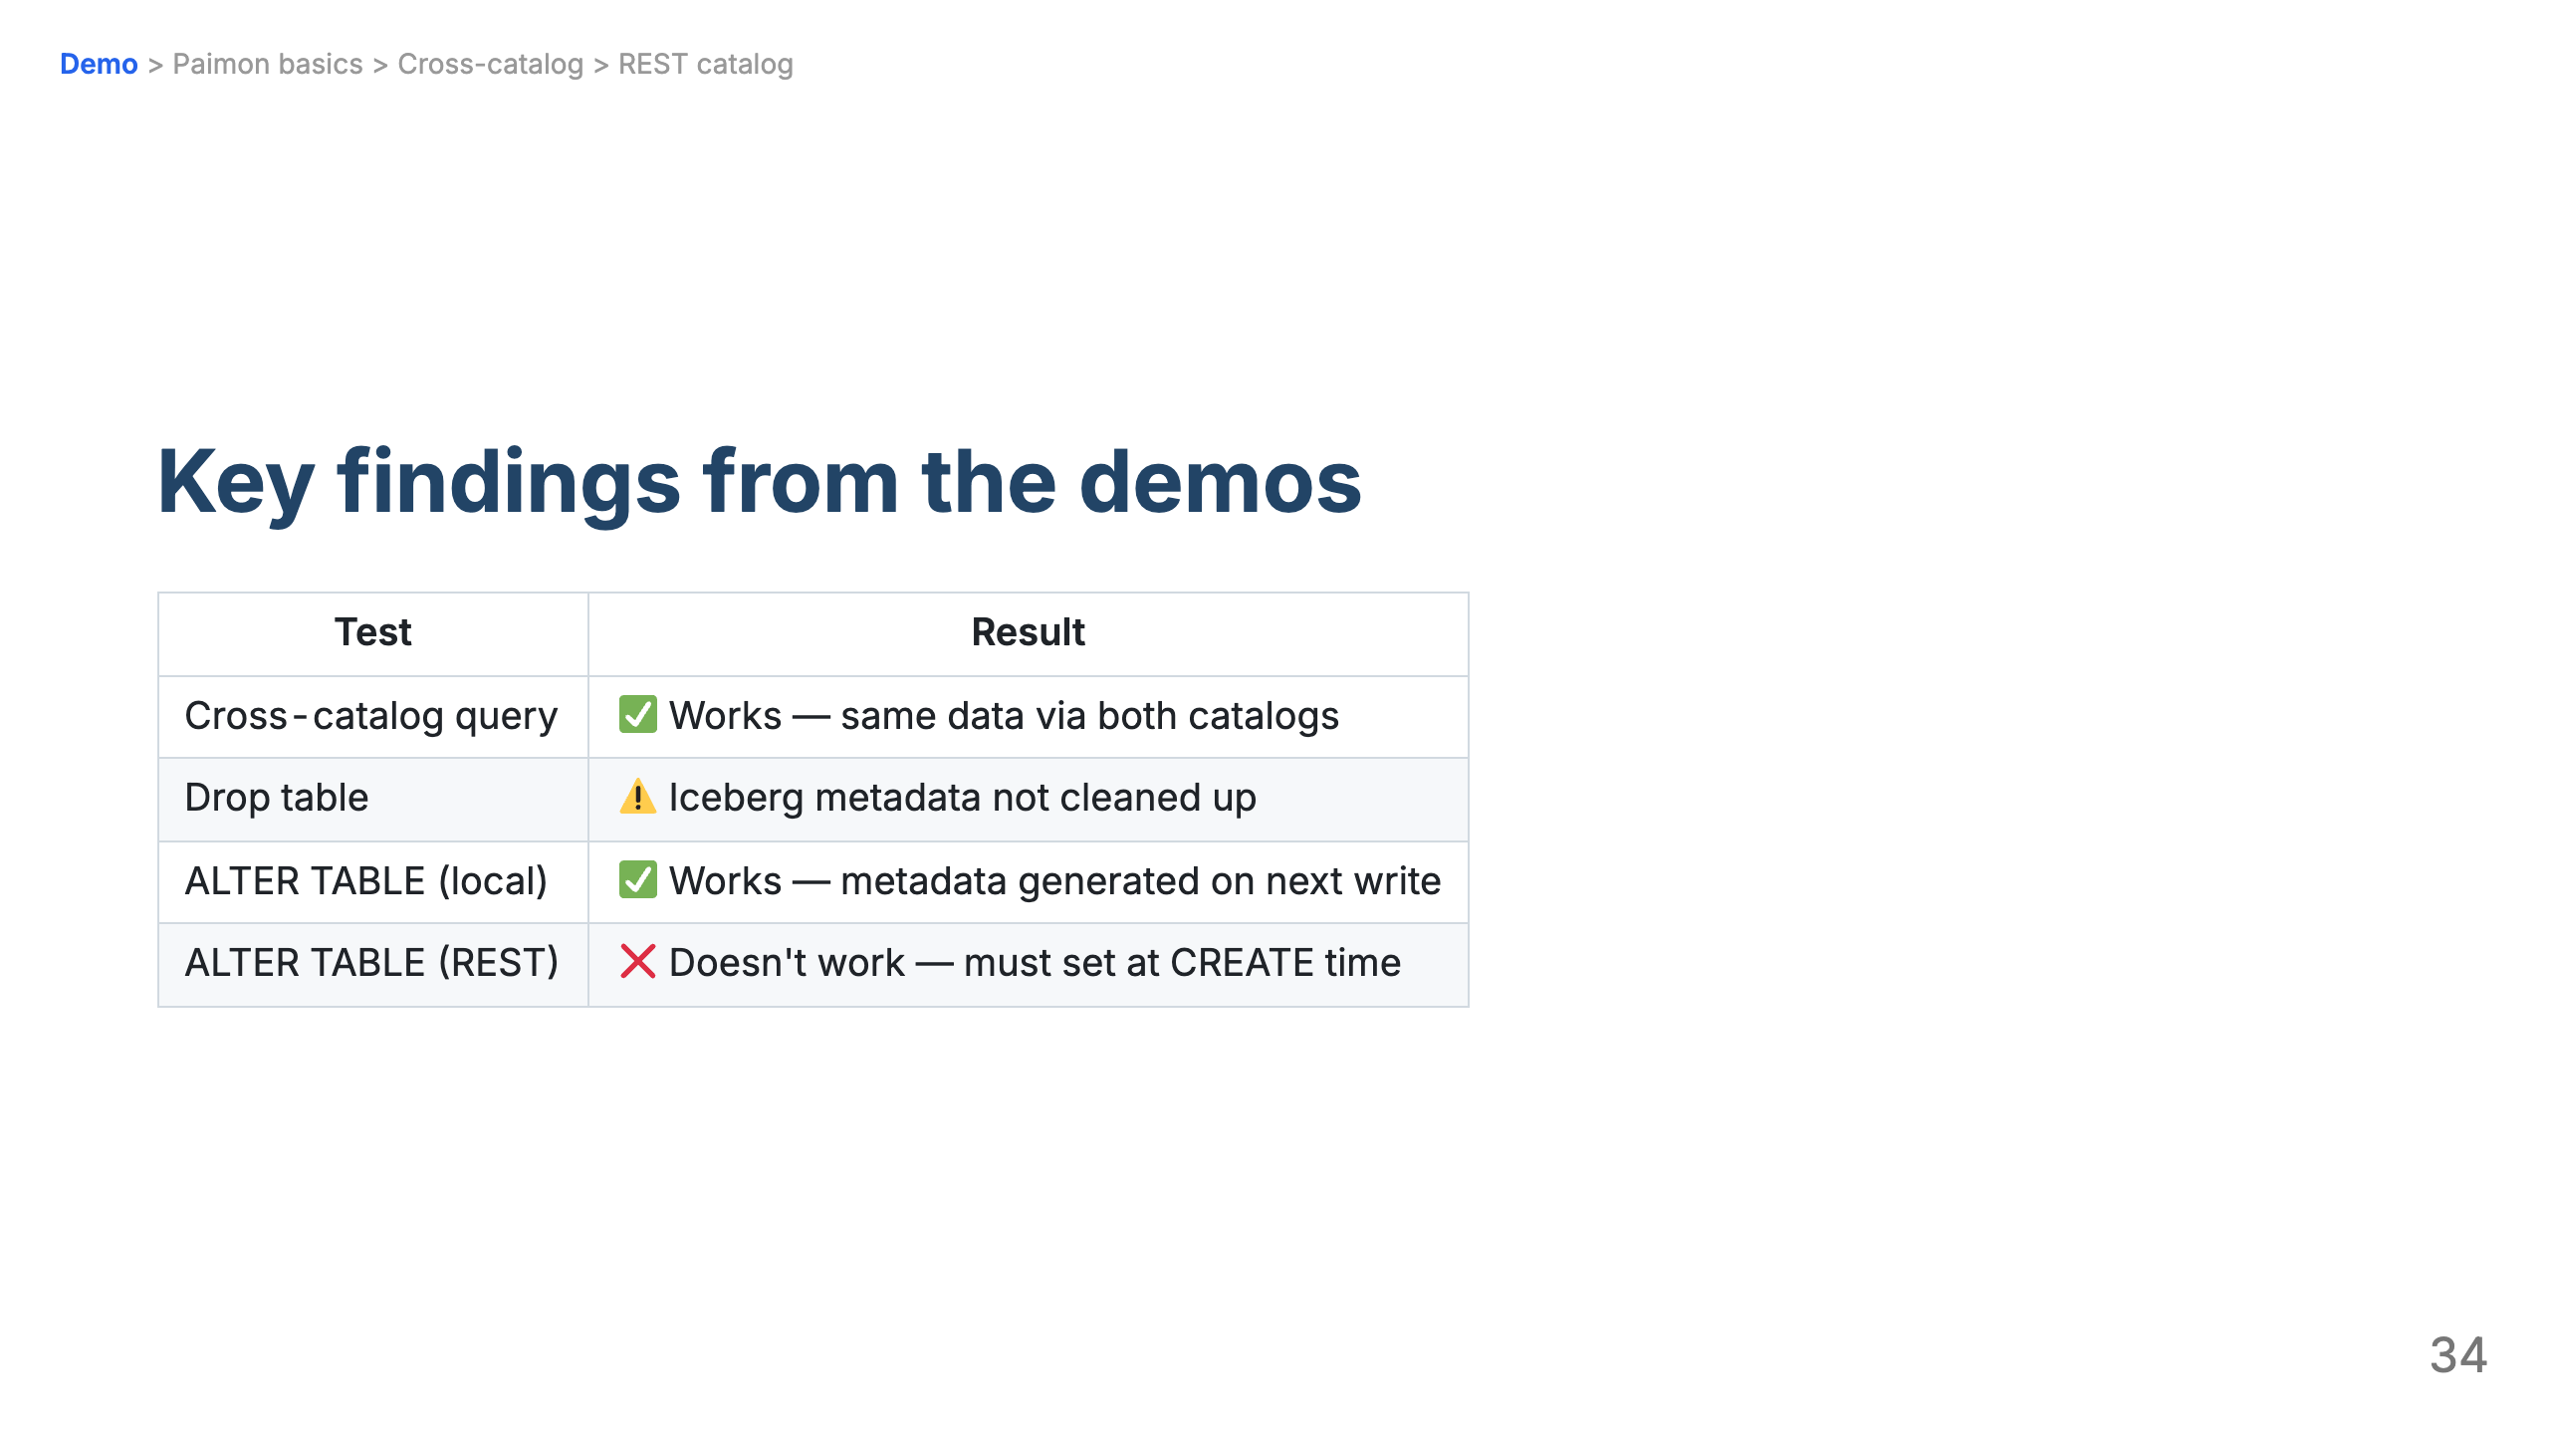

Slide 35
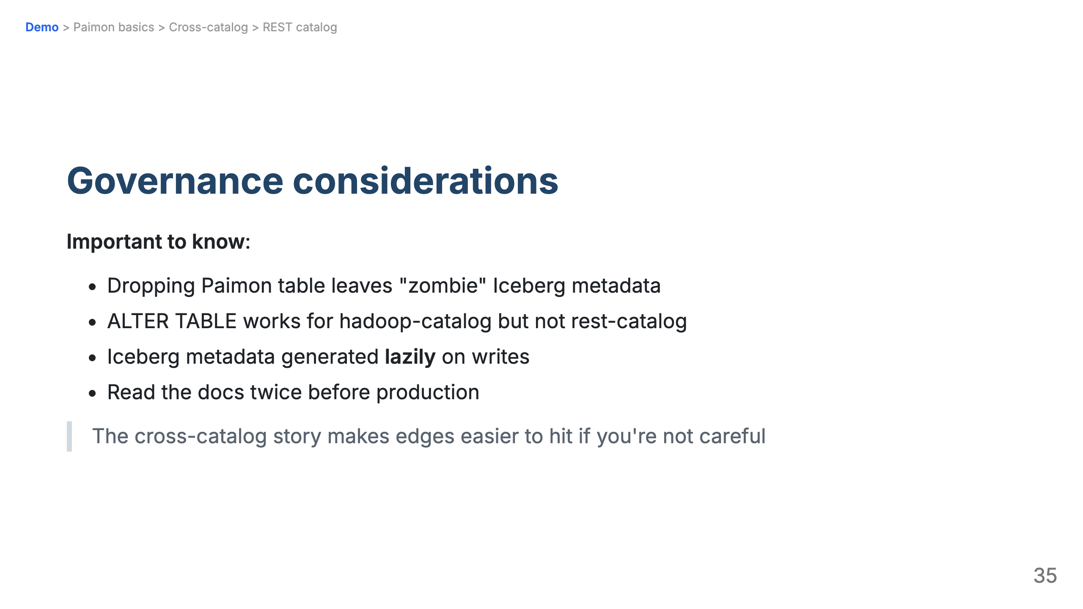

Slide 36


Slide 37
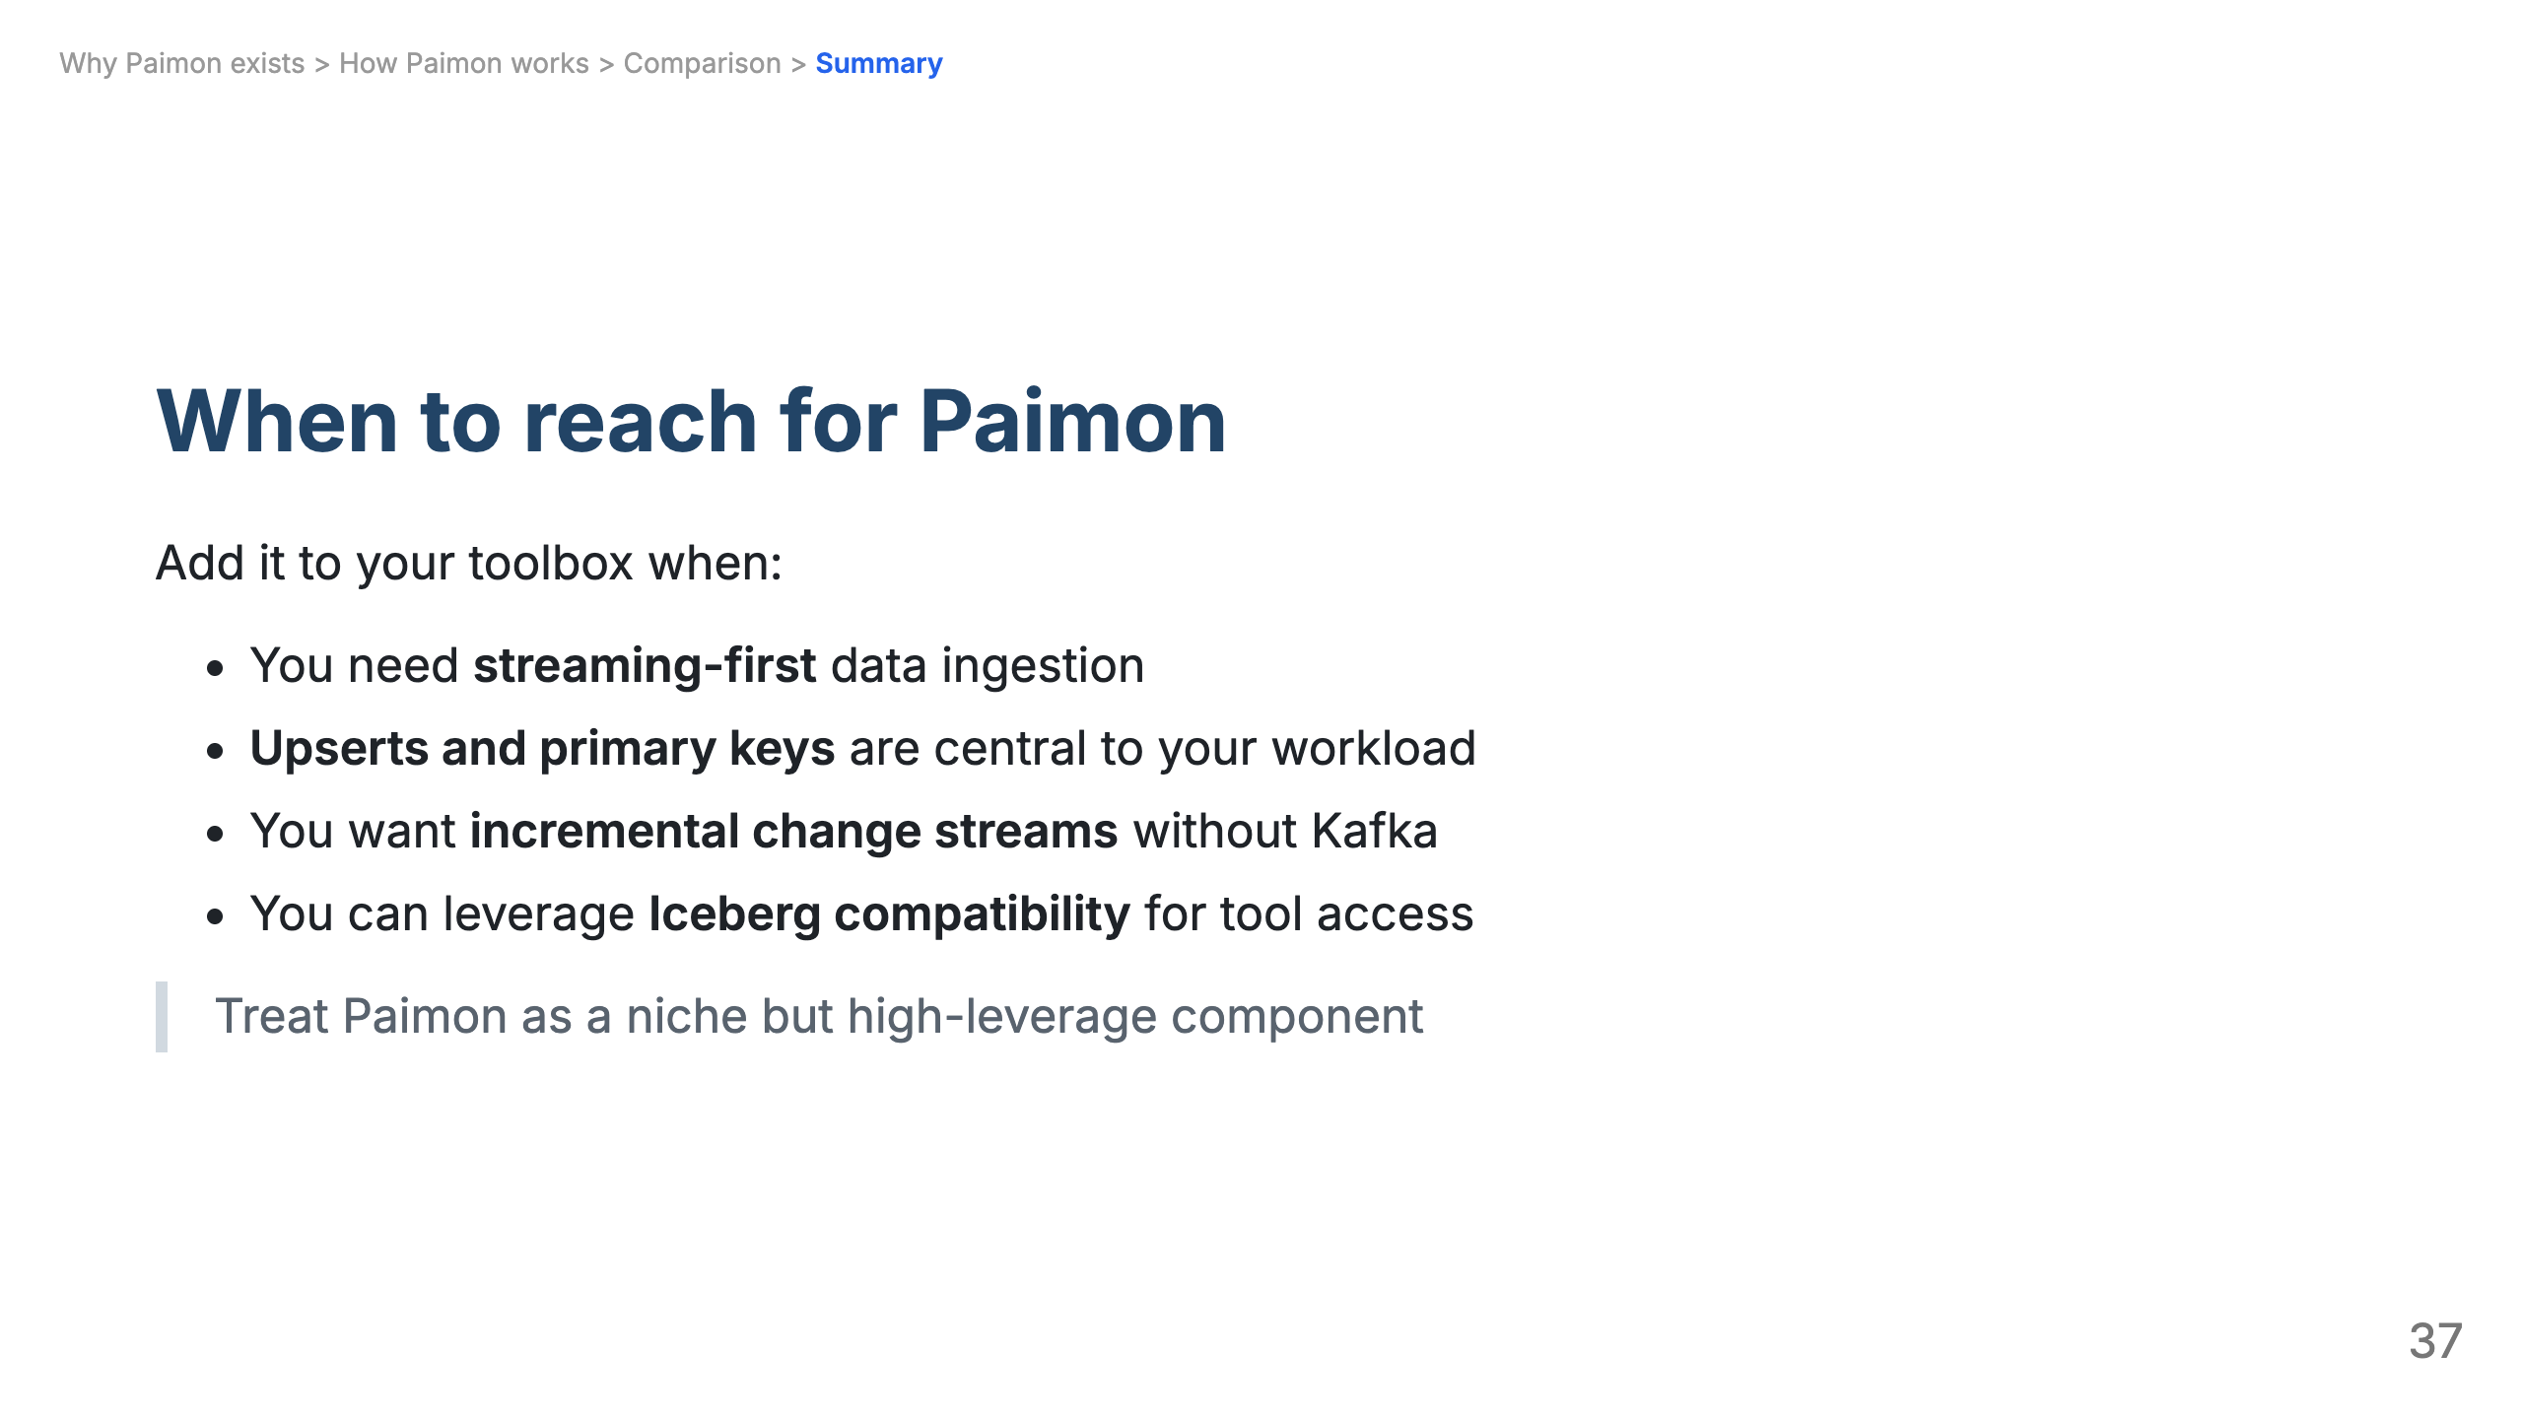

Slide 38
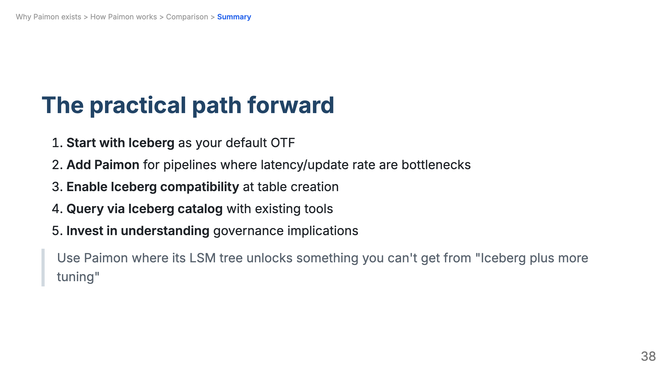

Slide 39
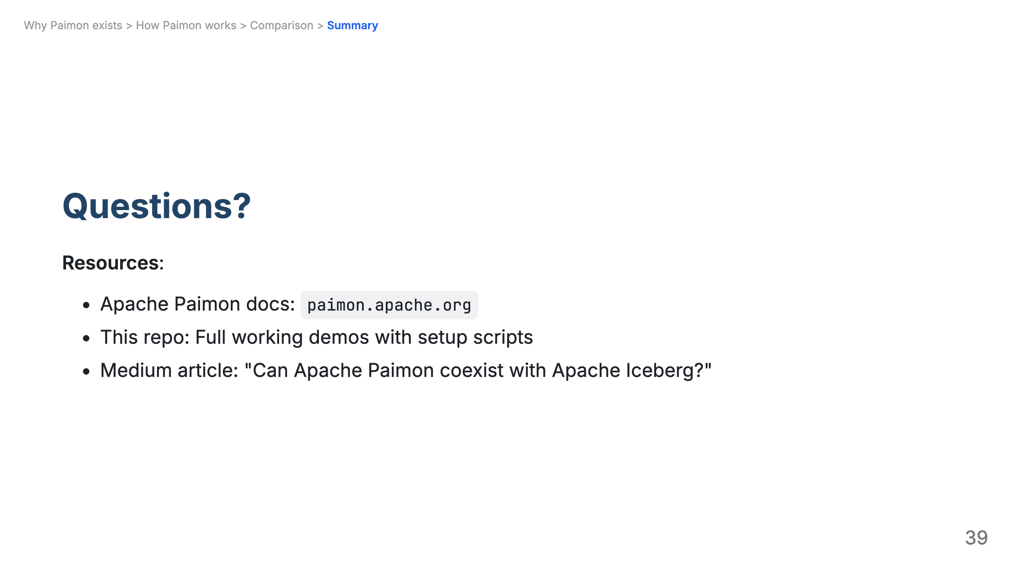

Slide 40
