Slide 1

Restart Game – Press ESC

Slide 2
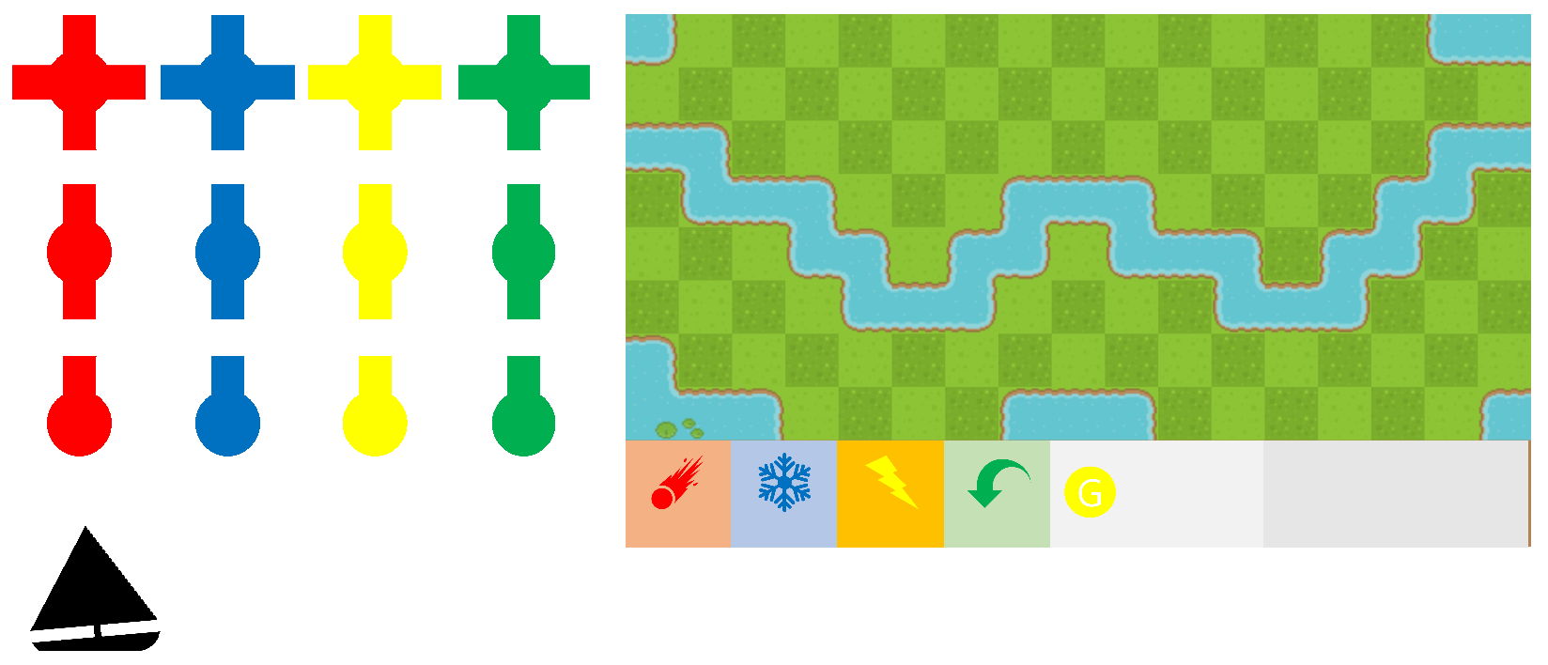

Slide 3
NEXT STAGE

