Slide 1
Build a Movie Recommendation System in Python
Pushpakov Yerkebulan
Talas Balnur
ADA-2201

Slide 2
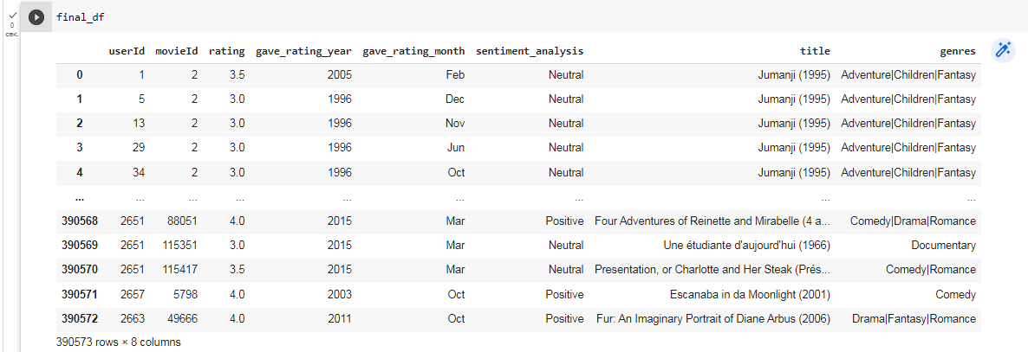
Dataset observation (MovieLens)

Slide 3
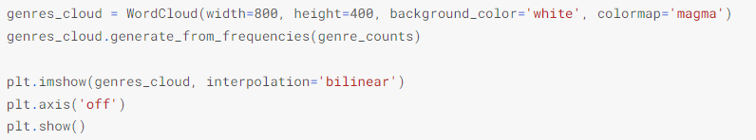
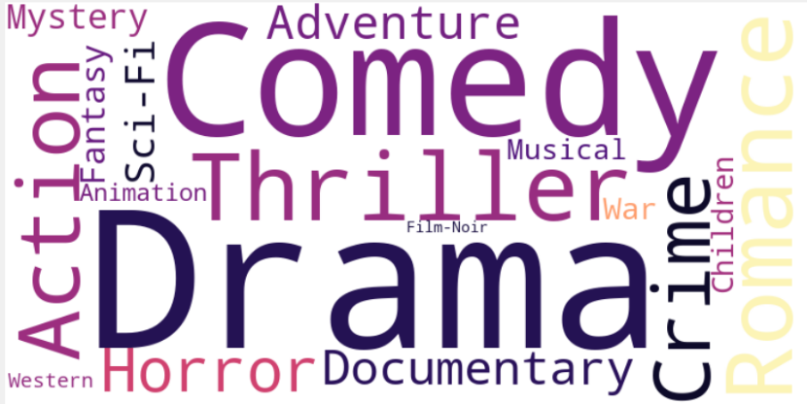
Data visualization(EDA)

Slide 4
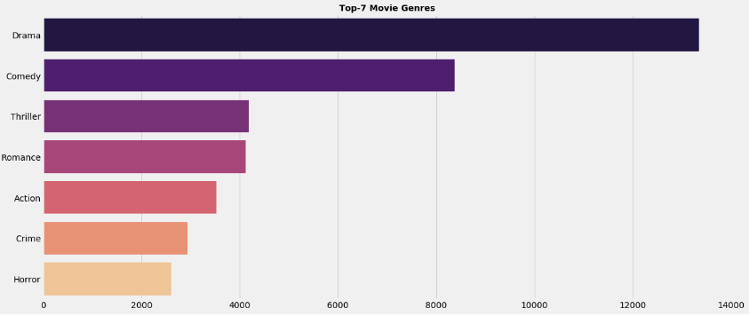
Top 7 genres

Slide 5
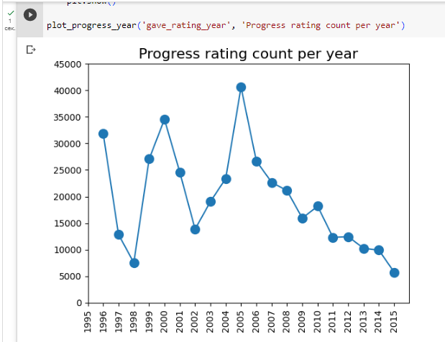
Progress rating count per year

Slide 6
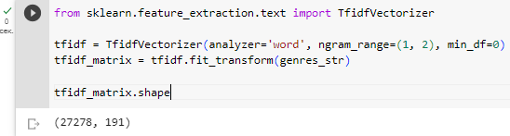
Represent text numerically (TF-IDF)
TF is simply the frequency of a word in a document
IDF is the inverse of the document frequency among the whole corpus of documents

Slide 7
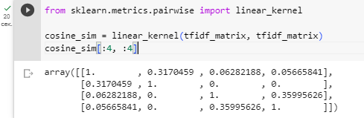
Cosine similarity distance metric to evaluate similarity scores
Now we have a pairwise cosine similarity matrix for all the movies in the dataset.
The next step is to write a function that returns the 10 most similar movies based on the cosine similarity score.

Slide 8
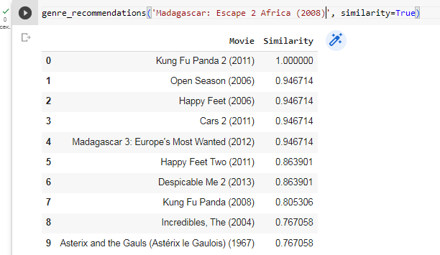
Movie recommendations

