Slide 1
Class

Slide 2
Class
Classes are in fact "special functions"
Clases contains:
1. Constructors
2. Methods

Slide 3
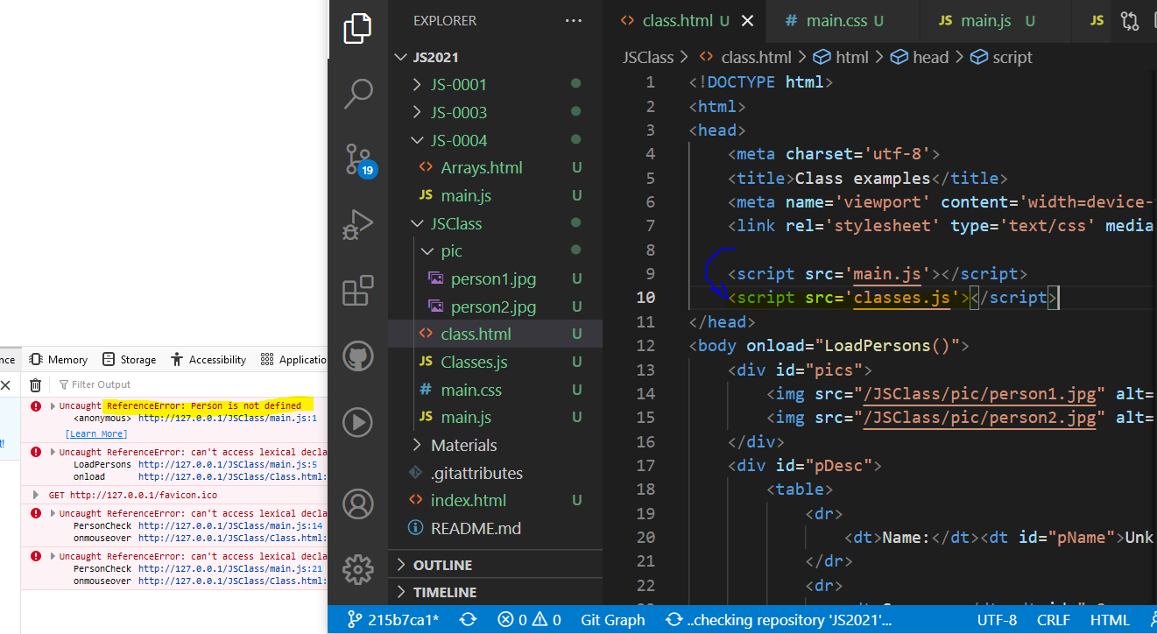

Slide 4
Constructor
const p1 = new Person();
let p2;
function LoadPersons()
{
p1.name="John";
p1.surname = "Smith";
p2 = new Person("Kate", "Brown");
}
class Person{
constructor(name, surname) {
this.name = name;
this.surname = surname;
}
}

Slide 5
let vs var vs const
let
let x = 1;
if (x === 1) {
let x = 2;
console.log(x);
// output: 2
}
console.log(x);
//output: 1
var
var x = 1;
if (x === 1) {
var x = 2;
console.log(x);
// output: 2
}
console.log(x);
//output: 2
const
const x = 1;
if (x === 1) {
const x = 2;
console.log(x);
//output: 2
}
console.log(x);
//output: 1

Slide 6
Methods
get birthYear()
{ return this.getBirthYear(this.age); }
getBirthYear(age)
{ return new Date().getFullYear()-age; }
document.getElementById("pSurname").innerHTML=p1.surname;
document.getElementById("pBorn").innerHTML=p1.birthYear;

Slide 7
Methods
get birthYear()
{ return this.getBirthYear(this.age); }
getBirthYear(age)
{ return new Date().getFullYear()-age; }
const p1 = new Person();
document.getElementById("pBorn").innerHTML=p1.getBirthYear(p1.age);

Slide 8
Static properties
Used for:
1. caches
2.fixed-configuration
Data will not be replicated across the instances.
class Person{
constructor(name, surname, age) {
...
}
static subject = "Client";
document.getElementById("idSubject").innerHTML=Person.subject;

Slide 9
Static methods
static checkAge(age)
{
if(parseInt(age)>=18)
{return "(Adult)";}
else{return "(Child)";}
}
….
document.getElementById("pBorn").innerHTML=p1.getBirthYear(p1.age)+Person.checkAge(p1.age);

Slide 10
Subclass
class Client extends Person {
constructor(name, surname, age, Id)
{
super(name, surname, age);
this.clientId = Id;
}
}
p3 = new Client("Samanta", "Stone", 26, 76548);

Slide 11
Subclass call superclass
get isSenior()
{
var by = super.getBirthYear();
if(by<1980)
{return "(Senior)";}
else {return "(Customer)"}
}
document.getElementById("cId").innerHTML=p3.clientId +p3.isSenior;

Slide 12
Private class
Class fields are public by default
Private class members mark by - #

Slide 13
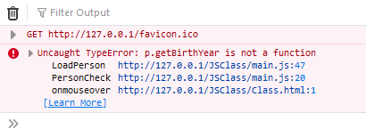
Private class method
get birthYear()
{return this.#getBirthYear(this.age); }
#getBirthYear(age)
{return new Date().getFullYear()-age; }
document.getElementById("pBorn").innerHTML=p.getBirthYear(p.age)+Person.checkAge(p.age);
document.getElementById("pBorn").innerHTML=p.birthYear+Person.checkAge(p.age);

Slide 14
Private properties
class Person{
#shopingCenter;
constructor(name, surname, age) {
this.name = name;
this.surname = surname;
this.age = age;
this.#shopingCenter = "Origo";
}

Slide 15
Task
Create 4 cars view page.
Cars describe – Mark, model, year, color, engineType
When you mouse move on 1 car you retrieve all this information using public class method.
When you mouse move on 2nd car you retrieve all data using extend class method(extra parameter – odometer and also if car odometer is greater than 2000 than mark car as “(used)”).
When you mouse move on 3rd car all values comes from private methods
When you mouse move on 4 car all values comes from static parameters.

Slide 16
Thanks

