Slide 1
Color Transparency in Dirty Kinematics
Douglas Higinbotham and Holly Szumila-Vance
https://xkcd.com/237/

Slide 2
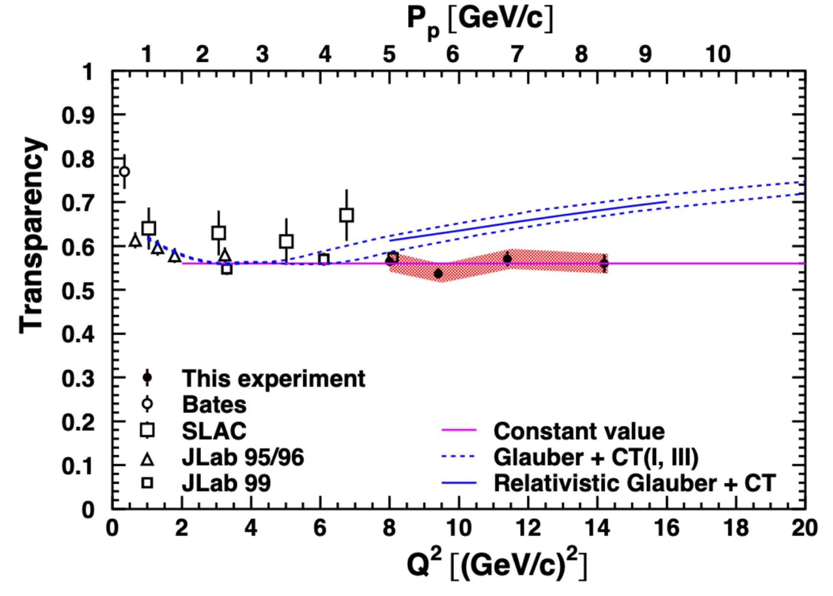
Need to check if the denominator of this point is the same as the rest.
Data Yield / Predicted Yield from Naive Model
“Transparency was extracted as the ratio of experimental yield to the PWIA yield integrated over the same phase space volume”
https://doi.org/10.1103/PhysRevLett.126.082301

Slide 3
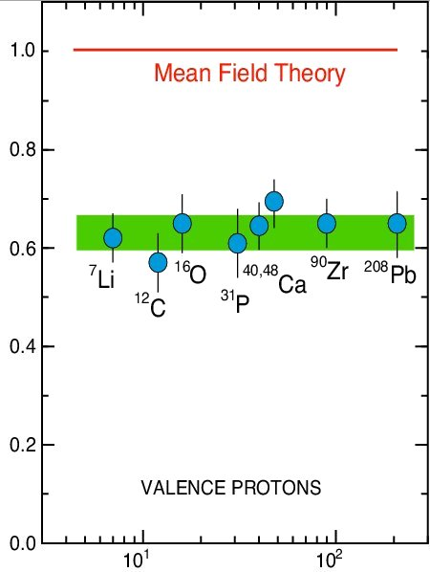
Classic (NIKHEF/SACLAY) Low Q² A(e,e’p) Scattering Results
Independent-Particle Shell-Model is based upon the assumption that each nucleon moves independently in an average potential (mean field)
induced by the surrounding nucleons
The (e,e'p) data for knockout rate is 60 – 70% of the mean field prediction.
SPECTROSCOPIC STRENGTH
We now know that that reduction is mostly due to initial-state effects (i.e. short-range and long-range correlations)
NOTE: I thought it was curious that the very low Q² ¹²C point has the same value as the extreme high Q² result from Hall C though denominators not the same.
Target Mass

Slide 4
Going to higher and higher Q² obtaining same ratio
From a simple minded experimentalists point of view this simple means the reduction in the ratio is an initial-state effect.
NOTE: From classic NIKHEF (e,e’p) data one would expect the constant
Transparency magnitude to change with the shells (i.e. E_{m} cut)
“The definition of insanity is doing the same thing over and over again, but expecting different results.” –Albert Einstein
Now we don’t doing exactly the same thing, but perhaps it is worth thinking about another kinematics.

Slide 5
Repeat Q² scan in “dirty” FSI dominated kinematics
q-vector
q-vector
q-vector
Proton detector
Proton detector
Proton detector
A simple cartoon where at some Q² the FSI re-scattering stops as the proton becomes transparent.
We know FSI dominated kinematics can give an order of magnitude larger cross sections that pure PWIA

Slide 6
Summary
New Hall C CT (e,e’p) Experiment has not seen CT to a Q² of 14.2 GeV²
The kinematics for that run were relatively clean and compared to a simple model
To try to enhance any possible accessible (e,e’p) CT signal in accessible kinematics, we are investigating making use of “dirty” FSI dominated kinematics
For the SRC (e,e’p) experiments we spend MANY years to minimize FSI, MEC, etc.
From those studies we know exactly where to go for FSI dominated kinematics
In dirty kinematics go from low Q² to high Q² taking a ratio to a FSI model without CT
Hall C (e,e’p) two spectrometer experiment experiment (this part is easy)
Still in VERY early stages of looking into this idea and calculations
At this point, I think the null hypothesis would be no ¹²C(e,e’p) CT at these Q², so this is the best we have come up with thus far to try to enhance any possible signal and challenge the null hypothesis.

