Slide 1

Chapter 6
The Force between Two Nucleons
◎ The deuteron
● Nucleon-Nucleon scattering

Slide 2




Fundamental Forces

Slide 3
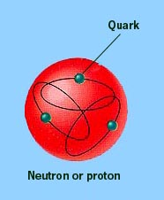
A few properties of nucleon-nucleon force:
1. At short distances it is stronger than the Coulomb force; the
nuclear force can overcome the Coulomb repulsion of protons in the nucleus.
At long distances, of the order of atomic sizes, the nuclear force is negligibly feeble; the interactions among nuclei in a molecule can be understood based only on the Coulomb force.
3. Some particles are immune from the nuclear force; there is no evidence from atomic structure, for example, that electrons feel the nuclear force at all.

Slide 4
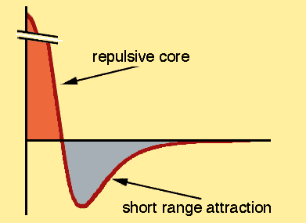
Some other remarkable properties of the nuclear force:
1. The nucleon-nucleon force seems to be nearly independent of
whether the nucleons are neutrons or protons. This property is
called charge independence.
2. The nucleon-nucleon force depends on whether the spins of the
nucleons are parallel or anti-parallel.
3. The nucleon-nucleon force includes a repulsive
term, which keeps the nucleons at a certain average separation.
4. The nucleon-nucleon force has a non-central or tensor component. This part of the force does not conserve orbital angular momentum, which is a constant of the motion under central forces.

Slide 5
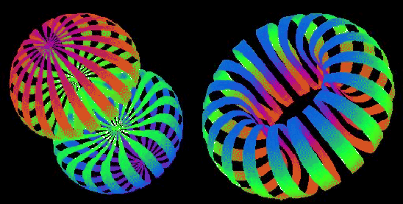

6-1 The deuteron
Shapes of the deuteron in the laboratory reference frame. Stripes show surfaces of equal density for the M_{J} =1 (left) and M_{J} =0 (right) magnetic substates of the J =1 ground state.
From http://www.phy.anl.gov/theory/movie-run.html.

Slide 6
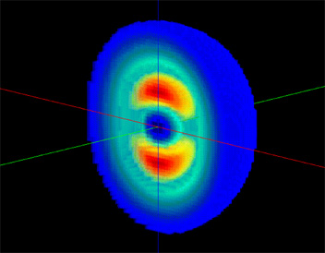
The Deuteron
1. A deuteron (²H nucleus) consists of a neutron and a proton. (A
neutral atom of ²H is called deuterium.)
2. It is the simplest bound state of nucleons and therefore gives us an ideal system for studying the nucleon-nucleon interaction.
3. An interesting feature of the deuteron is that it does not have excited states because it is a weakly bound system.

Slide 7
This image shows the intrinsic shape of the deuteron by combining the results from three recent nuclear physics experiments.
Image courtesy of JLab
The simplest nucleus in nature is that of the hydrogen isotope, deuterium. Known as the “deuteron,” the nucleus consists of one proton and one neutron. Due to its simplicity, the deuteron is an ideal candidate for tests of our basic understanding of nuclear physics. Recently, scientists have been studying the intrinsic shape of the deuteron. Dominated by three components describing the interactions of the quark components of the neutron and proton, its shape is not spherical. Recent tests have shown no deviations in the predictions of standard nuclear physics.
www.physicscentral.com/.../2002/deuteron.html

Slide 8
The Deuteron - Angular momentum
1. In analogy with the ground state of the hydrogen atom, it is reasonable to assume
that the ground state of the deuteron also has zero orbital angular momentum L = 0
2. However the total angular momentum is measured to be I = 1 (one unit of h/2π)
thus it follows that the proton and neutron spins are parallel. s_{n}+s_{p} = 1/2 + 1/2 = 1
3. The implication is that two nucleons are not bound together if their spins are anti-parallel, and this explains why there are no proton-proton or neutron-neutron bound states (more later).
4. The parallel spin state is forbidden by the Pauli exclusion principle in the case of identical particles
5. The nuclear force is thus seen to be spin dependent.
• Note that there is a small electric quadrupole moment so our assumption latter of zero angular momentum is not quite correct

Slide 9

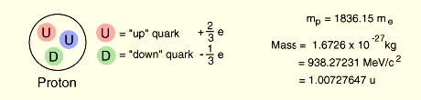
The Deuteron
The deuteron, composed of a proton and a neutron, is a stable particle.
abundance of 1.5 x 10-4 compared to 0.99985 for ordinary hydrogen.
Constituents 1 proton 1 neutron
Mass 2.014732 u
Binding energy 2.224589 ± 0.000002 MeV
Angular momentum 1
Magnetic moment 0.85741 ± 0.00002 μ_{N}
Electric quadrupole moment +2.88 x 10^{–3} bar
RMS separation 4.2 fm

Slide 10
The Deuteron - Binding energy
Binding energy of the deuteron is 2.2 MeV.
If the neutron in the deuteron were to decay to form a proton, electron and antineutrino, the combined mass energies of these particles would be 2(938.27 MeV) + 0.511 MeV = 1877.05 MeV
But the mass of the deuteron is 1875.6 MeV !!

Slide 11
The Deuteron – Measured Binding energy
• Mass doublet method
m(²H) = 2.014101789 ± 0.000000021 u
m(²H) = 2.014101771 ± 0.000000015 u
B = [m(¹H) + m(n) - m(²H)]c² = 2.22463 ± 0.00004 MeV
(1)
• Measure energy released (gamma) on
formation from a neutron and proton
¹H + n → ²H + γ B = 2.2245 ± 0.000002 MeV
(2)
• Photodissociation
γ + ²H → ¹H + n B = 2.224 ± 0.002 MeV
(3)
For experimental descriptions see Krane’s textbook in chapters 3 and 4.

Slide 12
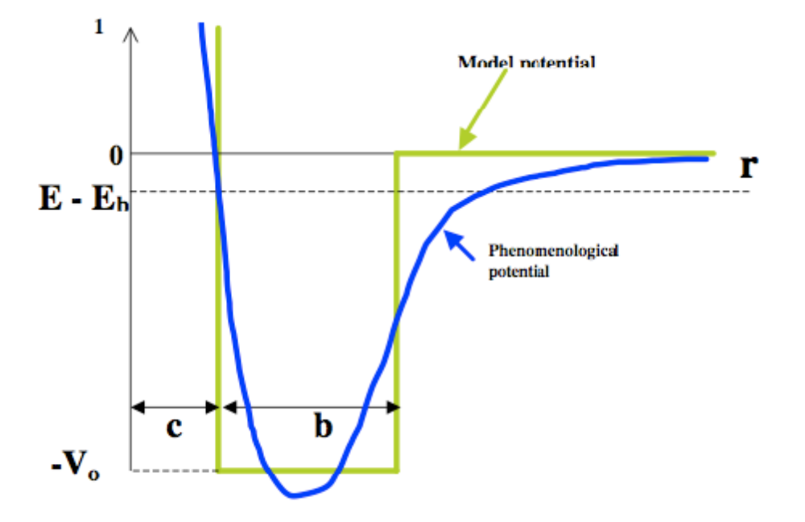
As we have discussed previously, the average binding energy per nucleon is about 7 ~ 8 MeV for typical nuclei. The binding energy of the deuteron, B = 2.224 MeV, is away too small when compared with typical nuclei. This means that the deuteron is very weakly bound.
Here we want to explore more about this result and study the properties of the deuteron.
To simplify the analysis of the deuteron, we assume that the nucleon-nucleon potential is a three-dimensional square well, as shown in the figure a:
figure a
Nuclear model potential for studying the deuteron

Slide 13
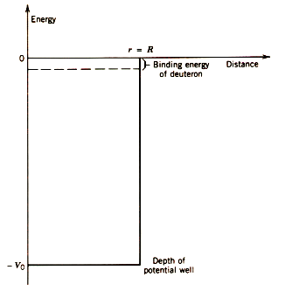

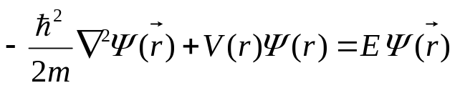

Quantum mechanical description of the weak binding for the deuteron
(4)
Here r represents the separation between the proton and the neutron, so R is in effect a measure of the diameter of the deuteron.
The dynamical behavior of a nucleon must be described by the Schrödinger’s equation:
where m is the nucleon mass.
(5)
If the potential is not orientationally dependent, a central potential, then the wave function solution can be separated into radial and angular parts:
(6)

Slide 14
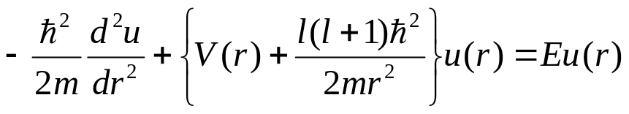


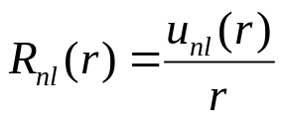
Substitute R(r) = u(r)/r in to the Schrödinger’s equation the function u(r) satisfies the following equation ;
(7)
The solution u(r) is labeled by two quantum numbers n and l so that:
(8)
The full solution Ψ(r) then can be written as
with
(9)
n: the principal quantum number which determines
the energy of an eigenstate.
l: the orbital angular momentum quantum number.
m: the magnetic quantum number, –l ≦ m ≦ l.
Three quantum numbers to define an eigenstate

Slide 15


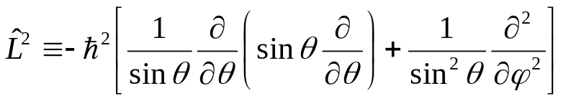
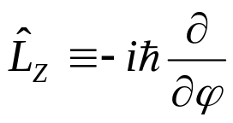
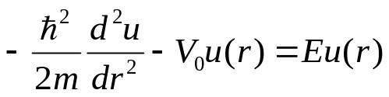
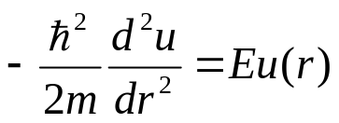
The angular part of the solution Y_{lm}(θ,φ) is called the “spherical harmonic” of order l, m and satisfies the following equations:
and
(10)
where
and
(11)
For the case of a three dimensional square well potential with zero angular momentum (l = 0), which we use as the model potential for studying the ground state of the deuteron, the Schrödinger’s equation can be simplified into:
, for r < R
(12)
, for r > R

Slide 16

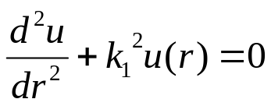
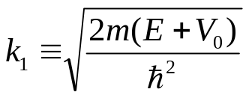

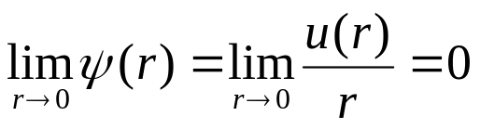

I. When r < R
The Schrödinger’s equation is
(13)
This equation can be rearranged into:
with
(14)
And the solution is
(15)
To keep the wave function finite for r → 0
The coefficient B must be set to zero. Therefore the acceptable solution of physical meaning is
(16)

Slide 17

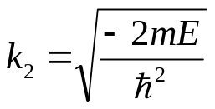


II. When r > R
(17)
The Schrödinger’s equation is:
The solution is
(18)
with
To keep the wave function finite for r → ∞
The coefficient D must be set to zero. Therefore the acceptable solution of physical meaning is
(19)

Slide 18

Applying the continuity conditions on u(r) and du/dr at r = R, we obtain
(20)
This transcendental equation gives a relationship between V₀ and R.
From electron scattering experiments, the rms charge radius of the deuteron is known to be about 2.1 fm. Taking R = 2.1 fm we may solve from equation (20) the value of the potential depth V₀. The result is V₀ = 35 MeV.
R = 2.1 fm
The bound state of the deuteron, at an energy of about -2 MeV, is very close to the top of the well.
V₀ = 35 MeV

Slide 19
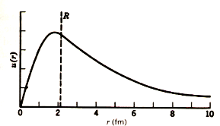
Here we show the deuteron wave function for R = 2.1 fm. The exponential joins smoothly to the sine at r = R, so that both u(r) and du/dr are continuous.
If the nucleon-nucleon force were just a bit weaker the deuteron bound state would not exist at all. In this situation the whole universe would be all quite different from the one we are observing.

Slide 20
Spin and parity of the deuteron
● The measured spin of the deuteron is I = 1.
● By studying the reactions involving deuterons and the property
of the photon emitted during the formation of deuterons, we know
that its parity is even.
The total angular momentum I of the deuteron should be like
I = s_{n} + s_{p} + l
(21)
where s_{n} and s_{p} are individual spins of the neutron and proton.
The orbital angular momentum of the nucleons as they move about their common center of mass is l.

Slide 21
There are four ways to couple s_{n}, s_{p}, and l to get a total I of 1.
(a) s_{n} and s_{p} parallel with l = 0
parallel
(b) s_{n} and s_{p} antiparallel with l = 1
(c) s_{n} and s_{p} parallel with l = 1
antiparallel
(d) s_{n} and s_{p} parallel with l = 2
● Since we know that the parity of the deuteron is even and the parity associated
with orbital motion is determined by (-1)^{l} we are able to rule out some options.
● Orbital angular momentum l = 0 and l = 2 give the correct parity determined from
experimental observations.
● The observed even parity allows us to eliminate the combinations of spins that
include l =1, leaving l = 0 and l = 2 as possibilities.

Slide 22
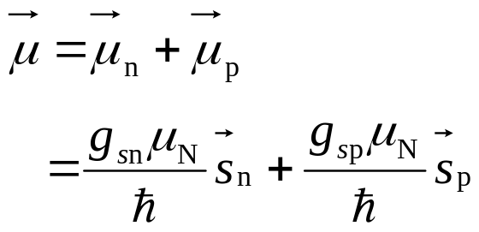
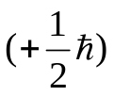
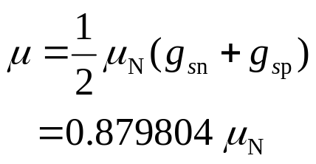
The magnetic dipole moment of the deuteron
If the l = 0 is perfectly correct description for the deuteron, there should be no orbital contribution to the magnetic moment. We can assume that the total magnetic moment is simply the combination of the neutron and proton magnetic moments:
(22)
where g_{sn} = -3.826084 and g_{sp} = 5.585691.
If we take the observed magnetic moment to be the z component of μ
when the spins have their maximum value
(23)
The observed value is 0.8574376 ± 0.0000004 μ_{N}, in good but not quite exact agreement with the calculated value.

Slide 23



In the context of the present discussion we can ascribe the tiny discrepancy to the small mixture of d state ( l = 2) in the deuteron wave function:
(24)
Calculating the magnetic moment from this wave function gives
(25)
The observed value is consistent with
(26)
This means that the deuteron is 96% l = 0 ( s orbit) and only 4% l = 2 (d orbit).

Slide 24

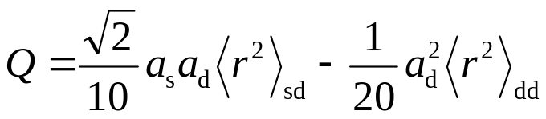


The electric quadrupole moment of the deuteron
The bare neutron and proton have no electric quadrupole moment, and so any measured nonzero value for the quadrupole moment must be due to the orbital motion.
― The pure l = 0 wave function would have a vanishing quadrupole moment.
The observed quadrupole moment for the deuteron is
(27)
When the mixed wave function [equation (24)] is used to calculate the quadrupole moment of the deuteron (Q) the calculation gives two contribution terms. One is proportional to (a_{d})² and another proportional to the cross-term (a_{s}a_{d}).
(28)
where
To calculate Q we must know the deuteron d-state wave function and it is obtainable from the realistic phenomenological potentials. The d-state admixture is of several percent in this calculation and is consistent with the 4% value deduced from the magnetic moment.

Slide 25
Some comments concerning the d-state admixture obtained from the studies of magnetic moment μ and the quadrupole moment Q:
1. This good agreement between the d-state admixtures deduced from μ and Q should
be regarded as a happy accident and not taken too seriously. In the case of the magnetic dipole moment, there is no reason to expect that it is correct to use the free-nucleon magnetic moments in nuclei.
2. Spin-orbit interactions, relativistic effects, and meson exchanges may have greater effects on μ than the d-state admixture (but may cancel one another’s effect).
3. For the quadrupole moment, the poor knowledge of the d-state wave function makes the deduced d-state admixture uncertain.
4. Other experiments, particularly scattering experiments using deuterons as targets, also give d-state admixtures in the range of 4%. Thus our conclusions from the magnetic dipole and electric quadrupole moments may be valid after all.
5. It is important that we have an accurate knowledge of the d-state wave function because the mixing of l values in the deuteron is the best evidence for the noncentral (tensor) character of the nuclear force.

Slide 26
6-2 Nucleon-Nucleon Scattering
● The total amount of information about nucleon-nucleon interaction that we acquire from
the study of the deuteron is very limited. As far as we know there is only one weakly
bound state of a neutron and a proton.
● The configuration of the deuteron is l = 0, parallel spins, and ~ 2 fm separation.
● To study the nucleon-nucleon interaction in different configurations we need to perform
nucleon-nucleon scattering experiments.
There are two ways to perform nucleon-nucleon experiments.
(a). An incident beam of nucleons is scattered from a target of nucleons.
The observed scattering of a single nucleon will include the complicated effects of the multiple encounters and is very difficult to extract the properties of the interaction between individual nucleons.
(b). An incident beam of nucleons is scattered from a target of hydrogen.
Incident nucleons can be scattered by individual protons. Multiple encounters are greatly reduced by large spatial separations between nucleons. Characteristic properties of nucleon-nucleon interactions can therefore be deduced without complications.

Slide 27
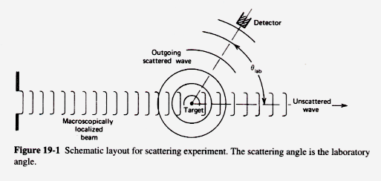
As in the case of electron scattering the nuclear scattering problem is analogous to the diffraction problem in optics. There are three features worth mentioning:
1. The incident wave is represented by a plane wave, while far from the target (obstacle) the scattered wave fronts are spherical. The total energy content of any expanding spherical wave front cannot vary; thus its intensity (per unit area) must decrease like r⁻² and its amplitude must decrease like r⁻¹.
2. Along the surface of any spherical scattered wave front, the diffraction is responsible
for the variation in intensity of the radiation. The intensity thus depends on angular coordinates θ and φ.
3. A radiation detector placed at any point far from the target would record both incident
and scattered waves.

Slide 28


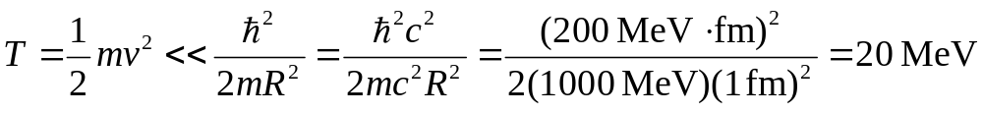
To solve the nucleon-nucleon scattering problem using quantum mechanics we assume the nuclear interaction by a square-well potential, as we did for the deuteron.
In fact, the only difference between this calculation and that of the deuteron is that here we concerned with free incident particles with E > 0.
V
For low energy nucleon-nucleon scattering we may simplify the Schrödinger’s equation by assuming l = 0.
E
R
r
Consider an incident nucleon striking a target nucleon just on the surface so that the impact parameter is of the order of b ≈ 1 fm.
-V₀
If the incident particle has velocity v, its angular momentum relative to the target is mvR.
We have
where l is the angular momentum quantum number
If
, then only l = 0 interactions are likely to occur.
This corresponds to the kinetic energy
If the incident energy is far below 20 MeV, the l = 0 assumption is justified.

Slide 29
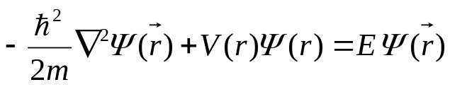
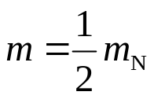


The Schrödinger’s equation of the two nucleons system is
(29)
The mass appearing in the equation is the reduced mass and is about half of the nucleon mass.
(30)
V
E
R
r
By defining the radial part wave function as u(r)/r, the Schrödinger equation is
-V₀
, for r < R
(31)
, for r > R
The acceptable solution in the region r < R is
with
(32)

Slide 30









The acceptable solution in the region r < R is
with
(32)
For r > R, the wave function is
with
(33)
For further discussions it is convenient to rewrite Equation (33) as
(34)
where
and
The boundary condition on u and du/dr at r = R give
and
(35)
V
E
R
r
Dividing then we have a transcendental equation to solve:
(36)
-V₀
Given E, V₀, and R, we can in principle solve for δ.
δ is called the “phase shift”

Slide 31
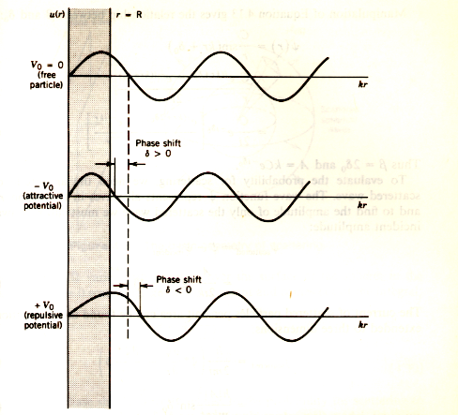
(attractive potential)
The effect of a scattering potential is to shift the phase of the scattered wave at points beyond the scattering regions, where the wave function is that of a free particle.
(repulsive potential)

Slide 32
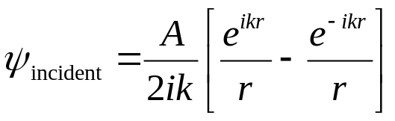
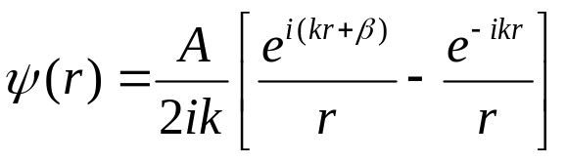
A more general scattering theory with zero angular momentum (l = 0).
Incident particles are described quantum mechanically the incident plane wave. Mathematically the incident plane wave can be described with spherical waves e^{ikr}/r and e^{-ikr}/r. By multiplying with the time-dependent factor e^{-iωt} it is easily recognized that e^{ikr} gives an outgoing wave whereas e^{-ikr} gives an incoming wave.
For l = 0 we can take,
(37)
The minus sign between the two terms keeps the incident wave function finite for r → 0, and using the coefficient A for both terms sets the amplitudes of the incoming and outgoing waves to be equal.
We further assume that the scattering does not create or destroy particles, and thus the amplitudes of the e^{ikr} and e^{-ikr} terms should be the same.
All that can result from the scattering is a change in phase of the outgoing wave:
where β is the change in phase.
(38)

Slide 33



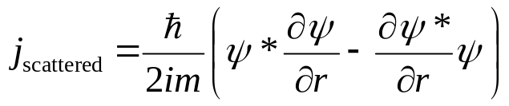
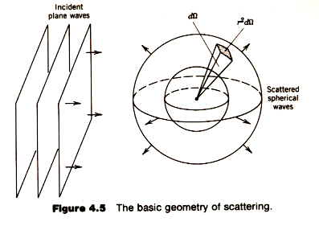
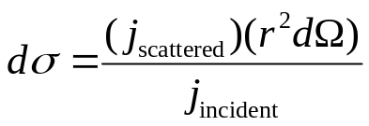
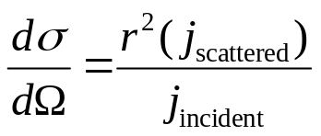
If we want to find the amplitude of the scattered wave we need to subtract the incident amplitude from
(39)
In terms of , the current of scattered particles per unit area can thus be calculated by the following equation:
(40)
The scattered current is uniformly distributed over a sphere of radius r. The probability dσ that an incident particle is scattered into dΩ is the ratio of the scattered current to the incident current:
(41.a)
The differential cross section dσ/ dΩ, which is the probability per unit solid angle, can thus be written as:
(41.b)

Slide 34
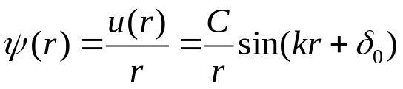
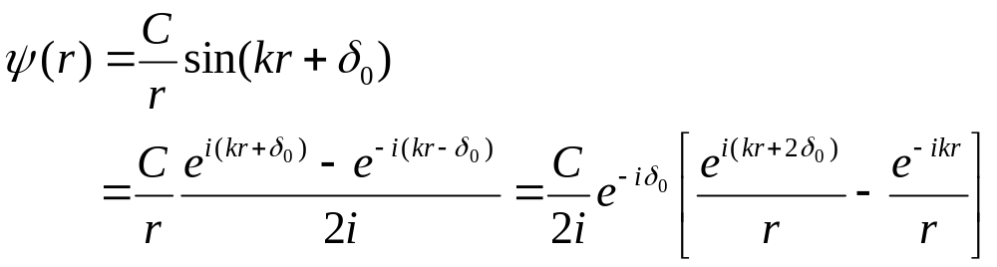


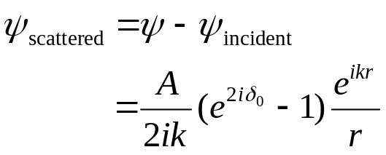
Taking the equation (34) we know that in the region r > R the wave function is of the form
(42)
This form can be manipulated in the following way:
(43)
where
and
when compared with the equation (38).
By subtracting the incident part of the wave function from Eq. (43) we have the scattered wave.
(44)

Slide 35
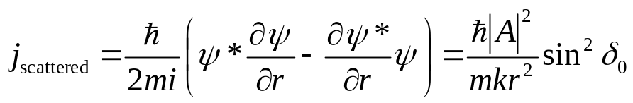
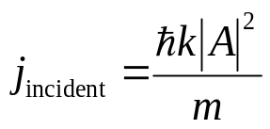
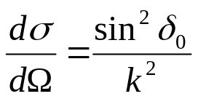
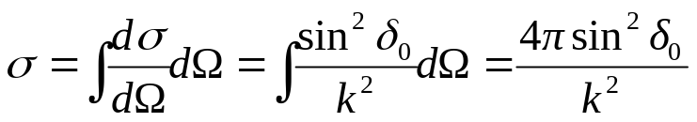
Using Eq. (40) the current of scattered particles per unit area is:
(45)
The incident current is
(46)
The differential cross section is
(47)
In general, dσ/ dΩ varies with direction over the surface of the sphere; in the special case of l = 0 scattering, dσ/ dΩ is constant and the total cross section σ is
(48)
The l = 0 phase shift is directly related to the probability for scattering to occur. That is, we can evaluate δ₀ from our simple square-well model, Eq. (36), and compare with the experimental cross section.

Slide 36
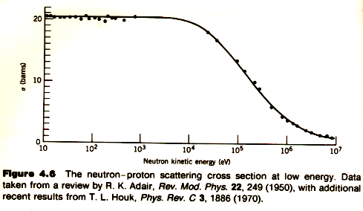



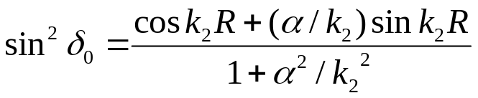
In order to understand the data taken from the low-energy neutron-proton scattering we may return to the analysis of Equation (36) by putting in proper values for all related quantities.
(36)
Assume that the incident energy is small, say E ≦ 10 keV and take V₀ = 35 MeV from our analysis of the deuteron bound state.
(49)
If we let the right side of Equation (36) equal –α then
(50)
A bit of trigonometric manipulation gives
(51)

Slide 37
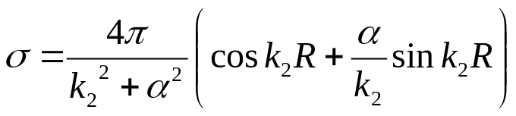
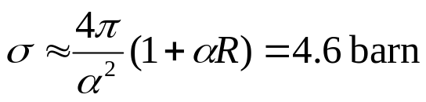

and so
(52)
Using R ≈ 2 fm from the study of the ²H bound state gives α ≈ 0.2 fm⁻¹. Thus k₂² << α² and k₂R << 1, giving
(53)
In this figure the experimental cross sections for scattering of neutrons by protons is indeed constant at low energy, and decreases with E at large energy as Equation (52) predicts.
However the low-energy cross section, 20.4 barns, is not in agreement with our calculated value of 4-5 barns.
3. This has to do with the spin-dependent characteristics in the NN interaction which we will not go any further.

Slide 38
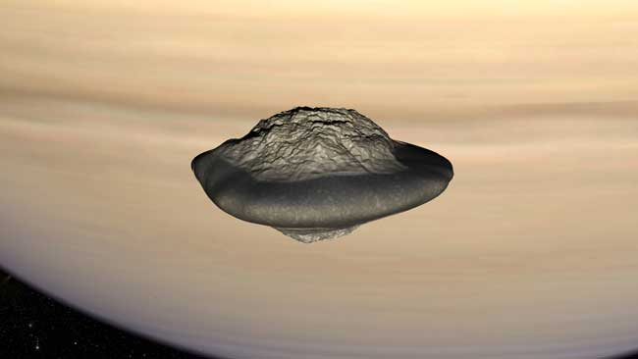
~ The End ~
A computer-generated image of Saturn's moon Atlas. Scientists now think it's flying-saucer shape comes from having snagged particles out of the planet's rings. Credit: CEA/ANIMEA
http://www.space.com/scienceastronomy/071206-saturn-moons.html

