Slide 1
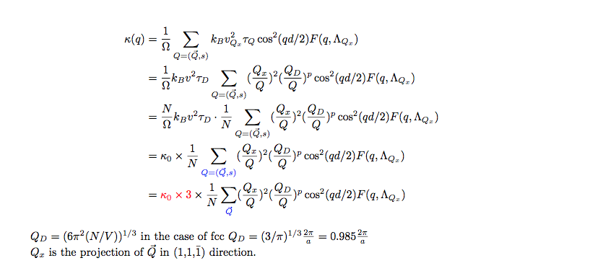
I made a similar mistake(Can be ignored)

Slide 2
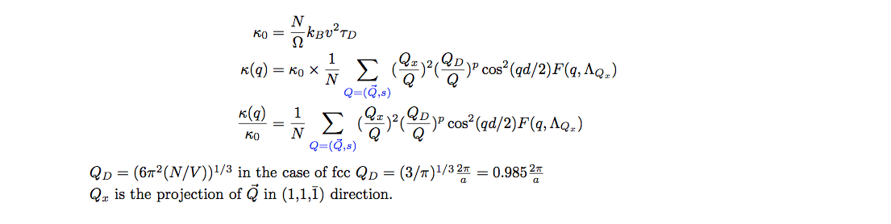
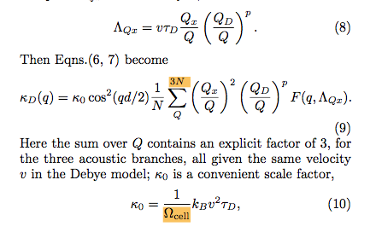
1.Suggestions on how to correct euaqtion (9) and (10)
It’s up to you

Slide 3
2. Fig 4 is modified

Slide 4
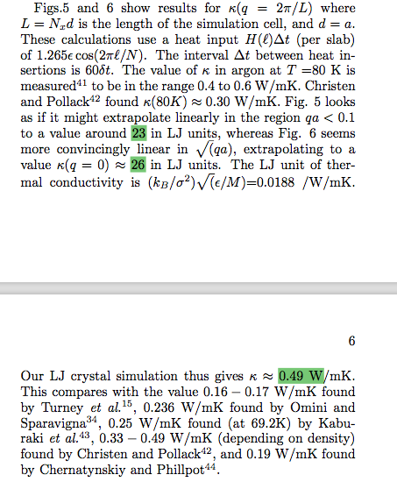
3. A correction in statement page 5 and 6
(A)26 should be 8.68
(26.00408352/3=8.6680278)
(B)0.49 should be 0.162
(8.6680278*0.0188= 0.16295892339)

