Slide 1
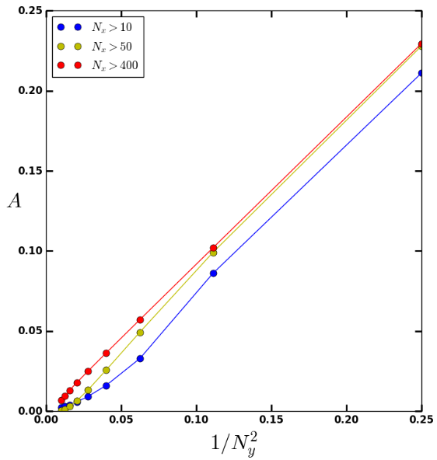
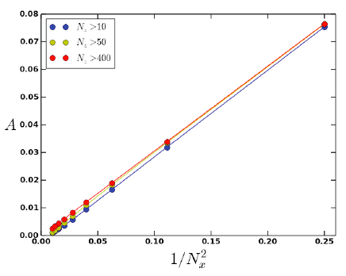
Yerong – why are the data in the new not just those in the old, multiplied by 3?
The new one has a different aspect ratio. That’s fine. I would then like to shrink
the whole thing a little. The legend box should be made larger by 2, and the
tick labels larger by 50% at least.

Slide 2
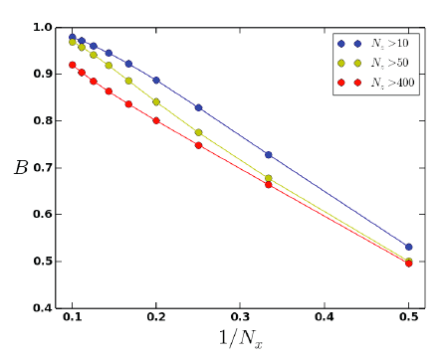
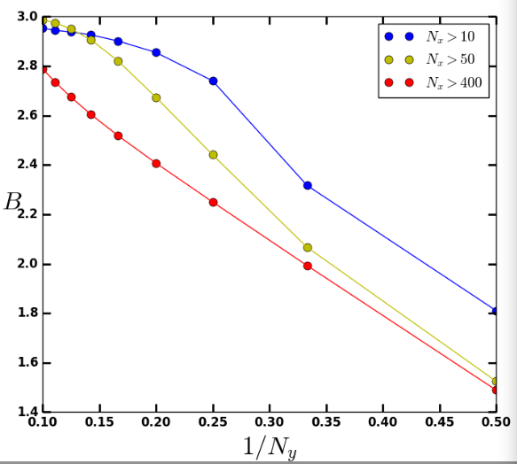
Same question as before.
Please increase size of legend box about 80%.
Please start the horizontal axis at 1/N_{y}² = 0.
Please increase size of tick labels a bit.

Slide 3
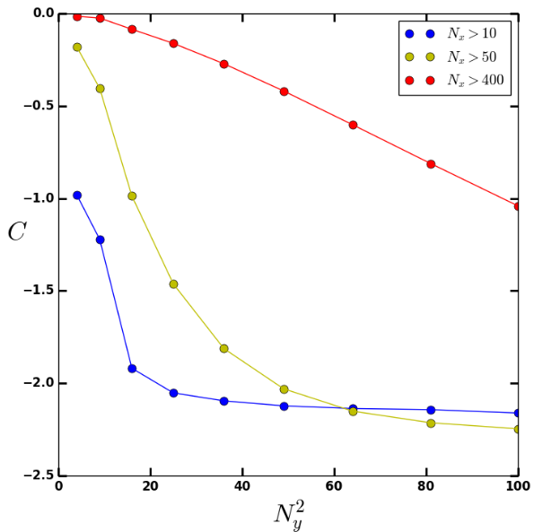
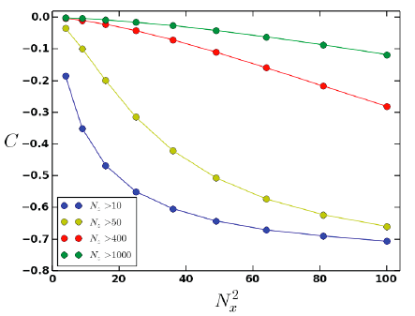

Yerong – why are the data in the new not just those in the old, multiplied by 3?
New legend box?
Same requests about tick labels.

