Slide 1
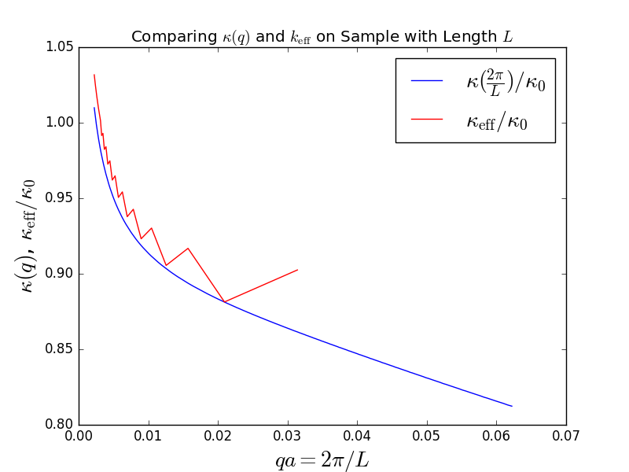
k_{eff} is the summation from (A.4)
For Ns which are not multiples of 4, (A.4) need correction

Slide 2
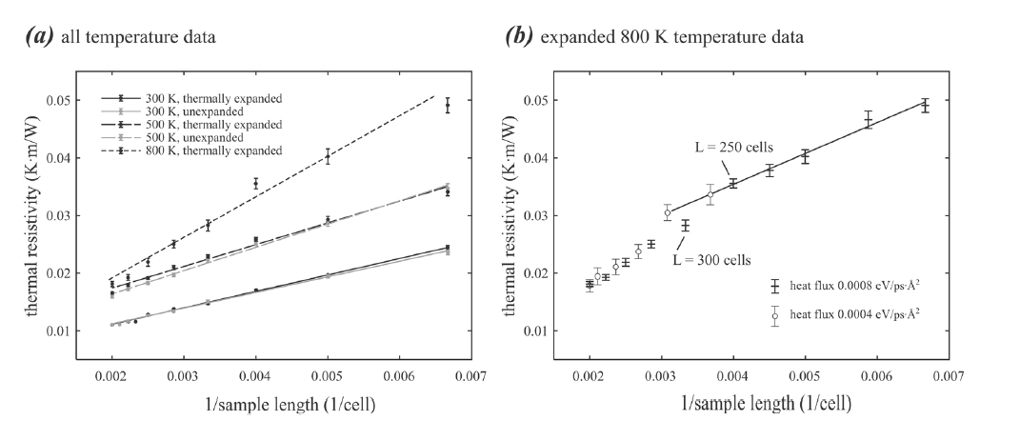
Comparing resistance
K_eff vs GaN in reference (3)

Slide 3
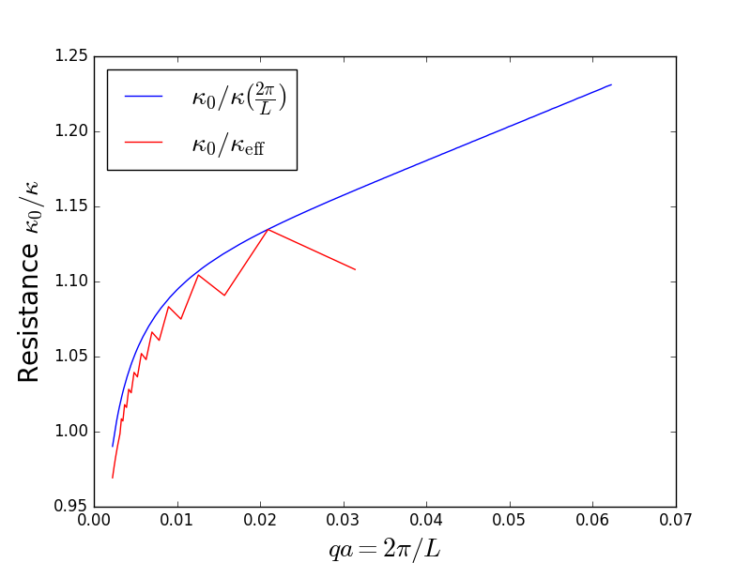
Comparing resistance
K_eff vs GaN in reference

Slide 4
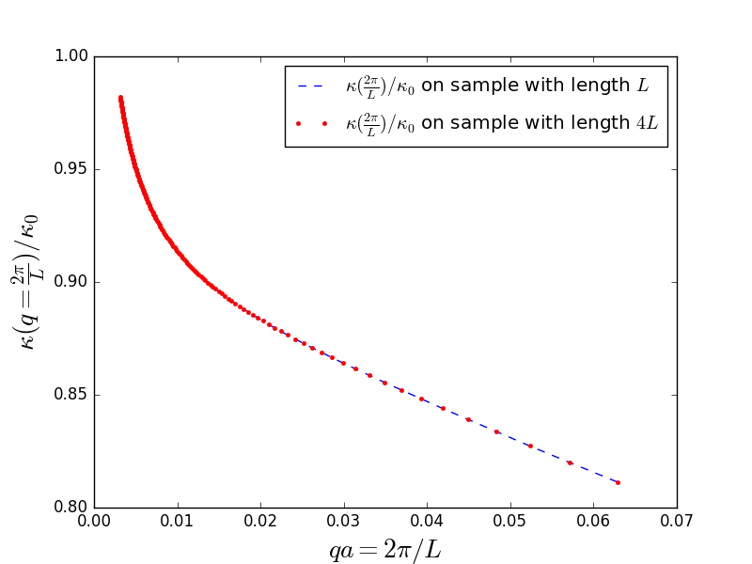
This shows k(q) is the same when simulate on samples with different lengths.

Slide 5
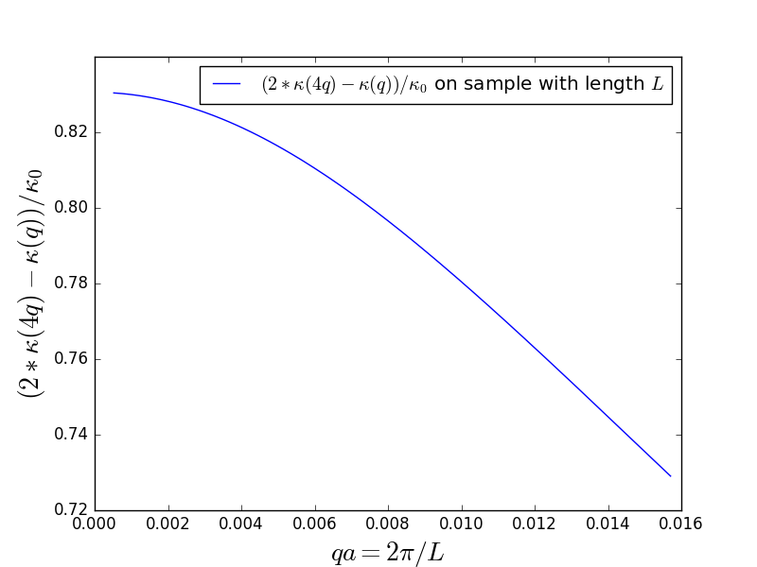
Other tests: From this, we can see may design a profile to cancel k_00 modes is not wise.

