Slide 1
Summary is on the last page.

Slide 2
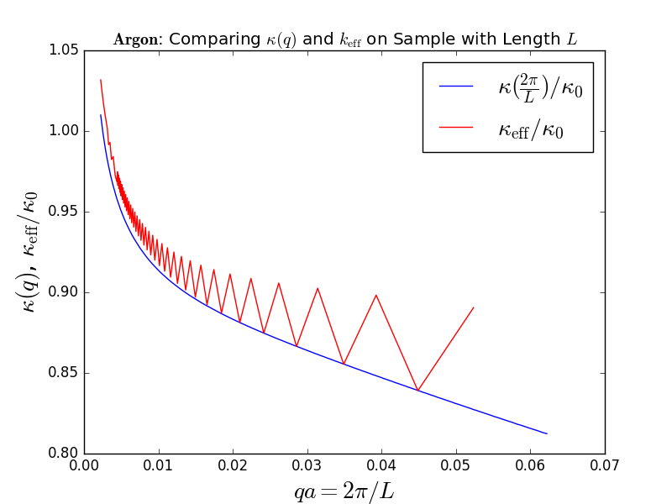
1. k_{eff} is the summation from (B.4)
We can see k_{eff} is fluctuating

Slide 3
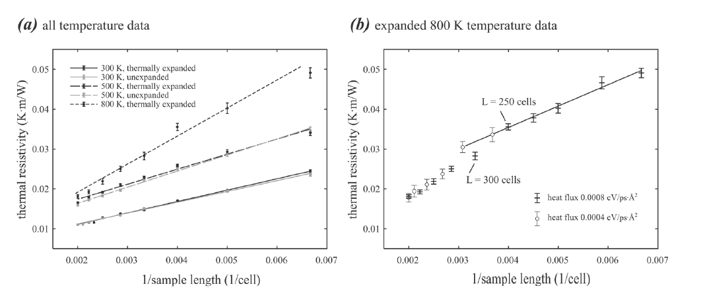
Comparing resistance
K_eff vs GaN in reference (3)

Slide 4
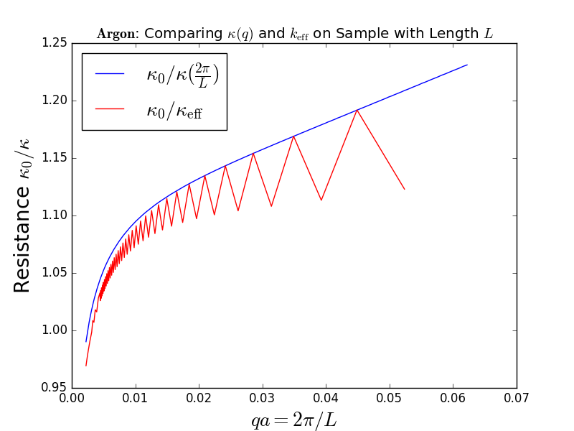
Comparing resistance: We can see k_{eff} is fluctuating
K_eff vs GaN in reference

Slide 5
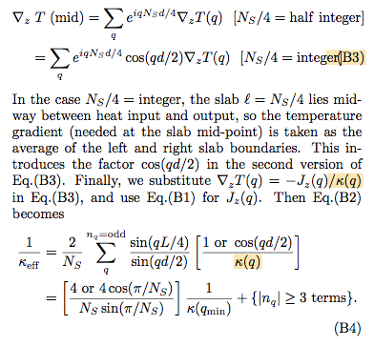
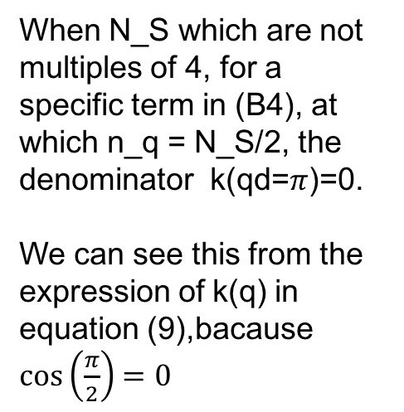
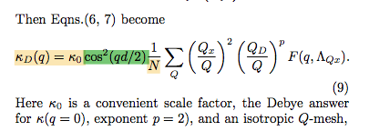
For N_S which are not multiples of 4, (B4) need correction

Slide 6
Summary
1. k_{eff} is fluctuating, which may be another indicator that k_{eff} is not good for extrapolation
2. Should I try to calculate k_{eff} on crystal GaN?
3. For Ns which are not multiples of 4, (B.4) we have k(q) = 0 in the denominator.

