Slide 1
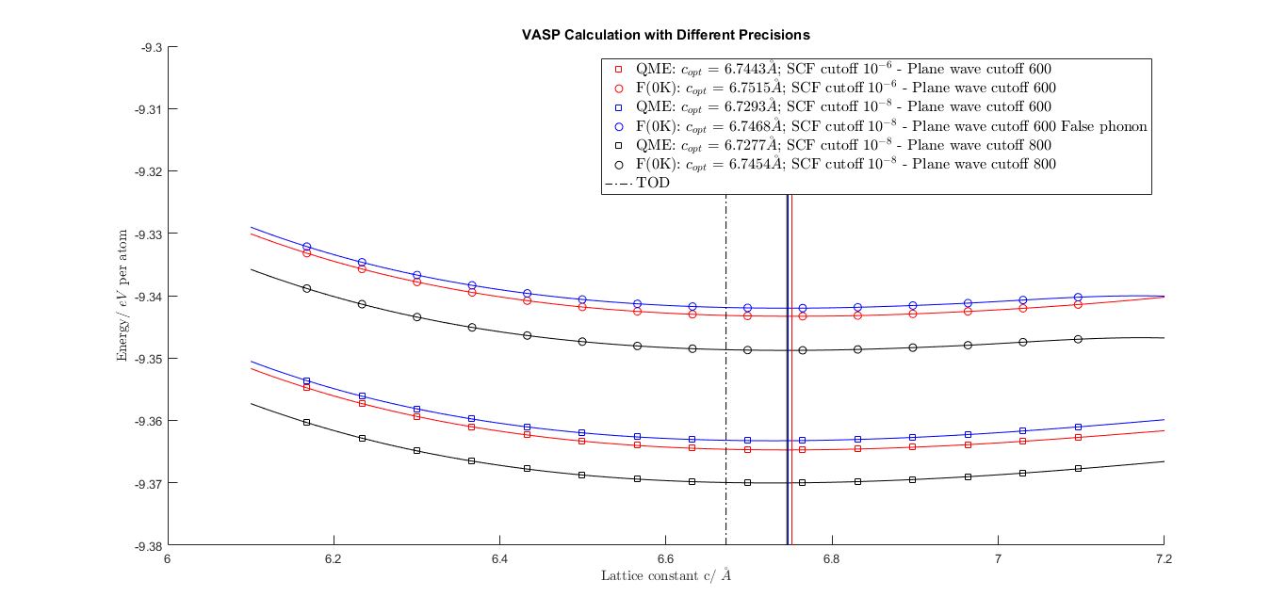

Slide 2
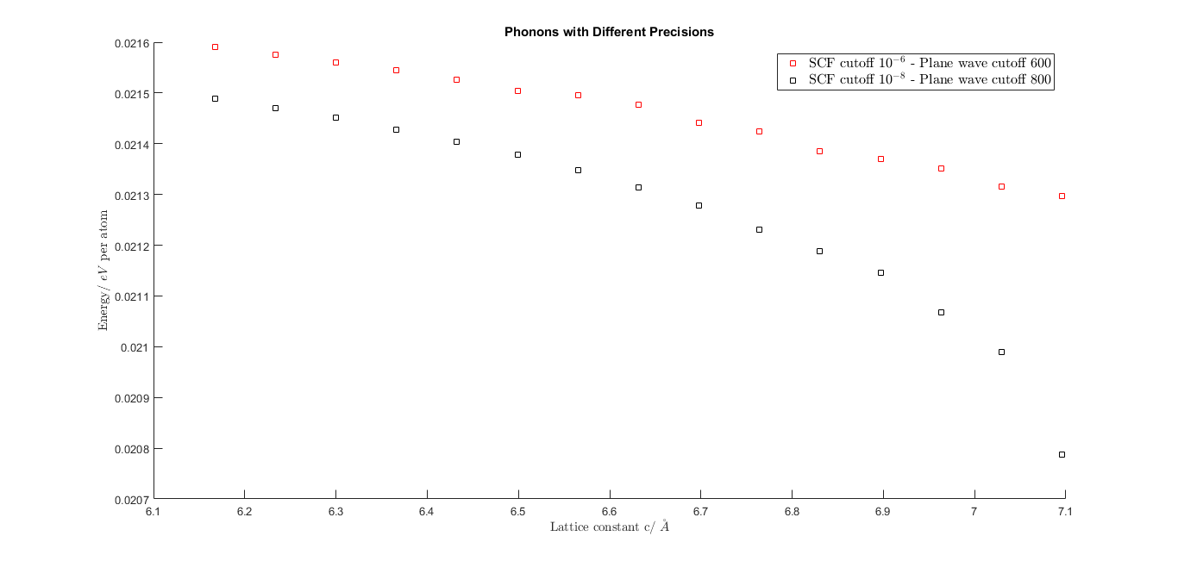
High precision seems more reliable in phonon calculation

Slide 3
QM/ QM + phonons | SCF cutoff(eV/atm) | Plane wave cutoff(eV/atm) | minimum lattice constant C/ (\AA)
QM | 10^(-6) | 600 | 6.7443
QM + phonons | 10^(-6) | 600 | 6.7515
QM | 10^(-8) | 600 | 6.7293
QM | 10^(-8) | 800 | 6.7277
QM + phonons | 10^(-8) | 800 | 6.7454
 |  | Tod | 6.6721

