Slide 1
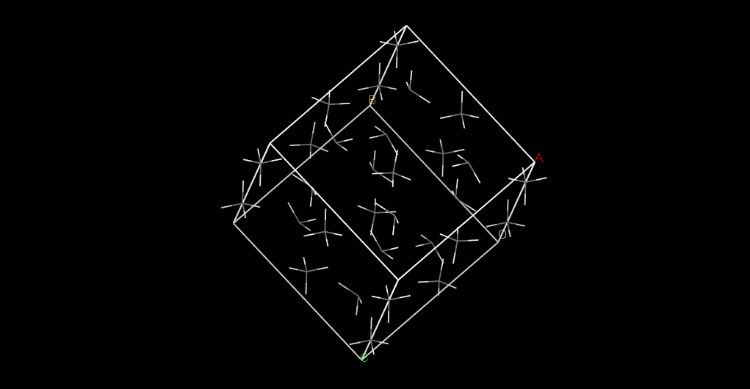
Methane in phase III
16 molecules
Data from temperature at 18K (<22.4)
close to normal
pressure
Space group Cmca

Slide 2
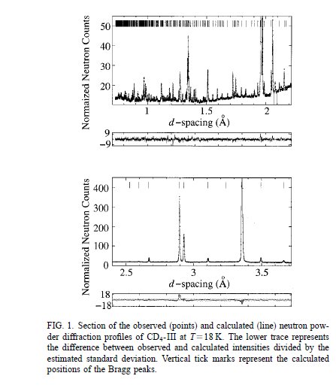
Density from experiment 0.52g/cm3 (around 20.4K) (https://www.nature.com/nature/journal/v127/n3210/full/127707c0.html) Density from our starting structure 0.526127g/cm3

Slide 3
About the reference: http://aip.scitation.org/doi/abs/10.1063/1.1580809
Structure solution was attempted in the 29 tetragonal space groups, and they calculated diffraction pattern to compare with the experiment.
Experiment data:
a=11.708Å b=c=8.187Å
data from software GSAS and rietveld refinement:
a=511.7079(1) Å, b=8.1893(1) Å, and c=8.1842(1) Å

