Slide 1
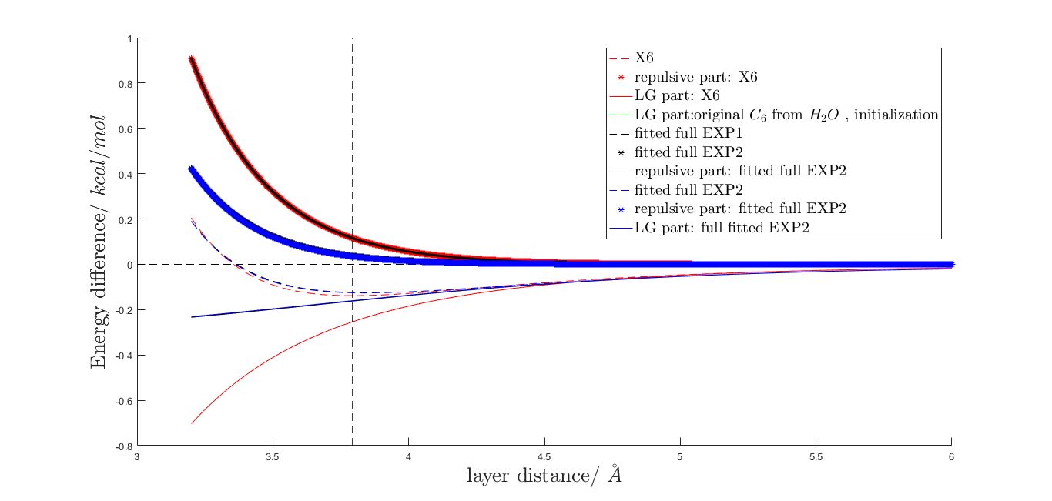
explanation of legend is in the next page

Slide 2
X6 : fitted with X6 potential EXP1 : fitted with single exponential EXP2 : fitted with double exponential

