Slide 1
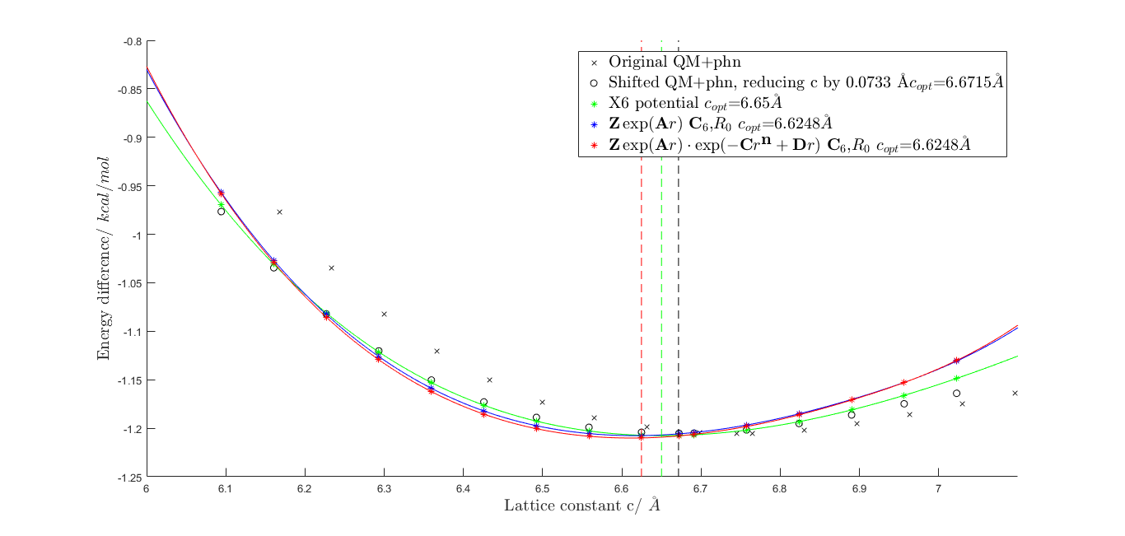
1.ffoptimization with c reduced to 6.6715 Ȧ(Tod's experimental value is 6.6721Ȧ)

Slide 2
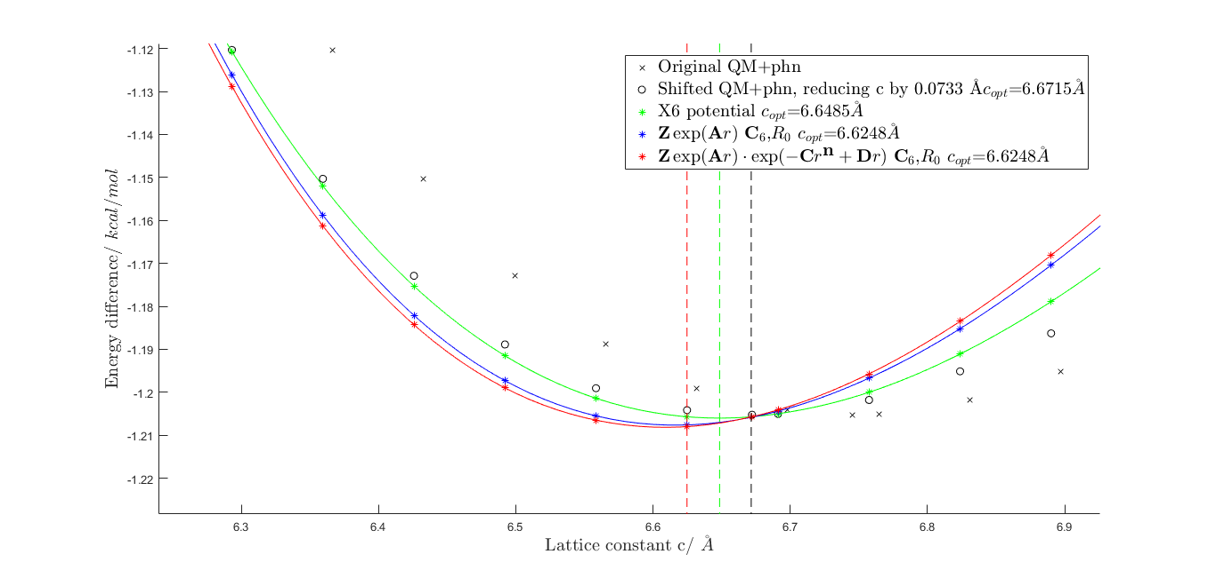
1.ffoptimization with c reduced to 6.6715 Ȧ(Tod's experimental value is 6.6721Ȧ)
Zoom in!

Slide 3
Summary
SUBJECT |  | minimum lattice constant C/ (\AA)
Tod's extrapolation |  | 6.6721
QM+phonons after decreasing c by 0.0073 |  | (6.7454 - 0.0073 = 6.6721) 6.6715
shifted data with | X6 ffopt fit | 6.6485(-0.3448%)
 | ffopt fit | 6.6248(--0.700%)
 | ffopt fit | 6.4248(-0.700%)

Slide 4
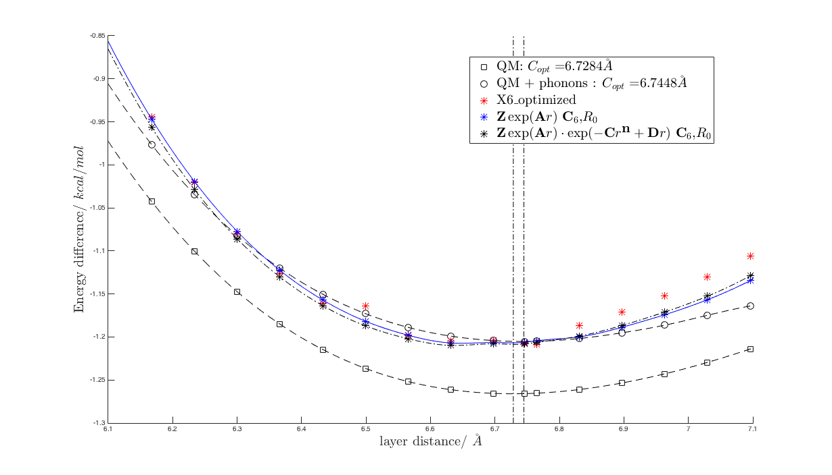
ffopt for QM+phonons with optimal training point

Slide 5
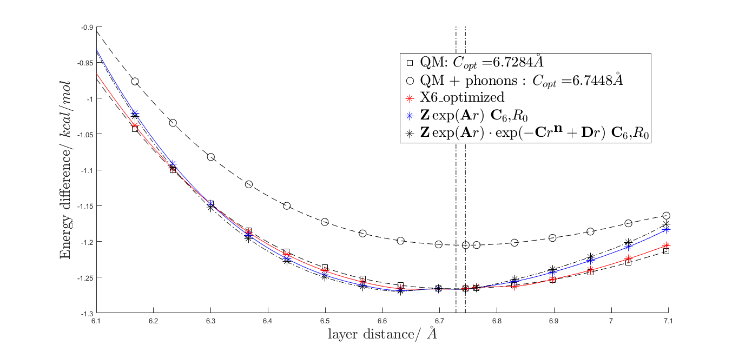
ffopt for QM with optimal training point

Slide 6
Conclusion
Probabily PBE3 correction is not a good fit for graphite? Try a carbon-hydrogen system?

