Slide 1
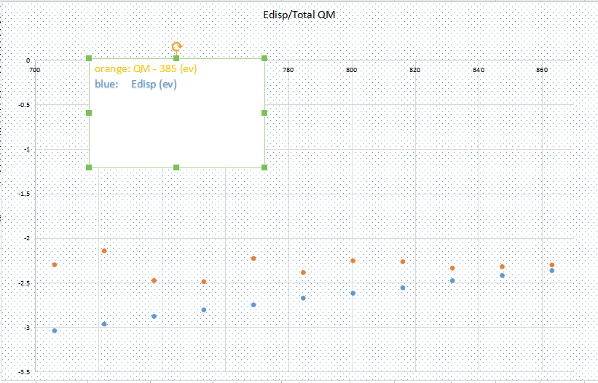
CH4: QM calculation and Edisp

Slide 2
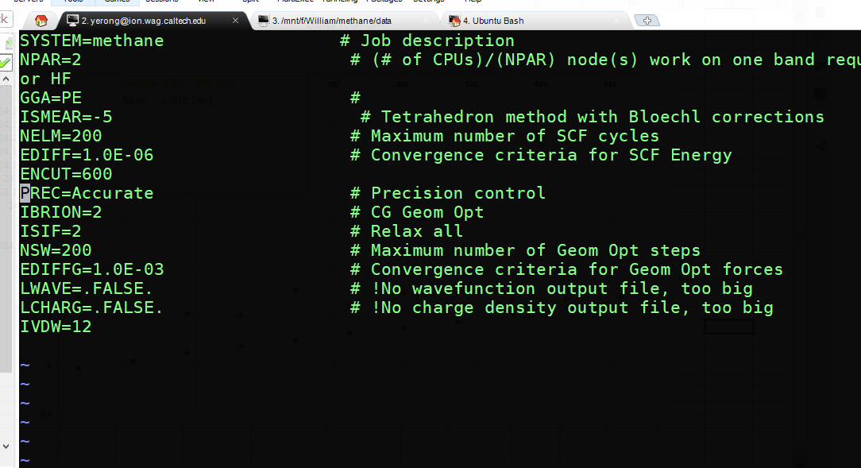
INCAR

Slide 3
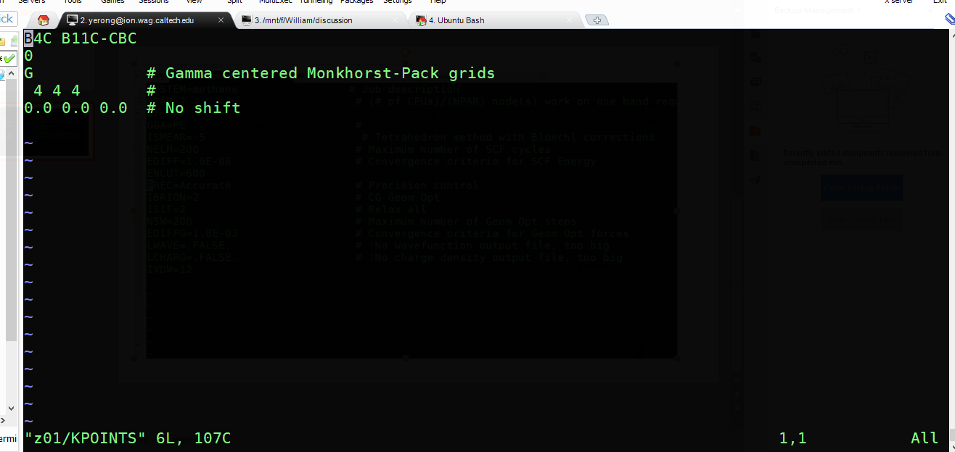
KPOINTS

