Slide 1
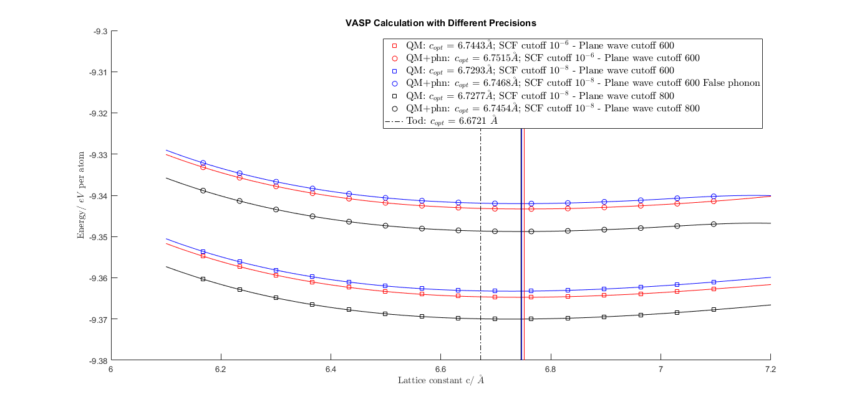

Slide 2
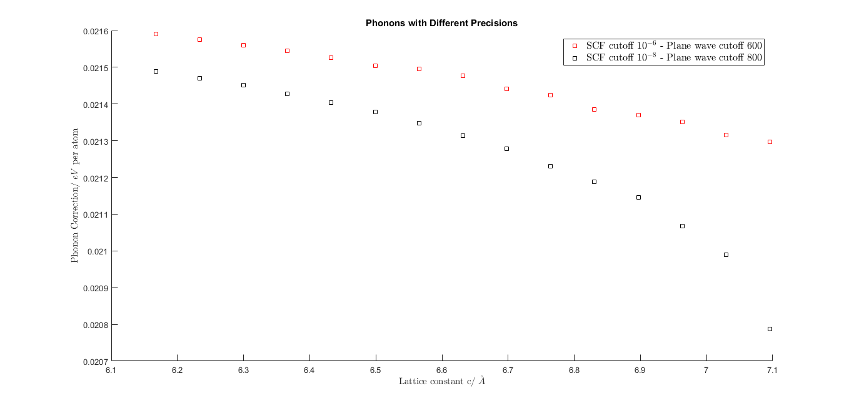
High precision seems more reliable in phonon calculation

Slide 3
QM/ QM + phonons | SCF cutoff(eV/atm) | Plane wave cutoff(eV/atm) | minimum lattice constant C/ (\AA)
 |  | Tod | 6.6721
QM | 10^(-6) | 600 | 6.7443(+1.082%)
QM + phonons | 10^(-6) | 600 | 6.7515(+1.190%)
QM | 10^(-8) | 600 | 6.7293(+0.857%)
QM | 10^(-8) | 800 | 6.7277(+0.833%)
QM + phonons | 10^(-8) | 800 | 6.7454(+1.086%)

Slide 4
