Slide 1
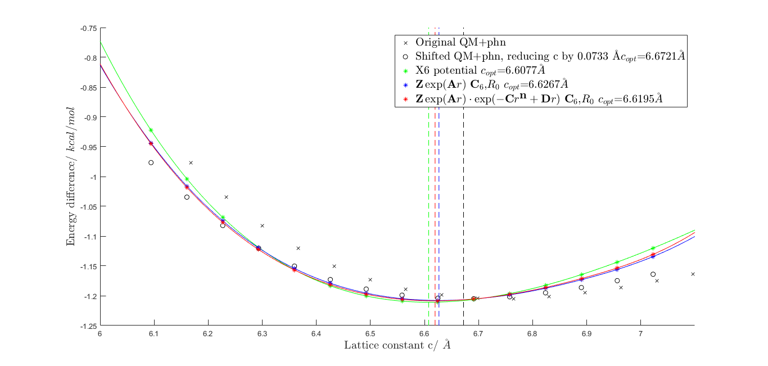
ffoptimization with c reduced to 6.6721 \AA(Tod's experimental value)

Slide 2
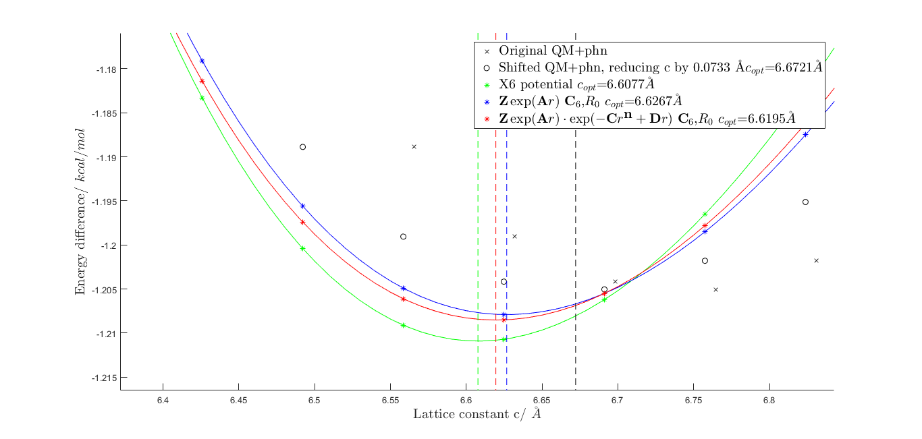
ffoptimization with c reduced to 6.6721 \AA(Tod's experimental value)

Slide 3
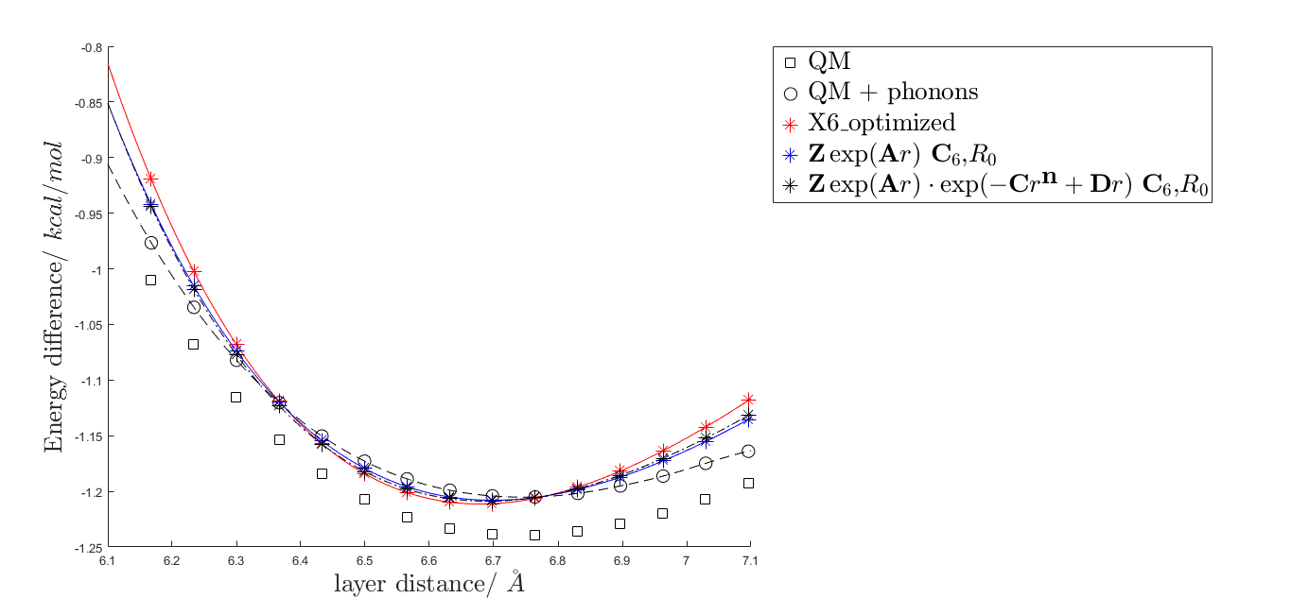
Comparsion: ffoptimization with no reduction of c, with c_{opt}=6.7454\AA -- Maybe there is a litte improvement when reduction c to Tod's value

Slide 4
Summary
SUBJECT | minimum lattice constant C/ (\AA)
Tod's extrapolation | 6.6721
QM+phonons after reducing c to Tod's vaule | 6.7454 - 0.0073 = 6.6721
fit with X6 potential | 6.6077(-9.652%)
 | 6.6267(-6.804%)
 | 6.6195(-7.884%)

Slide 5
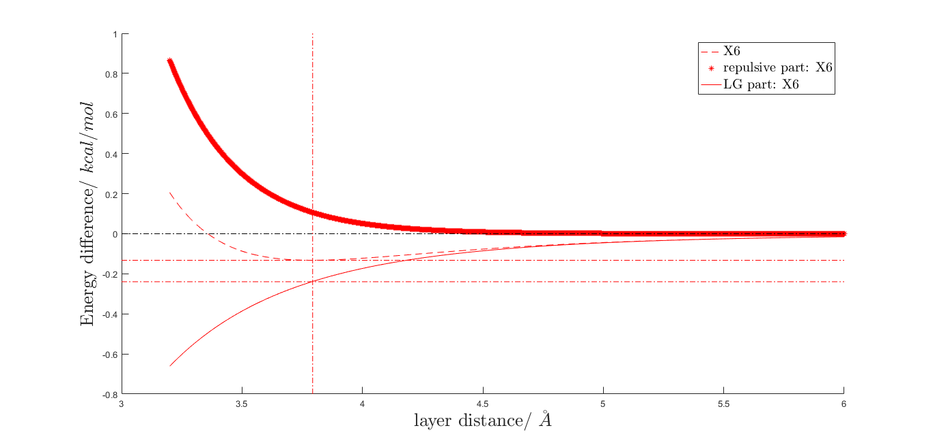
ffoptimization with c reduced to 6.6721 \AA : X6 fit looks good

Slide 6
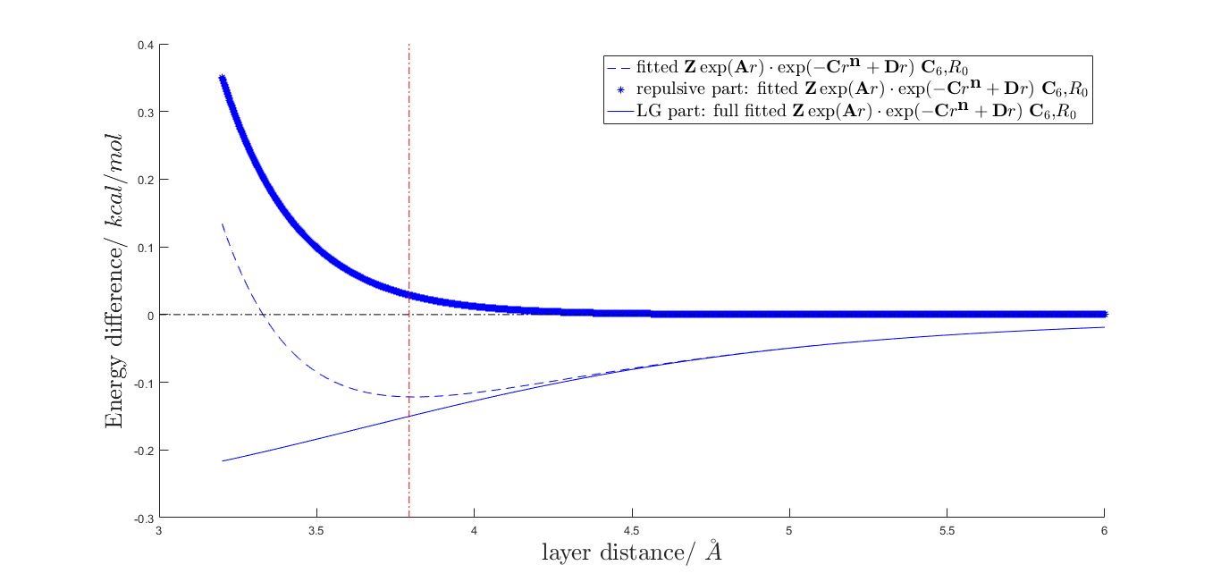
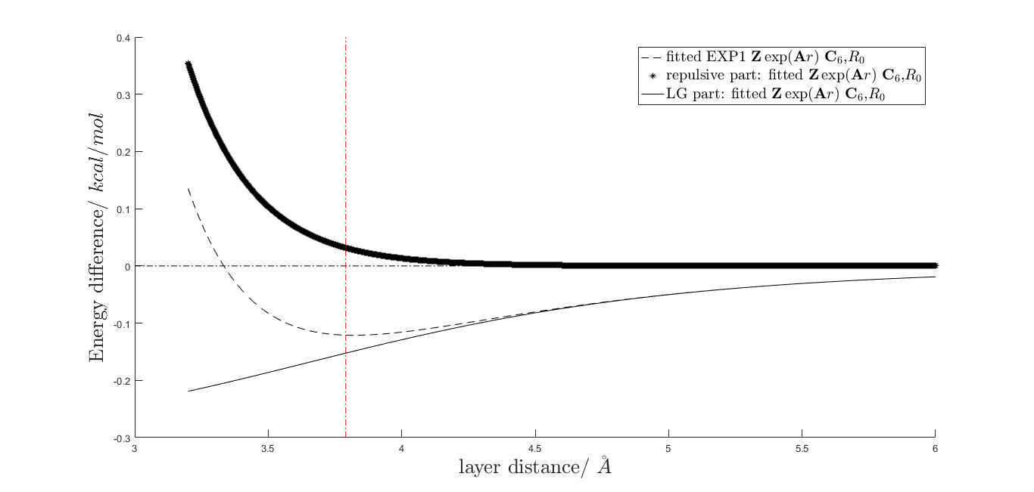
ffoptimization with c reduced to 6.6721 \AA : fit with exponetial repulsive potential shows deviation from the empirical rule

Slide 7
#Can be ignored# Studies on the reference structure
The dispersion energy for the optimal structure
-0.61928 (eV)
The dispersion energy for the reference structure
-0.17722 (eV) ---- Why not zero?

Slide 8
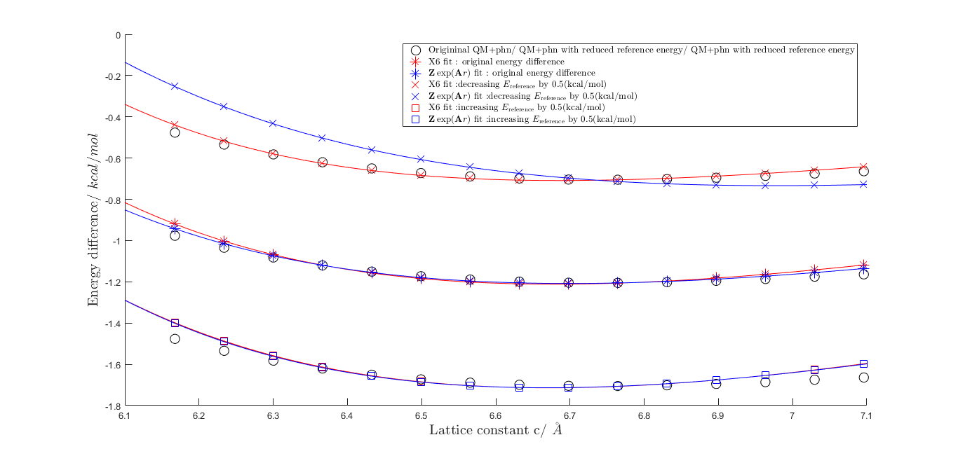
#Can be ignored# Studies on the reference structure : increasing and decreasing reference energy

