Slide 1
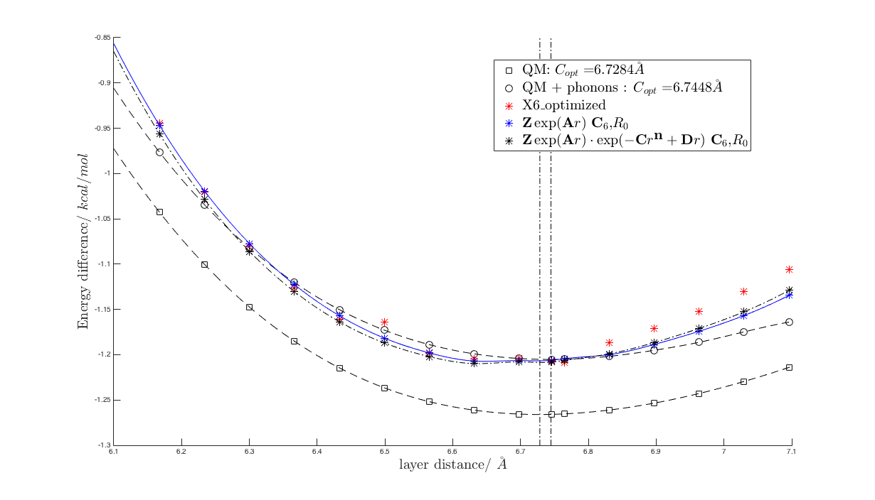

Slide 2
X6 potential
D_v=0.1260
R=3.9062
\epsilon=10.7019

Slide 3
(simple eponential NB, Tod's LG) pair
Z=32.7068
A=-4.0796
B=8.6854
C_6= 1023.4529
R_0=342.475

Slide 4
(complicated eponential NB, Tod's LG) pair 1 1 -3.9012 120.1949 7.5755 0.7450 -1.0000 -1.00001003.4679 -0.4059 0.5192 -0.4758 1.0000
Z=120.1949 A=-3.9012 B=7.5755
C=-0.4059 n=0.5192 D=-0.4758
C_6= 1003.4679
R_0=342.475

