Slide 1

ADVANCED ENCRYPTION STANDARD

Slide 2
INTRODUCTION
Advanced Encryption Standard (AES) specifies a FIPS-approved cryptographic algorithm
Used to protect electronic data.
The AES algorithm is a symmetric block cipher
The AES algorithm is capable of using cryptographic keys of 128, 192, and 256 bits to encrypt and decrypt data in blocks of 128 bits.

Slide 3

Algorithm

Slide 4
Byte Substitution
A simple substitution of each byte
Uses one table of 16x16 bytes containing a permutation of all 256 8-bit values
Each byte of state is replaced by byte indexed by row (left 4-bits) & column (right 4-bits)
  eg. byte {95} is replaced by byte in row 9 column 5
  which has value {2A}
S-box constructed using defined transformation of values in GF(2⁸)
Designed to be resistant to all known attacks

Slide 5

Byte Substitution

Slide 6
Shift Rows
A circular byte shift in each row
  1st row is unchanged
  2nd row does 1 byte circular shift to left
  3rd row does 2 byte circular shift to left
  4th row does 3 byte circular shift to left
Decrypt inverts using shifts to right
Since state is processed by columns, this step permutes bytes between the columns

Slide 7

Shift Rows

Slide 8

Mix Columns
MixColumns transformation operates on the State column-by-column
The columns are considered as
polynomials over GF(2⁸) and multiplied modulo x^4 + 1 with a fixed polynomial a(x)

Slide 9

Mix Columns

Slide 10
Add Round Key
XOR state with 128-bits of the round key
Round Key is added to the State by a simple bitwise XOR operation.

Slide 11

Add Round Key

Slide 12
AES Key Expansion
Takes 128-bit (16-byte) key and expands into array of 44/52/60 32-bit words
Start by copying key into first 4 words
Then loop creating words that depend on values in previous & 4 places back
  in 3 of 4 cases just XOR these together
  1st word in 4 has rotate + S-box + XOR round constant on previous, before XOR 4th back

Slide 13
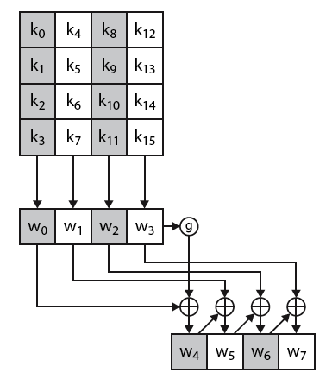
AES Key Expansion

Slide 14
AES Decryption
AES decryption is not identical to encryption since steps done in reverse
But can define an equivalent inverse cipher with steps as for encryption
  but using inverses of each step
  with a different key schedule
works since result is unchanged when
  swap byte substitution & shift rows
  swap mix columns & add (tweaked) round key

Slide 15
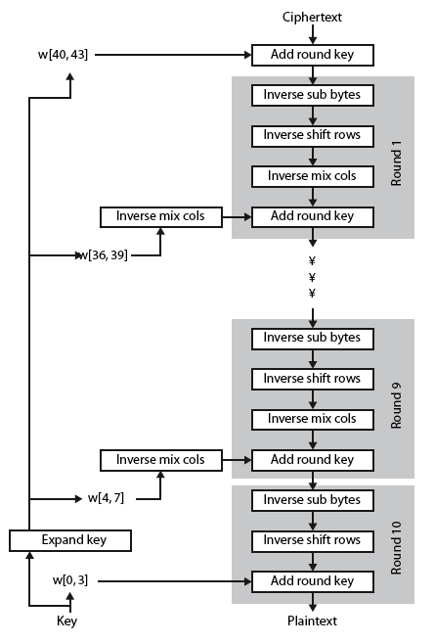
AES Decryption

Slide 16
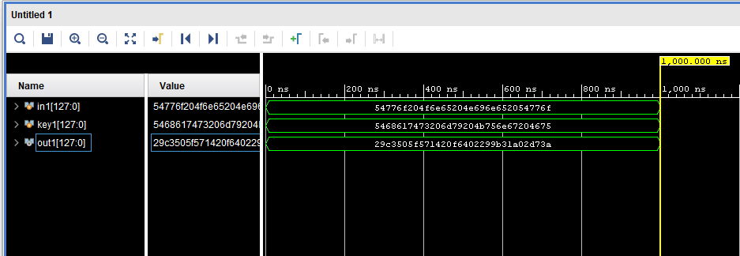
ENCRYPTION

Slide 17
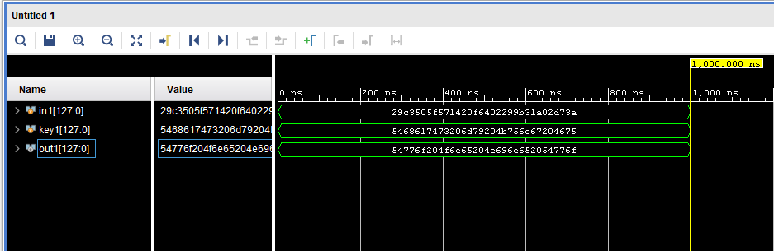
DECRYPTION

Slide 18
Conclusion
Successful AES-128 Implementation.
Enhanced Understanding of AES.
Boosts Data Security.
In summary, our project's successful AES-128 implementation contributes to data security and deepens our understanding of the AES algorithm
-------------THANK YOU ----------------

