Slide 1
Cipher Block Chaining
YERRA BHASKARA VARA PRASAD
N180570
ECE-04

Slide 2
INTRODUCTION
We dont run just a cipher, we need a mode of operation.
Fixed block length (AES-128)
If data input is greater than 128 bit, we need a mechanism
Breaking the plain text into X bits in each block
National Institute of standards and Technology (NIST) introduces 5 modes
For different applications, different modes of operations

Slide 3
Need of mode of operation:
1. A lengthy message
2. Image file
3. Multimedia file
4. Real time data etc...

Slide 4
5 Modes of Operation
Electronic Codebook Mode
Cipher block chaining Mode
Cipher Feedback Mode
Output feedback Mode
Counter Mode

Slide 5
Cipher Block Chaining
Invented in 1976 in IBM
Mode of operation for block cipher
Uses initialization vector (IV) for each block of plaintext to produce each of ciphertext
XOR method is used for both the encryption and decryption
CBC mode is applicable whenever large amounts of data need to sent securely. (eg.email, FTP,web etc)

Slide 6
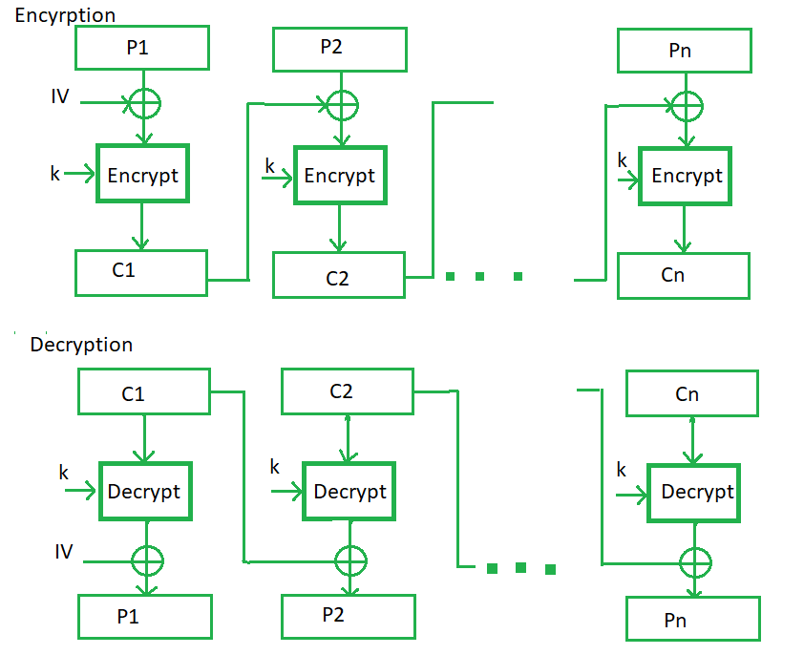

Slide 7
Conclusion
In summary, Cipher Block Chaining ensures strong data security, adapting to evolving threats. A crucial tool for safeguarding digital information.

Slide 8
THANK YOU

