Slide 1
RGUKT, Nuzvid Department of Electronics and Communication Engineering
Project implementation on
‘SMART GLOVE’
By:-
YERRA BHASKARA VARA PRASAD

Slide 2
INDEX
Introduction
Proposed system
Scope of the project
Methodology
Data flow diagrams
Materials
Advantages
Arduino code
Advantages
My Result
Conclusion

Slide 3
INTRODUCTION
What is Sign Language??
Communicating language used primarily deaf people.
Uses different medium such as hands, face, or eyes rather than vocal tract or ears for communication pupose.
Sign language is used by deaf & dumb people.
Smart glove will be used to translate sign language into text.
In sign language signs are used to communicate.
Our system is aimed at maximum recognition of gesture without any training.
This makes the system usable at public places where there is no room for long training sessions.

Slide 4
Reason behind making this project…?
There are similar types of gadget which already exist but there are various drawbacks in them.
The glove which we are going to develop will translate sign language to facilitate coversation between speech and hearing impaired people and those are not conversion with sign language.

Slide 5
Proposed System
The sign language translator that we are going to developed uses a glove fitted with sensors that can interpret the 15 English words in Indian sign language.
The gloves uses flex sensors, bluetooth module to gather data on each finger’s position and the hand’s motion to differentiate the words.

Slide 6
Scope of the Project
Speechless people will be able to communicate with normal people.
Speechless people will be able to communicate with speechless people as well as deaf people.
Safety is one of the highest priority for this translator. The translator is carefully to not to expose the user to any current from the circuit.

Slide 7
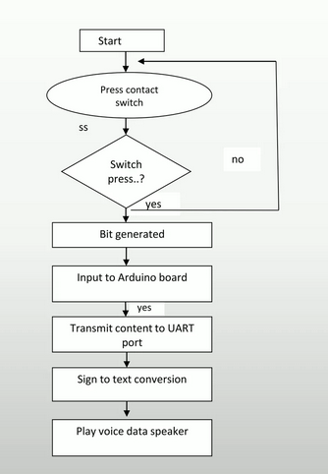
Methodology

Slide 8
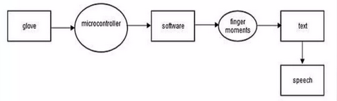
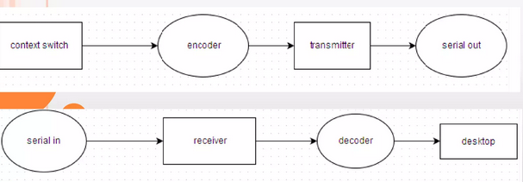
Data Flow Diagrams

Slide 9
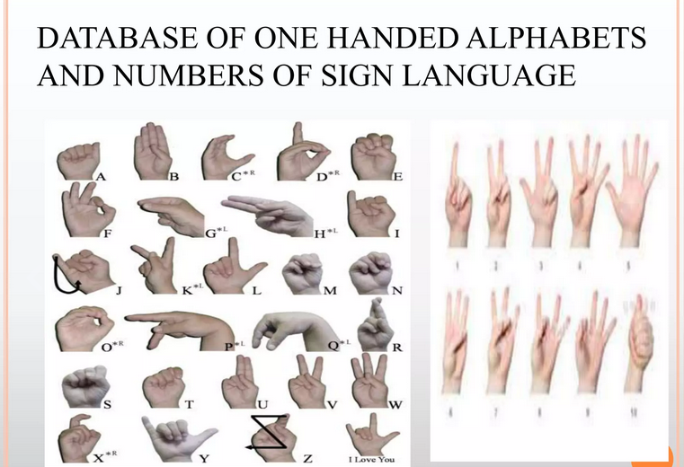
Sign Language

Slide 10
MATERIALS
Hardware Requirement :-
Glove
Arduino UNO
Flex sensors
Bluetooth module
Jumper wires
Software Requirement :-
Arduino
OS: windows 10
Implementation Requirements:-
Monitor
Glove
External Requirements:-
Battery

Slide 11
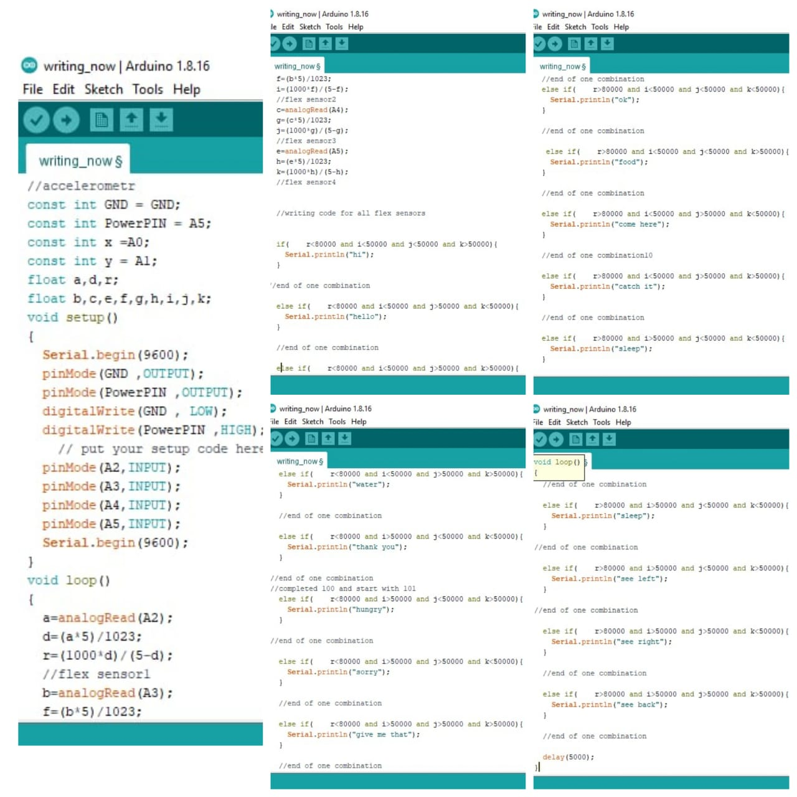
Arduino code

Slide 12
Advantages
It requires fewer components so its cost is low.
Due to small size we can place its hardware on our hand easily.
Light weight.
Flexible to users.
Easy to operate.
Real time translation.

Slide 13
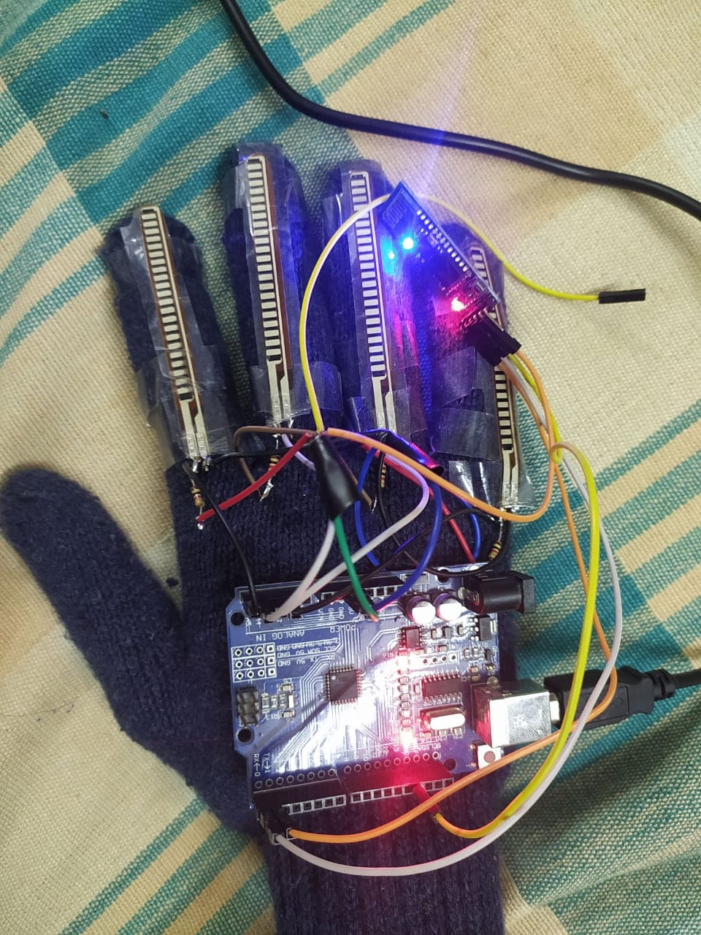
My Result

Slide 14
Conclusion
This methodology could mean a new way for about 70 million people with hearing and speech impairment to verbally communicate and connect to people around them.
This project aims to lower the communication gap between the deaf or mute community and the normal world.

