Slide 1
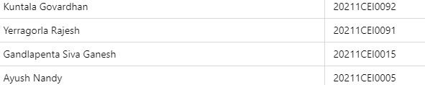
A One Step Solution for Focusing on Tourism
PIP2001 Capstone Project
VIVA - VOCE
Batch Number: CEI - 03
Student Name | Roll Number
Under the Supervision of,
Ms. Yogeetha B R
Professor
School of Computer Science and Engineering
Presidency University
Name of the Program: B. Tech (Computer Engineering (AI & ML)
Name of the HoD: Dr. Gopala Krishna Shyam
Name of the Program Project Coordinator: Yogeetha B R
Name of the School Project Coordinators: Dr. Sampath A K / Dr. Abdul Khadar A / Mr. Md Ziaur Rahman

Slide 2
Introduction of our Project
This project involves the development of a multi-functional booking system using Django, targeting three main domains: cab booking, event booking, and hotel booking. The goal of this system is to provide a unified, streamlined solution where users can book transportation, reserve event tickets, and arrange accommodations. Each booking system includes its own set of models, views, and templates, allowing users to browse options, calculate fares or total costs, and confirm bookings. This system demonstrates the integration of different booking services within a single application, which could be beneficial for travel agencies, event planners, and accommodation providers looking to provide a seamless experience to their users.

Slide 3
Literature Review
“Creating and implementing a model for sustainable development in tourism enterprises”
Authors: Pernille Kernel
Algorithms/Methodologies: This paper primarily focuses on a collaborative model rather than specific algorithms. The approach involves a four-step model to engage stakeholders in sustainable tourism and uses action research as a methodology to study and implement this collaborative process.
Drawbacks: The paper highlights the complexity of stakeholder engagement and the challenges in maintaining equal influence among diverse tourism actors. It also notes the difficulty in sustaining political support for sustainable practices, which affects long-term planning​.

Slide 4
Literature Review
“Journal of Tourism 2013”
Authors: Anita Zehrer, Ph.D.
Algorithms/Methodologies: Largely descriptive and qualitative methods, focusing on challenges and frameworks within tourism.
Drawbacks: The paper discusses challenges like fragmented research approaches that do not fully consider the interconnectedness of tourism components. This limitation reduces the effectiveness of outcomes in real-world applications.

Slide 5
Literature Review
“Designing a Tourism System Thinking Approach for Tourism Research”
Authors: Ahmed Mahrous Khodair
Algorithms/Methodologies: This paper advocates for a systems thinking approach over traditional linear and reductionist methods. It proposes a ten-step approach for tourism research, focusing on understanding complex interconnections within tourism systems.
Drawbacks: The systems thinking approach is complex and may be difficult to implement fully due to its reliance on holistic data and the integration of diverse and sometimes unpredictable factors. Additionally, traditional reductionist methods are still prevalent, making adoption of systems thinking challenging in practice

Slide 6
Research Gaps Identified
Existing booking systems often focus on one specific domain, such as hotels or flights, lacking a comprehensive platform that includes multiple booking categories in one place. Additionally, many existing platforms don’t adequately handle personalized bookings or dynamic cost estimations based on factors such as distance for cab bookings, ticket availability for events, or guest count for hotel reservations. This project addresses these gaps by:
Combining cab, event, and hotel bookings into one system.
Providing real-time cost estimation and availability checks within each domain.
Ensuring a personalized user experience by integrating login-protected booking features.

Slide 7
Proposed Methodology
The project is built using the Django web framework, with a separate set of models and views for each booking service:
Cab Booking: Manages cab types, fare calculation based on distance, and booking confirmation.
Event Booking: Manages event details, ticket availability, pricing, and user reservations.
Hotel Booking: Manages hotel details, booking dates, and total cost based on the duration and number of guests.
Each service has its dedicated models, views, and templates. Django's ORM is used for database interactions, and user authentication ensures bookings are made only by logged-in users.

Slide 8
Objectives
To develop a unified booking platform that supports cab, event, and hotel reservations.
To enable real-time fare and cost estimation for users before booking.
To provide personalized booking services with user authentication.
To demonstrate a modular approach in Django, where each booking type is managed independently yet functions within a single platform.
To create a seamless user experience across different types of bookings, facilitating easy navigation and accessibility.

Slide 9
Methodology/Modules
Each module is developed as a standalone application within the Django project, following a modular structure:
Cab Booking Module:
Includes Cab and CabBooking models for storing cab details and booking information.
Views for listing cabs, estimating fares, and confirming bookings.
A form to input pickup location, drop location, and distance, which dynamically calculates the estimated fare.
Event Booking Module:
Includes Event and EventBooking models to manage event details and user bookings.
Views for listing available events, viewing event details, booking tickets, and checking availability.

Slide 10
Methodology/Modules
Logic for ticket availability to prevent overbooking and ensure accurate tracking of tickets sold.
Hotel Booking Module:
Includes Hotel and Booking models for storing hotel information and reservation details.
Views for listing hotels, viewing hotel details, selecting check-in and check-out dates, and calculating total price.
Provides booking confirmation and handles multiple guest counts, calculating costs based on duration and guest number.
Each module has templates for user interaction and uses Django forms for data input and submission.

Slide 11
System design and Implementation
The system is designed as a modular Django project, where each booking type (cab, event, hotel) functions as a separate Django app. Each app has its own models, views, and templates, allowing for easy extension or modification in the future. The Django authentication system is integrated to manage user accounts, ensuring only registered users can make bookings. Key components include:
Database: Django’s ORM manages data persistence for cab, event, and hotel booking data.
Authentication: Login is required for booking actions, which secures user data and personalizes the experience.
Frontend Templates: Templates are designed to be intuitive, allowing users to easily view options, enter booking details, and confirm reservations.

Slide 12
Architecture
The system architecture includes the following components:
Frontend (HTML templates): User interface for browsing options and interacting with the system, using Django template language to dynamically render data.
Backend (Django Framework): Manages business logic, data processing, and interactions with the database. Each booking category is an app within the Django project.
Database: Stores user information, booking data, cab/event/hotel details, and transactional records.
User Authentication Layer: Secures booking functionality behind a login requirement, linking bookings to user accounts.

Slide 13
Hardware/software components
Hardware:
Development computer/server for running the Django server.
Any server capable of running a Django application if deployed online.
Software:
Django: Backend framework for model-view-template (MVT) architecture, ORM for database interactions, and user authentication.
SQLite (or other DBMS): Database to store booking and user data.
HTML/CSS: For creating the user interface and displaying booking forms and lists.

Slide 14
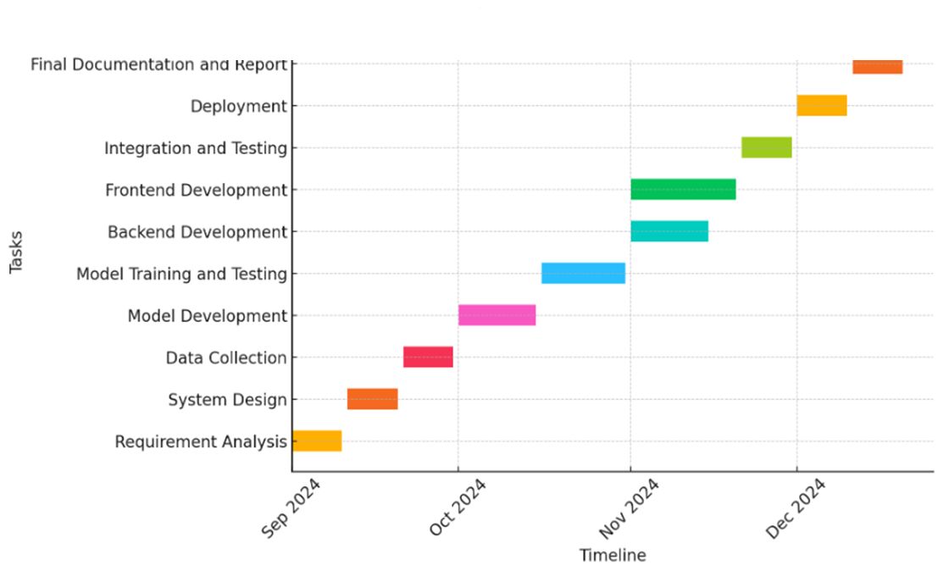
Timeline of Project

Slide 15
Expected Outcomes
Functional Multi-Service Booking Platform: A single platform that enables users to book cabs, events, and hotels.
Real-Time Cost Estimations: Users receive fare estimates and total costs dynamically, enhancing the booking experience.
Personalized User Experience: Logged-in users can make bookings and view their reservations, providing a personalized experience.
Scalable Design: The modular structure makes it easy to add additional services in the future.
Efficient Database Management: Each booking service maintains accurate records, avoiding data redundancy and ensuring efficient use of database resources.

Slide 16
Conclusion
This project demonstrates the development of a unified booking system capable of managing multiple types of reservations (cabs, events, and hotels) using Django. By structuring each booking type as a separate module, the system remains flexible, scalable, and easy to maintain. With user authentication and dynamic cost estimation, the platform not only enhances convenience but also ensures security and personalization.
This approach can be expanded to include additional booking services or integrated with external APIs, making it a viable option for businesses seeking a comprehensive booking solution. This project serves as an excellent foundation for real-world applications, combining multiple services into a single, cohesive platform that caters to diverse booking needs.

Slide 17
References
Kernel, P. Creating and implementing a model for sustainable development in tourism enterprises.
Anita Zehrer, Ph.D. (2013). Journal of Tourism.
Khodair, A. M. Tourism Systems Thinking: Towards an Integrated Framework to Guide the Study of the Tourism Phenomenon.
Khodair, A. M. System Thinking Versus Conventional Thinking in Tourism Research.

Slide 18
Publication Details

Slide 19

Thank You

