Slide 1

Basic Details of the Team and Problem Statement
Ministry/Organization Name/Student Innovation:
PS Code:SIH1435
Problem Statement Title : Developing an algorithm / program to measure increase in income of FPOs on account of project interventions under WDC 2.0.
Team Name : COFARMER
Team Leader Name : Saleti Thrinadh
Institute Code (AISHE) : C-18099
Institute Name : Vishnu Institute of Technology
Theme Name : increase the selling price of production of a farmer

Slide 2
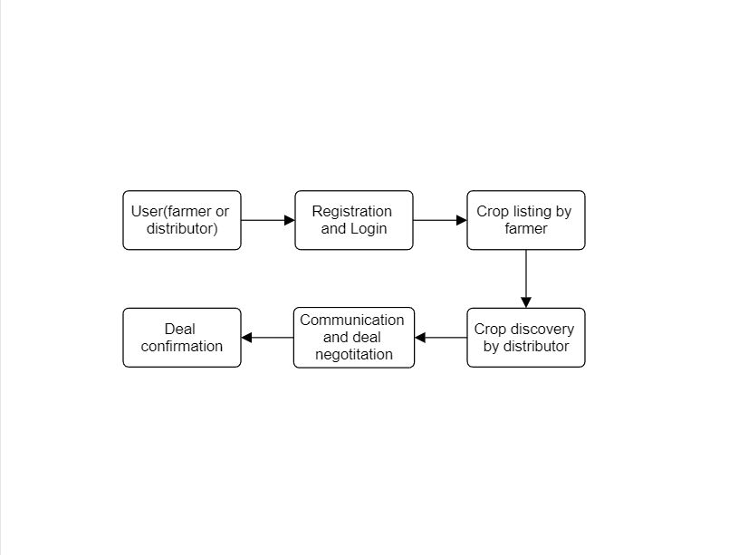
Idea/Approach Details
Process flowchart:
Describe your idea/Solution/Prototype here:
Title: AgriConnect: Bridging Farmers and Distributors
AgriConnect is an innovative and user-friendly mobile application designed to revolutionize the agricultural industry by serving as a seamless interface between farmers and distributors. This platform empowers farmers to showcase their crop production to a wide range of potential buyers, allowing for efficient and transparent transactions.
Describe your Technology stack here:
Front-End:
JavaScript Framework: React.js
Authentication: Firebase Authentication
Back-End:
Server-Side Language: Node.js
Web Framework: Express.js
Database: MongoDB
Other Technologies:
Geolocation Services: Google Maps API

Slide 3
Idea/Approach Details
Describe your Use Cases here
Describe your Dependencies / Show stopper here
Direct Communication and Negotiation:
Use Case: Once a distributor identifies a potential crop listing, they can initiate direct communication with the farmer through the application. They can negotiate deals, discuss pricing, and arrange logistics.
Crop Listing and Showcase:
Use Case: Farmers can use AgriConnect to create listings for their crop production. They upload images, specify crop details, such as type, quantity, and location, and set pricing expectations.
Market Expansion:
Use Case: Farmers can use AgriConnect to expand their reach beyond local markets, connecting with distributors from different regions.
Amazon Web Services (AWS) or Google Cloud Platform (GCP): The application needs cloud hosting services to deploy and scale the server-side components. This includes hosting the Node.js server, MongoDB, and serverless functions if used.
MongoDB Atlas (Cloud-hosted MongoDB): MongoDB is used to store data related to crop listings, user profiles, transactions, and more. MongoDB Atlas provides managed cloud-hosted MongoDB instances.

Slide 4
Team Member Details
Team Leader Name : Saleti Thrinadh
Branch : BTech Stream : CSE Year : III
Team Member 1 Name : Seela Durga Surya Prasad
Branch : BTech Stream : CSE Year : III
Team Member 2 Name : Yerraguntla Rajesh
Branch : BTech Stream : CSE Year : III
Team Member 3 Name: Mohammad Subhan
Branch : BTech Stream :CSE Year : III
Team Member 4 Name: Rudraraju Krishnam Raju
Branch : BTech Stream :CSE Year : III
Team Member 5 Name: Mahalakshmi Rayudu
Branch : BTech Stream :CSE Year :III
Team Mentor 1 Name: P Krishna Madhuri
Category : Academic Expertise : AI&ML Domain Experience : 4 Years

