Slide 1

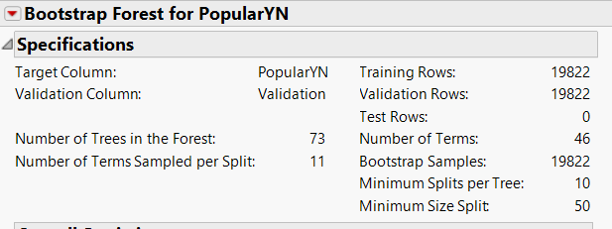
MODEL and ASSESS
BEST MODEL and WHY???
 | AUC
 | Training | Validation
Logistic - No Feature Engineering | 0.6914 | 0.6842
Logistic - With Feature Engineering | 0.6742 | 0.6748
Lasso - No Feature Engineering | 0.6908 | 0.6801
Lasso - With Feature Engineering | 0.5441 | 0.5567
Ridge - No Feature Engineering | 0.6882 | 0.6910
Ridge - With Feature Engineering | 0.5590 | 0.5555
Boosted Trees - No Feature Engineering | 0.7084 | 0.6941
Boosted Trees - With Feature Engineering | 0.7065 | 0.6933
Partition - No Feature Engineering | 0.6856 | 0.6679
Partition - With Feature Engineering | 0.6849 | 0.6673
Bootstrap Forest - No Feature Engineering | 0.7183 | 0.6947
Boostrap Forest - With Feature Engineering | 0.7167 | 0.6929
Neural Network - No Feature Engineering | 0.7099 | 0.6947
Random Forest Hyperparameters Hyperparameters
AUC for Bootstrap Forest and Neural Nets comes out to be the same here. As far as usage of Neural Nets is concerned, given our business problem, hammering to an accurate model would be too brute a force to be used here. Also being a black box model and with no difference in AUCs with the second best model(Random Forest) ,it is preferable to go ahead with a less complex model which is the latter in our case.

