Slide 1

GDApp
10.04.2024
Sanna-Mari Jortama
Pavel Kuhn

Slide 2
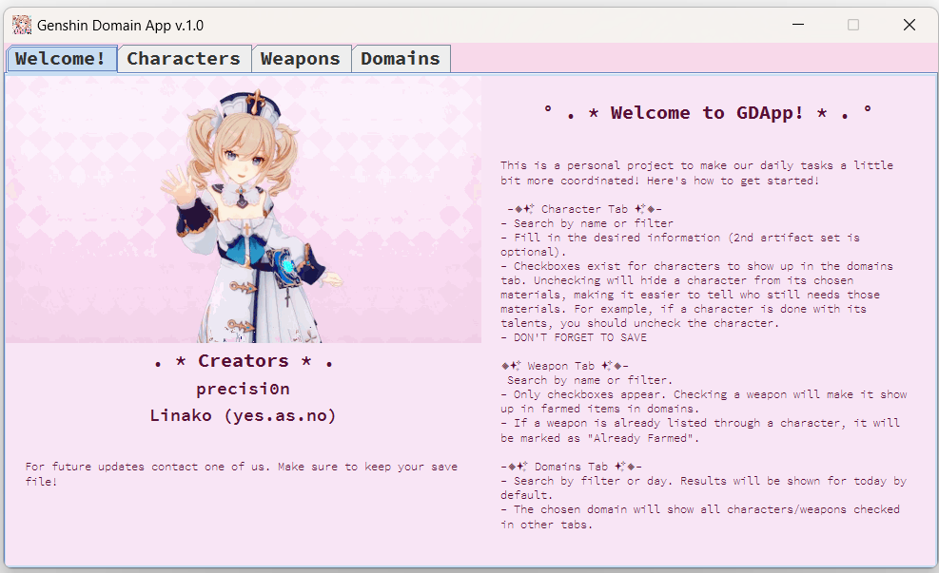

Introduction
Genshin Domain Application (GDApp) is a personal project developed to help us with our daily tasks in a game called Genshin Impact.
Key functions include:
- Saving user data for each character and weapon in the game.
- Listing characters/weapons for the materials they need.
- Giving an overview of all listed items.

Slide 3
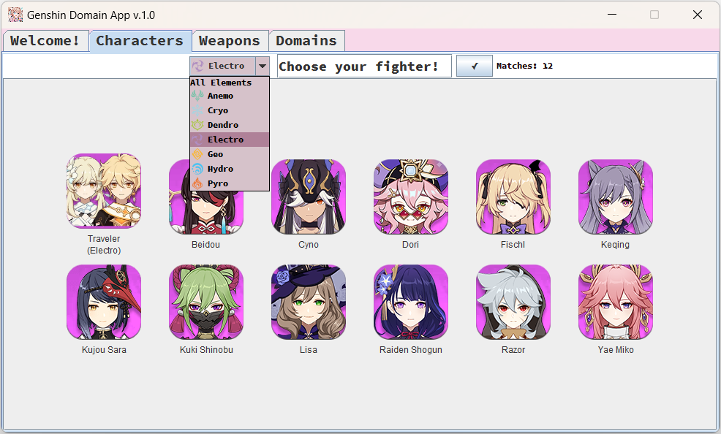

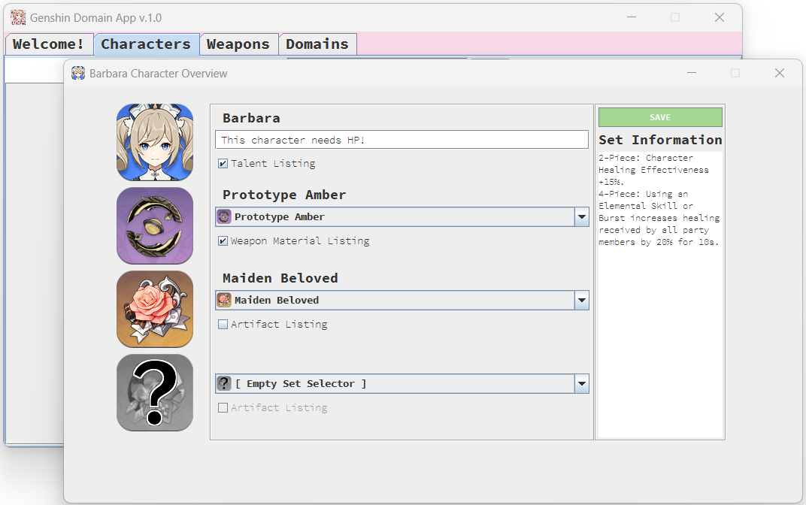
Characters Tab & Window
The tab lets the user first search for a character by name or filter.
Clicking on a character will open a new window with its overview.
In this window, the user can fill in the desired information (notes, selected weapon and artifacts) and whether they will be listed or not.
Listed items will be gathered in Domains tab.

Slide 4
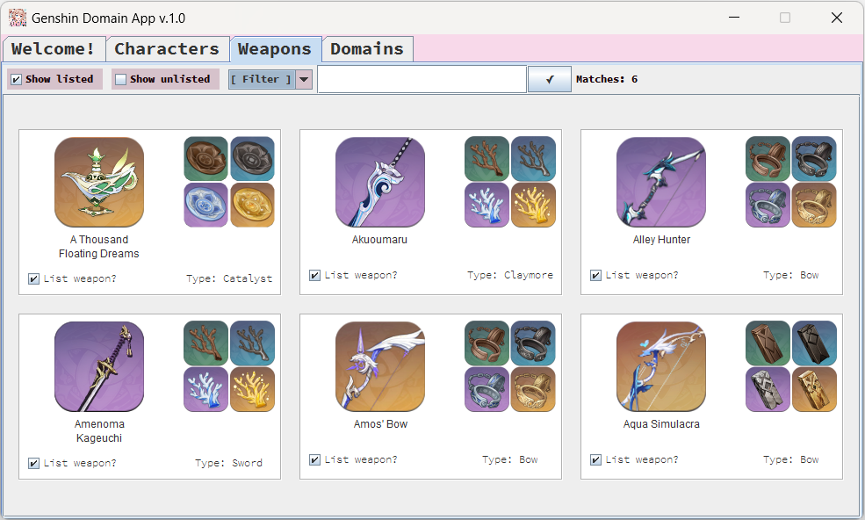
Weapons
Weapons tab allows the user to search and list weapons.
All weapons have a check box attached to their weapon card; any new windows won’t be generated.
Additionally, the weapon also shows the materials it needs on the right. These materials are fixed.
Clicking on the check box will automatically save changes and the weapons will show as listed in Domains tab.

Slide 5
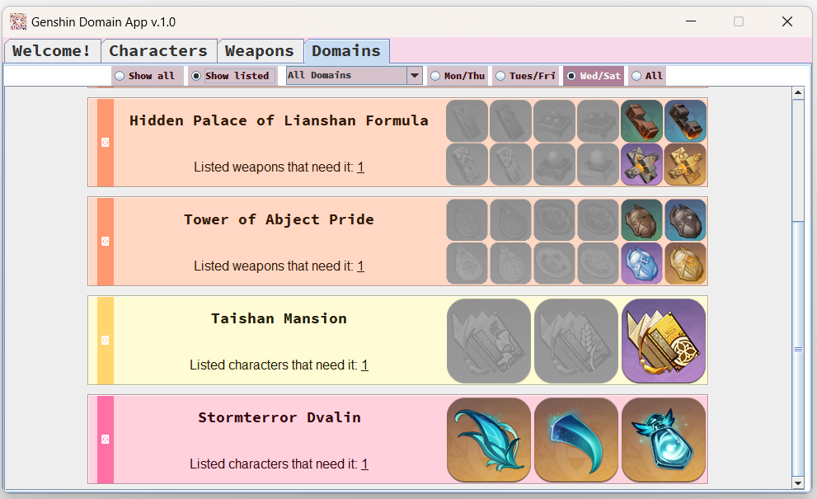
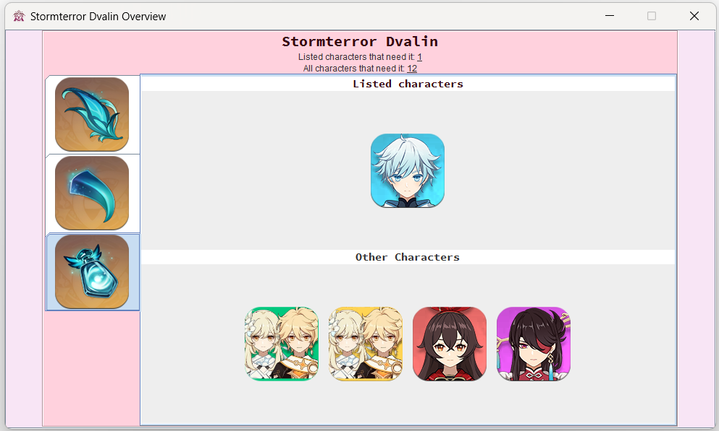
Domains Tab & Window
This tab combines user input from other tabs and lists everything that the user is looking for.
Results are color-coded to represent the type of material. Materials not available on the filtered day will be greyed out. Multiple other filter options exist.
When the user clicks on the desired domain, it will show both listed and unlisted items, apart from artifact domains.

Slide 6


Future Plans & Updates
Although the program is somewhat complete, we will continue to add new resources and fix possible bugs. These include:
Adding yet to be released characters, weapons, etc.
Sharing the program with others and get feedback.
Possibly add new features
We also have plans for a similar project for another game :)

Slide 7



Tools and Assets
Software used:
- This project is coded with Java using IntelliJ IDEA.
- Fire Alpaca is used for image editing.
- GitHub is utilized for sharing the project between the two of us.
Key libraries include:
- Java Swing (UI)
- Google Gson (parsing and saving JSON files)
Images used in the project are official art from the game, some are slightly edited.

Slide 8
Thank you
Project can be found in GitHub
https://github.com/YesAsNo/GDApp

